Slide 1
Exploratory analysis of Microarray data - PCA, SVD
Ji-Ping Wang
Department of Statistics
Northwestern University

Slide 2
Outline
Principal component analysis
Singular value decomposition

Slide 3
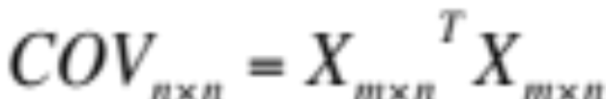
Principal component analysis
X_{ij} is the centered expression of gene i array j.
Define the covariance matrix as
Principal component analysis:
COV=VS²V^{T}
Where V=[v_{j}] is the eigen vector matrix and S² is a diagonal matrix from eigen values.
v_{j} are orthogonal vectors with length 1.

Slide 4
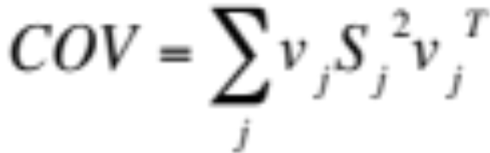
PCA
Consider the transformation: Y_{mxn}=X_{mxn}V_{mxn}=[Y_{j}], then
Y_{j} is called the jth principal component of X.
Principal components are orthogonal to each other
Y_{j} has variance S_{j}²
In convention, S₁>S₂>S₃ …
The eigen vector forms the basis in the p-dimensional
space, the principal component of Y_{j} is the projection
of X to the basis v_{j}

Slide 5
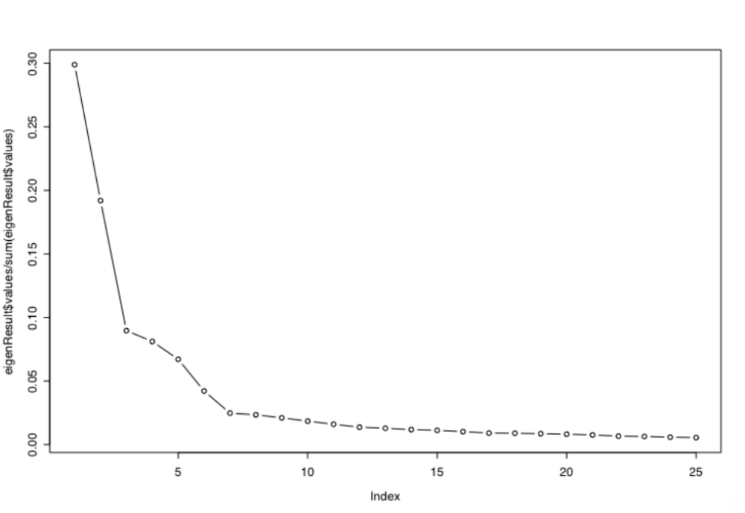
Eigen value plot or yeast Cell cycle data
# of clusters ?

Slide 6
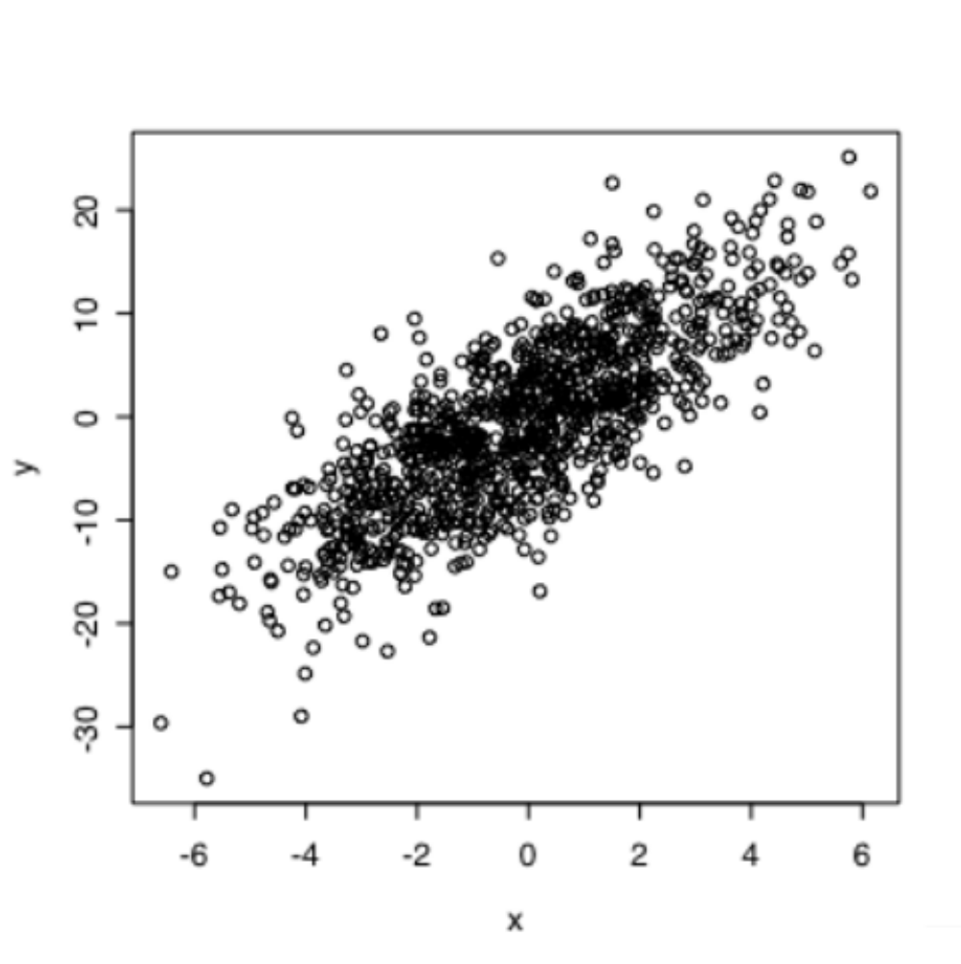
An example
PCA2 basis
PCA1 basis

Slide 7
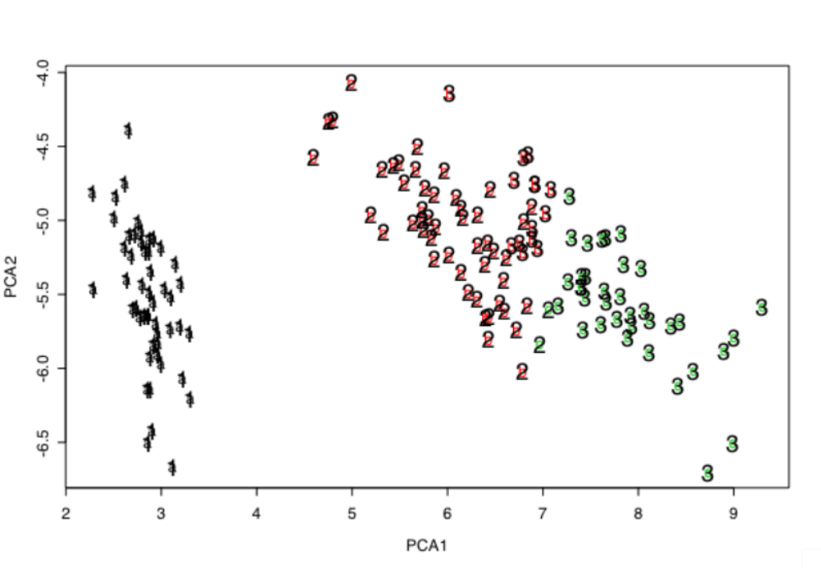
Visualization of the data by PCA
Kmeans examples-- Fisher’s Iris data
V1 V2 V3 V4 V5
1 5.1 3.5 1.4 0.2 setosa
2 4.9 3.0 1.4 0.2 versicolor
3 4.7 3.2 1.3 0.2 virginica
……

Slide 8
Singular value decomposition(SVD)
X_{mxn}=U_{mxn}S_{nxn}V^{T}_{nxn} where
X is the original expression matrix,
U and V are called left and right singular vectors, and
S is a diagonal eigen value matrix, i.e. S=diag(s₁,s₂,…,s_{n}), s_{k}>0 for 1<=k<=r and s_{k}=0 for k>r. r is the rank of matrix X, often is n.

Slide 9
More about SVD and PCA
SVD VS PCA: Let X be centered expression (eg. X-X_bar)
X^{T}X=VS²V^{T,}
where V and S are same as in last slide
U=XVS⁻¹

Slide 10
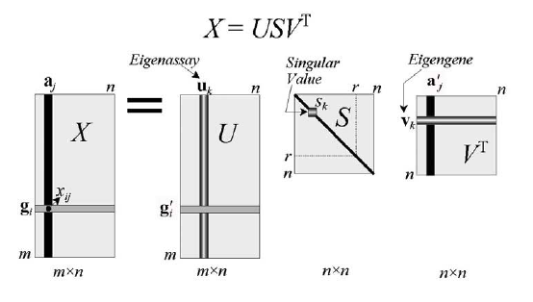
Eigen array and Eigen Gene
Eigen genes can be inferred as the independent processes.

Slide 11
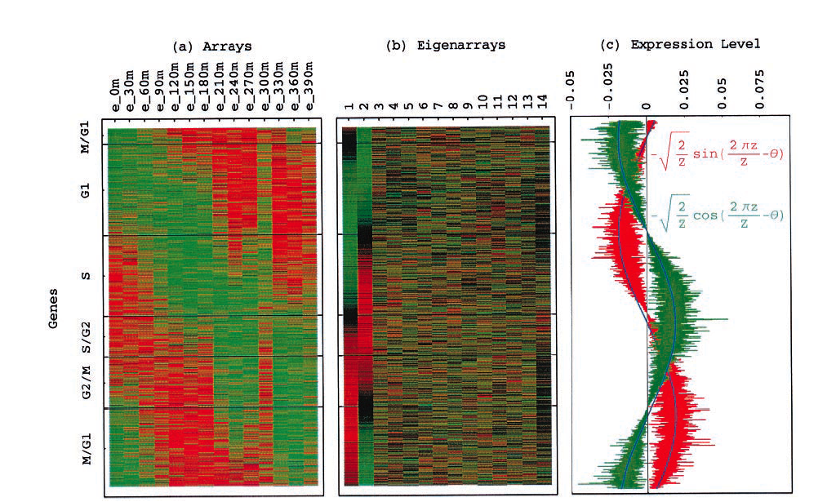
Eigen genes and eigen arrays

Slide 12
