Slide 1
Profile HMM in sequence alignment and motif searching
Ji-Ping Wang
Department of Statistics
Northwestern University

Slide 2
What is a profile?
Sequences of interest are homologous.
The similarity and dissimilarity can often be summarized as a consensus primary structure consisting of position-specific scores and insertion and deletion penalties.

Slide 3
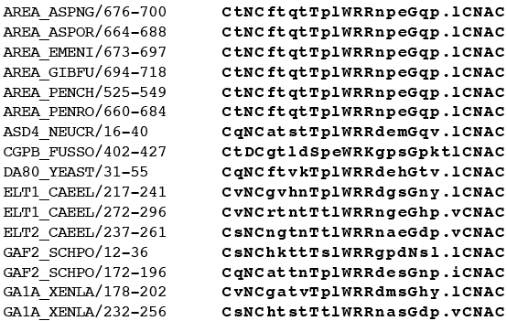
GATA-type zinc finger domain signature and profile

Slide 4
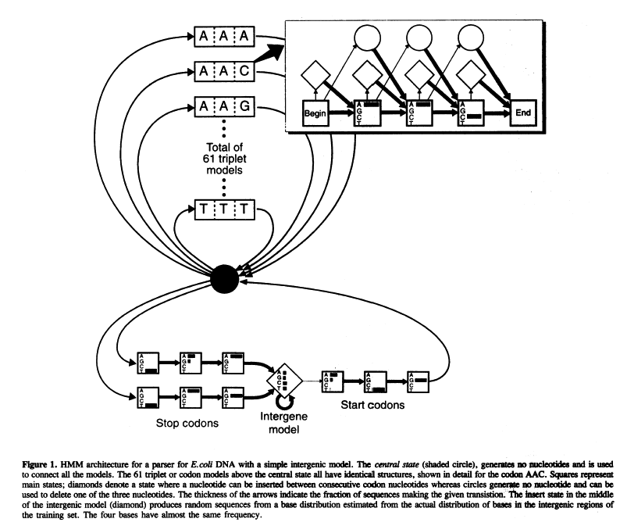
Krogh et al. 1994
Codon HMM model
in gene finding for E.coli.
Note: no intron in E.coli.

Slide 5
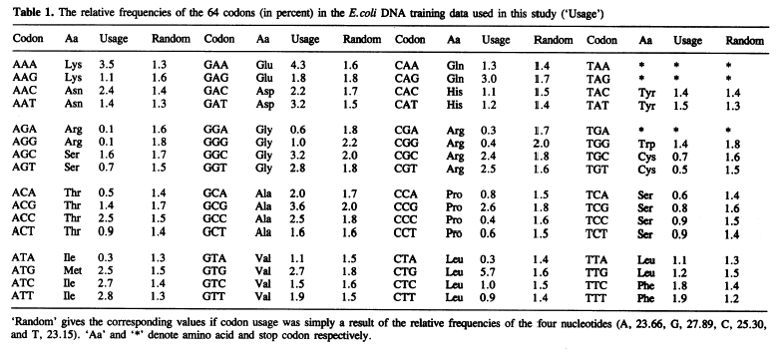
Codon usage

Slide 6
Assumptions of profile HMM
Correlation between residues (emissions) are ignored.
Sequences are generated independently from the model.

Slide 7
An example
match states M_{j}, and
insertion states I_{j}
I_{j}
begin
M_{j-1}
M_{j}
M_{j+1}
end
Suppose we model a codeon (3 nucleotides). Let M_{j} denote that
a nucleotide in the query sequence matches (aligns) to the jth
position of the model. Let I_{j} denote that insertions occur in the
query sequence right after the jth position.
The score of a gap of length k at position j is:
log α_{mjIj}+log α_{IjMj+1}+(k-1)log α_{IjIj}

Slide 8
Model deletion
D_{j}
begin
M_{j-1}
M_{j}
M_{j+1}
end
Match states M_{j}
Silent deletion states D_{j}
Deletion at which position?
D_{j}
begin
M_{j-1}
M_{j}
M_{j+1}
end

Slide 9
Insertion and deletion
D_{j}
I_{j}
begin
M_{j-1}
M_{j}
M_{j+1}
end

Slide 10
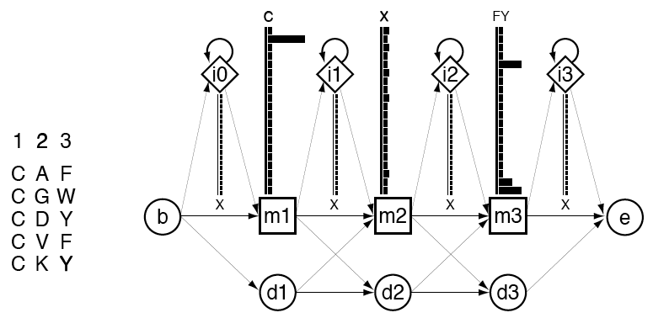
An example

Slide 11
PHMM advantage
PHMM align sequence explicitly under probabilistic assumptions
Dynamic programming requires choice of score matrix (eg. PAM, or BLOSUM), which actually is a transformation of probabilistic models.
PHMM is more effective to find distantly related homologies.

Slide 12
Deriving profile HMMs from multiple alignment
Deletion or insertion?
GATA-type zinc finger domain: “.”
Model as “insertion”
if more than half of
the sequence have a
gap, and “deletion”
otherwise.

Slide 13
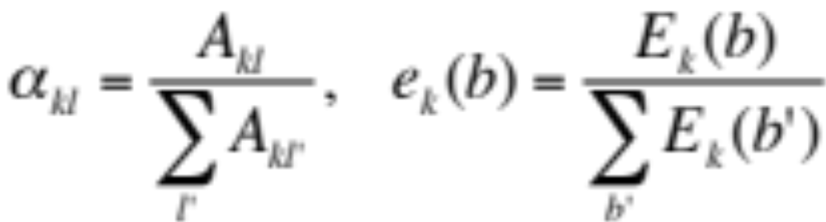
Estimating the parameters
Transition and emission probabilities:
Laplace rule for zero count:
  For small samples, the zero probability for some emission A_{j} (amino acid, or nucleotide) causes related sequence containing A_{j} undetectable by the model. To avoid zero-probability, add one to each frequency.

Slide 14
PHMM softwares
HMMER by Eddy (Eddy 1996,1998)
SAM (Hughey & Krogh, 1996)
PFTOOLS(Bucher et al, 1996)
Functions of these tools:
  Multiple domains;
  global and local alignment

Slide 15
PHMM libraries
PROSITE profile database(Bairoch et al. 1997), 1749 different protein families or patterns.
Pfam data base(Sonnhammer et al. 1997), 7677 families.

Slide 16
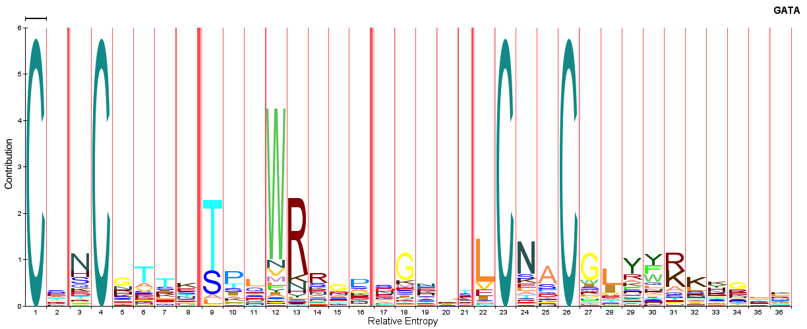
HMM logo for GATA zip finger protein domain

Slide 17
Example: GATA-type zinc finger protein signature
HMMER2.0 [2.3.2]
NAME ps00344
LENG 25
ALPH Amino
RF no
CS no
MAP yes
COM hmmbuild zipfinger.hmm ps00344.fa
NSEQ 99
DATE Sun Nov 14 10:44:54 2004
CKSUM 145
XT -8455 -4 -1000 -1000 -8455 -4 -8455 -4
NULT -4 -8455
NULE 595 -1558 85 338 -294 453 -1158 197 249
HMM A C D E F G H I K . . .
m->m m->i m->d i->m i->i d->m d->d b->m m->e
-415 * -2000
1 -1667 5612 -3405 -3570 -2842 -2113 -2800 -2422 -3305 -2879 . . . 1
- -149 -500 233 43 -381 399 106 -626 210 -466 . . .
- -21 -6672 -7714 -894 -1115 -701 -1378 -415 *
2 421 -890 -570 -17 -435 -1365 -98 -587 261 -816 . . . 2
- -149 -500 233 43 -381 399 106 -626 210 -466 . . .
- -21 -6672 -7714 -894 -1115 -701 -1378 * *
Transition from Beginning
Emission for Match states
Emission for insertion states
Transition probability
Three lines:Match emission score; insertion score; transition score

Slide 18
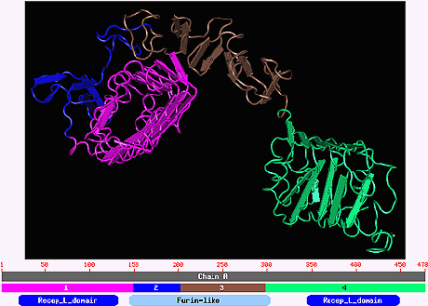
Protein domain and motif
Domain: interconnected α helix and β sheets.
    certain combination of the α helix and β-sheets often
    is called a motif.

Slide 19
Motif
SAP motif:
The SAP motif is a 35-residue motif, which has been named after SAF-A/B,
Acinus and PIAS, three proteins known to contain it. The SAP motif is found in
a variety of nuclear proteins involved in transcription, DNA repair, RNA
processing or apoptotic chromatin degradation. As the sap motif of SAF-A has
been shown to be essential for specific DNA binding activity, it has been
proposed that it could be a DNA-binding motif [1,2].
A multiple alignment of the SAP motif reveals a bipartite distribution of
strongly conserved hydrophobic, polar and bulky amino acids separated by a
region that contains a glycine. Secondary structure predictions suggest that
the SAP motif could form two alpha helices separated by a turn [1].

Slide 20
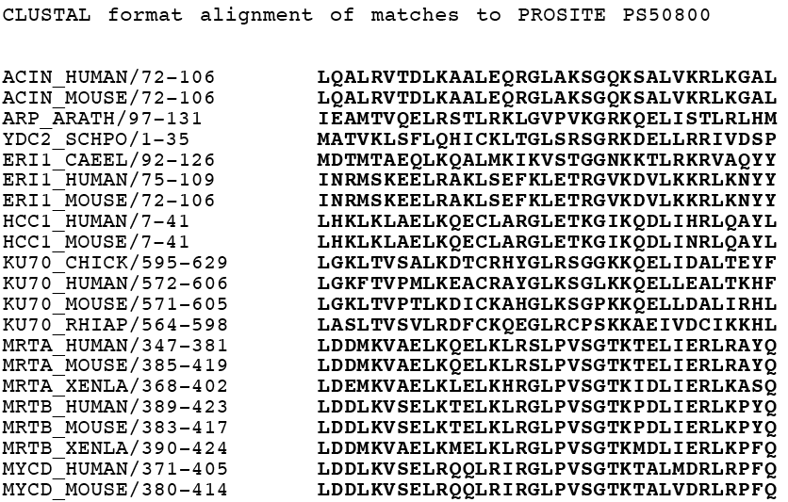
SAP motif
A motif often has well-conserved residues at certain
positions of a short stretch of amino acids. Often no
gaps in the “block”.

Slide 21
PHMM for Motif
PHMM clearly is a general tool can be used for motif searching, however, it requires a trained profile before search.
Imagine that if we do not allow deletion or insertion, I.e. M_{j}-->M_{j+1} with probability 1, or the transition probability T_{MjMj+1}=1, then the probability model becomes a product multinomial.
1
2
3
4
A
C
G
G
A
C
G
T
A
C
G
T
A
C
G
T
……
P(x)=P₁(A)P₂(G)P₃(C)P₄(T)…

Slide 22
Iterative searching
Other motif search tools such as
  MEME: multiple EM for motif elicitation
  Gibbs sampler: Bayesian motif sampler (Lawrence et al. 1993)
  use an iterative searching method.
Assume we are given a set of sequences each of which contain a motif of size 20 (residues).

Slide 23
Iterative motif searching
Initialize algorithm by random assigning motif region
Updating the column-wise residue distribution P₁, P₂, ….P₂₀ .
Updating the flanking region residue distribution
Make new prediction of motif position based on current probabilities.
Iterate 2 and 3 to maximize the likelihood ratio of motif region over the flanking region.

Slide 24
Comments
Dynamic programming, HMM, PHMM, motif searching all have available software or database searching tools ready for use.
The idea and computing algorithms behind these tools are important when developing new methods to tackle new problems.
PHMM does not model the emission dependent structure, so perhaps it is more effective to model the protein than DNA in motif or domains.

