Slide 1
Next generation sequencing
Ji-Ping Wang
Department of Statistics

Slide 2
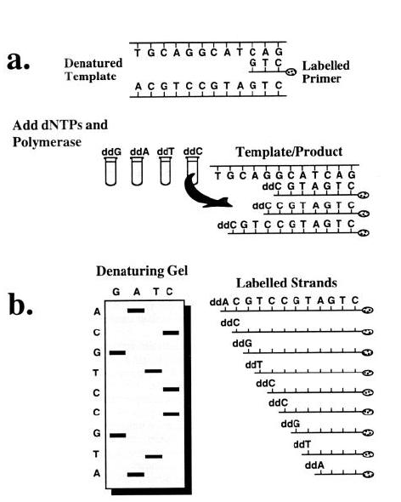
Sanger-sequencing: 1970, Fredrick Sanger, DNA chain termination method
DNA template, DNA polymerase, normal dexoynucleotide (dNTP) and modified deoxynucleotides (ddNTP)
Each tube contains one type of ddNTP, which terminates the DNA synthesis.
Gel electrophoresis is used to denature the DNA to obtain the newly synthesized strands from the given template. High voltage is utilized to heat up the gel to 60 degree centigrade and this makes sure that the two strands don’t re-associate. Autoradiography helps in determining the strands as they are radio labeled.
Dye-labeling of the ddNPT allows sequencing in a single reaction instead of four reactions.
http://www.dnasequencing.org/history-of-dna

Slide 3
Sequencing cost
1980 In the 1980s methods were augmented by
partial automation
the cloning method, which allowed fast and exponential replication of a DNA fragment.
1990 Start of the human genome project: sequencing efficiency reached 200,000 bp/person/year.
2002 End of the human genome project: 50,000,000 bp/person/year. (Total cost summed to $3 billion.)

Slide 4
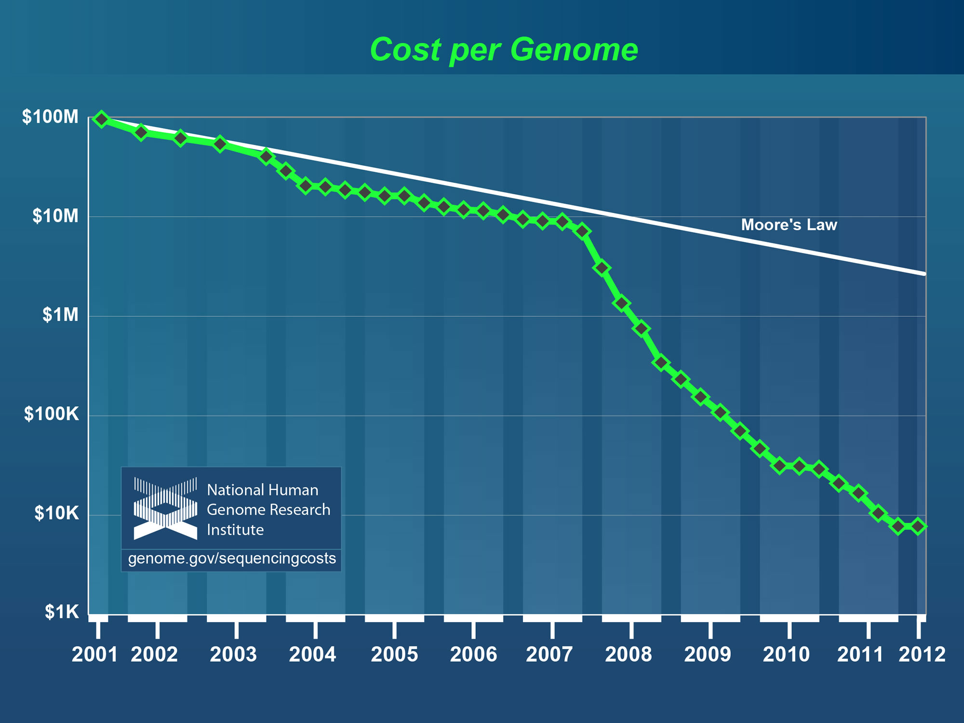

Slide 5
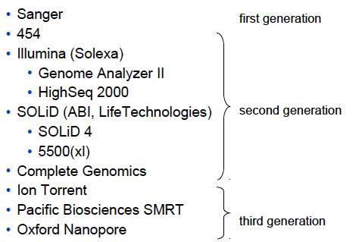
Sequencing technology evolution

Slide 6
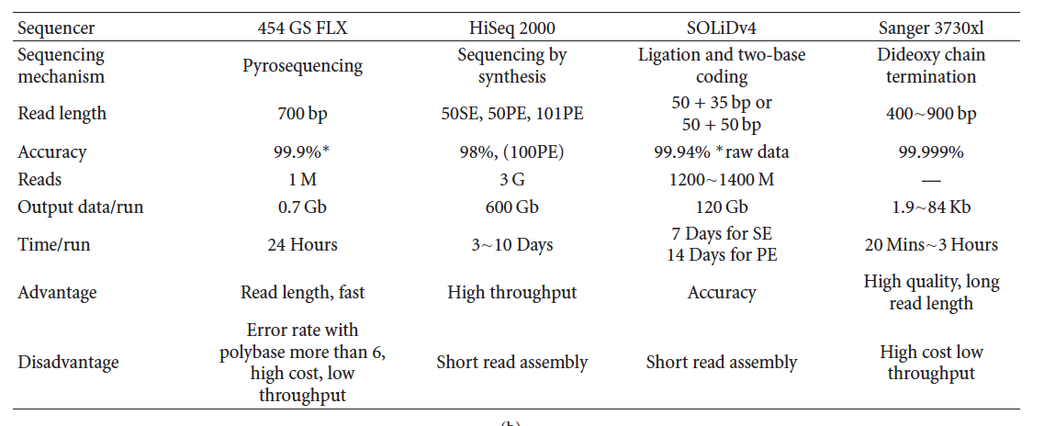
Comparing different NGS platforms
Liu et al 2012.

Slide 7
Single-end vs paired-end sequencing
tag1
tag2
Single– end sequencing:
the 5’ end of only one strand of DNA fragment is sequenced, either
tag1 or tag2 is observed. If both are observed, but they are not known as a pair.
Paired-end sequencing:
the 5’end of both strand are simultaneously sequenced,
therefore both tag1 and tag2 are observed as a pair
Paired-end increase mappability, but more costy.

Slide 8
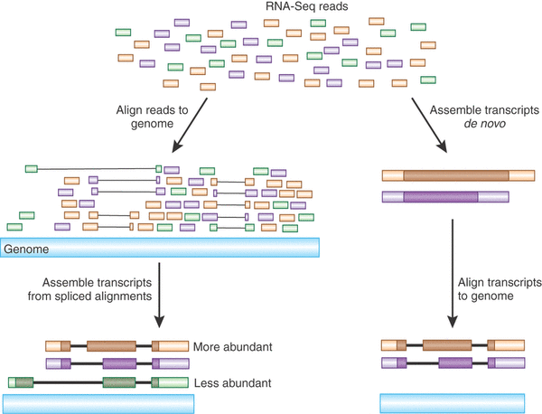
Sequence alignment

Slide 9
Bowtie--an ultrafast, memory-efficient short read aligner--ungapped
bowtie-bio.sourceforge.net/manual.shtml
Download: http://sourceforge.net/projects/bowtie-bio/files/bowtie/
Installation of bowtie:
Requirement of GNU-like environment. Typically this is
already set in Mac/unix/linux machines. For Windows users, you
need install Cygwin or MinGW.
Unzip the downloaded package and unzip it.
Type “make” under the unzipped directory to install bowtie.
If building with MinGW, run “make” from the MSYS command line
You probably want to set up the environmental variable $path to make the
bowtie directory accessible from any working directory. Under the mac machine,
this can be set up by editing the .bashrc file. Or you can run bowtie under the
bowtie directory.

Slide 10
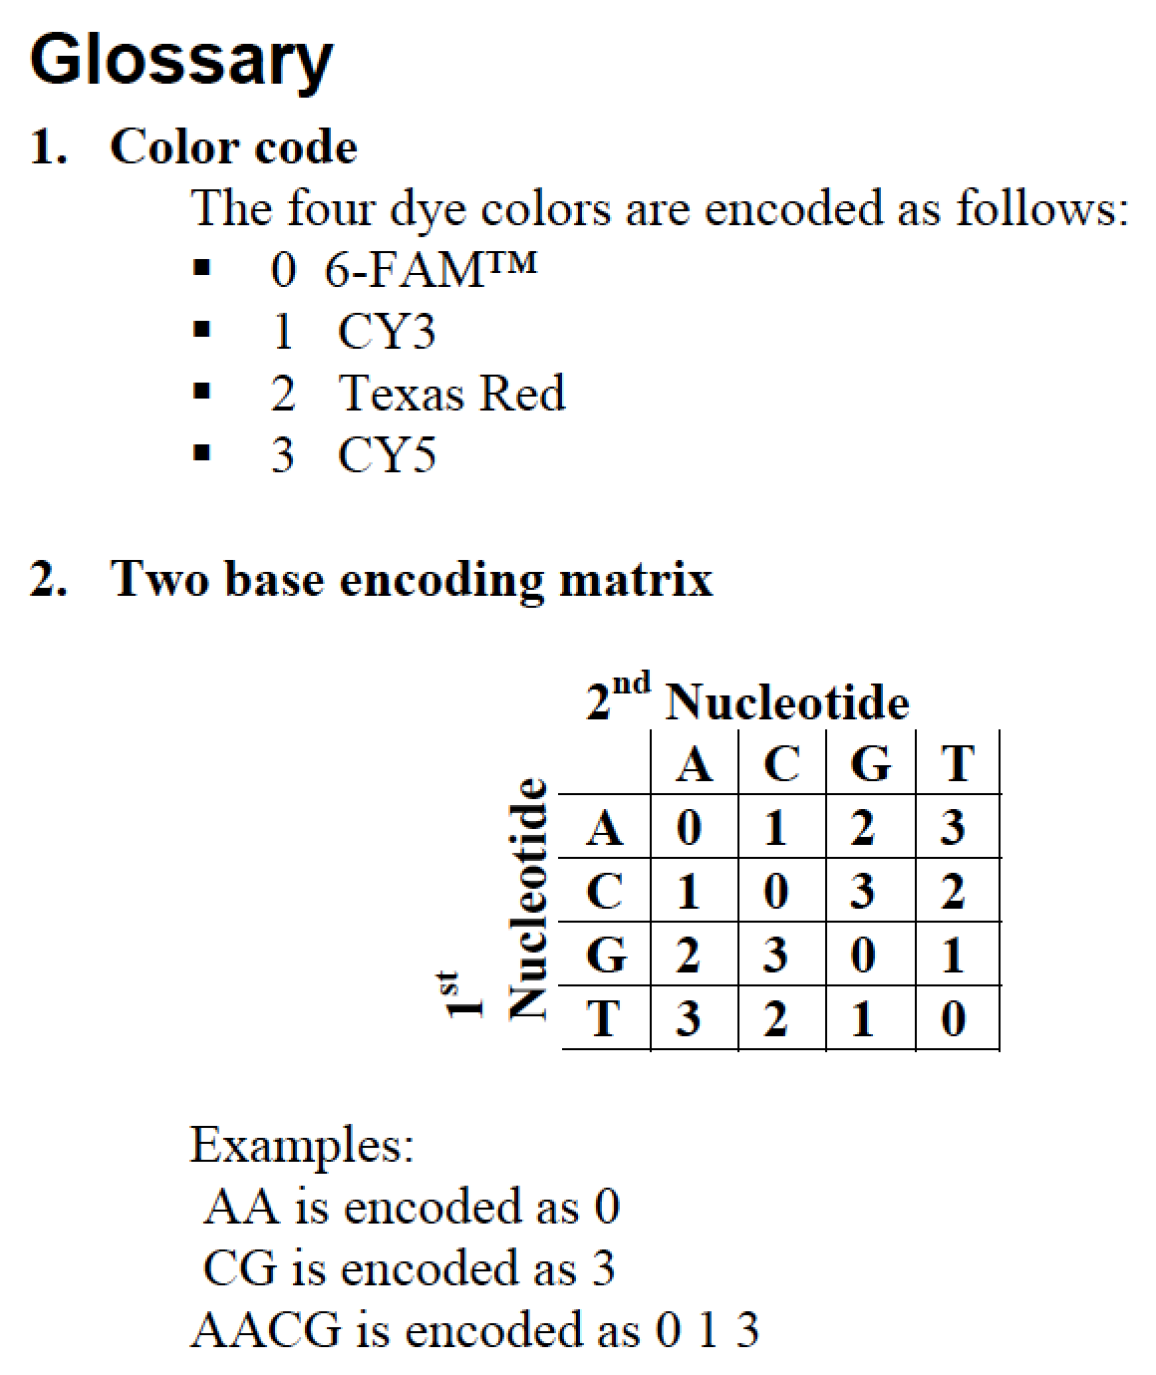
Example raw data from SOLiD: the raw data fromSOLiD is in color space.
dhcp-129-105-18-228:test jon$ ls
test_F3.csfasta # 3’ end reads in color space fasta format
test_F3.QV.qual # quality file
test_F5.csfasta # 5’ end reads in color space fasta format
test_F5.QV.qual # quality file
csfasta file:
>1_40_1437_F5-DNA
T32120001333210202303300310221221103
>1_40_1542_F5-DNA
T30333213223320132131202101122002130
Quality file
>1_40_1437_F5-DNA
31 30 21 23 14 14 17 31 14 26 25 31…
>1_40_1542_F5-DNA
31 31 31 31 31 31 31 31 31 31 31…..
Quality score=-10log10( incorrect probability)

Slide 11
Index genome
Index in nucleotide space(illumina, 454)
bowtie-build -f chromosome1.fasta,chromosome2.fasta,chromosome3.fasta spombe
Index in color space (SOLiD)
bowtie-build -f chromosome1.fasta,chromosome2.fasta,chromosome3.fasta -C spombeC
Note: similar in blast, when you do alignment, you need to index the genome to make
the pattern search more efficient.

Slide 12
> bowtie -v 2 -B 1 spombe -c AAGGAATCTTTTTCATCTCCGGTCATTTG
0 + chr3 380089 AAGGAATCTTTTTCATCTCCGGTCATTTG IIIIIIIIIIIIIIIIIIIIIIIIIIIII 0 10:G>T
# reads processed: 1
# reads with at least one reported alignment: 1 (100.00%)
# reads that failed to align: 0 (0.00%)
Reported 1 alignments to 1 output stream(s)
where
“spombe” is the index;
“-v 2” tells that the valid alignments may have no more than 2 mismatches;
“–B 1” tells Bowtie that the first base of the reference sequence is
indexed as position1 (default is 0).
“-c ” means the query sequence is given on command line.

Slide 13
Control output alignment:
> bowtie -a -v 2 -B 1 spombe -c CAAAACATAAATAAATATTACAAAA
0 + chr3 15743 CAAAACATAAATAAATATTACAAAA IIIIIIIIIIIIIIIIIIIIIIIII 1
0 + chr3 4873 CAAAACATAAATAAATATTACAAAA IIIIIIIIIIIIIIIIIIIIIIIII 1
0 - chr3 2448379 TTTTGTAATATTTATTTATGTTTTG IIIIIIIIIIIIIIIIIIIIIIIII 0
By default, Bowtie will only report the first valid alignment it encounters.
But sometimes, there may be multiple valid alignments. If you want to show all
the valid alignments, you should use “-a”.
If you want no more than 2 alignment, then use “-k 2”
> bowtie -k 2 -v 2 -B 1 spombe -c CAAAACATAAATAAATATTACAAAA
0 + chr3 15743 CAAAACATAAATAAATATTACAAAA IIIIIIIIIIIIIIIIIIIIIIIII 1
0 + chr3 4873 CAAAACATAAATAAATATTACAAAA IIIIIIIIIIIIIIIIIIIIIIIII 1

Slide 14
Control output alignment:
If we want to suppress alignments that have more than m hits, then :
> bowtie -v 2 -B 1 spombe -c TGATCTATTATATTACATTACACAGGTTA -m 1
No alignments
> bowtie -a -v 2 -B 1 spombe -c CAAAACATAAATAAATATTACAAAA –m 1
No alignments
> bowtie -a -v 2 -B 1 spombe -c CAAAACATAAATAAATATTACAAAA -m 2
No alignments
> bowtie -a -v 2 -B 1 spombe -c CAAAACATAAATAAATATTACAAAA -m 3
0 + chr3 15743 CAAAACATAAATAAATATTACAAAA IIIIIIIIIIIIIIIIIIIIIIIII 1
0 + chr3 4873 CAAAACATAAATAAATATTACAAAA IIIIIIIIIIIIIIIIIIIIIIIII 1
0 - chr3 2448379 TTTTGTAATATTTATTTATGTTTTG IIIIIIIIIIIIIIIIIIIIIIIII 0

Slide 15
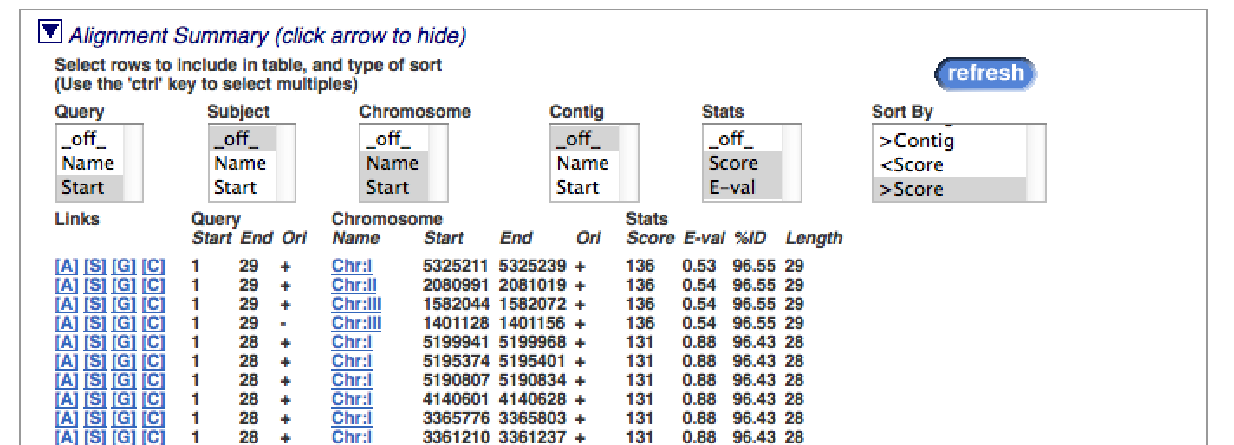
Sort alignment based on quality:
> bowtie -a --best -v 2 -B 1 spombe -c TGATCTATTATATTACATTACACAGGTTA
0 + chr1 5325211 TGATCTATTATATTACATTACACAGGTTA IIIIIIIIIIIIIIIIIIIIIIIIIIIII 1 17:A>T
0 + chr2 2080991 TGATCTATTATATTACATTACACAGGTTA IIIIIIIIIIIIIIIIIIIIIIIIIIIII 1 17:A>T
0 - chr3 1401128 TAACCTGTGTAATGTAATATAATAGATCA IIIIIIIIIIIIIIIIIIIIIIIIIIIII 0 8:G>A
0 + chr3 1582044 TGATCTATTATATTACATTACACAGGTTA IIIIIIIIIIIIIIIIIIIIIIIIIIIII 0 3:C>T
0 - chr1 2854315 TAACCTGTGTAATGTAATATAATAGATCA IIIIIIIIIIIIIIIIIIIIIIIIIIIII 15 17:T>A,28:C>T
0 - chr2 1826516 TAACCTGTGTAATGTAATATAATAGATCA IIIIIIIIIIIIIIIIIIIIIIIIIIIII 15 17:T>A,28:C>T
0 - chr1 5021818 TAACCTGTGTAATGTAATATAATAGATCA IIIIIIIIIIIIIIIIIIIIIIIIIIIII 15 17:T>A,28:C>T

Slide 16
Alignment using fasta file
> bowtie –p 4 -m 1 -v 0 –B 1 spombe -f ./examples/example6/reads.fa > ./examples/example6/map_m1_v0.txt
# reads processed: 6
# reads with at least one reported alignment: 4 (66.67%)
# reads that failed to align: 2 (33.33%)
Reported 4 alignments to 1 output stream(s)
>1
AGAGCGATCGTTGTTCATATTATGTTTAT
>2
TGTTCTCCGGATTATCATTGATCTTTTGA
>3
TTAGTAAGTCGTATATTAGAGTAGGCAAT
>4
CAACCTGTGTAATGTAATATAATAGATCA
>5
GTATACCCAGTTCCCTCCCTAAATGCTCC
>6
GTAGATCTCGATTTATTTAAAGAAGATAT
> more map_m1_v0.txt
1 + chr2 532913 AGAGCGATCGTTGTTCATATTATGTTTAT IIIIIIIIIIIIIIIIIIIIIIIIIIIII 0
6 + chr2 4000074 GTAGATCTCGATTTATTTAAAGAAGATAT IIIIIIIIIIIIIIIIIIIIIIIIIIIII 0
2 + chr1 4558453 TGTTCTCCGGATTATCATTGATCTTTTGA IIIIIIIIIIIIIIIIIIIIIIIIIIIII 0
5 + chr1 1760089 GTATACCCAGTTCCCTCCCTAAATGCTCC IIIIIIIIIIIIIIIIIIIIIIIIIIIII 0
The alignments were saved into the file “map_m1_v0.txt”.
“-p 4” tells Bowtie to launch 6 parallel search threads (default: 1). Threads will run
on separate processors/cores and synchronize when parsing reads and outputting alignments.
“-f ” tells Bowtie the input file was in “fasta” format(use “-q” for “fastq” format).

Slide 17
-1, -2 specify the two mate files.
-I specify minimum insert size
-X specify maximum insert size
Paired-end alignment
> bowtie –p 4 -m 1 -v 3 -B 1 spombe --fr -f -1 ./examples/example7/read1.fa -2 ./examples/example7/read2.fa > ./examples/example7/paired_map_m1_v0.txt
tag1
fr
tag2
tag1
rf
tag2
ff:
tag1
tag2
tag2
tag1

Slide 18
Colorspace single-end alignment
> bowtie -p 4 -m 1 -v 3 -B 1 -C spombeC --col-keepend -f ./examples/example8/reads.csfasta
-Q ./examples/example8/reads.qual > ./examples/example8/col_map_m1_v3.txt
# reads processed: 4
# reads with at least one reported alignment: 3 (50.00%)
# reads that failed to align: 3 (50.00%)
Reported 3 alignments to 1 output stream(s)
- C : specifies color space
--col-keepend: whether keeps initial and last colorspace numbers, the default is to trim
-Q: specify quality files
ASII-encoded qualities.
>more col_map_m1_v3.txt
427_96_802_F3 + chr1 3666149 AACATGTTGGAAGAACCCGAATATA !!9B81!'$!6=GNFSQNO@46NS5 0
427_96_376_F3 + chr1 1201942 TCACGATCACCGTTATCACGCTGGA >H5J<.LIKG@.!<>A0!CMIDOR3 0
427_96_1644_F3 + chr1 5160407 TGAAGAGCTCATATATTCCTTTCCC 73)=?IB44!"CVVO:",D?1-DN1 0

Slide 19
Colorspace paired-end alignment
> bowtie -p 6 -m 1 -v 3 -B 1 -C spombeC --col-keepend --fr -f -1 ./examples/example9/read1.csfasta
-2 ./examples/example9/read2.csfasta --Q1 ./examples/example9/read1.qual
--Q2 ./examples/example9/read2.qual > ./examples/example9/paired_col_m1_v3.txt
# reads processed: 27
# reads with at least one reported alignment: 10 (37.04%)
# reads that failed to align: 17 (62.96%)
Reported 10 paired-end alignments to 1 output stream(s)

