Slide 1
RNA-seq data analysis
Ji-Ping Wang
Department of Statistics

Slide 2
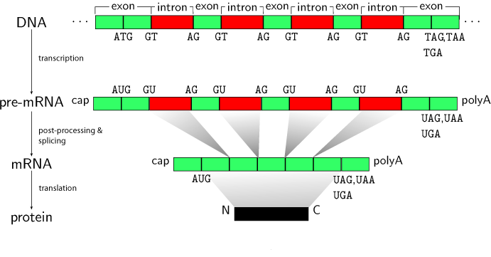
Transcription

Slide 3
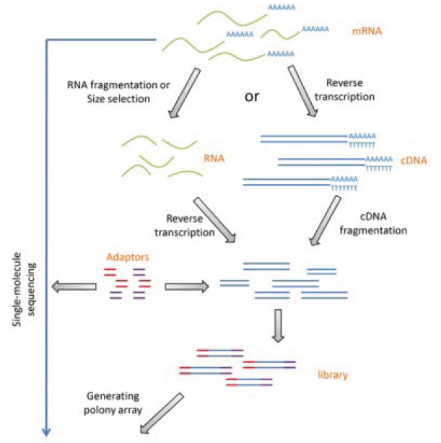
RNA-seq

Slide 4
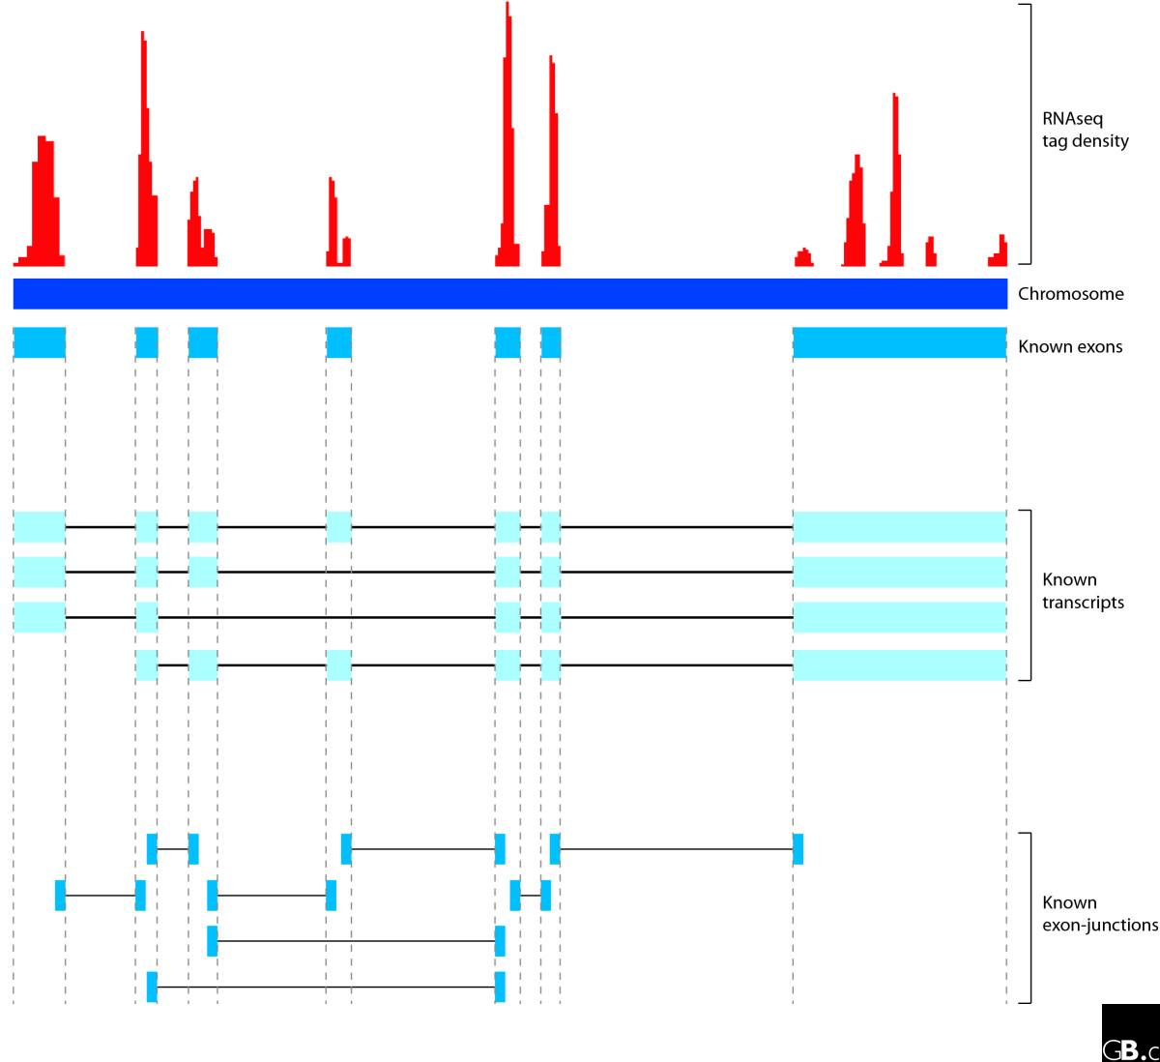
Quantify gene expression by RNA-seq
Reads count at each exon is convolution of reads from different transcript isoforms.
Reads span adjacent exons provide key information of alternative splicings.

Slide 5
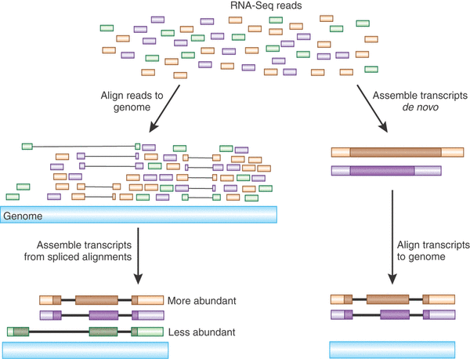
Bowtie,
Tophat
Cufflinks

Slide 6
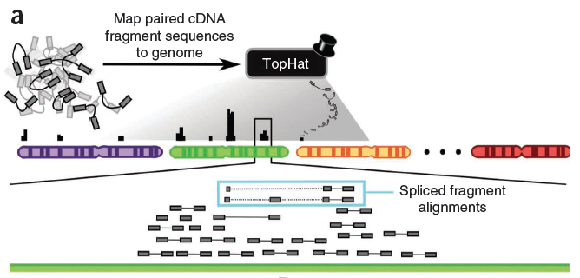
Cufflinks work flowchart
Trapnell et al 2008

Slide 7
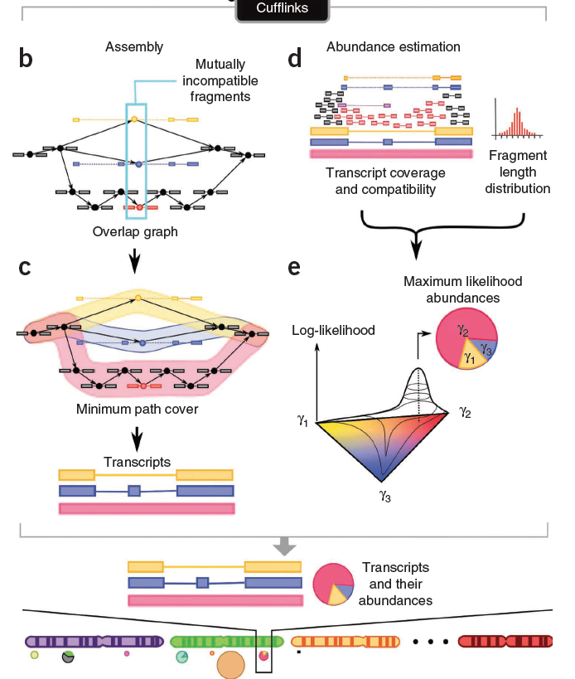

Slide 8
Discovering splicing junctions
mRNA
single-end
S3 will not be aligned.
s1
s2
s4
s5
s6
s7
s3
DNA
Tophat spits each read into 25 bp pieces and align each piece to the genome.
If s_i-1 and s_i+1 both map to genome, but s_i fail to, then s_i must span the splicing site.
The splicing site must within +/-12 bp of the center of the read.
Multiple such reads help refine the center positions

Slide 9
Transcript abundance estimation
FPKM: expected frequency of fragment per kilo base of transcript per million fragments.
This will be the abundance parameter to estimate.

Slide 10
Model reads distribution within a transcript
Suppose reads of length k from transcript t can arise randomly from anywhere within a transcript, then the position follows a uniform distribution 1/(l(t)- k+1)
…….
l(t)
However the DNA fragments were size selected, therefore the size of DNA fragment
has special distribution.
The size distribution of DNA fragment impose constraint to the start position of
reads, whether single-end or paired-ends.

Slide 11
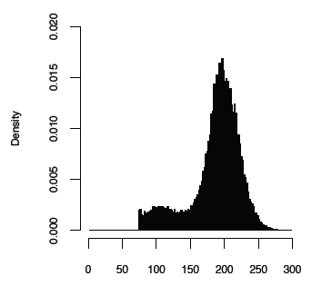
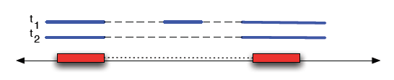
DNA fragment length distribution
The paired ends are compatible to two different
transcripts from the same locus.
The inferred DNA fragment distributions are
different, which helps weight the likelihood of which
transcript it truly arise from.

Slide 12

Let F(i) be the DNA fragment size distribution.
The adjusted total length for transcript becomes
The total length for a group of transcript becomes

Slide 13
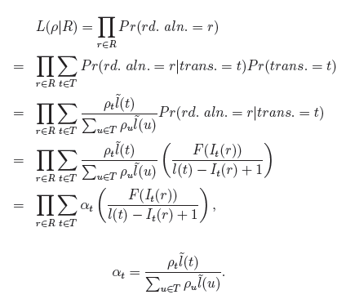
Likelihood:
R: all alignment

Slide 14
FPKM
Expected frequency per kilo base per million tags

Slide 15
Cufflinks output
genes.fpkm_tracking : FPKM for each gene as a sum of different isoforms sharing the same gene id
isoforms.fpkm_tracking: FPKM fro each isoforms
transcripts.gtf: cufflinks assemble transcripts (if user does not provide annotation file), which can be used to discover new transcripts.

Slide 16
Isoform FPKM:
tracking_id class_code nearest_ref_id gene_id gene_short_name tss_id locus length coverage FPKM FPKM_conf_lo FPKM_conf_hi FPKM_status
NM_133826 - - Atp6v1h Atp6v1h TSS17978 chr1:5083172-5162549 1976 5.8223 727868 622534 833201 OK
NR_033530 - - Mrpl15 Mrpl15 TSS23373 chr1:4773199-4785726 1761 0.226635 28332.5 0 58381.7 OK
NM_025300 - - Mrpl15 Mrpl15 TSS23373 chr1:4773199-4785726 1916 1.61141 201449 127445 275453 OK
NM_001177658 - - Mrpl15 Mrpl15 TSS23373 chr1:4773199-4785726 4201 5.4912 686475 615129 757822 OK
Transcripts:
chr1 Cufflinks transcript 4807893 4846735 1000 + . gene_id "Lypla1"; transcript_id "NM_008866"; FPKM "1025426.4060280573"; frac "1.000000"; conf_lo "913957.136274"; conf_hi "1136895.675783"; cov "8.202502";
chr1 Cufflinks exon 4807893 4807982 1000 + . gene_id "Lypla1"; transcript_id "NM_008866"; exon_number "1"; FPKM "1025426.4060280573"; frac "1.000000"; conf_lo "913957.136274"; conf_hi "1136895.675783"; cov "$
chr1 Cufflinks exon 4808455 4808486 1000 + . gene_id "Lypla1"; transcript_id "NM_008866"; exon_number "2"; FPKM "1025426.4060280573"; frac "1.000000"; conf_lo "913957.136274"; conf_hi "1136895.675783"; cov "$
chr1 Cufflinks exon 4828584 4828649 1000 + . gene_id "Lypla1"; transcript_id "NM_008866"; exon_number "3"; FPKM "1025426.4060280573"; frac "1.000000"; conf_lo "913957.136274"; conf_hi "1136895.675783"; cov "$
chr1 Cufflinks exon 4830268 4830315 1000 + . gene_id "Lypla1"; transcript_id "NM_008866"; exon_number "4"; FPKM "1025426.4060280573"; frac "1.000000"; conf_lo "913957.136274"; conf_hi "1136895.675783"; cov "$
chr1 Cufflinks exon 4832311 4832381 1000 + . gene_id "Lypla1"; transcript_id "NM_008866"; exon_number "5"; FPKM "1025426.4060280573"; frac "1.000000"; conf_lo "913957.136274"; conf_hi "1136895.675783"; cov "$
chr1 Cufflinks exon 4837001 4837074 1000 + . gene_id "Lypla1"; transcript_id "NM_008866"; exon_number "6"; FPKM "1025426.4060280573"; frac "1.000000"; conf_lo "913957.136274"; conf_hi "1136895.675783"; cov "$
chr1 Cufflinks exon 4839387 4839488 1000 + . gene_id "Lypla1"; transcript_id "NM_008866"; exon_number "7"; FPKM "1025426.4060280573"; frac "1.000000"; conf_lo "913957.136274"; conf_hi "1136895.675783"; cov "$
chr1 Cufflinks exon 4840956 4841132 1000 + . gene_id "Lypla1"; transcript_id "NM_008866"; exon_number "8"; FPKM "1025426.4060280573"; frac "1.000000"; conf_lo "913957.136274"; conf_hi "1136895.675783"; cov "$
chr1 Cufflinks exon 4844963 4846735 1000 + . gene_id "Lypla1"; transcript_id "NM_008866"; exon_number "9"; FPKM "1025426.4060280573"; frac "1.000000"; conf_lo "913957.136274"; conf_hi "1136895.675783"; cov "$

Slide 17
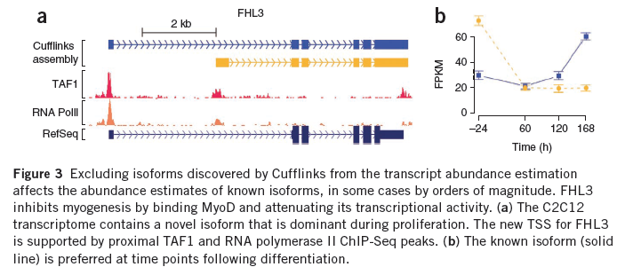
Trapnell et al, 2010

Slide 18
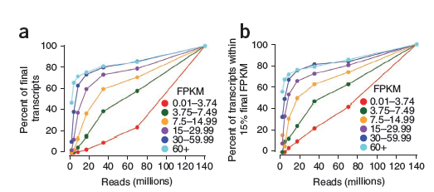
Robustness of assembly and abundance estimate as a function sequencing depth and expression level
Each x coordinate stands for a subset with indicated reads count selected from full data.
Trapnell et al, 2010

Slide 19
Pipelines and scripts
Install bowtie2 (different from bowtie)
Install sra toolkit: convert .sra to fastq
Install SAMtools: alignment formating tools
Install tophat: call bowtie2 to align short reads
Install cufflinks: expression call and differential expression analysis
Edit your environmental variables so that all executables can be accessed.
Download genome index/annotation http://tophat.cbcb.umd.edu/igenomes.html

Slide 20
Differential expression
Define:
Cufflinks does not require replicates to test differential expression.
Biological replicates can be incorporated in Cufflinks, which use negative binomial
to account for over-dispersion

