Slide 1
RAN-seq data analysis--II
Jip-Ping Wang
Department of Statistics

Slide 2
Normalization
What and why normalization in RNA-seq?
Possible methods?

Slide 3
Normalization methods
fpkm(rpkm) in cufflink
Upper quartile
Total reads (or mean)
Median quartile
Quantile (used in affy, limma)
Trimmed mean (edgeR)
DEseq (Anders and Huber)

Slide 4
edgeR (Robinson et al 2009)
TMM: assumption: most genes do not have differential expression.
trimmed mean of M-values, the M is defined as the log2 ratio as in the MVA plot.
The top and bottom (+/-) 30% of M values are removed.
Likewise the bottom 5% of average A value are removed .
The rest is to used to calculate the normalization factor.
Every sample is compared with the reference sample.
Note: normalization factor is to use to adjust the effect library size.
In the negative bionomial example:
g: gene. i: sample; j: sample group, for example, normal vs cancer, phi: overdispersion
parameter

Slide 5
DEseq (Anders and Huber 2010)
where q_{i,\rho(j)} is proportional to to true concentration of gene $i$ under condition \rho(j), and s_j is the effective library size.
where mu_ij is called shot noise, and the second part is called raw variance.
Assume, v_{i,\rho} is a smooth function of q_{i,\rho}, for small sample consideration.

Slide 6
Parameters in DEseq model
k_ij is observed, reads count,i=1,..n
m size factors s_j, j=1,…,m
For each condition rho, n expression q_{i\rho}
The smooth function v_{\rho} for each condition.

Slide 7




Parameter estimation
m_\rho is the number of replicates of the same condition
Is unbiased estimator of raw variance, but w_{ip}
is too variable. Fit smooth curve of (w_{ip}, hat q_{ip}).

Slide 8

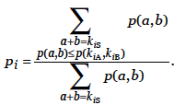



Differential expression
Condition A vs B
P-value:
Under NB assumption, and independence: p(a,b)=p(a)*p(b)
Under null, pulled estimate

Slide 9
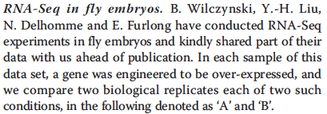
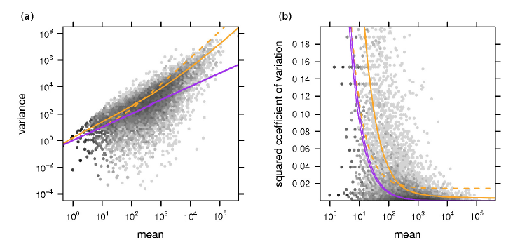
Variance depends on mean

Slide 10
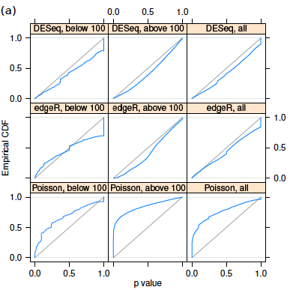
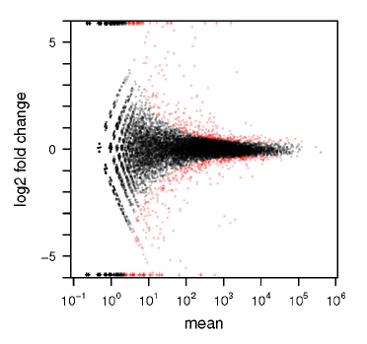
DEG

Slide 11
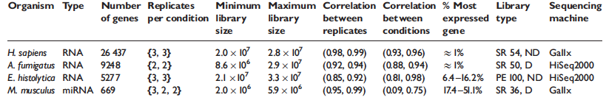
Comparison of different normalization methods (dillies et al 2012)
Criteria: 1. distribution of normalized data
2. called differentially expressed genes

Slide 12
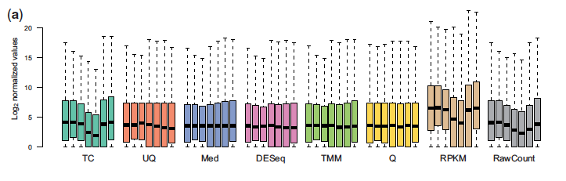
Normalized count
Boxplot of log2(count+1) for mouse data

Slide 13
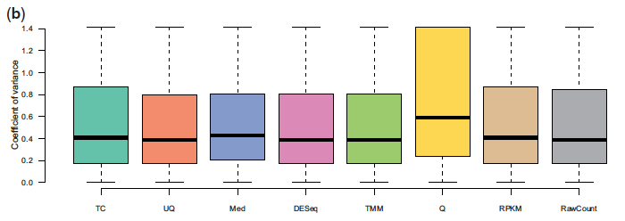
Intro-sample variation
Mouse data, condition B.

Slide 14
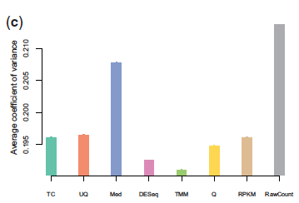
Variance of housekeeping genes
Human data

