Slide 1
L4--Low level analysis
of Affymetrix data
Ji-Ping Wang
Department of Statistics
Northwestern University

Slide 2
An outline
Challenges in Affy low-level data analysis
Method in Normalization
Methods in intensity call
Use Affy package in data analysis

Slide 3
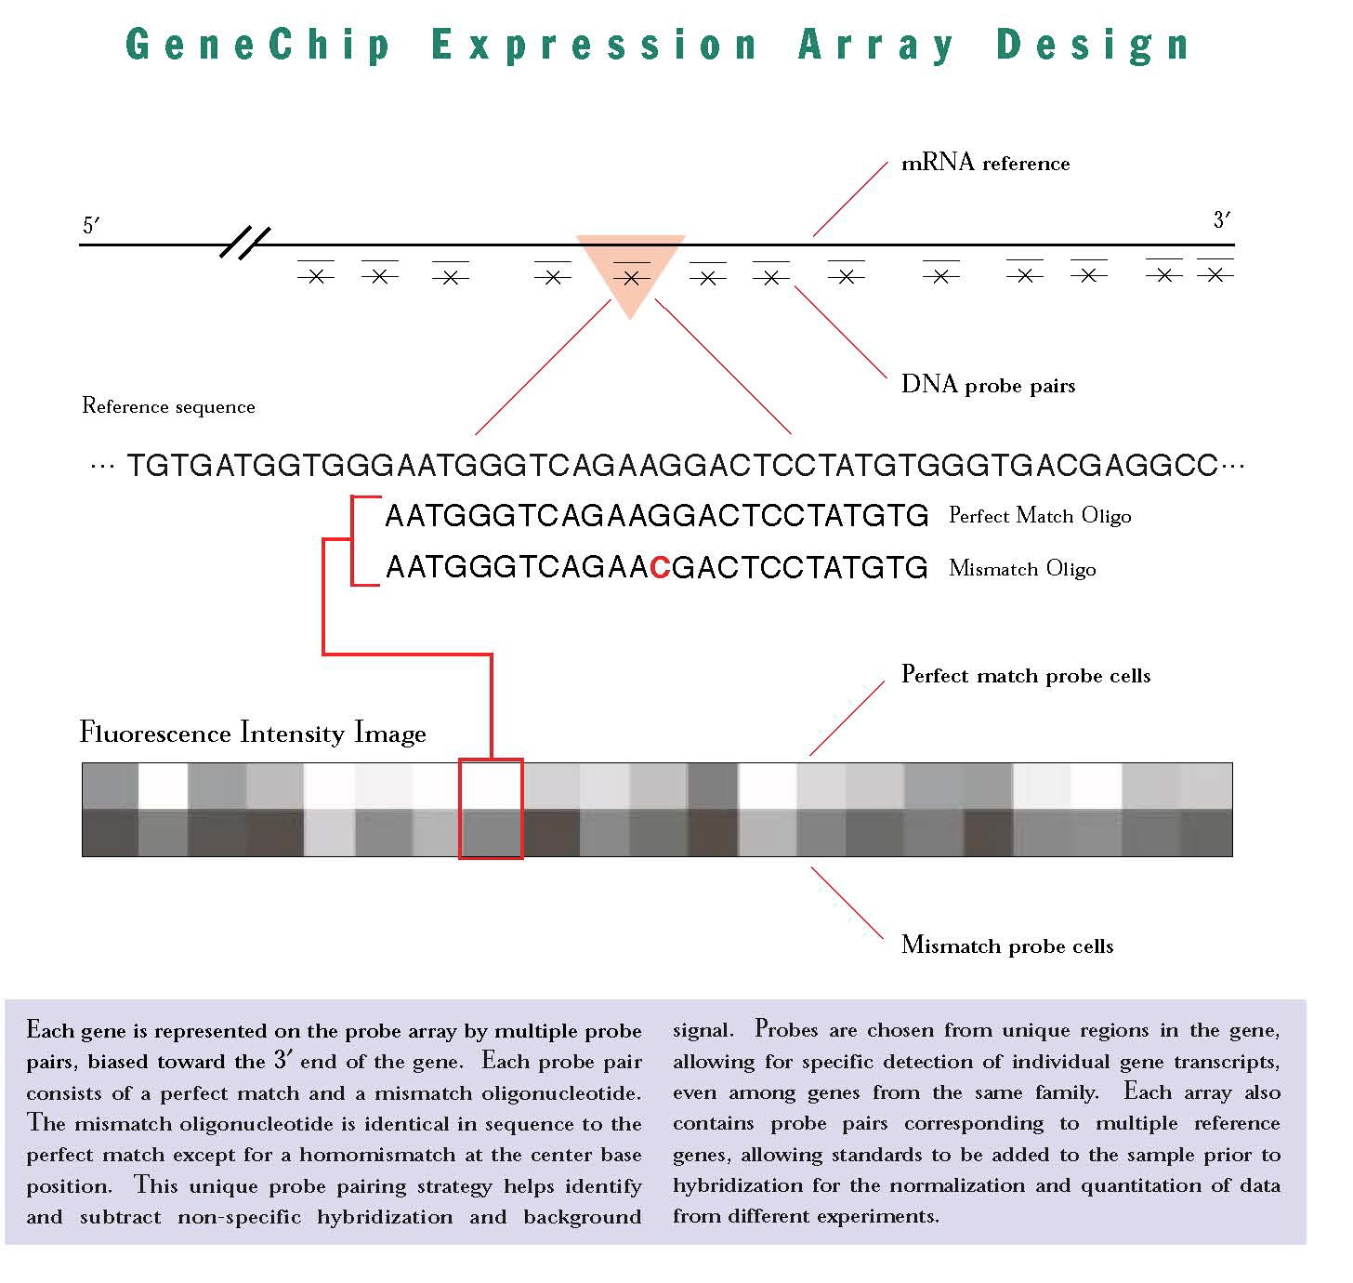

Slide 4
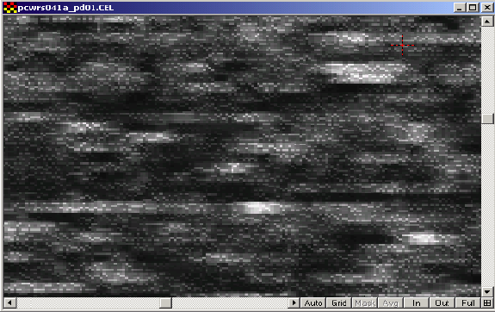
Image analysis
Affymetrix uses it own software to generate image file .DAT (MAS 5.1)
After image analysis, a .CEL file(RAW) is generated recording the intensity reads of all probe cells(MM and PM).

Slide 5
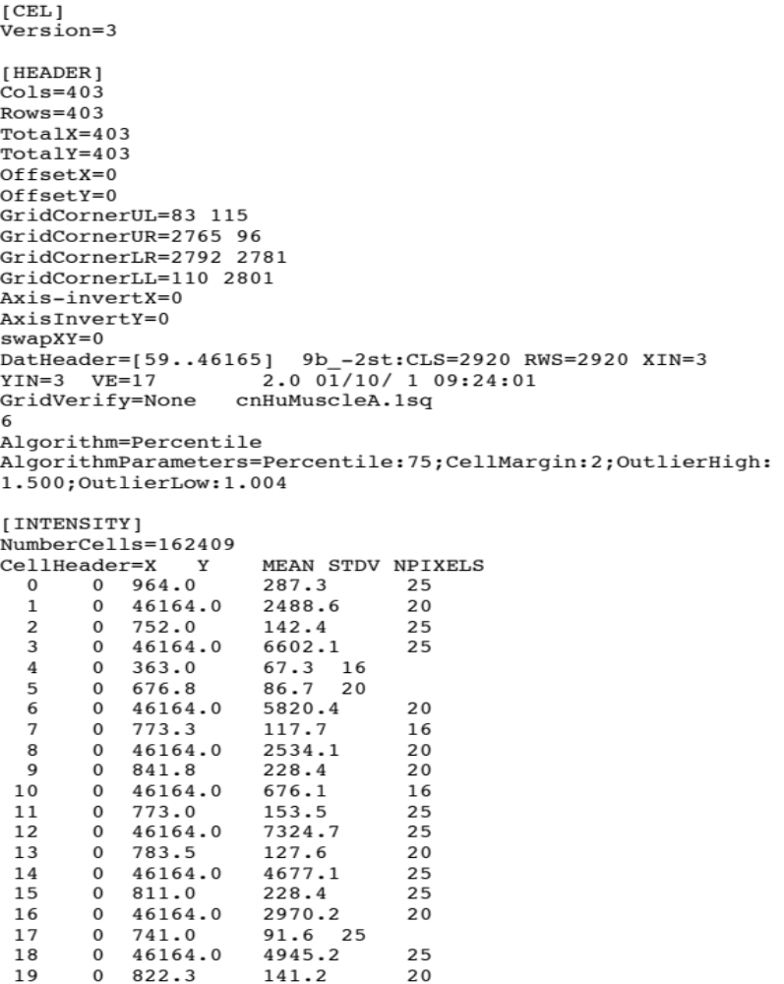
CEL file
.CEL file contain the raw intensity data at each probe cell.

Slide 6
Present or Absent call for each probe set
1. low-level Affy data analysis starts with Present or absent call of the signal.
2. Difference between PM and MM is designed to
measure the signal due to specific binding of target and
probes. Non-specific binding can be removed by taking
the difference between PM and MM, i.e. PM-MM
3. Random variation or other factors can make PM-MM
<0 even if a specific binding exists, and vice versa.
4. Rigorous measures are needed to assess whether the difference PM-MM is due to true signal or random variation

Slide 7
Discriminant score
R = (PM-MM)/(PM+MM)
R is calculated for each probe pair
The following statistical hypotheses are tested:
  H0: E(R) =0
    Ha: E(R) !=0
Assumptions:
Assume R1, R2, …Rk are independent observed discriminant scores from pair 1, 2, …K,
R1, R2.. have the same mean,
The distribution of Ri is symmetric.

Slide 8
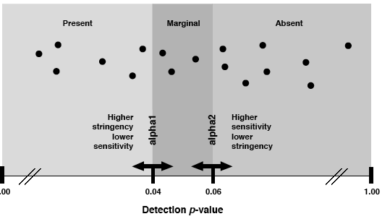
Wilcoxson’s signed rank test--P-value
Affymetrix used Wilcoxson’s signed rank test to test H0: R=0 for each probe set.
P-value:=prob(X>x0|H0 is true), it is referred as type I error.
P-value measures the significance of the test. The smaller p-value is more significant to call a signal.

Slide 9
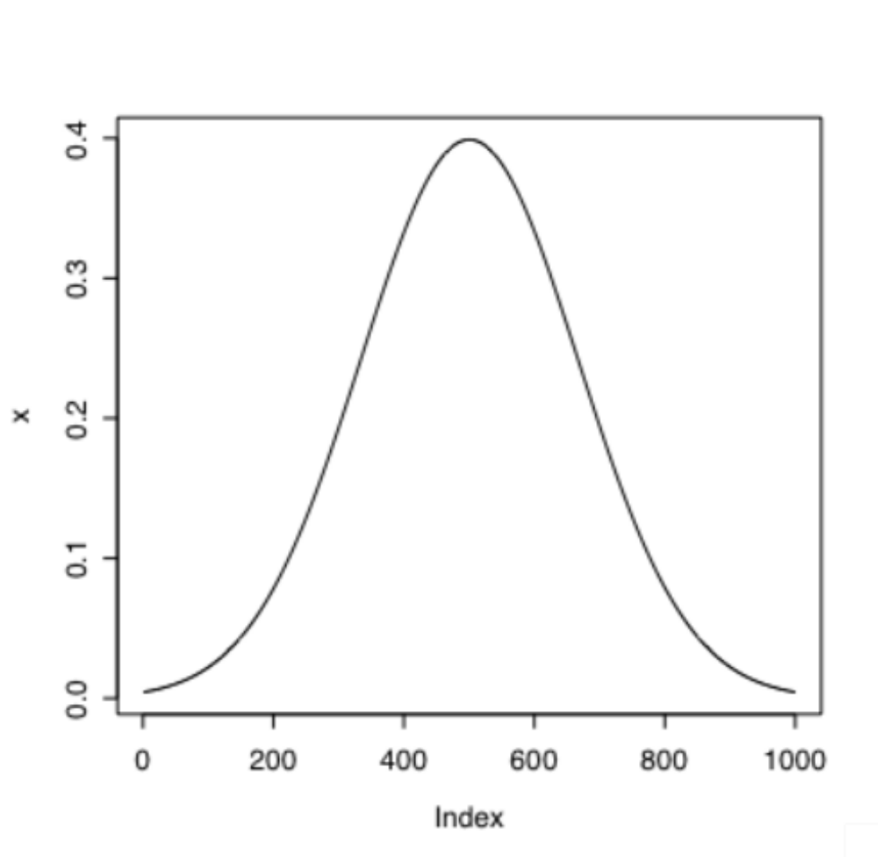
More about p-value
Distribution of X under H₀
If H1: u1!=u2,
p-value=P(X>|x₀| given H0)
If H1: u1>u2, then
p-value=P(X>x₀| given H0)
If H1: u1<u2, then
p-value=P(X<x₀| given H0)
P-value<0.05 usually we say the test is significant.
In PM-MM case, we call the signal present.
x₀

Slide 10
Informative or uninformative intensity
Rules used by Affymetrix for signal call:
If MM>PM, the probe cell is called uninformative.
If MM<PM, MM value is directly used to calculate PM-MM
If MM cells are generally informative, only a few are uninformative, a weighted score called change threshold (CT) is used for these uninformative MM.
If MM cells are generally uninformative, “absent” will be called for this probe set.
Signal=TukeyBiweight(log(Adjusted PM)), robust to outliers.

Slide 11
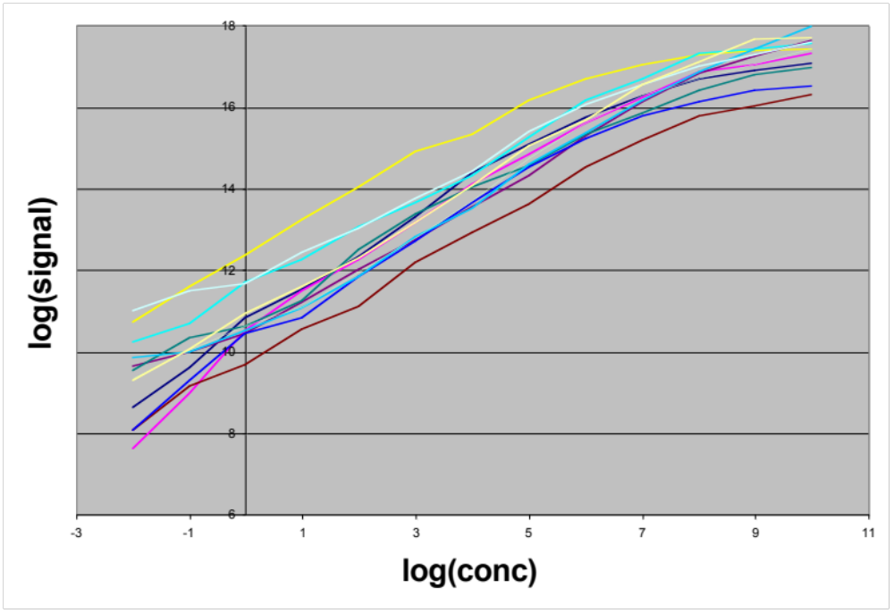
Average Signal for 12 human spiked transcripts

Slide 12
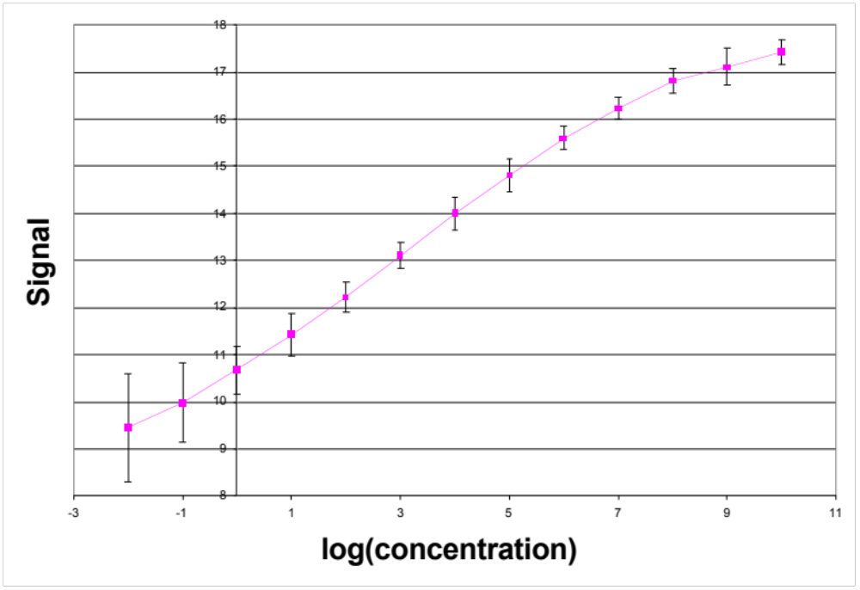
Signal is near-linear with constant variance

Slide 13
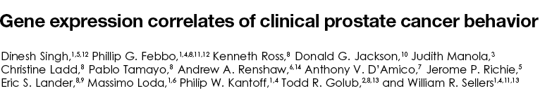
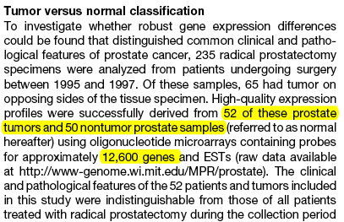
An example Singh et al. 2002 Cancel cell

Slide 14
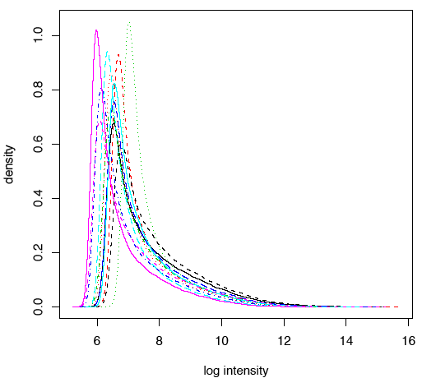
Why normalization?
Singh et al 2002
Affy data, subset of 6 normal, 6 tumor

Slide 15
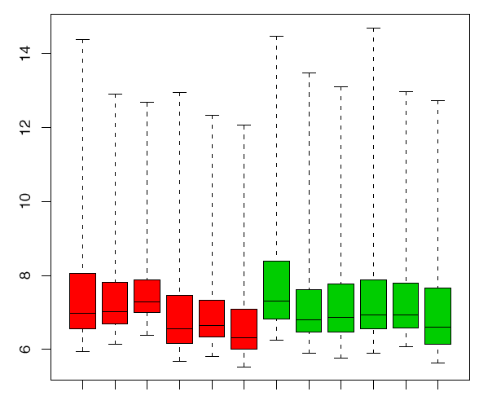
Boxplot before normalization
red: Tumor, green: Normal

Slide 16
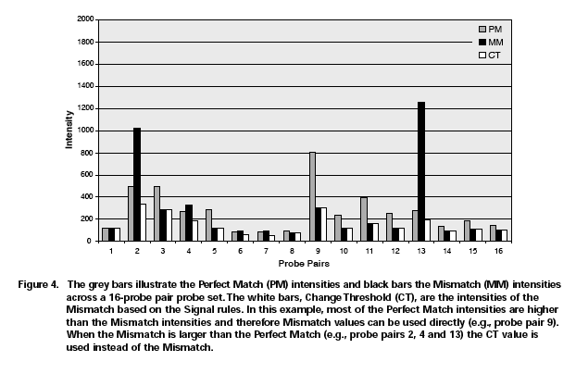
How to make Intensity call?
Probe binding variability

Slide 17
Two tasks in low-level analysis of Affy data
How to normalize the data?
  Linear, Nonlinear
How to make density call after normalization.
  AvgDiff, Li and Wong 2001(MBEI), MAS5.0, Irizarray et al 2002(rma).

Slide 18
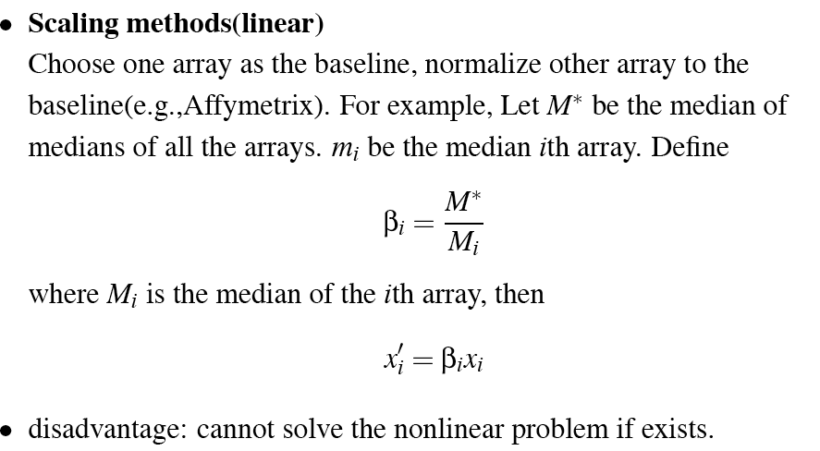
Linear normalization--using baseline

Slide 19
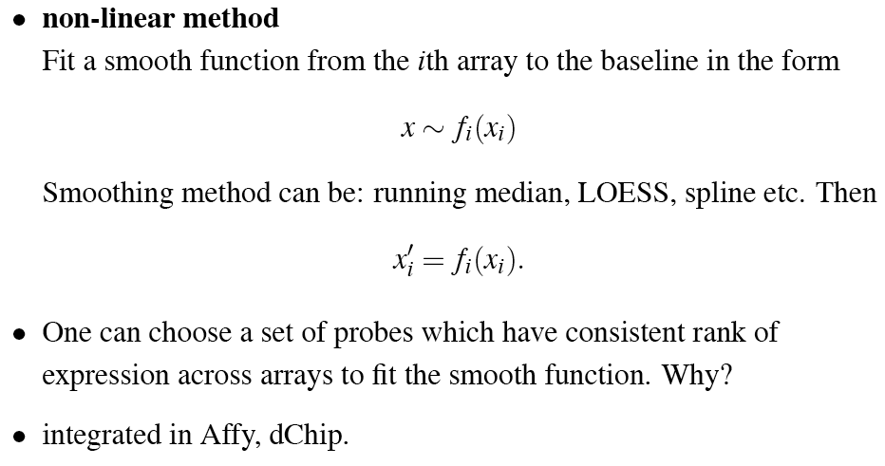
Non-linear normalization--use baseline

Slide 20
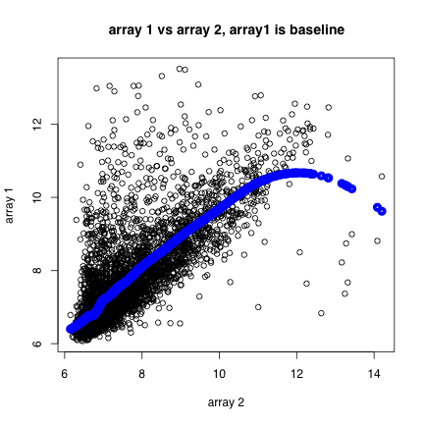

Slide 21
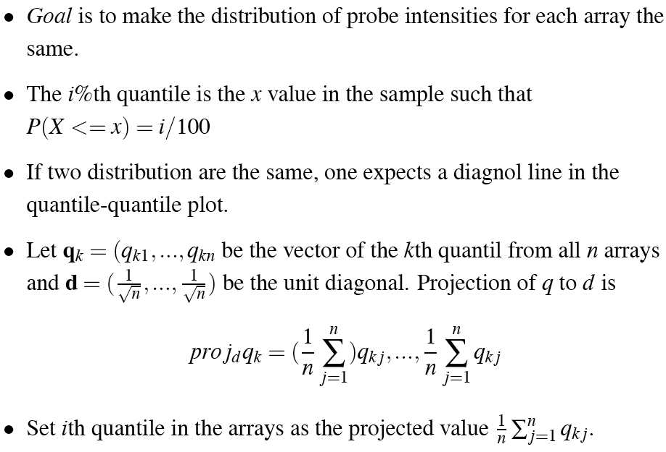
Non-linear normalization--use all arrays
Quantile normalization by Bolstad et al. 2003

Slide 22
A simple case
Array 2
(q_{k1}*, q_{k2}*)
q_{k2}*
q_{k2}
(q_{k1},q_{k2})
q_{k1}*
q_{k1}
Array 1

Slide 23
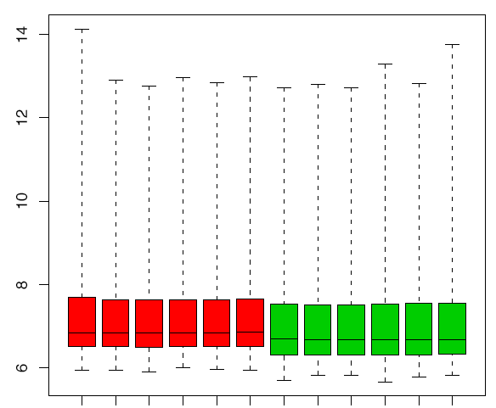
After Quantile Normalization
Boxplot for PM
Tumor and normal arrays are normalized separately.
In practice, they should be normalized together in order to differentiate gene expression.
Both PM and MM values are adjusted.

Slide 24
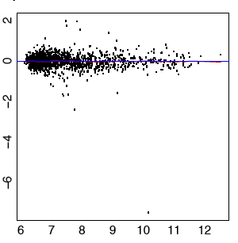
MVA plot of a random set of 100 genes after loess normalization

Slide 25
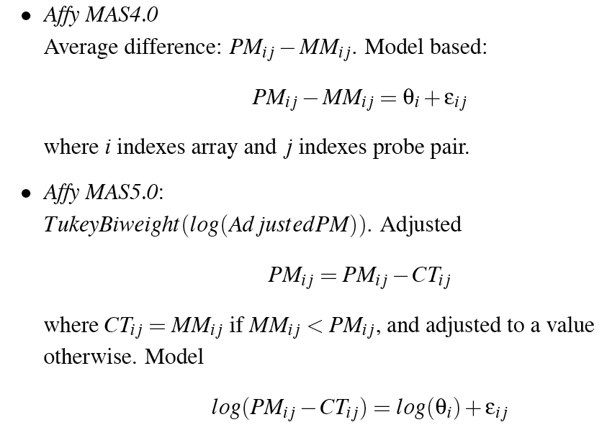
Expression intensity read

Slide 26
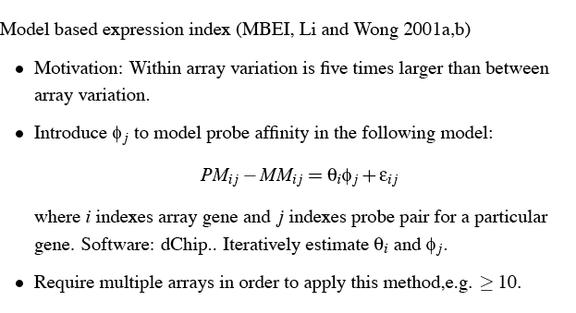
Model based expression index- a multiplicative model

Slide 27
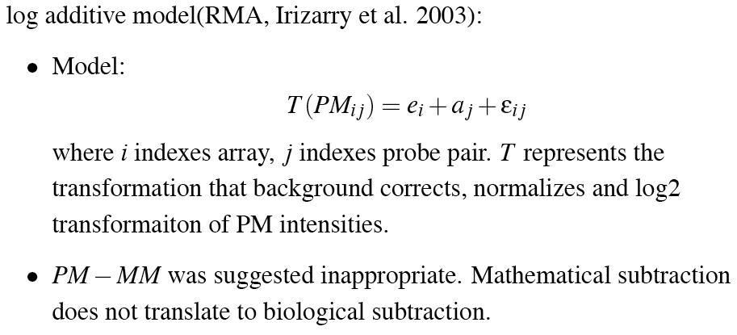
Log additive model (RMA, (PM-bg) only)
Robust Multi-array

Slide 28
Compare different methods
Data: Two sources of cRNA, human liver tissue and A central nervous system cell line(CNS)
Dilution: samples were diluted to concentrations 1.25, 2.5, 5.0,7.5,10.0, 20.0 ug
Replicates: Five replicates for each sample each concentration, this gives total n=60 arrays.
http://qolotus02.genelogic.com/datasets.nsf/

Slide 29
R^{2,} standard deviation, fold change
Dilution does not change relative abundance of transcripts. Hence correlation of samples at different diluted concentration must be close to 1.
Average of R² among the pairwise regression of 120 pairs of arrays is 0.995,0.993 and 0.990 for RMA, dChip and MAS5.0

Slide 30
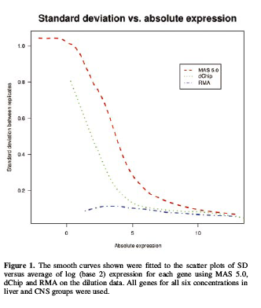
Variation across technically replicated arrays

Slide 31
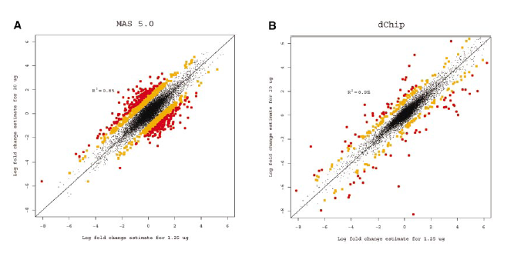
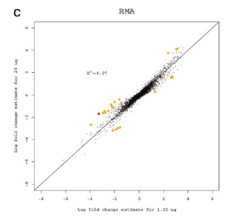
X: fold change of liver and CNS samples at concentration of 1.25 ug.
Y: fold change of liver and CNS samples at concentration of 20 ug.
Idea: fold change should be constant at different concentrations (2 or 3 fold changes for orange and red dots).

Slide 32
Data ready for high-level analysis
N1 N2 N3 N4 T1 T2 T3 T4
1000_at 7.696 7.673 7.579 7.556 7.550 7.197 7.324 7.398
1001_at 4.017 4.420 4.398 4.573 4.342 4.021 4.170 4.257
1002_f_at 3.587 4.027 4.122 4.263 4.211 3.706 3.847 3.828
1003_s_at .817 7.156 6.992 7.055 7.159 6.171 6.870 6.914
1004_at 5.467 6.197 5.986 6.074 6.147 5.651 5.696 5.946
1005_at 7.225 5.399 5.489 5.503 5.517 3.839 3.808 3.701
1007_s_at 7.456 7.362 7.289 7.462 7.301 7.614 7.160 7.364
1008_f_at 7.426 12.406 12.340 12.058 12.747 10.100 12.077 12.372
1009_at 8.651 6.770 7.136 6.842 7.242 6.522 9.110 8.389

Slide 33
Concluding remarks
cDNA array: background noise filtering, print-tip normalization, dye effect
Affymetrix array: PM-MM subtraction or PM adjusted by background. Normalization across arrays includes linear and nonlinear methods. Signal read requires delicate modeling.
cDNA array is more customizable, and Affy is more standarlized.

Slide 34
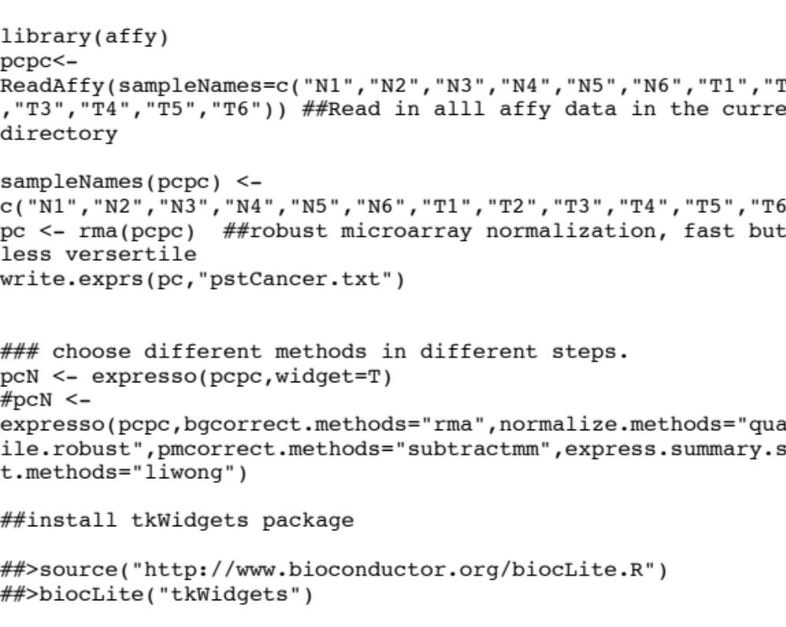
Using Affy package in R

Slide 35
