Slide 1
Glct-3 mutant verification
44
60
ATGTCGAATAGACTCGGGGGTTTTGCAATACGTTGGTATGCTGTTGG①AGGATTGTTTGGAGG②TTCAGAGATCGTATC
①
②
Crispr primer target site

Slide 2
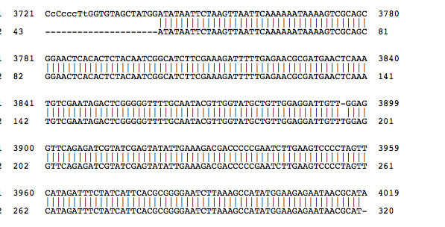
Glct-3_clone3, 5, 7, 22, 24(1 point deletion)
57
#

