Slide 1
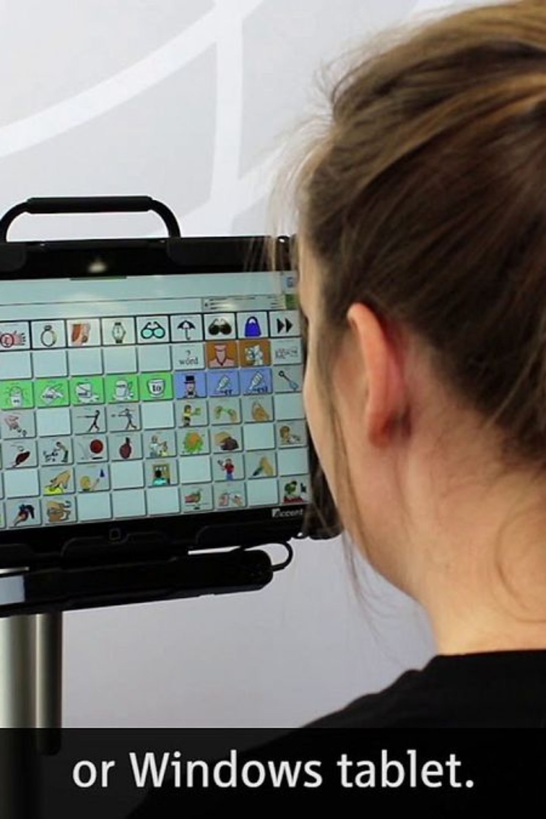
GazeType
Adaptive Eye-Gaze Communication Keyboard
Hands-Free Text Entry Using Eye Gaze & Blinks
MOHNISH RAM (23BCE1081), ADAVAN (23BCE1053)

Slide 2
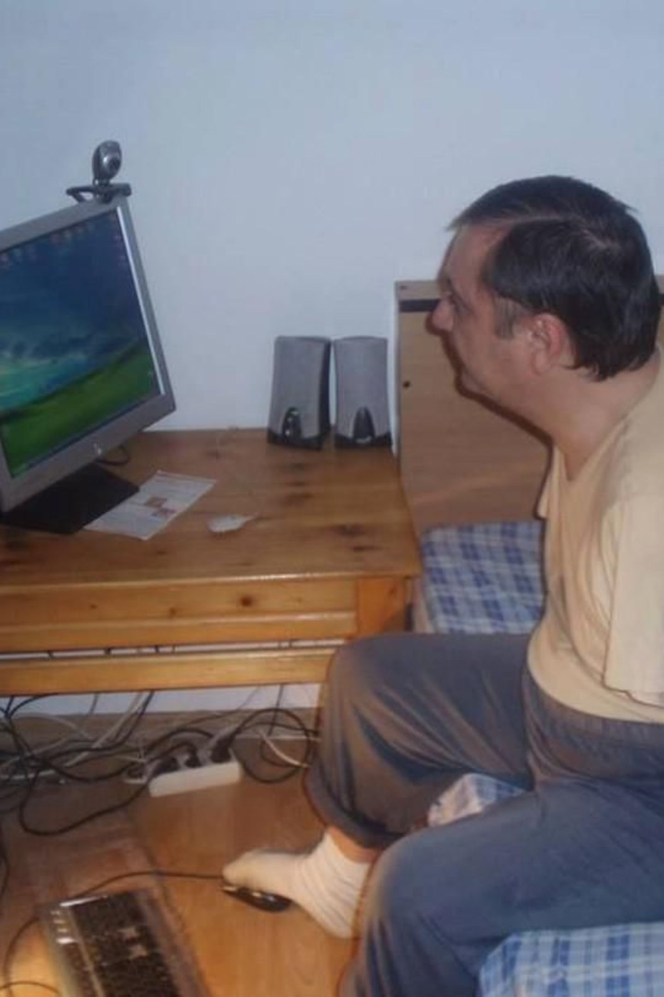


The Problem
Physical Barriers
Traditional keyboards require physical interaction — difficult or impossible for many users.
Cost & Complexity
Eye-tracking systems are expensive. Basic scanning keyboards require prolonged eye fixation.
Error-Prone Input
Accidental selections occur due to blink and gaze detection errors in existing systems.
Our Goal: Create a low-cost, webcam-based communication interface using only eye movement and blinking.

Slide 3
Our Solution: GazeType
A webcam-based virtual keyboard — Look → Navigate → Blink → Select → Type
01
02
03
Webcam Capture
Eye Landmark Detection
Gaze Selection
Captures the user's face in real time
Estimates gaze direction from eye landmarks
Look left/right to navigate the keyboard
04
05
Two-Blink Confirm
Communication Board
First blink pauses the letter, second blink confirms
Selected letters appear on screen

Slide 4
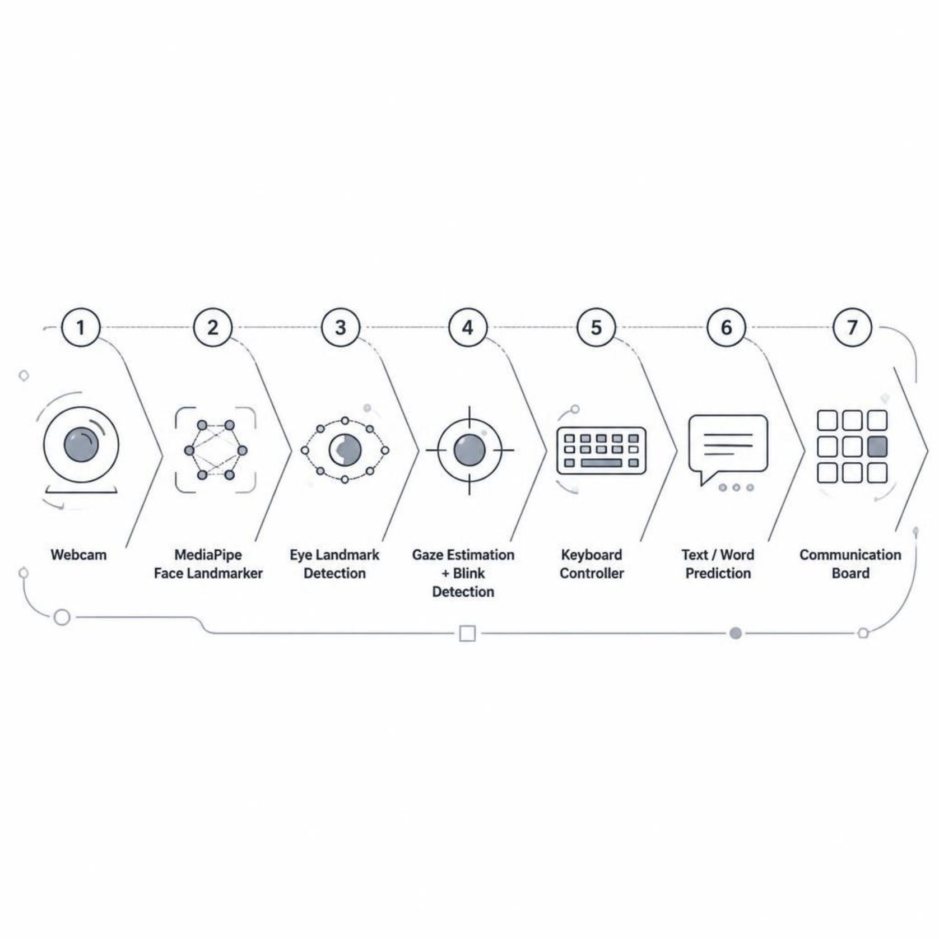
System Architecture
Technologies Used
MediaPipe's Face Landmarker handles landmark detection. OpenCV processes video frames. NumPy manages numerical data. Pyglet renders the interface. JSON stores user profiles locally.
Python
OpenCV
MediaPipe
NumPy
Pyglet
JSON

Slide 5
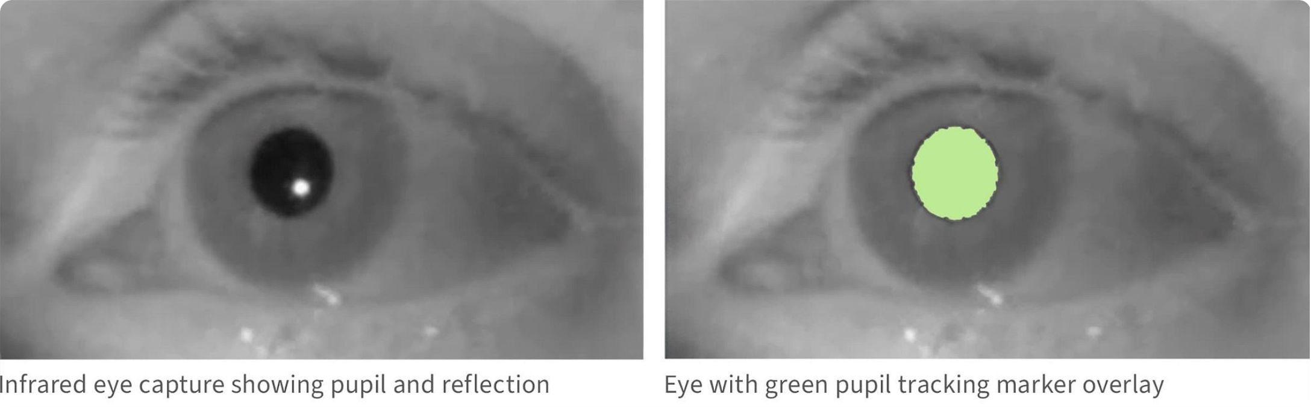
Computer Vision Core
👁️ Gaze Detection
Calculates horizontal iris position relative to the eye. Look left → left keyboard. Look right → right keyboard. Short-term smoothing reduces noise; stable gaze is required before changing screens.
😉 Blink Detection
Uses Eye Aspect Ratio (EAR). Open-eye baseline is measured during calibration. Personalized blink threshold is calculated per user. Multiple frames are used to reduce false detections.

Slide 6
What Makes GazeType Different?
1
Personalized Calibration
Adapts blink detection to the individual user.
2
Two-Stage Blink Confirm
First blink = pause. Second blink = confirm.
3
Adaptive Scanning Speed
Letter cycling adjusts based on selection behavior.
4
Offline Word Prediction
Common words suggested without internet.
5
Persistent User Profile
Calibration data reused between sessions.
6
Session Performance Metrics
System tracks interaction performance.

Slide 7
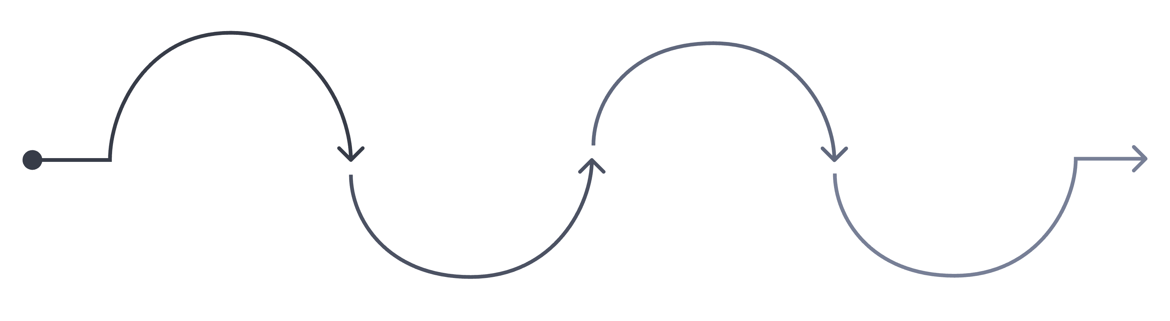
Designed Around User Comfort
Continue Typing
Normal Scanning
Blink #1
Blink #2
Pause on current letter
Confirm and select letter
Resume scanning after confirm
Continuous letter cycling
If the user blinks once accidentally but doesn't confirm, the selection is not immediately committed. A 5-second confirmation timeout ensures the whole project isn't just about detecting eyes — it's about making the interaction comfortable and error-resistant.

Slide 8

Word Prediction & Communication
Reduces the number of eye interactions required for common words. The system includes an offline dictionary and returns up to three matching predictions for the current partial word.
Without Prediction
With Prediction
H → E → L → L → O
5 selections
H → E → L → HELLO
4 selections
User types HEL → System suggests: HELLO | HELP | ... → User selects desired word

Slide 9

Testing & Results
Feature | Status
Webcam Detection | Working
Eye Landmark Tracking | Working
Gaze Selection | Working
Personalized Calibration | Working
Blink Detection | Working
Two-Stage Selection | Working
Letter Scanning | Working
Word Prediction | Working
Backspace / Space | Working
Adaptive Scanning | Working
Live Demo: Type "HELLO WORLD" using only eyes

Slide 10
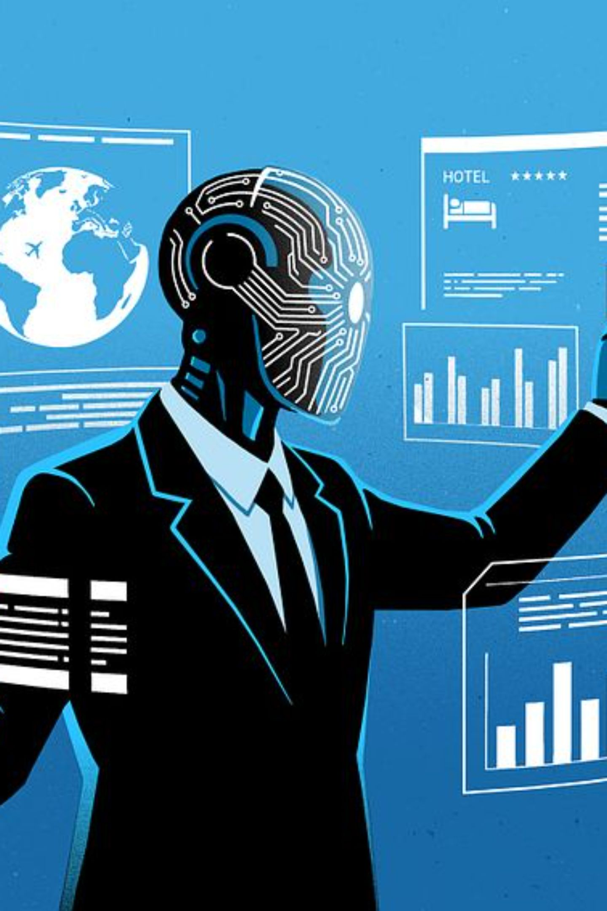
Conclusion & Future Work
GazeType demonstrates that a standard webcam can create a practical hands-free communication interface — combining Computer Vision + Eye Gaze + Blink Detection + Adaptive Interaction.
Larger Vocabulary
Expanded personalized word list
Multilingual Support
Prediction for multiple languages
Head Compensation
Better head-movement tolerance
User Testing
Performance comparison with conventional scanning systems

