Slide 1

NYC Taxi Trip Duration
Problem Definition through Predictive Modelling
ECSA Graduate Attribute Project 1
Name: Thato Xauka
Programme: WIL AI/ML Programme

Slide 2
Model Building Life Cycle
Stage 1 — Problem Definition (TOSCAR)
Stage 2 — Hypothesis Generation
Stage 3 — Data Extraction / Collection
Stage 4 — Data Exploration & Transformation (EDA)
Stage 5 — Predictive Modelling
Dataset: NYC Taxi Trip Duration (NYC.csv)

Slide 3
Stage 1: Problem Definition — TOSCAR
TOSCAR is used to frame the problem before any data is examined.
Six questions: Trouble, Owner, Success Criteria, Constraints, Actors, References.

Slide 4
T — Trouble | O — Owner
T — Trouble
What is the pain point? Riders and dispatchers receive inaccurate trip-duration estimates (ETAs) — duration is only known after the trip ends.
O — Owner
Who is most impacted? Taxi companies and dispatchers, who are directly responsible for fleet allocation.

Slide 5
S — Success Criteria | C — Constraints
S — Success Criteria
Accurate trip-duration estimates before a trip begins, fewer rider complaints, better fleet allocation, more customer trust.
This project covers Problem Definition through EDA only — no model exists yet to evaluate. A future modelling stage would measure success by how closely predicted duration matches actual duration.
C — Constraints
Only historical trip records are available — no live traffic or weather feed. Any future prediction would also need to run fast enough for near real-time dispatch.

Slide 6
A — Actors | R — References
A — Actors
Passengers (need reliable ETAs), Drivers (need fair scheduling), Dispatchers/Operations Managers (need efficient fleet allocation), Taxi companies/vendors (need revenue and trust).
R — References
The historical NYC TLC Yellow Cab dataset (NYC.csv) — pickup/dropoff coordinates, timestamps, vendor info, passenger counts, and actual trip durations.

Slide 7
Final Problem Statement
Trip duration for NYC taxi rides is unpredictable, causing dispatchers to misallocate taxis, passengers to receive unreliable ETAs, drivers to lose income from inefficient scheduling, and taxi companies to lose customer trust and revenue.
Guiding question:
“Which factors in a taxi trip's pickup information can help us understand and estimate trip duration before the trip begins?”

Slide 8
Stage 2: Hypothesis Generation
H1 — Trips covering a longer distance take longer.
H2 — Trips during rush hour (7–9am, 4–7pm) take longer than off-peak trips.
H3 — Weekday trips take longer than weekend trips.
H4 — Trips with more passengers may have longer trip durations.
H5 — Trip duration may differ between the two vendors.
H6 — Trips taken at different times of the day may have different trip durations.

Slide 9
Stage 3: Data Extraction / Collection
Libraries imported: pandas, numpy, matplotlib, seaborn, scipy.stats
Dataset loaded: data = pd.read_csv('NYC.csv')
Structural checks performed before any cleaning:
data.head() / data.tail() — confirm the file loaded correctly start to end
data.shape — 1,458,644 rows x 11 columns
data.columns — confirm all column names
data.dtypes — check data types of every column

Slide 10
Stage 4: Data Exploration & Transformation
Missing values checked (data.isnull().sum()) — none found.
pickup_datetime / dropoff_datetime converted from text to datetime.
store_and_fwd_flag converted to category type.
Target variable (trip_duration) explored using .describe() before any visualisation.

Slide 11
Target Exploration — trip_duration
1,458,644 trips, no missing values.
Mean = 959.5 seconds (~16 min), but Std Dev = 5,237 seconds — over 5x the mean.
Median = 662 seconds (~11 min) — a far more realistic “typical trip” than the mean.
Maximum = 3,526,282 seconds (40.8 days) — a clear data error / extreme outlier.
Mean > Median confirms a right-skewed distribution (a long tail of high values).

Slide 12
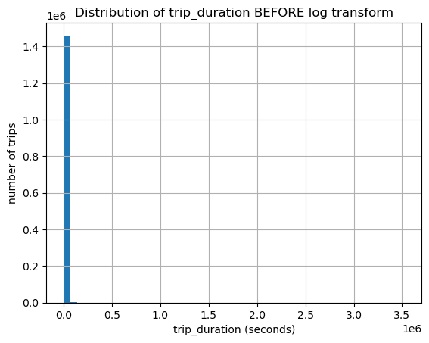
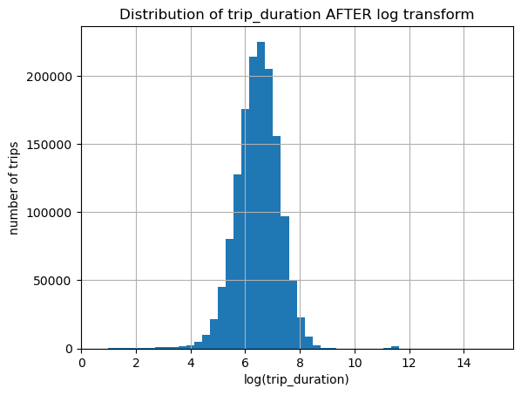
Log Transform of trip_duration
Before: raw trip_duration is heavily right-skewed by extreme outliers.
After: log1p(trip_duration) is far closer to a normal, bell-shaped distribution.

Slide 13
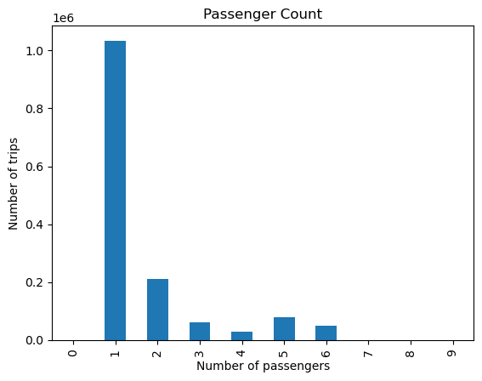
Univariate — Passenger Count
Over 70% of trips (1,033,540) carry just 1 passenger — solo rides dominate.
2 passengers is next most common (210,318 trips); numbers drop off steadily after that.
0 passengers (60 trips): a confirmed data error — a taxi cannot legally dispatch empty.
5–6 passengers: a grey area — could be larger accessible vehicles or errors.
7–9 passengers (1–3 trips each): too rare to represent a real pattern.

Slide 14
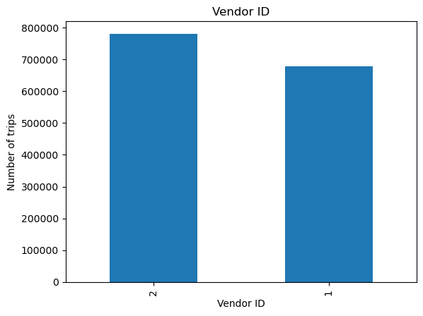
Univariate — Vendor ID
Vendor 1: 678,342 trips (46.5%).
Vendor 2: 780,302 trips (53.5%).
The split is fairly balanced — Vendor 2 handles roughly 100,000 more trips, but not an extreme imbalance.

Slide 15
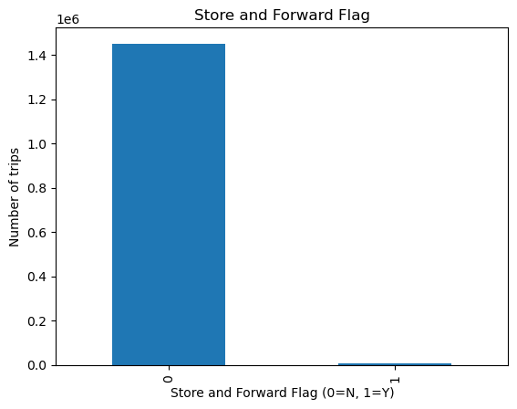
Univariate — Store & Forward Flag
99.45% of trips (1,450,599) have flag = 0 — data sent to server immediately, no connectivity issue.
Only 0.55% (8,045 trips) have flag = 1 — data was stored and forwarded later; the variable is highly imbalanced.
This only examines frequency, not trip_duration by group — so no hypothesis is supported or rejected from this analysis.

Slide 16
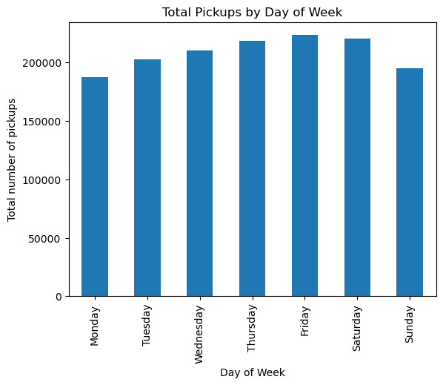
Univariate — Pickups by Weekday
Monday has the fewest pickups (187,418), rising through Tuesday–Thursday, and reaching the highest level on Friday (223,533).
Saturday remains almost as high (220,868), before decreasing on Sunday (195,366).
This measures pickup frequency only, not trip duration — so it does not confirm or reject H3 yet; that relationship is tested in the bivariate analysis.

Slide 17
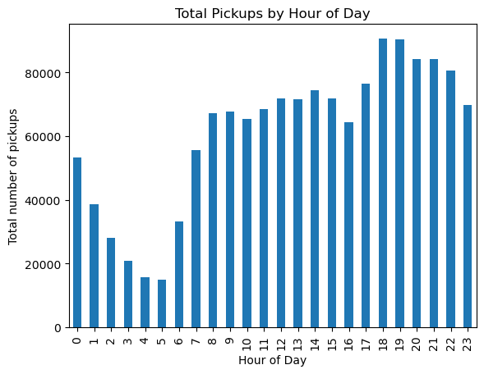
Univariate — Pickups by Hour
Pickups are lowest in the early morning (2am–5am), then increase throughout the day, reaching their highest levels in the evening (18:00–21:00).
Taxi demand varies considerably by time of day — substantially more trips occur during the daytime/evening than in the early morning.
This measures pickup frequency only, not trip duration — so it does not confirm or reject H2 yet; that relationship is tested in the bivariate analysis.

Slide 18
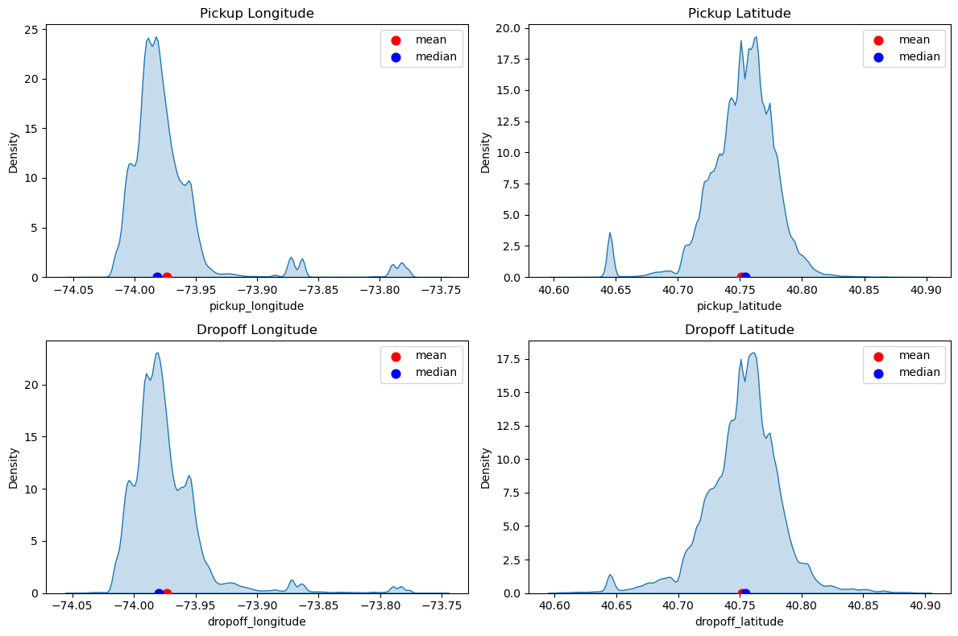
Pickup / Dropoff Coordinates
All four coordinate columns cluster tightly together — mean and median within 0.01 of each other.
Unlike trip_duration, these distributions are close to symmetrical.
Raw min/max values reveal a small number of GPS-logging errors (coordinates placing a trip outside the US) — excluded from the chart for readability, kept in the dataset for now.

Slide 19
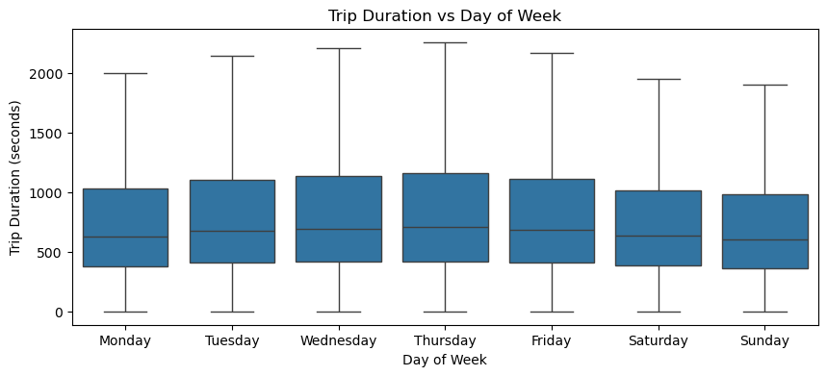
Bivariate — Duration vs Day of Week
Lowest average duration: Monday (898s) and Sunday (902s).
Highest: midweek, peaking Thursday (1,007s).
Supports H3 — weekday trips genuinely take longer than weekend trips, likely due to commuter traffic.

Slide 20
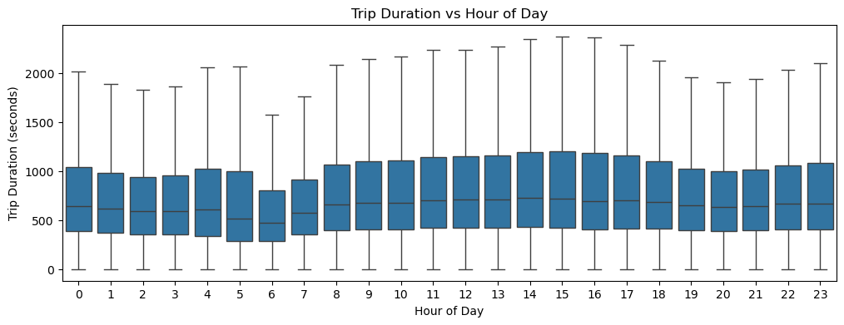
Bivariate — Duration vs Hour of Day
Lowest average duration: early morning, 6am (797s).
Highest: mid-afternoon, 3pm (1,119s), with a smaller secondary peak around 10pm (1,024s).
Partially supports H2 — duration does vary meaningfully by hour, but the true peak is 2–4pm, not the classic 7–9am / 4–7pm rush-hour windows named in the hypothesis.

Slide 21
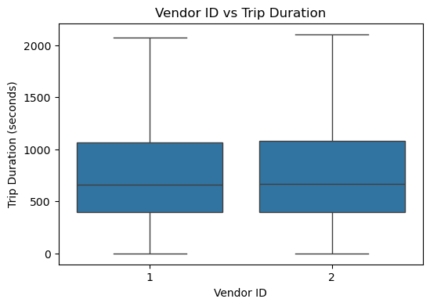
Vendor ID vs Trip Duration
Mean duration: Vendor 1 = 845.4s, Vendor 2 = 1,058.6s — a gap of 200+ seconds.
Median duration: Vendor 1 = 658s, Vendor 2 = 666s — a gap of only 8 seconds.
The mean-vs-median mismatch is the same warning sign seen earlier: a handful of extreme outliers in Vendor 2's data are pulling its average up. The median shows the two vendors are actually almost identical in typical duration.

Slide 22
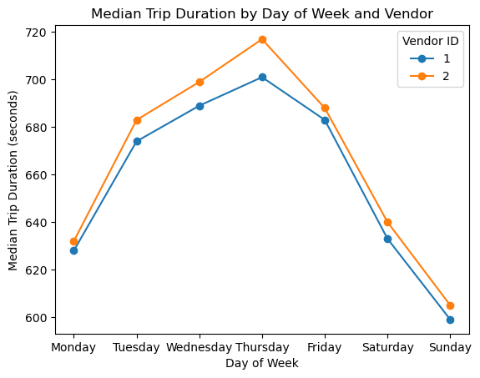
Median Trip Duration — Vendor x Weekday
Median duration: Vendor 1 = 658s, Vendor 2 = 666s overall — only an 8-second difference.
Broken down by day, both vendors follow the exact same weekly pattern — peaking Thursday (701s / 717s), lowest on Sunday (599s / 605s).
The two lines stay almost parallel and never cross — the small vendor gap is consistent and doesn't depend on the day.

Slide 23
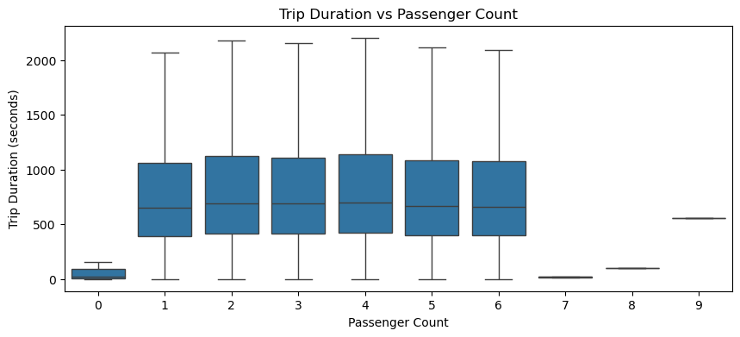
Passenger Count vs Trip Duration
Average duration rises gradually from 1 passenger (930s) to 6 passengers (1,061s) — a mild, steady increase.
Median duration (654–698s across 1–6 passengers) confirms a real but weak effect, matching H4.
0 passengers (mean 1,718s, median 20.5s) and 7–9 passengers (1–3 trips each): extreme mismatches confirm these are broken data or too small a sample to trust.

Slide 24
Pickup Density — Heatmap (Folium)
An interactive folium heatmap was built on a 5,000-trip NYC-boundary sample.
Pickup density is heavily concentrated in Manhattan, with the brightest clustering around the island's core.
Matches the earlier lat/long finding of a tight, narrow coordinate peak.
Outer boroughs and airports show noticeably lighter, more scattered activity — NYC yellow-taxi demand is overwhelmingly an inner-city phenomenon.

Slide 25
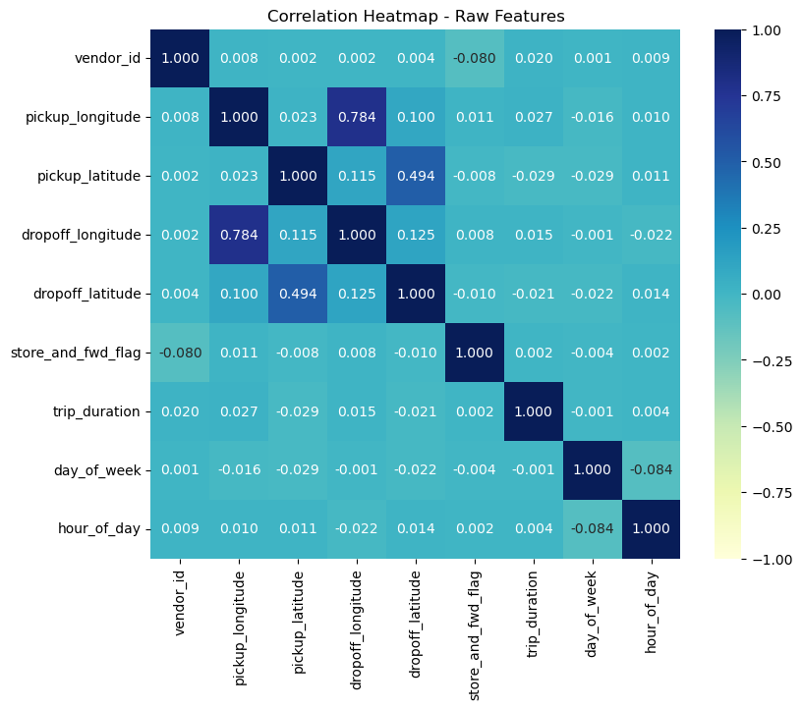
Correlation Heatmap (Raw Features)
Every raw feature shows an extremely weak correlation with trip_duration — the strongest is pickup_latitude at just -0.029.
The one genuinely strong relationship in the matrix is pickup_longitude vs dropoff_longitude (0.784), and pickup_latitude vs dropoff_latitude (0.494) — trips mostly start and end in a similar area of the city.
This supports the conclusion that distance (combining pickup and dropoff coordinates) will help predict trip duration — not any single raw column alone.

Slide 26
Stage 4 — Hypothesis Status Summary
H1 (distance) — to be confirmed via engineered distance feature in Stage 5.
H2 (rush hour) — partially supported; real peak is mid-afternoon, not classic rush hour.
H3 (weekday vs weekend) — supported, with demand/duration rising then falling across the week.
H4 (passenger count) — weak but real effect supported for 1–6 passengers.
H5 (vendor) — supported on the mean, but not on the median; outlier-driven.
H6 (store & forward flag) — not tested; sample too small (0.55%) to compare reliably.

Slide 27
Stage 5: Predictive Modelling — Preprocessing
Final missing-values check: none found. No imputation required.
Duplicate rows checked (data.duplicated().sum()): 0 duplicates found.
Columns reviewed via data.dtypes: identifiers, raw timestamps, and leakage columns removed.
model_data kept 10 columns: vendor_id, passenger_count, pickup/dropoff coordinates, store_and_fwd_flag, trip_duration, day_of_week, hour_of_day.

Slide 28
Outlier Handling — Domain-Based Cutoffs
trip_duration: IQR method flagged 74,220 trips (5.09%) as outliers (>35 min) — too many valid trips to discard. A domain rule was used instead: keep 1 minute to 4 hours (removed 10,672 trips, 0.73%).
passenger_count: IQR flagged 153,849 trips (10.63%) as outliers (4+ passengers) — a normal group-ride scenario, not an error. Domain rule: keep 1–6 passengers (removed only 19 trips).
Coordinates: IQR flagged 82,350 trips (5.69%); a realistic NYC boundary box was used instead, removing only 6,915 trips (0.48%) — targeting genuine GPS errors, not real edge-of-city trips.
Total removed across all three steps: 17,606 rows (~1.2% of the original dataset).

Slide 29
Feature Engineering — Trip Distance
Raw longitude/latitude differences don't represent real-world distance.
The Haversine formula was used to calculate straight-line distance (km) between pickup and dropoff coordinates.
trip_distance_km: mean 3.39 km, median 2.10 km, max 33.08 km — consistent with typical city taxi trips.
4,027 trips (0.28%) show 0 km distance (identical pickup/dropoff) — retained, since this is a small share and could reflect genuine short/cancelled trips.

Slide 30
Train/Test Split & Feature Scaling
X (10 features) and y (trip_duration) separated: 1,441,038 rows each.
Split before scaling, to avoid data leakage: 80% train (1,152,830) / 20% test (288,208).
Features scaled with StandardScaler (mean 0, std 1) — essential for KNN, a distance-based algorithm.
Scaler fit only on training data, then applied to both sets — prevents test-set information leaking into training.

Slide 31
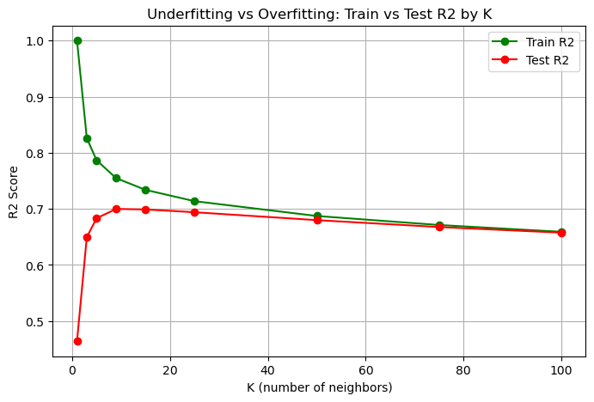
Choosing the Best K (KNN)
K = 1, 3, 5, 9, 15, 25, 50, 75, 100 tested on a 50,000-row sample.
K=1: severe overfitting (Train R2 = 1.0, Test R2 = 0.464).
K=75/100: underfitting (both scores low and near-identical).
Best balance around K=9–15, confirmed next with 5-fold cross-validation.

Slide 32
Cross-Validation & Final KNN Model
5-fold CV results: K=9 -> mean R2 = 0.6924; K=15 -> mean R2 = 0.6952 (highest).
K=15 selected as the final value.
Final KNN Model (K=15) — full training set:
MAE = 199.90 seconds | RMSE = 322.82 seconds | R2 = 0.7540

Slide 33
Linear Regression — Comparison Model
Linear Regression results:
MAE = 277.96 seconds | RMSE = 412.05 seconds | R2 = 0.5993
Model Comparison:
KNN (K=15) outperforms Linear Regression on all three metrics — lower MAE, lower RMSE, higher R2.
KNN was better able to capture the (non-linear) relationships in this dataset.

Slide 34
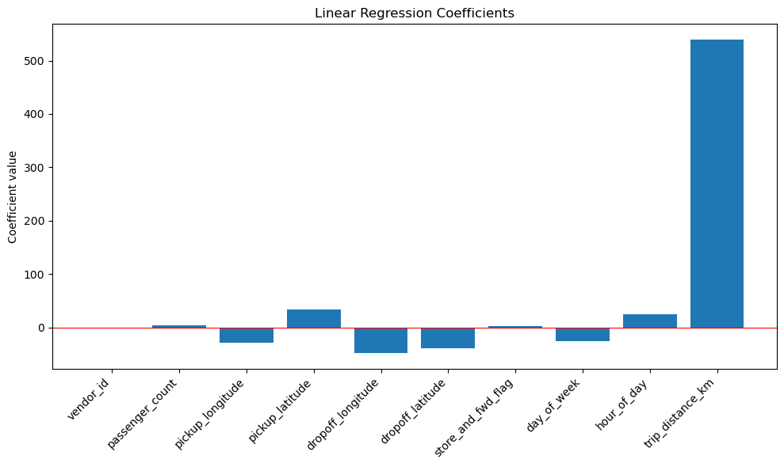
Linear Regression — Coefficients
trip_distance_km (539.16) is by far the strongest contributor to predicted duration.
hour_of_day (24.68) and day_of_week (-25.83) also meaningfully affect the prediction.
vendor_id (-0.044) contributes almost nothing once other features are included.

Slide 35
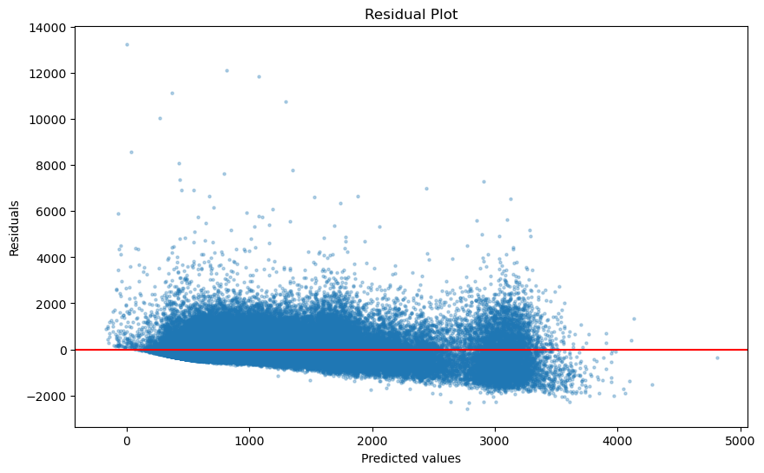
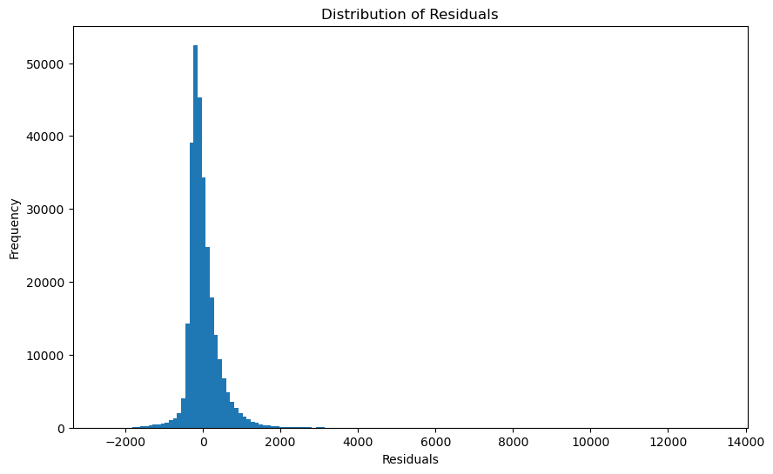
Residual Diagnostics (1/2)
Residual plot: a funnel shape — larger errors for shorter predicted trips, smaller errors for longer ones.
Histogram: roughly bell-shaped near zero, with a long right tail of underestimated trips.

Slide 36
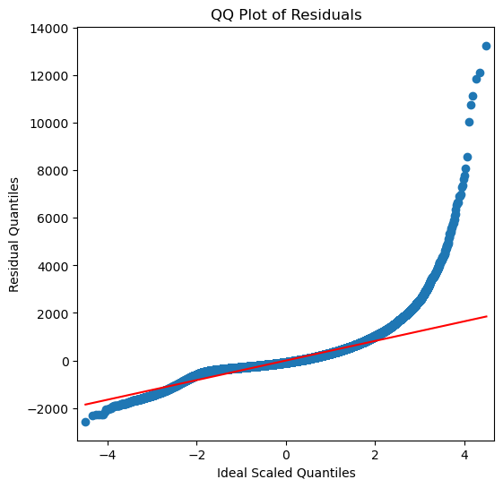
Residual Diagnostics (2/2) — QQ Plot
Middle of the plot follows the normal-distribution line closely.
Points curve sharply upward at the high end — more extreme positive residuals than a normal distribution predicts.
Confirms the relationship between features and trip duration isn't fully linear — a known limitation of Linear Regression on this dataset.

Slide 37
Final Conclusion
EDA showed trip duration is affected by time of day, day of week, and (weakly) vendor and passenger count.
Two models were trained and compared: KNN (K=15, tuned via cross-validation) and Linear Regression.
KNN (K=15): MAE 199.90s, RMSE 322.82s, R2 = 0.754 — the better-performing model on all three metrics.
Linear Regression: MAE 277.96s, RMSE 412.05s, R2 = 0.599 — residual diagnostics confirm the relationship isn't fully linear.
Recommendation: KNN (K=15) is the better model for predicting NYC taxi trip duration on this dataset.

