Slide 1

Customer Churn
Analysis and Prediction
William Chen Margaret Ji Catherine Ruan
1

Slide 2
Overview
Use the consumer dataset to:
Segment the Fulton Bank customer base
Build a model that predicts customer churn
Goals
Agenda
1
Data processing
2
Customer segmentation
3
Feature scoring and predictive model implementation
4
Business recommendations

Slide 3
Data Processing
Objective
Prepare data for analysis by removing and modifying data
Numerical/Binary Categorical Balances Missing Totals
Keep columns containing relevant characteristics of customer segments
Find appropriate level of detail
One-hot encode
Set missing balances to
-10,000
Use smooth symmetric log scaling
Fill blank cells with 0’s or -1’s depending on context
125 Columns

Slide 4
Customer Segmentation
Objective
Figure out if consumers naturally fall into certain groups
Methods
Results
Dimensionality reduction
Finding the optimal number of segments
Clustering
Segment analysis
Churn
Behaviors

Slide 5
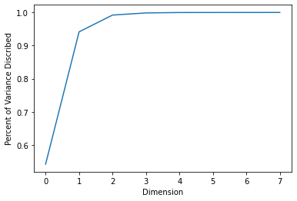
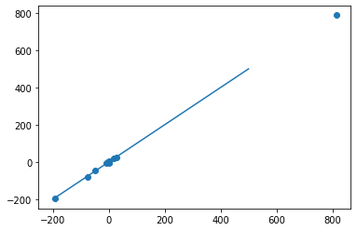
Customer Segmentation
Objective
Find a more concise representation of data
Reconstructed Data vs. Actual Data
Method
Percent of Data Described
Dimensionality reduction
Autoencoder
Principal Component Analysis
Performance analysis
Reconstruction loss

Slide 6
Customer Segmentation
Objective
Use unsupervised learning to segment customers into groups
Why unsupervised segmentation?
Select best number of clusters based on eigengaps
Cherry picking metrics may not capture nuances in the data
Unsupervised clustering can cover as much information as possible
To be understand churn, it is good to first understand its correlation with consumer behavior
Spectral clustering is best suited for nonconvex geometry
Perform large scale clustering using KMeans
Examine clustering performance using elbow method

Slide 7
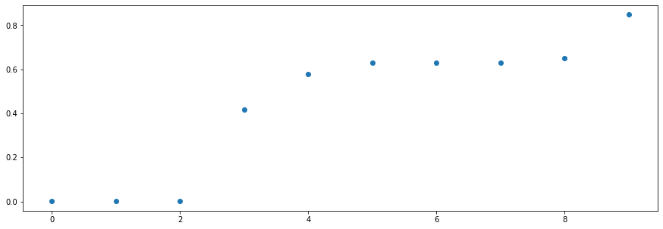
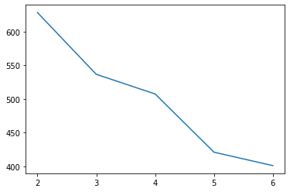
Customer Segmentation
Objective
Use unsupervised learning to segment customers into groups
Largest increases in eigenvalues
Minimized inner cluster distance

Slide 8
Customer Segmentation
Segment
Characteristics
Highest churn | Lower LTV | Lowest average mobile logins | Use Venmo/PayPal the least | Highest % of closed accounts | Lowest number of remote deposits
“Swing by”
Lowest churn | Highest number of calls to call center | Highest average age in households | Highest number of saving accounts | Highest % of high income
“Loyal”
Highest average mobile logins | Highest % Uber/Lyft payments | Use Venmo/PayPal the most
“Techy”
Largest percentage of H-P H-F | Highest direct deposit amounts | Lowest amounts of check deposits | Fulton customer the shortest | Younger households (often Gen X) | Highest % of middle income
“Valuable”
Highest average of billpay transactions | Highest average (deposit, investment, loan) products in household
“Active”

Slide 9
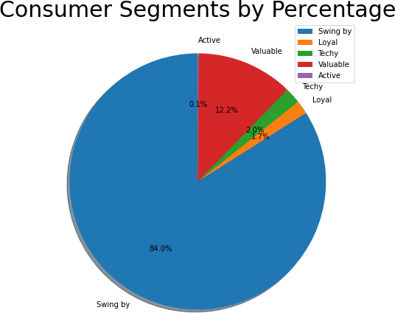
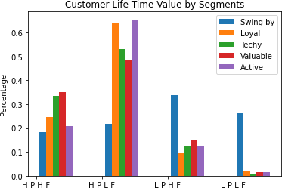
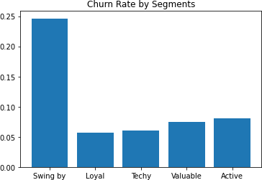
Customer Segmentation

Slide 10
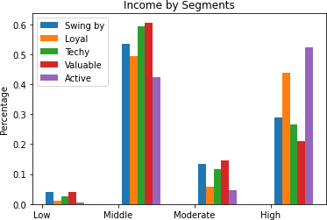
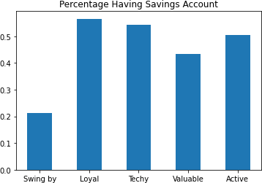
Customer Segmentation
1
0

Slide 11
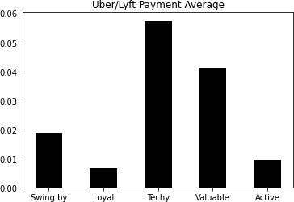
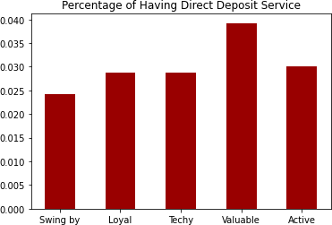
Customer Segmentation
1
1

Slide 12
Business Recommendation: Target Customer Segments
Objective
Classify customers into segments to provide customers with targeted recommendations that meet their needs and increase loyalty
Acquisition
Servicing Relationship Retention
Identify and execute campaigns targeting customers with characteristics of low-churn segments
Provide services tailored to the customer’s needs based on segment traits
Recommend or cross-sell products associated with loyalty
Build in-depth relationships with customers via analytics-based personalized services
Prioritize converting “swing by” customers to other segments with lower churn

Slide 13
Feature Scoring Procedure
Objective
Which features are giving the most improvements to accuracy in a nonlinear model?
125 Choose 2 = 7750 Columns
Fit 7750 Random Forests
(Each column will be in 124 of the models)
Distribution of average accuracies for each model that a column participated in
Scored column as the equally weighted average of the mean, median, 90th percentile, and max of the distribution
Graphed column scores and picked a natural cutoff point

Slide 14
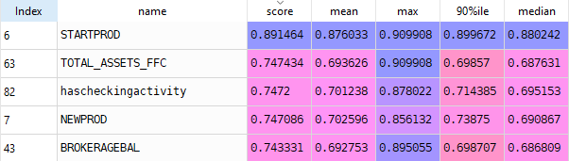
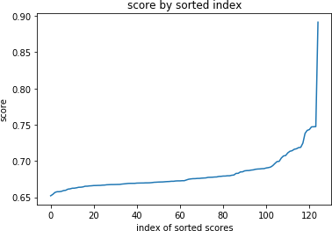
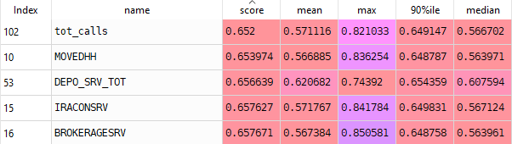
Feature/Column Scoring Results
Top Scoring Columns
Score by Sorted Column Index
Bottom Scoring Columns

Slide 15
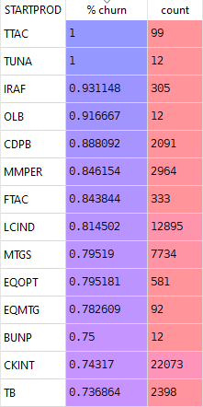
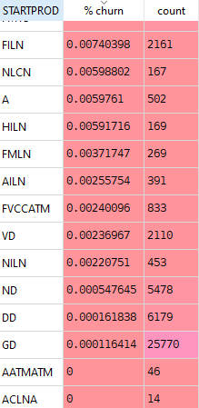
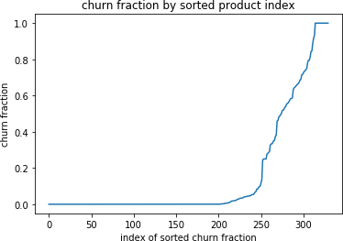
Starting Product
Most vs. Least Likely to Churn
Churn Fraction by Product

Slide 16
Predictive Model Implementation
Objective
Design a model that predicts whether a household churns or is kept
Method Implementation Notes
Nonlinear model allows for complex interaction
By using “class_weight = ‘balanced’” in the model, we make sure the accuracy on the kept households and churned households are prioritized equally
Since there are fewer churned HH, the precision suffers, but this is in line with business intuition of losing a customer is more expensive than the cost to keep an existing customer from churning

Slide 17
Churn Model Metrics
 | Accuracy-Kept HH | Accuracy- Churned HH | Precision | Recall | F-score
Random Forest (sqrt) | 0.867 | 0.94 | 0.656 | 0.94 | 0.773
Logistic Regression w/ L2 | 0.408 | 0.848 | 0.28 | 0.848 | 0.421
Random Forest (all) | 0.792 | 0.991 | 0.564 | 0.991 | 0.719
F.S. Random Forest (sqrt) | 0.866 | 0.933 | 0.655 | 0.933 | 0.769
F.S. Random Forest (all) | 0.793 | 0.991 | 0.565 | 0.991 | 0.72
AdaBoost | 0.988 | 0.92 | 0.954 | 0.92 | 0.936
F.S. Adaboost | 0.983 | 0.922 | 0.935 | 0.922 | 0.928
Random forest “sqrt” vs “all” refers to checking sqrt(features) or all features at each split
F.S means the model is run on feature selected data - the top 35 rows
Logistic regression has poor performance, but we may be able to get more meaningful significance data out of it.
17

Slide 18
Business Recommendation: Utilize Predictive Variables
Objective
Use variables most predictive of churn to inform insights and strategies personalized for the customer
Understand Predict Strategize
Examine intuition for starting product and other high- scoring variables
Improve data tracking to include more of customers product profile
Ensure data is robust enough to draw conclusions
Use a nonlinear model to predict whether customers are likely to churn
Reconsider profitability of high-churn products
Encourage customers to switch to or add low-churn products

Slide 19
Conclusion
Goals
Use the consumer dataset
Segment the Fulton Bank customer base
Build a model that predicts customer churn
Recommendations
Customer segmentation
Use customer characteristics to segment customers, allowing for easier acquisition, servicing, relationship development, and retention of customers
Predictive model
Predict the likelihood of churn in an individual customer
Formulate strategies based on a trait’s association with high or low churn

