Slide 1

Medical solution system for obstetrics [msso]
Supervisor - Danny Hamshananth
Lecturer at ICBT Jaffna
By - Thavakethan Olivannan
JF/BSC/CSD/14/10
St20243835

Slide 2

COntents
INTRODUCTION
OBJECTIVE
SYSTEM OVERVIEW
KEY COMPONENTS
CURRENT PROBLEMS
SOLUTIONS
FUTURE ENHANCEMENTS
CONCLUSION

Slide 3

INTRODUCTION
This system is designed to help pregnant women with personalized health advice during pregnancy.
MSSO offers useful features like food diet recommendations, a BMI calculator to track healthy weight gain, a menstrual cycle predictor, and even a question-and-answer section for quick support. It uses AI and machine learning to give real-time advice and make sure both the mother and baby stay healthy.

Slide 4

OBJECTIVES
Improve Pregnancy Care
Track Health Parameters
Early Detection
of Complications
Support Healthy Diet Plans
Provide Instant
Medical Guidance
Enhance Accessibility

Slide 5

SYSTEM OVERVIEW
Symptom Monitoring: Tracks common pregnancy complications and alerts healthcare providers in real time.
Dietary Recommendations: Personalized diet plans based on medical history, health conditions, and pregnancy stage.
BMI Calculator & Menstrual Cycle Predictor: Helps women track weight gain and fertility.
Chatbot : Powered by Natural Language Processing (NLP) to answer pregnancy-related queries.

Slide 6
KEY COMPONENTS
User Interface (UI):
A simple and intuitive web interface for users to interact with the system.
A chatbot that answers pregnancy-related questions, making it easier for users to access information.
Features like a BMI Calculator to track weight during pregnancy and a Menstrual Cycle Predictor for family planning.
AI & Machine Learning (ML):
Predictive models that analyze user health data to forecast potential risks such as gestational diabetes, preeclampsia, or other pregnancy complications.
Personalized recommendations on diet and health, based on the user's symptoms, weight, and other factors.
Data Management System:
User Data Repository: Stores patient information such as medical history, health records, and pregnancy progress.
Dietary Database: Offers customized nutrition plans based on user health status and pregnancy stage.
Health Records Database: Tracks ongoing pregnancy health data, vital signs, and medical records.

Slide 7
CURRENT PROBLEMS
Lack of Proper Knowledge:
Many pregnant mothers do not have sufficient knowledge about proper nutrition, healthy diets, and medical care during pregnancy.
This lack of information can lead to health issues for both the mother and the baby.
Lack of Reliable Advice:
Information available online or from non-professional sources may be unreliable or confusing, leading to poor health decisions during pregnancy.
Limited Access to Healthcare:
In rural areas or low-income families, pregnant women may not be able to regularly visit a doctor for check-ups and advice due to financial constraints or lack of nearby healthcare facilities.
Cost of healthcare and distance to hospitals can be significant barriers.

Slide 8
SOLUTIONS
Lack of Proper Knowledge:
MSSO provides accurate and reliable advice on nutrition, healthy diets, and pregnancy care, ensuring mothers have the right information to maintain their health and their baby’s well-being.
Lack of Reliable Advice:
MSSO uses trusted medical sources and integrates AI-powered chatbots to give verified health advice, avoiding confusion from unreliable online sources.
Limited Access to Healthcare:
MSSO offers remote health monitoring tools like BMI calculators and menstrual cycle trackers, so mothers can manage their health at home.
Voice chat and chatbot features enable mothers to ask questions and get advice without needing to visit a doctor frequently, helping those in rural areas or with financial challenges.

Slide 9

FUTURE ENHANCEMENTS
More Advanced AI Models:
Expand machine learning models to cover more pregnancy-related complications.
Mobile App Integration:
Create a mobile version for better accessibility and ease of use.
Additional Health Tracking:
Integration of more health-tracking devices such as wearables for even better monitoring.

Slide 10
CONCLUSION
Final Thoughts:
MSSO is a pioneering solution for improving the healthcare experience of pregnant women.
It harnesses the power of AI and machine learning to make pregnancy safer and healthier.
Call to Action:
The system will continue to evolve with future updates and enhanced features.
It represents a step forward in making healthcare more accessible and personalized for all.

Slide 11
REFERENCES
World Health Organization (2021) 'Maternal and Child Health', WHO. Available at: https://www.who.int/maternal_child_health (Accessed: 10 September 2024).
Django Software Foundation (2023) Django Documentation 3.1.3. Available at: https://docs.djangoproject.com (Accessed: 12 September 2024).
Smith, J. (2018) Pregnancy and Maternal Health. 3rd edn. London: Health Publishers.

Slide 12
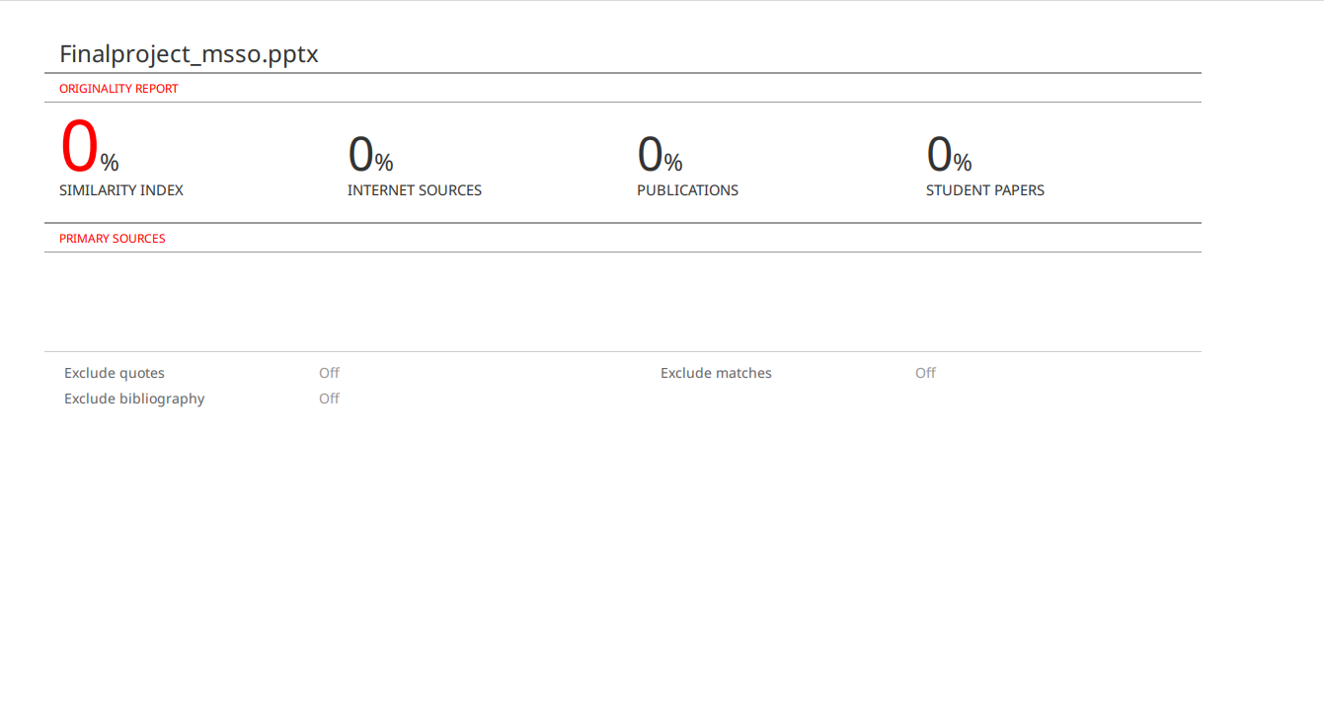
PLAGIARISM

Slide 13


Thank You
https://github.com/Thavakethan/Medical_Solution_System.git

