Slide 1
Introduction to Python for Finance{
LessonThree.html
workshop.css
[Lesson Three Workshop]
}
Programming Language
Notes:
Answers to Questions: https://colab.research.google.com/drive/1ZajANGSOy5pm_jyVGpOyv1IMCb3qUh5c#scrollTo=n9BnIYSUwZah

Slide 2
Table Of ‘Contents’ {
01
02
03
04
Introduction
Lists In Python
Arrays
}
Visualization

Slide 3
01 {
[Introduction]
Python Shell
Comments & Variables
Variable Data Types
}

Slide 4
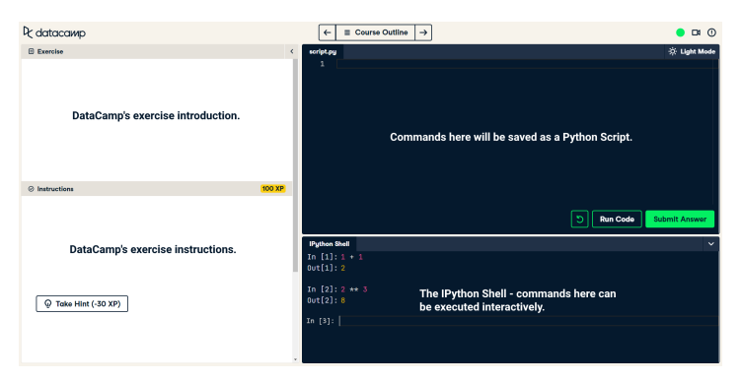
Python Shell

Slide 5
Comments & Variables
Comments in python are shown using the ‘#’
It you do want to view the output you will need to use the print() function
Variable names can be both upper/lower case letters, digits and underscores but CANNOT start with a digit.

Slide 6
Variable Data Types
The main data types used in Python are shown in the table below with the abbreviations used in Python.
If you want to view the data type of a variables use the function type()
Variable Type | Example | Abbreviations
Strings | ‘Tuesday’ | Str
Integers | 40 | Int
Floats | 3.14 | Float
Booleans | True or False | bool

Slide 7
Let’s Practise

Slide 8
Exercises
Q1
Q2
Q3
Q4
Print the output of 8 / 2
Store the value 229.23 in an variable called revenue_1 and print it
Find the data type of revenue_1
Complete the following sentence:
sentence = 'The data type of revenue 1 is’ + ____________+ 'and it has a value of ‘ + ______________
print(sentence)

Slide 9
02 {
[Lists]
Lists In Python
Lists in Lists
Methods & Functions
}

Slide 10
Lists in Python
Lists are described in Python using square brackets [], and each variable within it is separated by a comma.
Python is zero-indexed meaning it starts at 0 and NOT 1
When a positive number is used in the square brackets, it subsets the list from left to right, whereas a negative number is from right to left.
Slicing with steps:
myList[startAt:endBefore:step]

Slide 11
Lists in Lists
They contain various data types including lists themselves.
Nested lists within lists, is done by using extra square bracket arrays [ ].
To subset for a specific value in nested lists place the values in square brackets.

Slide 12
Methods & Functions
All methods are functions, and list methods are a subset of built-in function in Python
Not all functions are methods and require an input of an object
List.method() → the view the methods that can be conducted
List.sort() sorts the lists elements in ascending order.
List.append() adds a single element to a list
List.extend() adds each element to a list.
List.index() returns the lowest index where the element x appears
Min(list) or max(list) returns the smallest or largest element respectfully

Slide 13
Let’s Practise

Slide 14
Exercises
Q1
Q2
Q3
Q4
Create two lists, one called names and the other prices. Names should include Apple Inc, Coca-Cola and Walmart. Prices is 159.54, 37.13 and 71.71
Create and print the nested list called stocks, and use indexing to print the value 71.71
Append the name ‘Amazon.com’ to names and extend it further with DowDuPont and Alphabet Inc
Identify index of max price and the name of this company.

Slide 15
03 {
[Arrays]
Importing Packages
Two Dimensional Arrays
Using Arrays for Analyses
}

Slide 16
Importing packages
For this section of the class we will be working with numpy. Therefore the first code line should be ‘import numpy as np’
Arrays can handle very large data sets and therefore beneficial for financial analysis
The operations that can be carried out on Arrays is the same as when working with other data types

Slide 17
Two Dimensional Arrays
These can help us visualise large datasets
Array Methods:
.shape → gives you dimensions of the array
.size → gives you total number of elements in the array
Array Functions:
Np.mean() → calculates the mean of an input
Np.std() → calculates the standard deviation of an input
Numpy.arrange() creates an array with starrt, end and step
Numpy.transpose() switches rows and columns of a numpy array

Slide 18
Using Arrays for Analyses
Analyses is simply completed by using indexing and subsetting like we have learnt in previous exercises

Slide 19
Let’s Practise

Slide 20
Exercises
Q1
Q2
Q3
Q4
Import numpy as np and create and print numpy arrays with the given data.
Transpose the stock array and print both the shape and size of the transposed array
Calculate STD of prices
Create and print company IDS, and use array slicing to select specific company IDs

Slide 21
04 {
[Visualization]
Matplotlib
Histograms
}

Slide 22
Matplotlib
This function helps us graph and visualise the finanical data.
Firstly, the package should be imported into our workspace:
import matplotlib.pyplot as plt
pPlt.plot() → takes arguments that describe the data to be plotted
plt.show() → displats plot to screen
Within the plot function we can customise the graph we want.
Plt.plot(x-data, y-data, colour = ?, linestyle = ‘ ‘)
Labels can be added using the code below:
plt.xlabel()
plt.ylabel()
plt.title()
Scatterplots can be drawn using:
plt.scatter()

Slide 23
Histograms
Histograms can tell us if our data is skewed, and if the data is centered around the average for example
To draw histograms using matplotlib.pyplot:
plt.hist(x=?, bins=?, normed=1)
Changing the number of bins gives us a more detailed view of the data we have
The normed function normalizes the histogram data
Placing a ‘alpha=?’ value changes the transparency of the histograms within the graph so that the data of two or more graphs can be better visualised.
To add a legend:
plt.legend()

Slide 24
Let’s Practise

Slide 25
Exercises
Q1
Q2
Q3
Q4
Import matplotlib.pyplot as plt. Plot the price over time as a dashed red graph and display.
Plot price as function as a green scatterplot and s =0.1.
Plot histogram of stock_A and stock_B, with bins =100 and alpha =0.4.
Plot histograms of stock_A and stock_B with bins =100, alpha=0.4 and introduce labels and legend.

