Slide 1
Introduction to Statistics{
LessonTwo.html
workshop.css
[Lesson Two Workshop]
}
Programming Language

Slide 2
Table Of ‘Contents’ {
01
02
03
04
Statistics
Chances
The Binomial Distribution
}
Hypothesis Testing

Slide 3
01 {
[Statistics]
What is it?
Measures of centre
Measures of spread
}

Slide 4
What is statistics?
It is the practise & study of collecting & analysing data
Two main branches:
Descriptive
Inferential
Statistics allow us to answer practical questions and validates scientific breakthroughs
Types of data:
Numeric
Categorical
Descriptive / Summary Statistics

Slide 5
Measures of Centre
They are important because they can give us valuable information about our dataset
Three types of data can be used to describe the centre: Mean, median and mode.
Mean:
Mean = (sum of all values) / (count of all values)
Median:
Middle value for a given variable
Mode:
Most frequent value

Slide 6
Measures of Spread
Spread usually measures the variety of our data
Four measures of spread: Range, Variance, Standard Deviation & Interquartile Range (IQR)
Range:
Range = maximum – minimum
Variance
Variance = (value – mean value) / (number of observations)
Standard deviation:
Standard deviation = sqrt(variance)
IQR:
Can be split into 4 sections of: 0%, 25%, 50%, 75% and 100%
IQR = 3rd Quartile – 1st Quartile

Slide 7
Let’s Practise

Slide 8
Exercises
Q1
Q2
Q3
Q4
Should inferential or descriptive statistics be used to check whether a new product improves on a current version?
Describe the mean, median and mode
Find the range, variance and standard deviation of 1, 2, 3, 4, 5, 6, 7?
Find IQR of: 45, 47, 52, 53, 55, 56, 58, 62, 80
Notes:
Answers:
Q1:
Inferential
Q2:
Mean:
Mean = (sum of all values) / (count of all values)
Median:
Middle value for a given variable
Mode:
Most frequent value
Q3:
Range = 6
Variance = 14/3
STD = sqrt(14/3)
Q4:
IQR = 58-52 = 6

Slide 9
02 {
[Chances]
Measuring Chance
Conditional Probability
Discrete distributions
Continuous distributions
}

Slide 10
Measuring Chance
Probability of an event occurring
P(event) = (# ways event can happen) / (Total # of possible outcomes)
Independent probability is when the second event does not change based on the outcome of the first event

Slide 11
Conditional Probabilty
This is when sampling is done without a replacement
They rely on dependant events, which is when the second event is affected by the outcome of the first event.
Venn diagrams are very useful in giving a physical diagram about the probability of each event
The orders in which events occur matters significantly for conditional probability
The formula:
P (A|B) = [P(A & B)] \ [P(B)]

Slide 12
Discrete Distributions
The probability distribution helps us quantify risk and inform decision making
If given a graph the probability is the area, they are a discrete uniform distribution
Theoretically we want to believe that all options have an equal chance of occurring but this is not true in real life.
As the same size increases, the sample mean will approach the expected value (Theoretical)

Slide 13
Continuous Distributions
Probability is still the area under the graph, and the total area under the graph should be equal to 1.
The probability if given a function can be found using integration
There are a few graphs to remember:
Bimodal distribution
Normal distribution

Slide 14
Let’s Practise

Slide 15
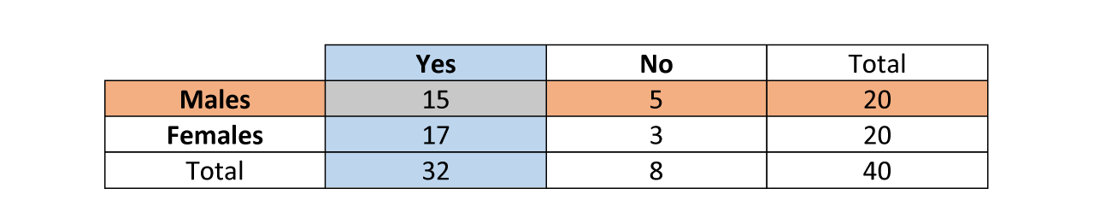
Exercises
Q1
Q2
Q3
Q4
Calculate the probability of each product, is basket is 551, Jewellery is 210, Home Décor is 131 and total orders is 1767.
Find P(yes|male)?
Name two condition associated with discrete distributions
What is the continuous probability value of the function 3x^2 – 4x
Notes:
Answers:
Q1:
Basket = 31.18%
Jewellery = 11.88%
Home Décor = 7.41%
Q2:
15/20
Q3:
Sum of all probabilities should equal 1 and each probability must be greater than or equal to 0
Q4:
66

Slide 16
03 {
[Binomial Distribution]
Binomial Distribution
Normal Distribution
Central Limit Theorem
Poisson Distribution
}

Slide 17
Binomial distribution
The probability distribution of the number of successes in a sequence of independent events
It is described as n (total number of events) and p (probabiluty of success)
The expected value is given by:
Expected value = n * p
If the events are not independent, the binomial distribution does not apply !

Slide 18
Normal Distribution
The normal distribution has an area of 1 and is symmetrical.
The curve never hits 0
Mean is 0 and standard deviation is 1
Skewness can also occur too, either to the left (positive) or right (negative)
Kurtosis is a way of describing the occurance of extreme values in a distribution, with 3 types
Leptokurtic
Mesokurtic
Platykurtic

Slide 19
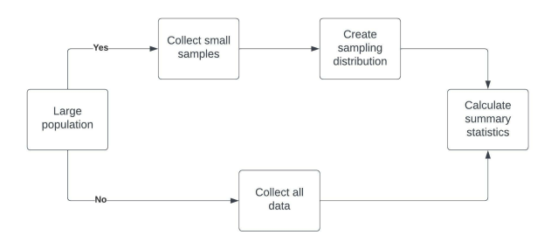
Central limit theorem
The sampling distribution of a statiistic becomes closer to the normal distribution as the size of the sample increases
Benefits of the central limit theorem:

Slide 20
Poisson Distribution
Poisson Process = Average number of events in a period is known but the time/space between events is random
Poisson Distribution = probability of some number of events occuring over a fixed period of time
Lambda (λ) = avaerage number of events per time interval (expected value of the distribution)

Slide 21
Let’s Practise

Slide 22
Exercises
Q1
Q2
Q3
Q4
Quiz contains 10 MCQ’s. each has 5 possible answers, but only one is correct. Find the probability of getting one answer correct?
If mean is 302.3 and STD is 1.2. Find P(x>301.5), using normal distribution.
Mean is 25, STD is 9.5. Sample size is 125. What is P(x>26), using central limit theorem.
Mean rate = 4 per minute. What is probability that at least 63 hits are received in the 15 minutes, using Poisson distribution?
Notes:
Answers:
Q1:
P(1) = 10!/(1!(10-1)!)(.20)(1-.02)^(10-1) = 0.2684
Q2:
Z = (301.5-302.3)/1.2 = -0.67
Area is 0.2514
Q3:
Mean = 25, STD = (9.5)/(sqrt(125)) = 0.85
P(x>26) = 0.1197
Q4:
Lambda = 4*15=60
P(x>=63)-1-e^(-62)*(60^62)/62! = 1-0.0066 = 0.9934

Slide 23
04 {
[Hypothesis Testing]
Hypothesis Testing
Experiments
Correlation
Interpreting Hypothesis test results
}

Slide 24
Hypothesis testing
It is used to compare populations and can be found everywhere
Null hypothesis = assuming no dofference exsits
Workflow:
Define target populations → develop null & alternate hypothesis → collect/access sample data → perform statistical tests on the sample data → draw conclusions about the population

Slide 25
Experiments
Are a subset of hypothesis testing which aim to answer What is the effefct of the treatment (indepedant) on the response (dependant)?
The gold standard of experiments:
Randomization = choosing randomly helps to ensure that groups are comparable
Blinding = participants will not know which group they are in
Double blind randomized controlled trial = Person running the study doesn’t know whether the treatment is real of a placebo (prevents bias)

Slide 26
Correlation
The relationship between two variables
Pearson correlation coefficent = quantifies the strength of a relationship between two variables
between -1 and 1
magnitude describes strength
sign is the direction
Correlation does not equal causation
A confounding variable is not measured, but may affect the relationship between the given variables

Slide 27
Interpreting Hypothesis Test Results
P-value = proabability of achieveing this results, assuming the null hypothesis is true
Signifiance level (α), reduces the risk of drawing a false conclusion, and decided before data collection to minimize bias.
Typically the threshold id 0.05, therefore is p ≤ α, then reject the null hypothesis
Type 1 and Type 2 Error:
 | Null Hypothesis is TRUE | Null Hypothesis is False
Reject Null Hypothesis | TYPE 1 ERROR | Correct Conclusion
Accept Null Hypothesis | Correct Conclusion | TYPE 2 ERROR

Slide 28
Let’s Practise

Slide 29
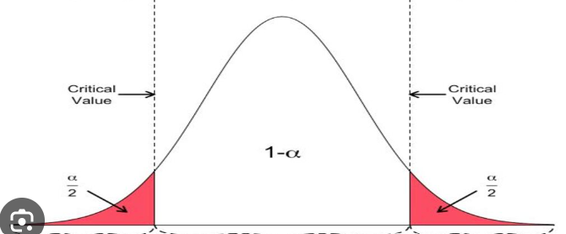
Exercises
Q1
Q2
Q3
Q4
Which is the null and alternate hypothesis:
a. Application of bio-fertilizer ‘x’ increase plant growth
b. Application of bio-fertilizer ‘x’ do not increase plant growth
Which experiments have equally likely outcomes? a. A baby is born. It can be girl or boy b. Trail is made to answer T/F. Answer is right or wrong c. Player attempts to shoot a basketball, and misses the shot d. Driver attempts to start a car. Car starts or does not start
Name the three things that need to be considered for correlation
When should null hypothesis be rejected in the graph to the right
Notes:
Answers:
Q1:
A = alternative
B = null
Q2:
A and B
Q3:
between -1 and 1
magnitude describes strength
sign is the direction
Q4:
The red sections

