Slide 1
Oklahoma Thunderstorms
Hodograph Study for the May 26 2008 Event
Matthew Little
METR 172
23 February 2012

Slide 2
Event & Data
26 May 2008 at 0800Z: Thunderstorms of interest began to develop around Lamont Oklahoma
Movement:
Initially east-southeast at 0800Z
Shift south-southeast near Tulsa, Oklahoma around 1100Z
Storms weaken and dissipate around 1500Z

Slide 3
Event & Data
Severe Reports
Large hail in Tulsa
No tornadoes in Oklahoma
Tornadoes in southern Kansas
Radar
Central Plains, May 26 2008 0000Z – 2330Z Composite
http://locust.mmm.ucar.edu/
Data from Lamont, about 150 km north of Oklahoma City

Slide 4
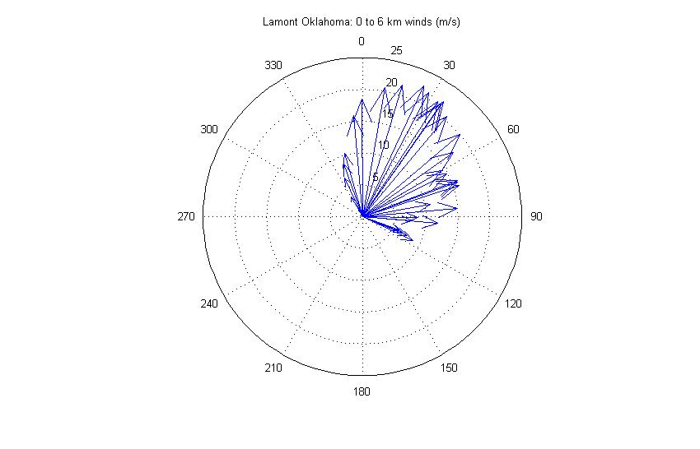

Slide 5
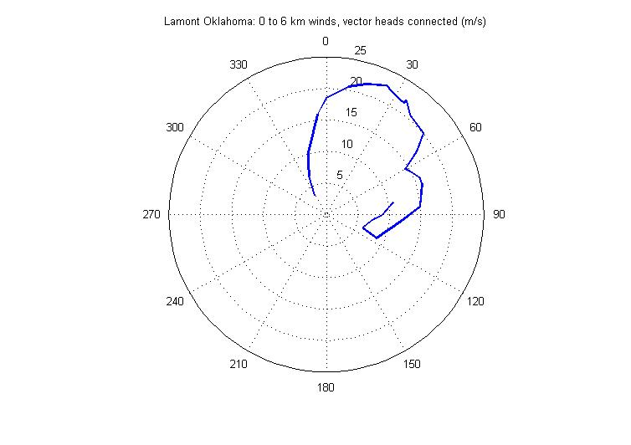

Slide 6
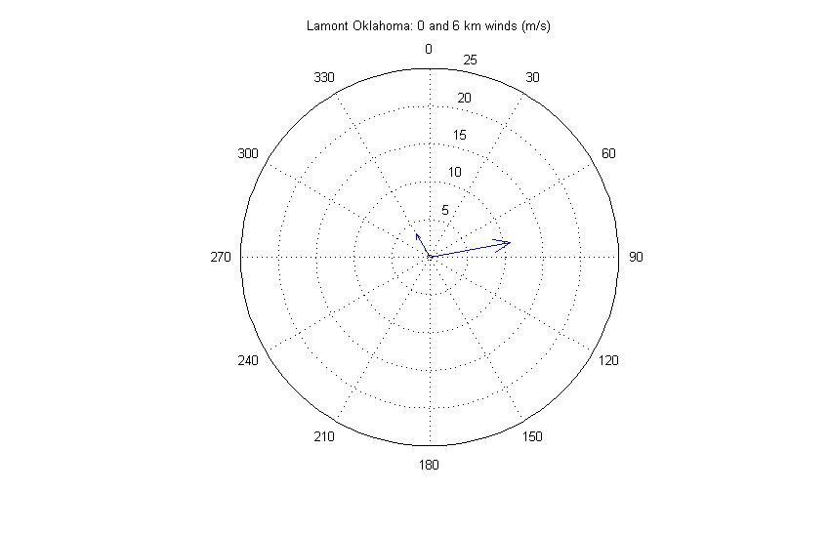

Slide 7
