Slide 1


Slide 2
MUSIC
Music is an Integral Part Of Our Daily Lives

Slide 3
BIG CONCEPT
A Platform That Enables Users To Have Music Be Played To Them Based Off Of Their Situation.

Slide 4
Get lyrics of songs and use algorithm to identify key words as well as APIs
Output in the form of playing music
Data Collection
Neural Network used to identify appropriate song for user
Inputs fed into a neural network

Slide 5






Underlying Tech

Slide 6

What We Have Done So Far...

Slide 7
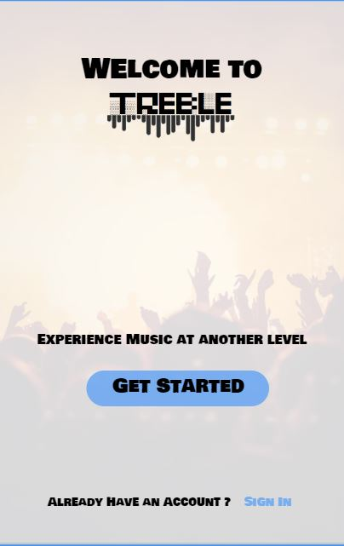
ANDROID Prototype
We’ve Created a Basic User Interface For The Application We Would Be Pursuing Later On

