Slide 1
The FRB 20121102A November rain in 2018 observed with the Arecibo Telescope
doi:10.1093/mnras/stac3446 Jahns J. N., et. al. (2022)

Slide 2
Data
849 bursts detected
using the 305m Arecibo Telescope
within 1150 to 1730 MHz
in the active period of FRB20121102A around Nov 2018

Slide 3
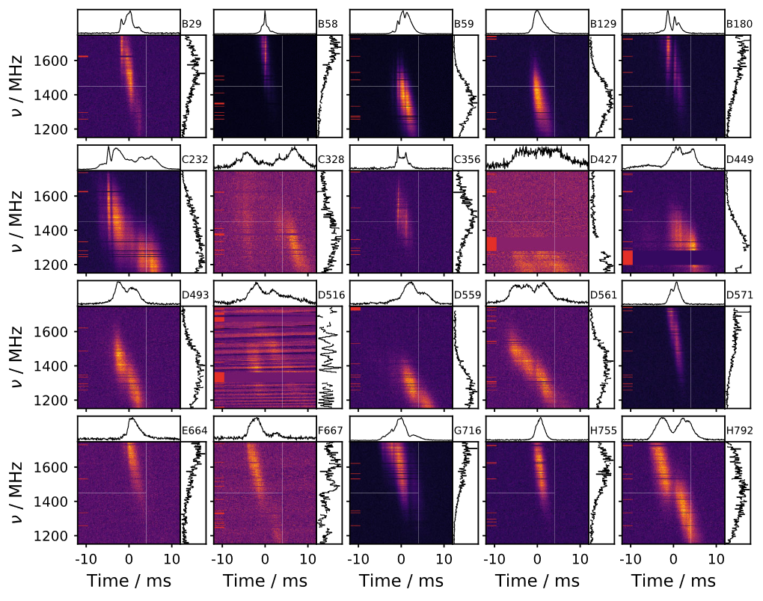
Observation
Figure 1: 20 most energetic bursts

Slide 4
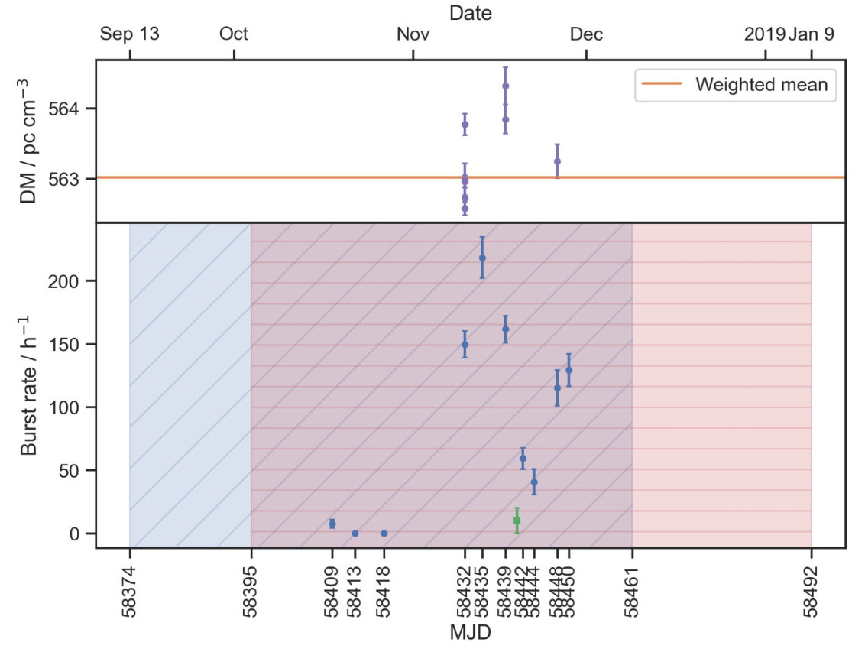
Burst Rates
Figure 2: The lower panel shows the burst rate in each observation and the upper panel shows DMs selected for dedispersion

Slide 5
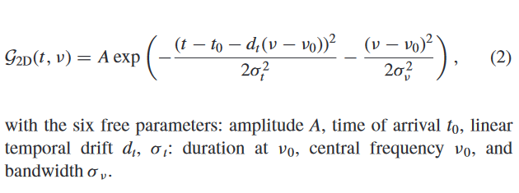
2D Gaussian Model

Slide 6
The 2D Gaussian is parameterized in such a way that it directly characterizes the center ($t_{0}$, $ν_{0}$) and the drift rate $d_{t}$. (As opposed to the commonly used form of an elliptical 2D Gaussian with rotation).

Slide 7
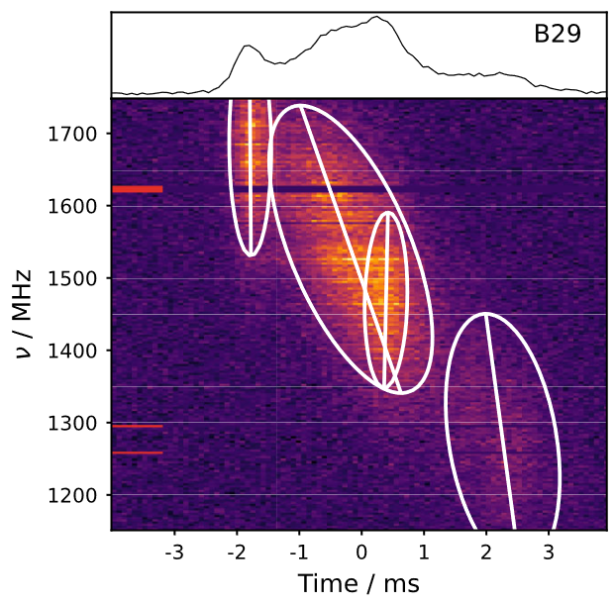
2D Gaussian Fit
There are two forms of drift: temporal drift, $d_{t}$ and frequency drift $d_{ν}$ which can be mapped into and from each other.
There are two types of drift: subburst drift (sad-trombone effect) and intraburst drift.
Figure 3: The resulting 2D Gaussian fits to an example burst

Slide 8
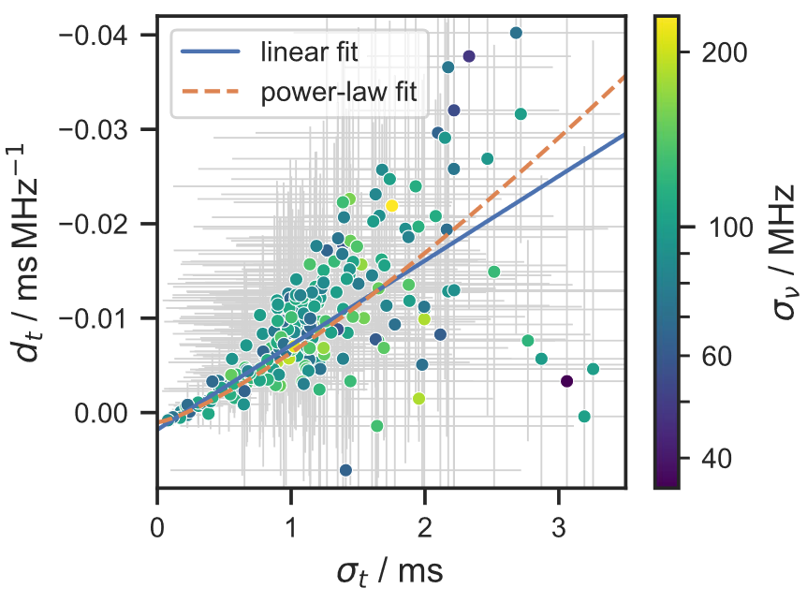
Drift Relationship
Figure 4: Relationship between intraburst drift and its center temporal width

Slide 9
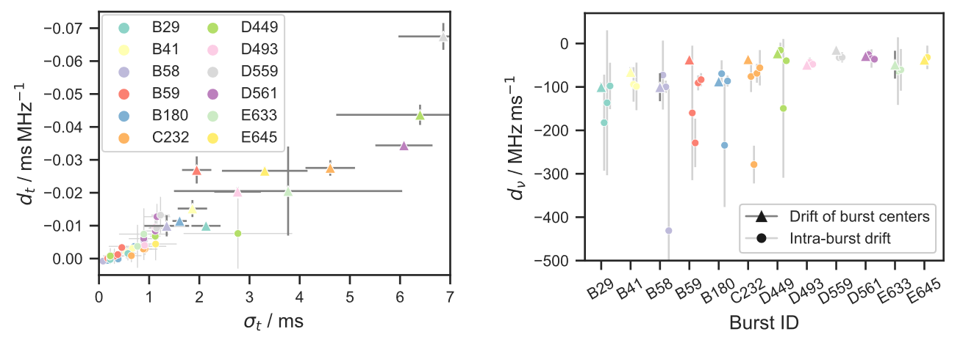
Inter- vs Intraburst Drift
Figure 5: Comparison of the temporal drift from the sad-trombone effect (triangles) to the intraburst drift (circles) for the 12 bursts with three or more sub-bursts.

Slide 10
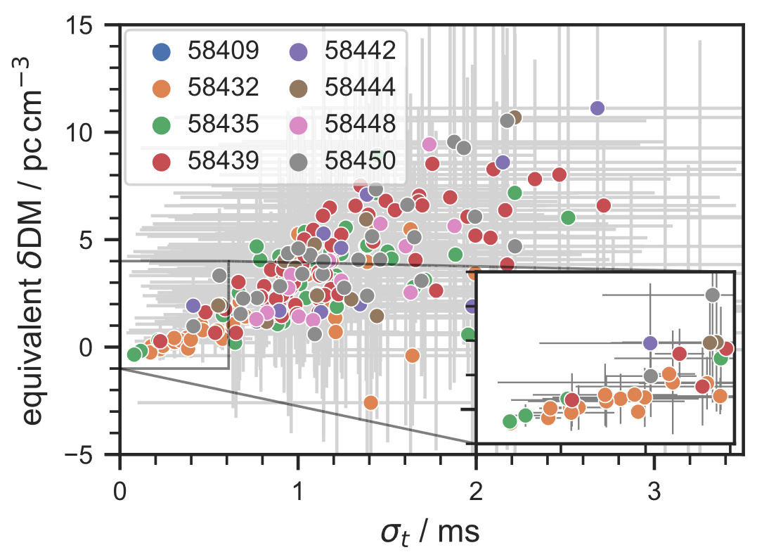
Temporal Drift vs DM
Figure 6: The apparent DM difference from the dedispersion DM caused by the intrinsic tilt of the sub-bursts

Slide 11
Periodicity
The periodicity is measured using the Lomb–Scargle Periodogram.
Since it is only measured within the active period, this only represents the short-term periodicity.
No short-term periodicity is found.

Slide 12
Conclusion
This paper proposes a new Gaussian fit based on physical parameters
There is linear relation between subburst drift and its duration
The intraburst drift is the cause of the apparent short-term variations in DM that have been reported.
No short-term periodicity despite large burst rate

Slide 13
Bibliography
Jahns, J. N., L. G. Spitler, K. Nimmo, D. M. Hewitt, M. P. Snelders, A. Seymour, J. W. T. Hessels, K. Gourdji, D. Michilli, and G. H. Hilmarsson. 2022. “The FRB 20121102A November Rain in 2018 Observed with the Arecibo Telescope.” Monthly Notices of the Royal Astronomical Society 519 (November): 666–87. https://doi.org/10.1093/mnras/stac3446.

Slide 14
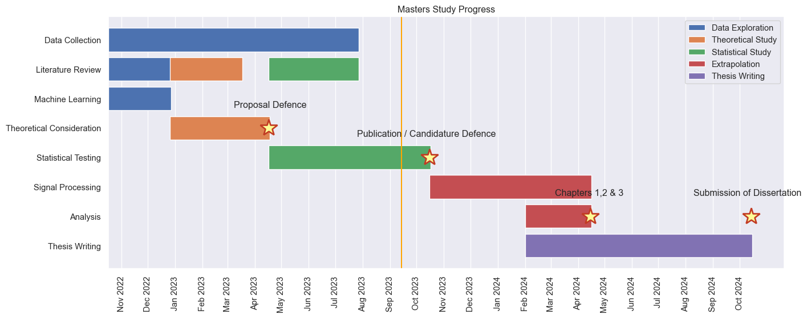
Progress Report

Slide 15
Progress Report
Periodicity of Some Repeaters with Limited Samples from CHIME/FRB Catalog 2023
Status: Writing
Fast Radio Burst Morphology Consideration of Unsupervised Machine Learning Result
Status: On Hold
BURSTT Collaboration
Status: Early communication with Taiwan team

