Slide 1
Masters Study Progress Report
Supervisor: Zamri Zainal & Norsiah Hashim Murthadza bin Aznam

Slide 2
Research

Slide 3
Objectives
To employ machine learning methods to differentiate known FRBs via their collective properties.
To study the statistical differences between properties of FRBs which will thus define characteristics of the respective subclasses.

Slide 4
Phases
Data Exploration
☒ To explore available data and methods.
Statistical Study
☐ To add new analysis for available data.
Extrapolation
☐ To add new data for known methods.
Thesis Writing
☐ To summarize research.

Slide 5
Report

Slide 6
Phase 1: Data Exploration
📅 October 2022
Read a general overview of the fast radio burst research.
Read Bo Han Chen et al. (2021), Luo, Zhu-Ge, and Zhang (2022), Zhu-Ge, Luo, and Zhang (2022)
Revise topics on machine learning.
Regression
Classification
Dimensional Reduction
Clustering Algorithm

Slide 7
Phase 1: Data Exploration
📅 November 2022
Fully replicated Bo Han Chen et al. (2021).

Slide 8
Phase 1: Data Exploration
📅 November 2022
Collected data relating to repeaters.
Added a method to score machine learning outcomes.
Tried to apply Bo Han Chen et al. (2021)’s method using FRBSTATS catalog and later found that FRBSTATS catalog does not have enough parameters to bring about significant score.

Slide 9
Phase 1: Data Exploration
📅 December 2022
Fix bugs in code.
Begin finding source files of raw data to be used in Phase 3: Extrapolation

Slide 10
Phase 2: Statistical Study
📅 January 2023
Read papers relating to using statistical methods to find difference between known fast radio bursts.¹
Revised topics in statistics.
likelihood function and posterior probability
point estimation and statistical inference
hypothesis testing and distribution comparison

Slide 11
Phase 2: Statistical Study
📅 January 2023
Writing literature review and proposal
Helped narrow down research objectives
Helped increase literature

Slide 12
Phase 2: Statistical Study
📅 February 2023
Downloaded and compressed waterfall data from the CHIME/FRB catalog using a download script.
Used multi-threading processes to download multiple files simultaneaously
Data can be corrupted if multiple processes write to the same file. Learned how to use thread-locking to avoid data corruption

Slide 13
Future Plans

Slide 14
Future
By the end of March, we should have a result on how FRB’s time series data distribution are affected by machine learning classifications.
By the end of April, we should be able to submit to a publication.
While waiting for publication, we can work on extending previous method using new data from CHIME/FRB and/or old data from other telescopes for Phase 3: Extrapolation

Slide 15
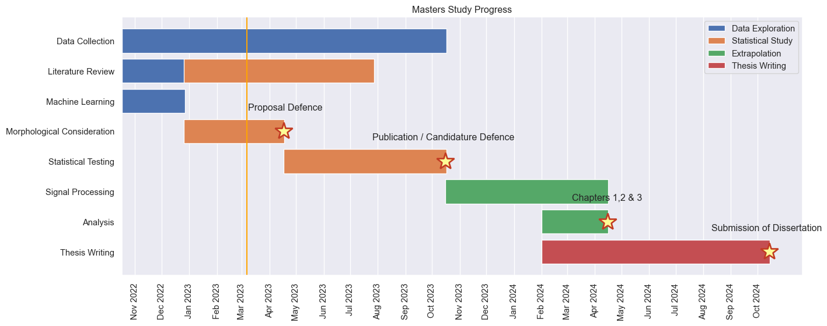
Gantt Chart

Slide 16
References
Arcus, W R, J-P Macquart, M W Sammons, C W James, and R D Ekers. 2021. “The Fast Radio Burst Dispersion Measure Distribution.” Monthly Notices of the Royal Astronomical Society 501 (4): 5319–29. https://doi.org/10.1093/mnras/staa3948.
Bo Han Chen, Tetsuya Hashimoto, Tomotsugu Goto, Seong Jin Kim, Daryl Joe D. Santos, Alvina Y. L. On, Ting-Yi Lu, and Tiger Y. -Y. Hsiao. 2021. “Uncloaking Hidden Repeating Fast Radio Bursts with Unsupervised Machine Learning.” Monthly Notices of the Royal Astronomical Society 509 (1): 1227–36. https://doi.org/10.1093/mnras/stab2994.
Cui, Xiang-Han, Cheng-Min Zhang, Shuang-Qiang Wang, Jian-Wei Zhang, Di Li, Bo Peng, Wei-Wei Zhu, Na Wang, et al. 2021. “Fast Radio Bursts: Do Repeaters and Non-Repeaters Originate in Statistically Similar Ensembles?” Monthly Notices of the Royal Astronomical Society 500 (January): 3275–80. https://doi.org/10.1093/mnras/staa3351.
Cui, Xiang-Han, Cheng-Min Zhang, Shuang-Qiang Wang, Jian-Wei Zhang, Di Li, Bo Peng, Wei-Wei Zhu, Richard Strom, et al. 2021. “Statistical Properties of Fast Radio Bursts Elucidate Their Origins: Magnetars Are Favored over Gamma-Ray Bursts.” Research in Astronomy and Astrophysics 21 (8): 211. https://doi.org/10.1088/1674-4527/21/8/211.
Guo, Han-Yue, and Hao Wei. 2022. “A Possible Subclassification of Fast Radio Bursts.” Journal of Cosmology and Astroparticle Physics 2022 (July): 010. https://doi.org/10.1088/1475-7516/2022/07/010.
Luo, Jia-Wei, Jia-Ming Zhu-Ge, and Bing Zhang. 2022. “Machine Learning Classification of CHIME Fast Radio Bursts: I. Supervised Methods.” Monthly Notices of the Royal Astronomical Society, November, stac3206. https://doi.org/10.1093/mnras/stac3206.
Zhu-Ge, Jia-Ming, Jia-Wei Luo, and Bing Zhang. 2022. “Machine Learning Classification of Fast Radio Bursts: II. Unsupervised Methods.” arXiv. https://doi.org/10.48550/arXiv.2210.02471.

Slide 17
Notes
1. Cui, Zhang, Wang, Zhang, Li, Peng, Zhu, Wang, et al. (2021), Guo and Wei (2022), Cui, Zhang, Wang, Zhang, Li, Peng, Zhu, Strom, et al. (2021), Arcus et al. (2021)

