Slide 1
CHIME/FRB Discovery of 25 Repeating Fast Radio Burst Sources
https://dx.doi.org/10.3847/1538-4357/ac33ac B. C. Andersen. et. al. (2023)

Slide 2
Data Source
Detected between 30 Sept 2019 - 01 May 2021.
Dispersion Measure (DM) ranging from ~220 to ~1700 pc cm⁻³
Signal-to-Noise Ratio (SNR) > 8.5
Frequency between 400 MHz - 800 MHz

Slide 3
Method: Identifying Repeaters
Clustering Algorithm
Contamination Rate

Slide 4
Method: Identifying Repeaters
Clustering Algorithm
Sources with similar RA, DEC, and DM likely come from the same source.
They used DBSCAN¹ to identify points with similar values in the three measures mentioned.

Slide 5
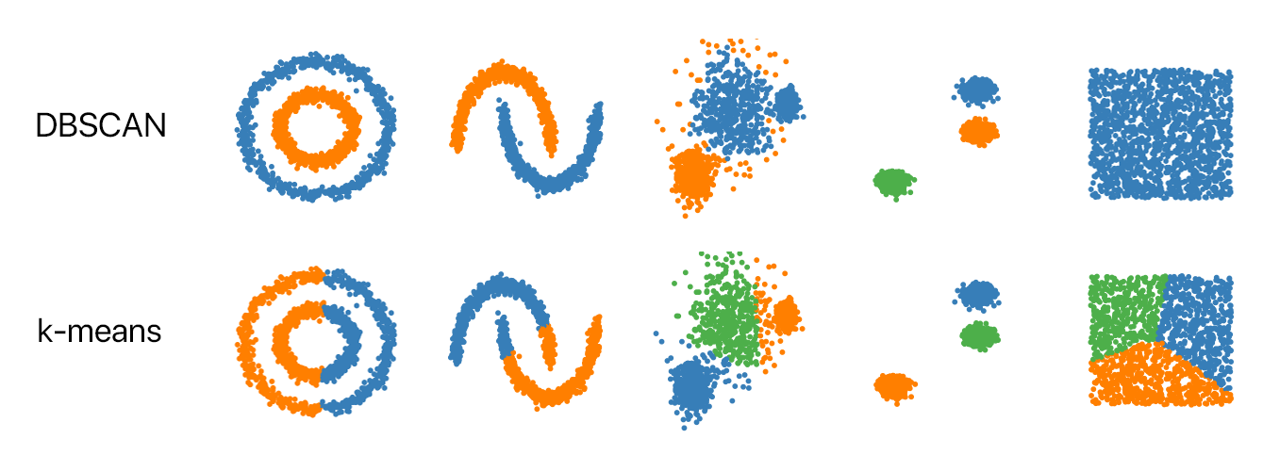
Clustering Algorithm
DBSCAN is a clustering algorithm whose number of clusters are entirely based on the shape of the data.
Comparison with another clustering algorithm, taken from https://github.com/NSHipster/DBSCAN

Slide 6
Method: Identifying Repeaters
Contamination Rate
For each cluster, they calculate the probability of detecting additional $x−1$ coincident bursts that are physically unrelated.
This probability of a coincident burst is a binomial distribution (either coincident, or non-coincident).
The contamination rate, $R_{cc}$, is then equals to this probability multiplied by the number of total detections, $N=2197$.

Slide 7
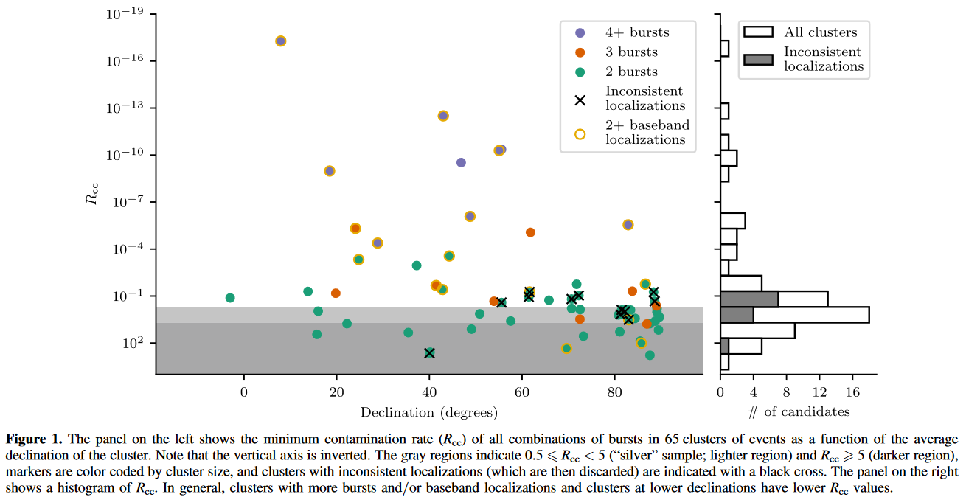
Contamination Rate

Slide 8
Contamination Rate
“Gold” sample (32 sources): A source with $R_{cc}<0.5$ is deemed as a real repeating sources of FRBs, such that there is less than 50% probability that one source in the sample got included by chance.
“Silver” sample (18 sources): A source with $0.5≤R_{cc}<5$ is a candidate repeater and warrants follow up observation.
Excluding those with inconsistent localizations, we arrive at 25 gold samples and 14 silver samples.

Slide 9
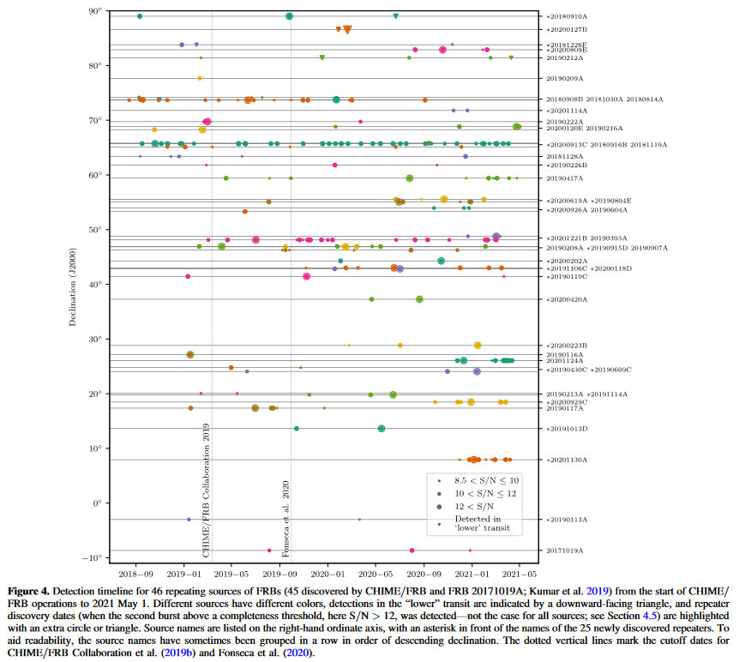

Slide 10
Analysis
Most repeater bursts show narrow bandwidths of typically 50–200 MHz.
Some sources showing bursts with clear cases of downward–drifting subbursts, consistent with Pleunis et al. (2021).
Repeaters have consistently lower DM compared to non-repeaters.
Repeater show no significant difference in flux.

Slide 11
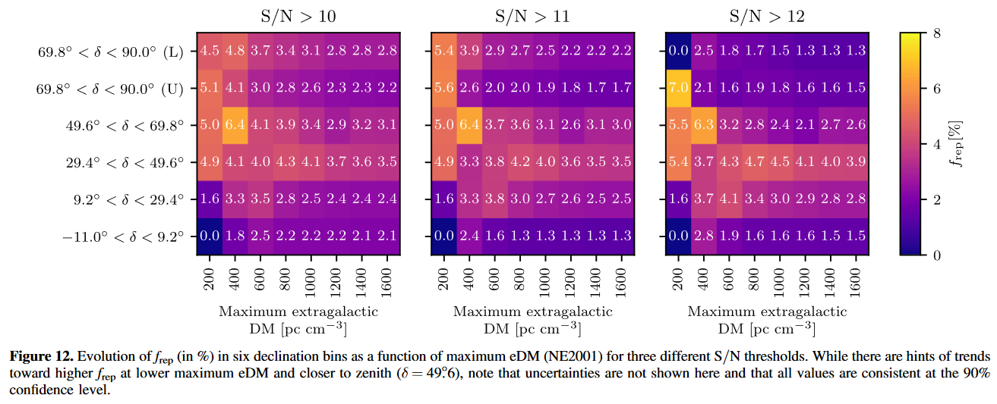
Repeater Fraction
By dividing the sky into 6 declination bins, they found that the repeater fraction tends to an equilibrium of 2.6%.

Slide 12
Conclusion
A combination of clustering algorithm and contamination rate calculation found 25 new repeaters and 14 candidate repeaters.
Repeaters have consistently lower DM from non-repeaters.
Repeater fraction tends to an equilibrium of ${2.6}_{−2.6}^{+2.9}\%$ over time.

Slide 13
Thank You

Slide 14
References
Ester, M., H. Kriegel, J. Sander, and Xiaowei Xu. 1996. “A Density-Based Algorithm for Discovering Clusters in Large Spatial Databases with Noise.” In Knowledge Discovery and Data Mining.
Pleunis, Ziggy, Deborah C. Good, Victoria M. Kaspi, Ryan Mckinven, Scott M. Ransom, Paul Scholz, Kevin Bandura, et al. 2021. “Fast Radio Burst Morphology in the First CHIME/FRB Catalog.” The Astrophysical Journal 923 (1): 1. https://doi.org/10.3847/1538-4357/ac33ac.

Slide 15
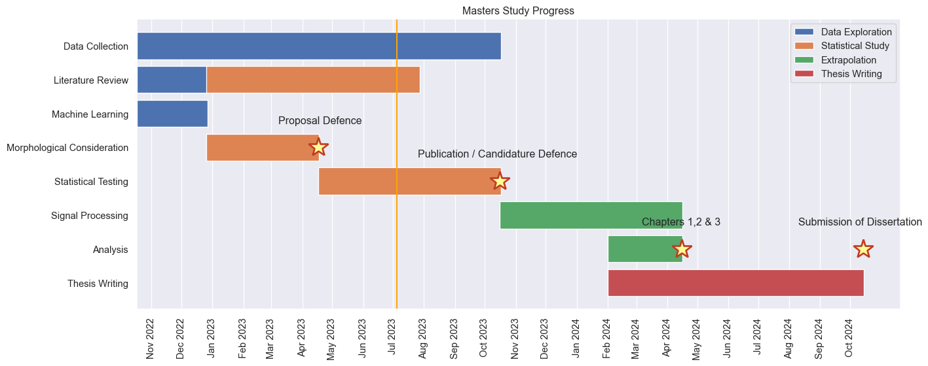
Progress Report

Slide 16
Progress Report
Fast Radio Burst Morphology Consideration of Unsupervised Machine Learning Result
Status: Calculation of Parameters for the new repeaters
BURSTT Collaboration
Status: Early communication with Taiwan team

Slide 17
Notes
1. Density–Based Spatial Clustering of Applications with Noise, Ester et al. (1996)

