Slide 2
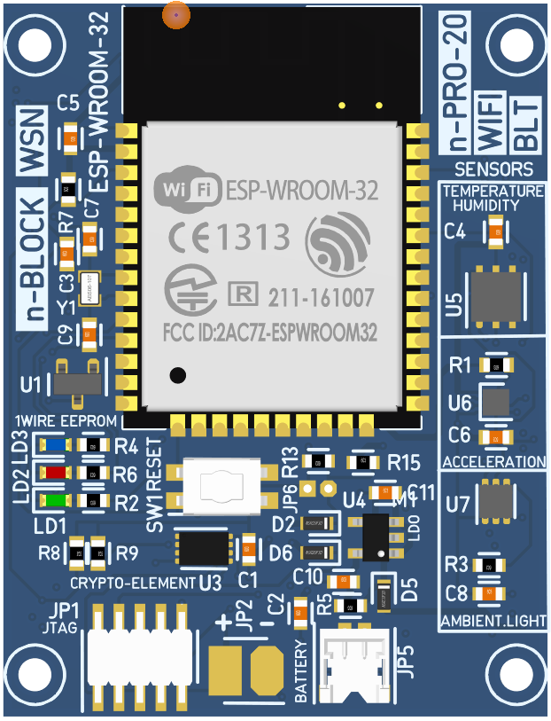
AT commands UART
Bootloader
And printf()
UART0
TxD
RxD
Boot button
TxD
AT Commands
UART1
RxD
5V_in
GND

