Slide 2
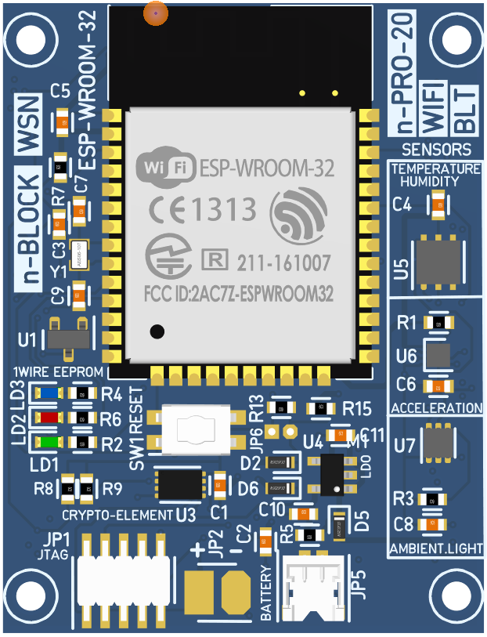
UARTs
Bootloader
And printf()
UART0
TxD
RxD
Boot button
TxD
AT Commands
UART1
RxD
5V_in
GND

Slide 3
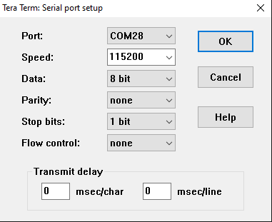
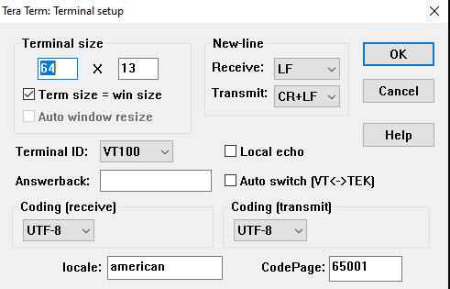
Tera-term setup
Important:
The serial port settings
NO Local echo
New-Line Transmit: CR+LF

Slide 4
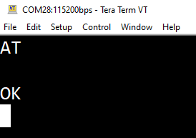
Modem response
The simplest test for testing the Modem AT-Commands is to send from the terminal: AT [CRLF]
The Terminal must be setup to send both CR and LF when pressing the button ‘ENTER’

Slide 5
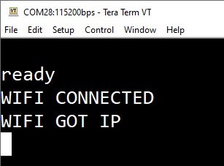
Automatic connection to Wi-Fi Access Point
After setting the ssid credentials for the first time, the Modem stores them in NV memory
With Reset (Reset Button or Power-on) the Modem is automatically connected to the Wi-Fi Access Point

