Slide 1
Lock In Amplifier
Nikolaos Chalikias

Slide 2
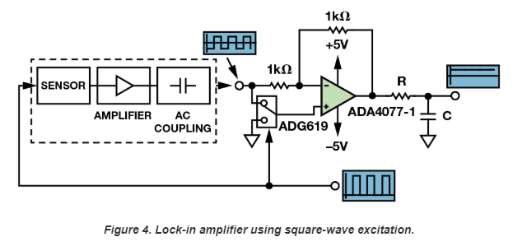
Synchronous Detector simple implementation
https://www.analog.com/en/analog-dialogue/articles/synchronous-detectors-facilitate-precision.html#

Slide 3
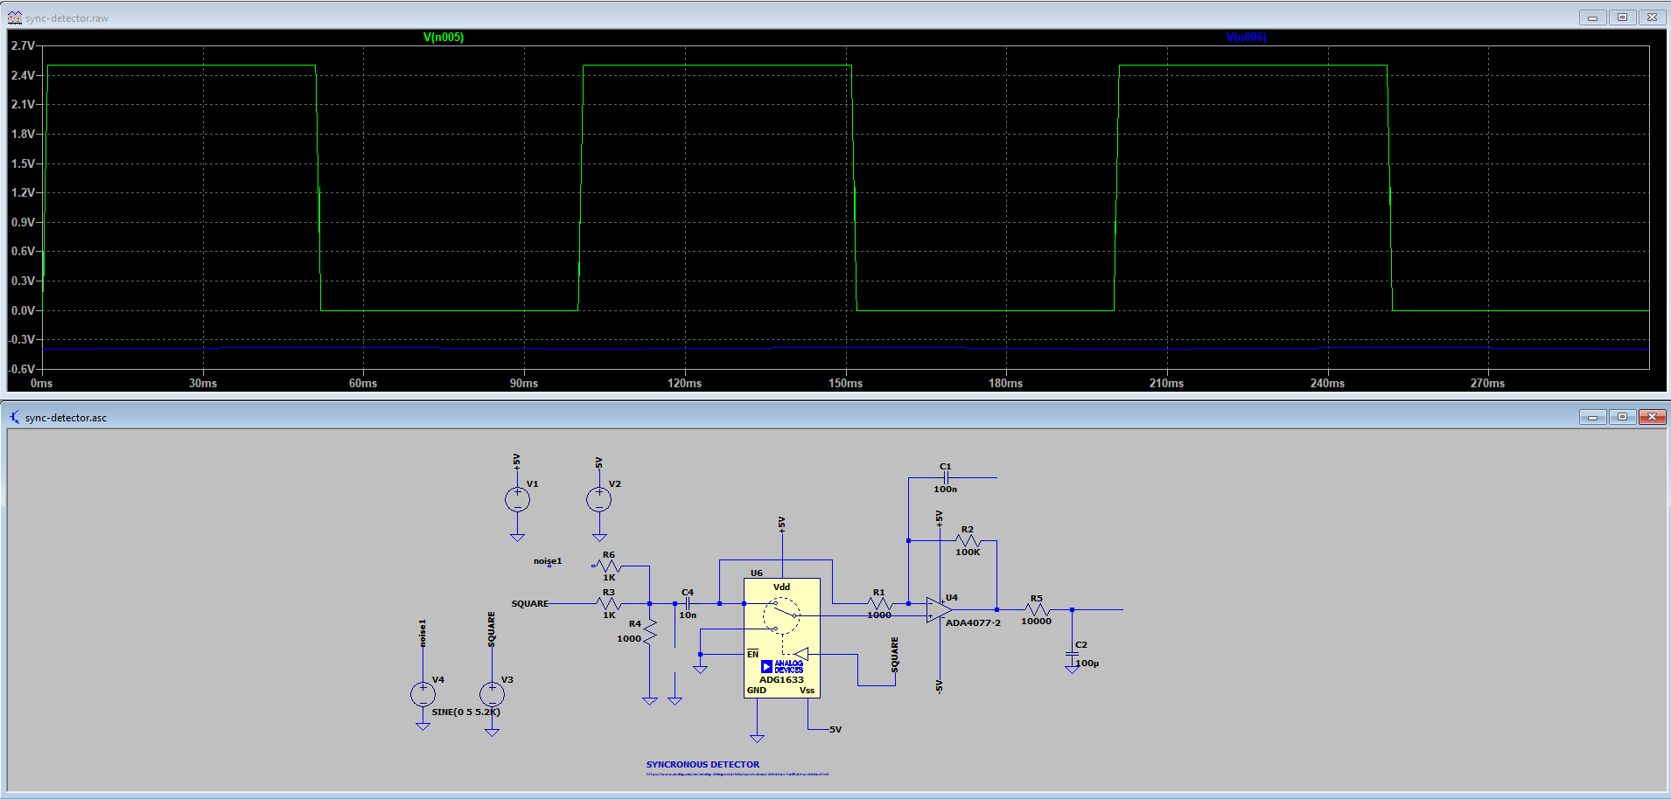
Synchronous Detector simulation

Slide 4
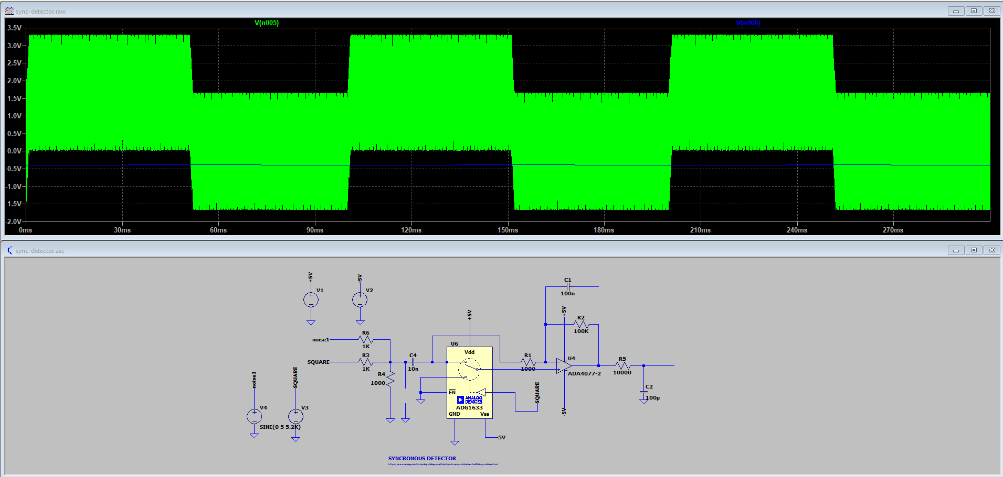
Synchronous Detector simulation

Slide 5
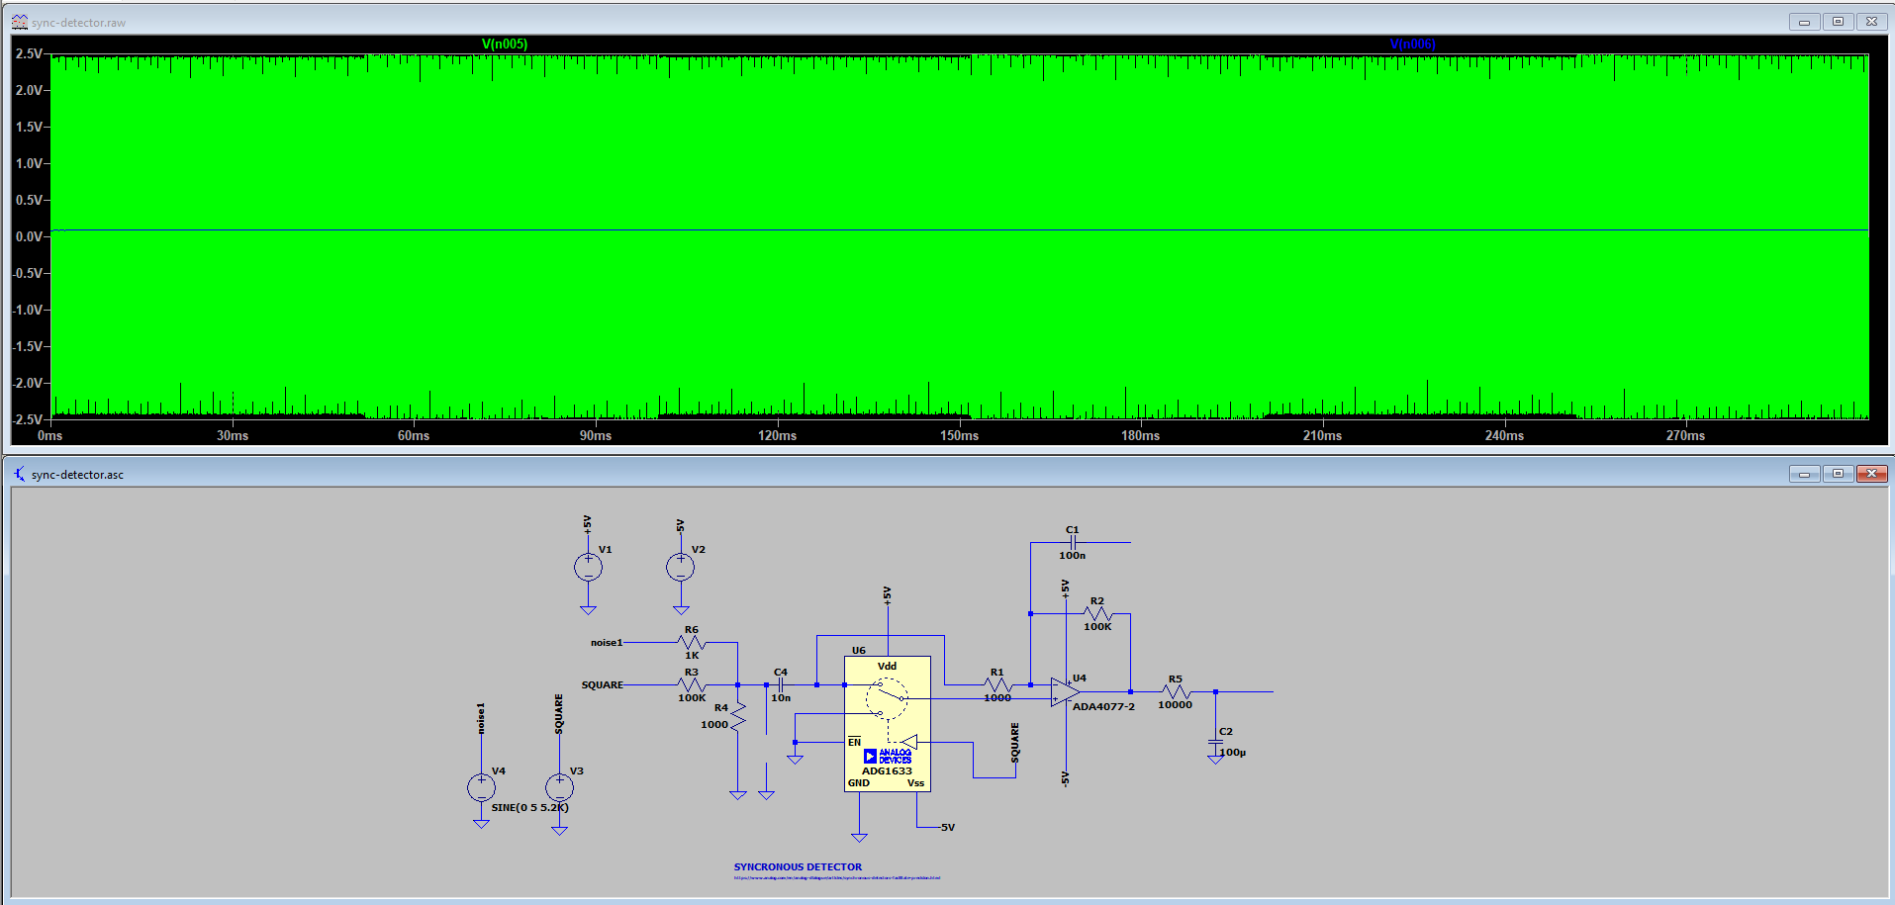
Synchronous Detector simulation

Slide 6
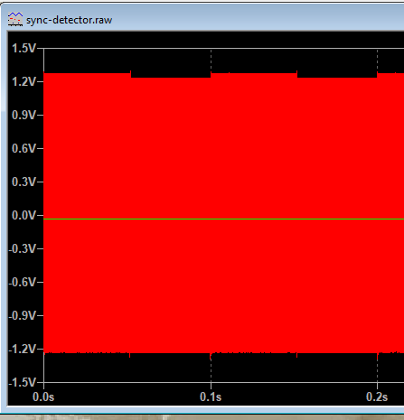
Synchronous Detector simulation

Slide 7
ADA2200
There are two key frequencies that are of interest to an application, the reference frequency and the modulation bandwidth. The reference frequency corresponds to the excitation frequency of the sensor. The modulation bandwidth refers to how fast the signal to be measured can change
The allowable range of reference frequency and modulation bandwidth that the ADA2200 supports is directly related to the input clock frequency. The input sample clock frequency range is between 1 KHz and 1 MHz. The ADA2200 allows the reference clock to be set to the input sample clock, f_{SI}, divided by 32 or 64. The input sample clock frequency range is between 1KHz and 1MHz, which results in a refclk frequency range of 15.625 Hz to 31.25KHz.
https://ez.analog.com/data_converters/precision_adcs/w/documents/3365/ada2200-faq

Slide 8
AD630
Although optimized for operation up to 1 kHz, the circuit is useful at frequencies up to several hundred kilohertz.
https://www.analog.com/media/en/technical-documentation/data-sheets/AD630.pdf

Slide 9
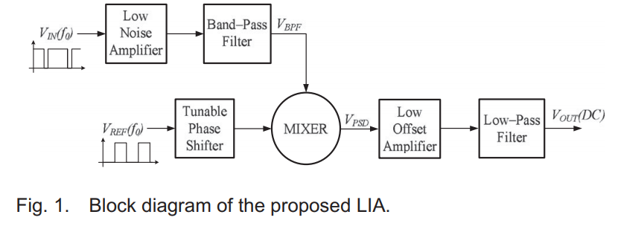
Low-Cost Portable 1 MHz Lock-In Amplifier for Fast Measurements of Pulsed Signals in Sensing Applications
…
The Mixer has been implemented by the phase sensitive demodulator MPY634KP
…
The other LIA blocks have been implemented through standard circuit solutions [39], employing high-speed wide-bandwidth operational amplifiers AD817 (Analog Devices) [40] as main active blocks and low noise low offset instrumentation operational amplifiers OP227 (Analog Devices)
https://www.researchgate.net/publication/317358089_Low-Cost_Portable_1MHz_Lock-In_Amplifier_for_Fast_Measurements_of_Pulsed_Signals_in_Sensing_Applications

