Slide 1

AI Kitchen
No code required to cook.
Hands-on AI at SCU for every major.
No application. No code. Just show up.
Spring 2026 · Fridays, 1:00 to 5:30 p.m. · Lucas 306

Slide 2

Two ways to cook
Drop in for an afternoon, or commit to a quarter.
Taste Tests 🍴
Slow Roasts 🍲
Drop in any Friday, no signup
One-hour tutorial from an industry pro, faculty member, or student
Open lab time after, with people who can help
Quarter-long team projects
Cross-major teams paired with a faculty or industry mentor
Present your work at the end-of-year Potluck Showcase

Slide 3
Every major welcome
No technical background needed.
English majors curious about AI writing tools
Business students automating spreadsheet work
Psych majors coding interviews with AI
Engineers building beyond the curriculum
First-gen students new to these tools
Anyone curious and willing to show up

Slide 4
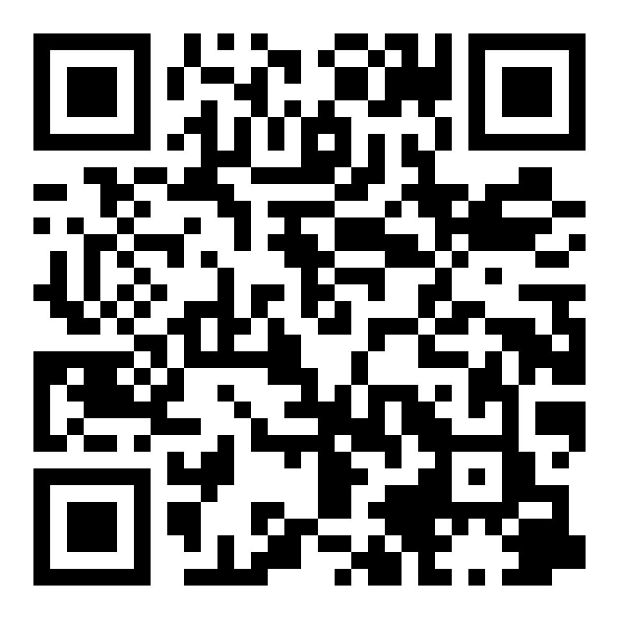
Get involved
Next Taste Test: Friday, April 24
1:00 to 5:30 p.m., demo at 2:30
Lucas 306, Santa Clara University
theaikitchen.org
Scan to join Discord

