Slide 1
The Golden Ratio – Our Way
Having seen this Hackathon only on the 28th of August, it’s probably a boon to have an increased submission time. We’ve made the most of it (at least that’s what we think!) and hope you’ll like it too. We did enter a wrong graduation date of 2023 when registering, while it’s 2024 for both of us (being school students), so hope you’ll consider that a mistake on our part. We did, however enter in our School Name and “N/A” under College Name. Well, let me not worry you with these details and dive straight to the point.
Pranav R
Siddhesh Agarwal

Slide 2

The Main Page
Our main page was supposed to be more of an old-school rotatory dial
menu (1960s style), but we decided against it and modified it to what it is
now. We didn’t make it an auto-scroll just because we couldn’t decide on
what speed the user would be comfortable with. We have 7 menus, all
clickable ones that would redirect you to a different page on the same tab.
We’ve added a “GO BACK” button to make it easy to go back to the menu
and navigate your way through. “main.html” is the one you’re looking for.
“The Divine Ratio” itself is a clickable link, that would take you to a page that gives
a brief about the Golden Ratio, basically it’s theory. We created a double-page scroll
effect to make it visually appealing. In this PPT, we’ve assumed you’ll be primarily
scrolling down the menu, rather than up, so we’ve explained about each page in that exact order.

Slide 3

The Nature Ratio
We decided to bring in a parallax effect on this one using a JavaScript
plugin called “parallax.min.js” which would essentially add a parallax
effect to the website when scrolling. The webpage talks about the Ratio’s
prevalence in nature.

Slide 4

The Attraction Ratio
Here, we used a jQuery plugin called “jquery.tiltedpage-scroll.js,” that would
add a smooth tilted/tiled effect when scrolling. This webpage talks about the different brands we’ve been accustomed to using or even hearing about, and the use of
The Golden Proportion in their logos.

Slide 5
The Interactive Ratio - 1
This is the first Interactive Content on the webpage. We created this using Python3 using Tensorflow, VGG16 (Transfer Learning) and Keras for Binary Image Classification. We created the dataset ourselves, having approximately 500 images belonging to each class: “true” and “false”, where “true” translates to the image having the Golden Ratio, while “false” doesn’t. The dataset is relatively small and we had to perform augmentation for better results. We didn’t, however, optimize our model using Tensorboard or any other similar libraries, and simply took in the epoch with the best accuracy (batch_size was 32 and epochs were 10). We trained the model twice on different occasions on Google Colab (thanks to my computer’s almost non-existent GPU), and downloaded the models onto my local machine in a .h5 format, and made a .ipynb file on Jupyter Notebook that would take in an image and predict the existence of the Golden Ratio in it, and later converted it into a .py file for easier viewing. The “false” part of the dataset contained images of everyday interest like tables, furniture, bottles, pens etc. and hence, the model gets confused sometimes and does not do too well when it comes to predicting “false” on images outside of everyday interests. “model_1.ipynb” in the “model_predictions” folder is the .ipynb file that we trained the model on in Google Colab, and “model.py” is the .ipynb file converted into a .py file, that generates a prediction on an image. “model_exec.bat” is a batch file that contains a command to run the “model.py” file to generate predictions. Please ignore all warnings, the prediction will be on the last line.

Slide 6
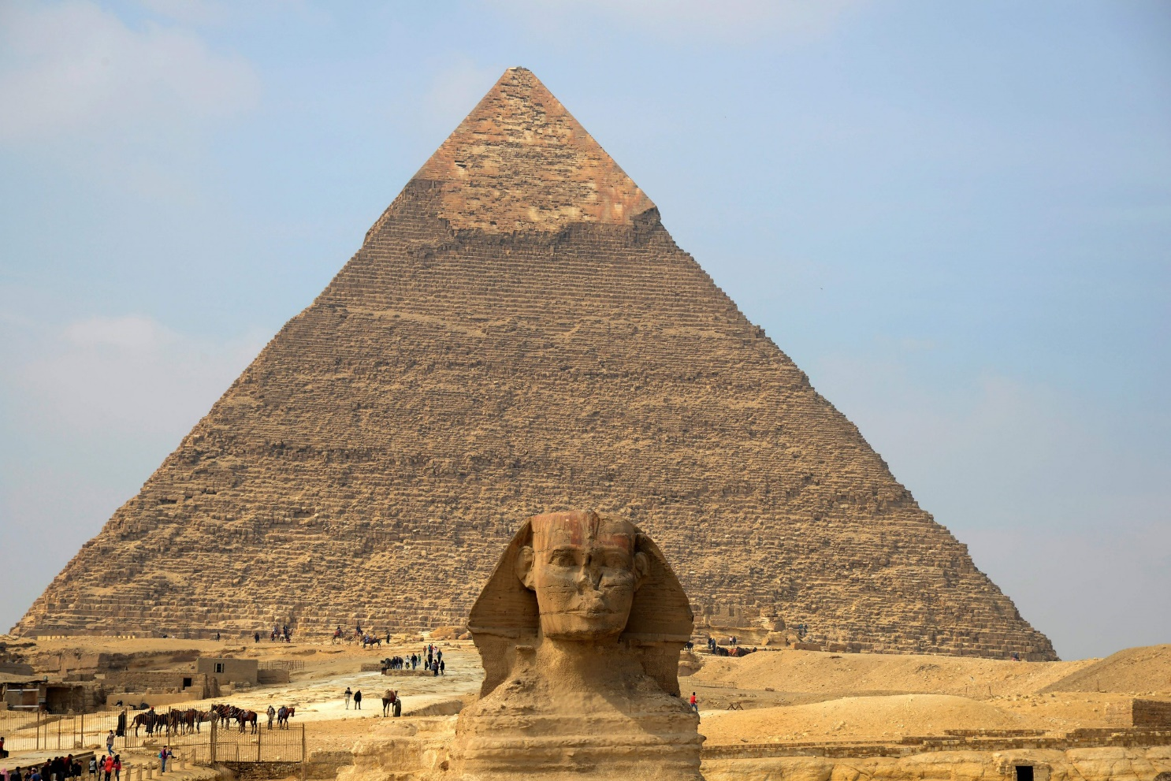
The Art and Architecture Ratio
In this webpage, we’ve talked about the use of the Divine Proportion in different forms
of both Art, and Architecture and how it has been observed right from the ages
of the Mona Lisa and The Great Pyramids of Giza, up until now. We’ve added a parallax effect on this webpage too.

Slide 7
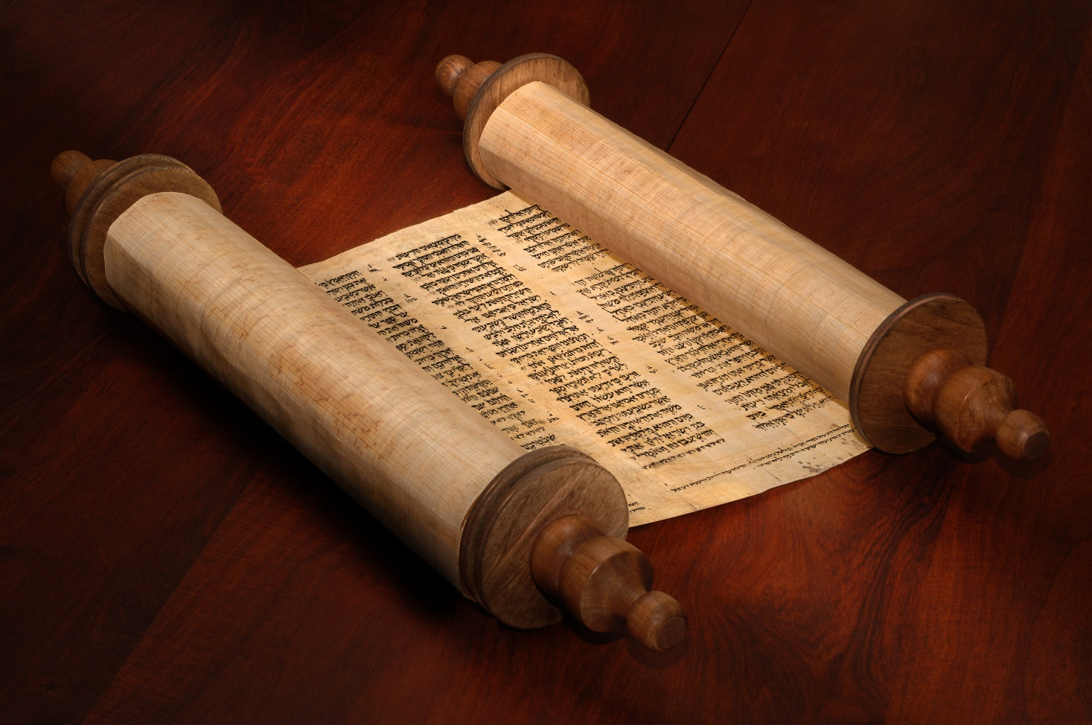
The History Behind
Here, we’ve used different sliding effects to make both the pictures, and the words
visually appealing. We also used the parallax effect (again) , but this time used Bootstrap
and JS only. This webpage talks about the beginnings of the Golden Ratio
in terms of it’s discovery post-Egypt era.

Slide 8
The Interactive Ratio - 2
This interactive has been made with the Turtle module in Python 3. It is focused on helping people understand the patterns formed due to a given deviation in angle. The code uses 2 modules – Turtle (to create the graphics) and math module (to find the coordinate of the blocks using the sine and cosine components). On entering the input of the angle, the blocks arrange themselves in a manner such that they deviate from the line formed by previous 2 blocks by an angle.
Please note that the angles are in radians, and not degrees
Real-life examples:
Plants can grow new cells in spirals, such as the pattern of seeds in a sunflower. The Golden Angle happens when you break up a circle so that the ratio of the big arc to the little arc is the Golden Ratio. The spiral happens naturally because each new cell is formed after a turn. If you enter “1.618” as the rotation angle for each cell, you’ll see a beautiful flower formed with the cells forming into four petals at the center and continue further as they bloom in that exact angle.
Spiral Galaxies are also known for having the Golden Ratio in them. “The density-wave spirals are usually well represented by logarithmic spirals with only slowly changing pitch angle”.
R = R₀ exp[x (Rϴ] or log R = A + B ϴ
with x = tgµ(R); where ϴ = winding angle; pitch angle µ being nearly constant. [Kennicutt, R.C. Jr. Astron. J. 86 (1981) 1847]
Pitch angles in different galaxies vary between a few and about 30° (0.52 radians); the change of the pitch angle within any system is at most ±4°(0.07 radians). If you enter in any rotation angle from 0.453 to 0.593, you’ll get perfectly formed spiral galaxies having the Golden Angle. Other rotation angles may give spirals too, but they will not have the Golden Angle in them.

Slide 9
The Interactive Ratio – 1 & 2
Since neither .py files nor .bat files can be run as a href link on HTML, each of them have to be opened separately.
For Interactive Content 1:
Windows: Open
Linux or Mac: Run “model.py” in “model_predictions” folder from the terminal, or open model.py directly
For Interactive Content 2:
Run “spiral.py” in “interactive_2” folder from the terminal, or open spiral.py directly

