Slide 1
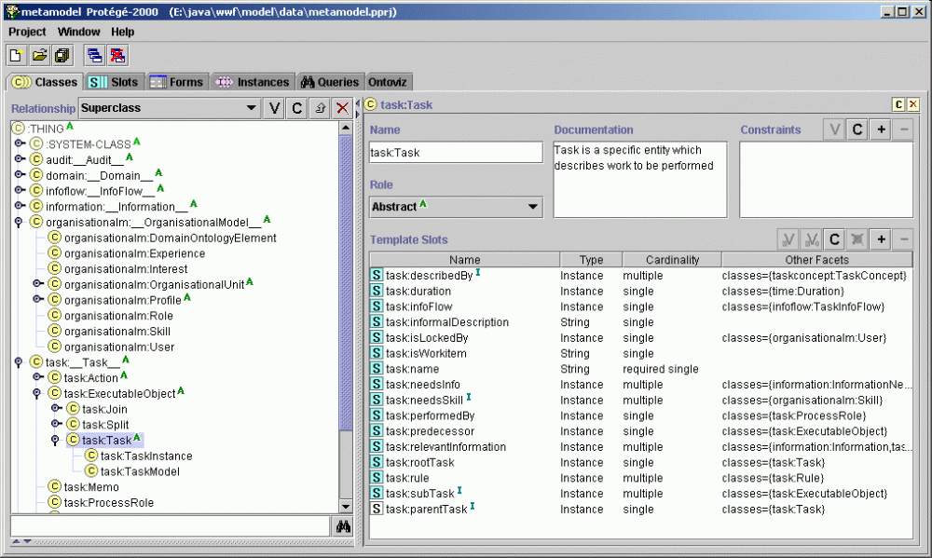
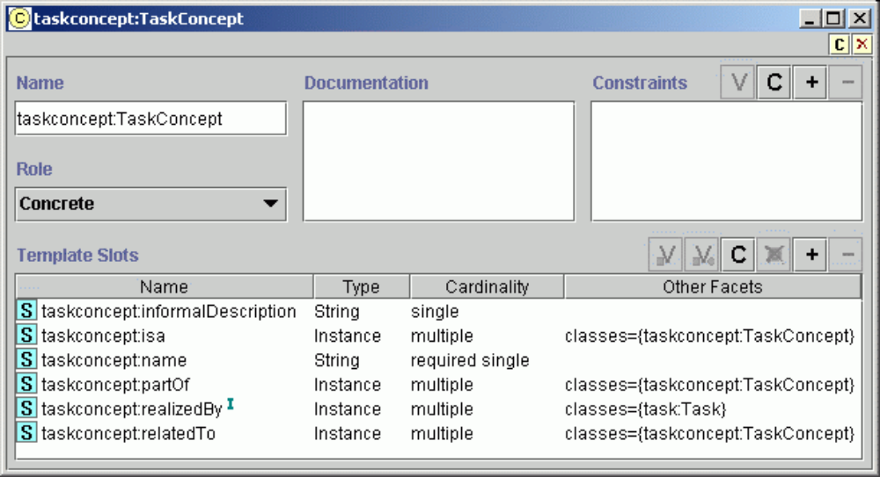
Meta-model (data structures) modeled in Protégé-2000
=> easy modeling and understanding, fast prototyping

Slide 2
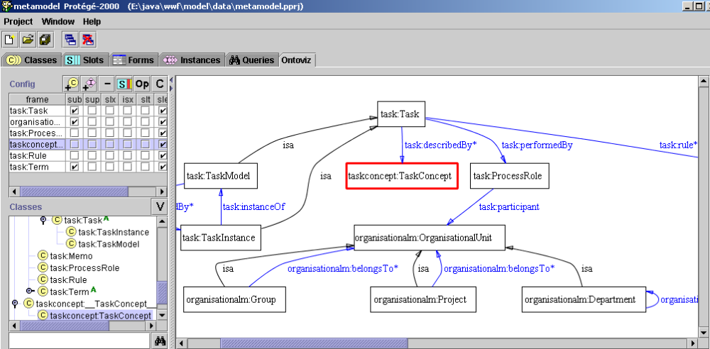
Graphical visualization greatly enhances modeling and understanding of (meta-)models, as well as, ontologies
Graph visualization corresponds to produced RDFS.
RDFS → Java mapping tool supplies Java classes corresponding to this RDFS:

Slide 3
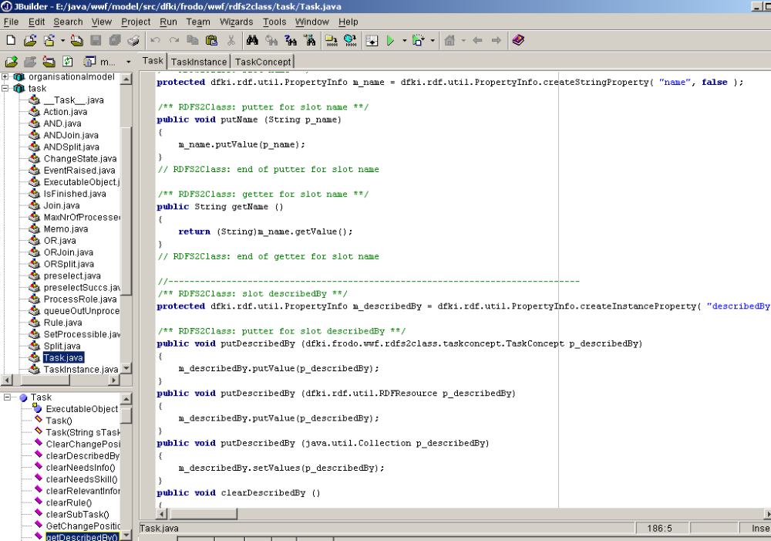
property / slot
putter for “name“
getter for “name“
property / slot

Slide 4
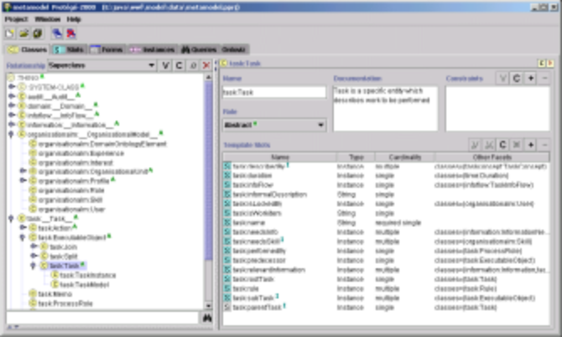
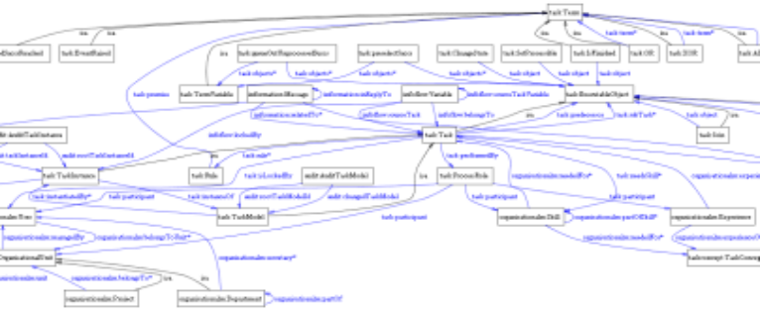
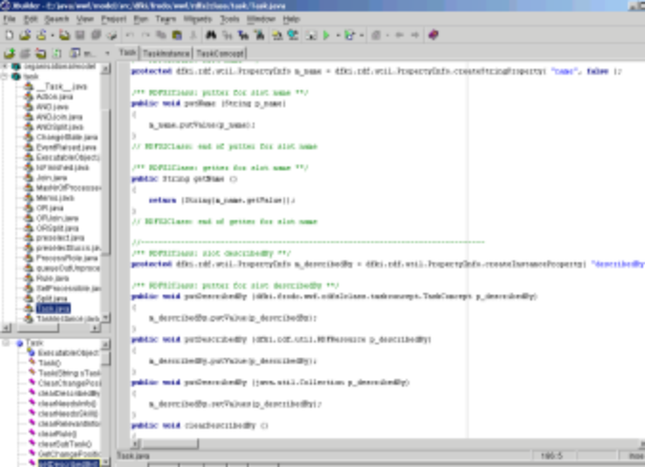
Architecture and rdf2java philosophy:
Switching seamlessly between (meta-)modeling and data access
export /
backend
RDF/S data (graph)
Protégé-2000 project
generation of
java classes
import / export
Meta-model is only
changed in Protégé-2000!
- this changes RDFS
- Java classes are updated
no source code has to be modified manually!
Data is changed by
- editing RDF directly
- changing corresponding Java objects
(via getters and putters) and export afterwards
Java objects /
classes

Slide 5
rdf2java tool: RDF/S ←→ Java
RDF/S
  holding data, (meta-)models, ontologies
← arbitrary interchange →
Java objects
  easy, convenient access and management

