Slide 1

Personalisation
Adith Augustine TJ
Sudhin Joseph T
Sandra M Varghese
Nikhila Ann Mathew

Slide 2

About Us
The Analyst is a growth hacking marketing company that helps to achieve rapid and sustainable growth.
The Analyst

Slide 3

Our Promise
Your exponential growth Starts here >>>
.
“Early Traction Detection”
“Mining to conversion thru Analytics”
“Maximum user Acquisition”
Boost your Brand Positioning

Slide 4

Services we offer
Tool which helps in Targeting customers
Develop Strategies to help Market products and services.
Personalising your Website using the data provided.
Recommending Products to targeted customers.

Slide 5
How we improve your market fit ?
Analyze the Current scenario..
Methods to improve..
Analyse the data
Identify the relevant features
Visualise the market trend .
Evaluate response of Customers.
Using browser Cookie information, evaluate the activity of customers.
From the variables, identify the customer needs.
Recommending products to targeted customers.

Slide 6
CUSTOMER SEGMENTATION
Classify customer based on using Cookies .
Recommend products based on search history.
Sends them notification about the product and evaluate responses from customer .
Track the activities of user and using web analytics.
Using Web analytics includes heatmaps of the page target population for further Marketing which results in higher conversion rates.

Slide 7
WEB ANALYTICS
Audience Analysis
Acquisition Analysis
Behaviour Analysis
Conversions Analysis

Slide 8

Large image
SCOPE
ONLINE RETAIL MARKETING
HEALTH CARE
BANKING

Slide 9





Thank You
The Analyst
+1 23 987 6554
analystofficial@gmail.com
analyst.com

Slide 10
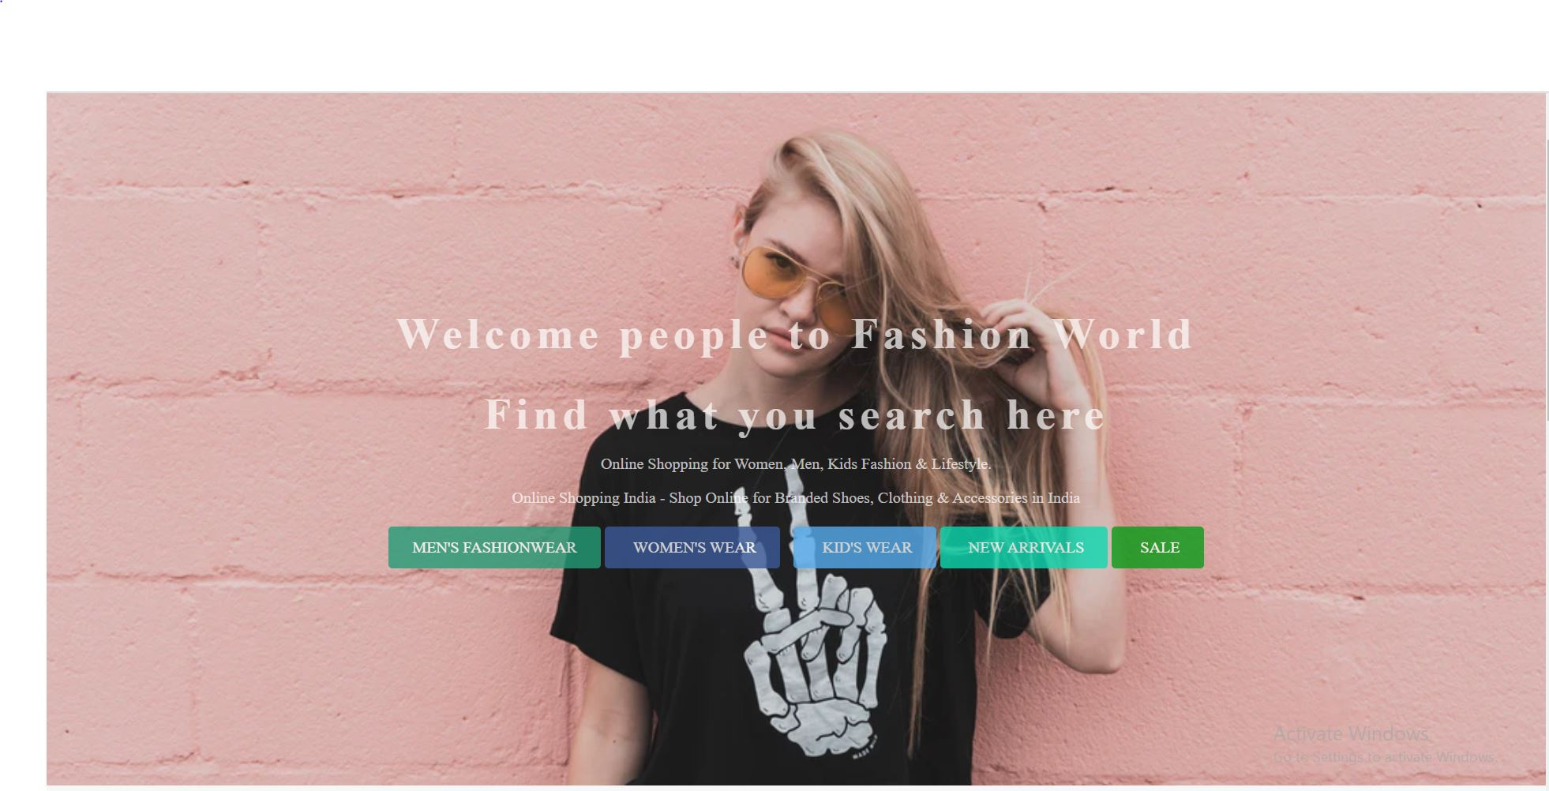
Let’s see the Demo page

