Slide 1


Slide 2
About the Assembly
A smart lab based out of In5 since Dec 2014
Over 250 free workshops done
ASSEMBLY: HACK - Embedded systems, iOT and hardware
ASSEMBLY: CODE - Software projects - APIs, frameworks, apps
Age range: 16-60 - students, professionals, entrepreneurs
Focus on smart technology and practical applications
Forum: members.theassembly.ae

Slide 3
TAG US ON OUR SOCIAL MEDIA
FACEBOOK
TWITTER
INSTAGRAM
YOUTUBE
The Assembly (@MakeSmartThings)
@MakeSmartThings
@MakeSmartThings
The Assembly

Slide 4
Overview
Purpose of this workshop
What is an Arduino?
Setting up the Arduino software
OLED and how to use it
Adafruit Library
Measured values on a contemporary multimeter
Testing out different parameters such as resistance, voltage.. etc

Slide 5
Arduino IDE : https://www.arduino.cc/en/main/software
Github Repository: https://github.com/The-Assembly/Arduino_Multimeter

Slide 6
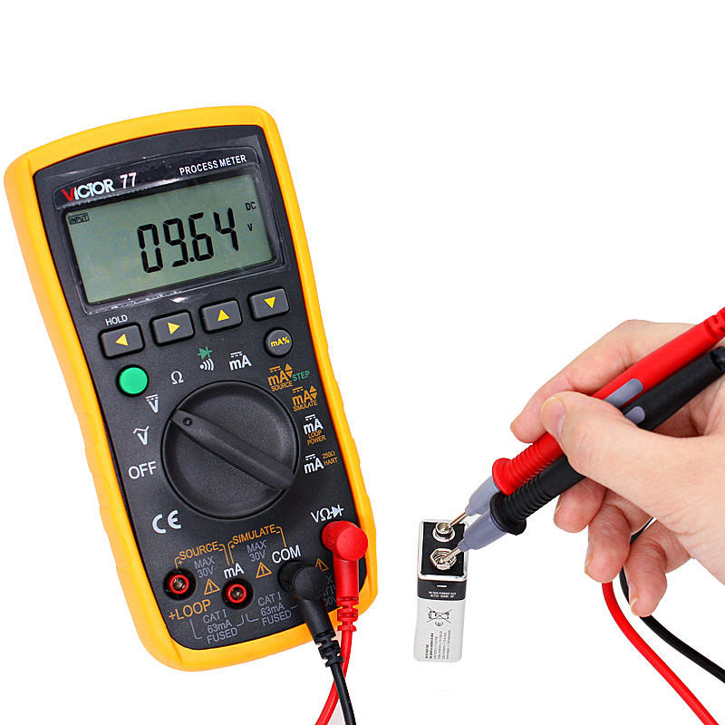
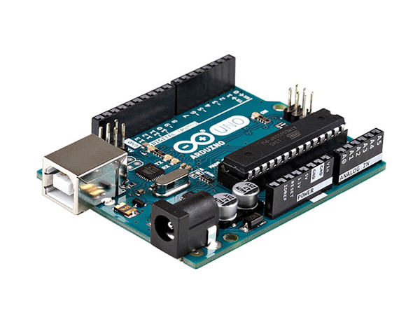
This workshop we will build a Multimeter using an Arduino
Notes:
What is a multimeter?
A multimeter or a multitester, also known as a VOM (volt-ohm-milliammeter), is an electronic measuring instrument that combines several measurement functions in one unit. A typical multimeter can measure voltage, current, and resistance.
A multimeter can be a hand-held device useful for basic fault finding and field service work, or a bench instrument which can measure to a very high degree of accuracy. Multimeters are available in a wide range of features and prices.
It's relatively simple to use an Arduino to measure voltages. The Arduino has several analog input pins that connect to an analog-to-digital converter (ADC) inside the Arduino. The Arduino ADC is a ten-bit converter, meaning that the output value will range from 0 to 1023. We will obtain this value by using the analogRead() function. If you know the reference voltage--in this case we will use 5 V--you can easily calculate the voltage present at the analog input.

Slide 7

Variation of Multimeters
Notes:
A fluke digital multimeter is used mainly for calibration efforts. It can be used to calibrate volts, currents, and other electrical units.
A clamp digital multimeter uses built-in tools to measure electrical flow. This highly differs from the fluke digital multimeter in that it uses a clamp in order to measure this flow, and is usually only recommended for use by a professional.
An autoranging digital multimeter is used for easier projects. This is the most highly recommended type for use by DIY enthusiasts and at-home electricians. It usually just measures one component at a time

Slide 8
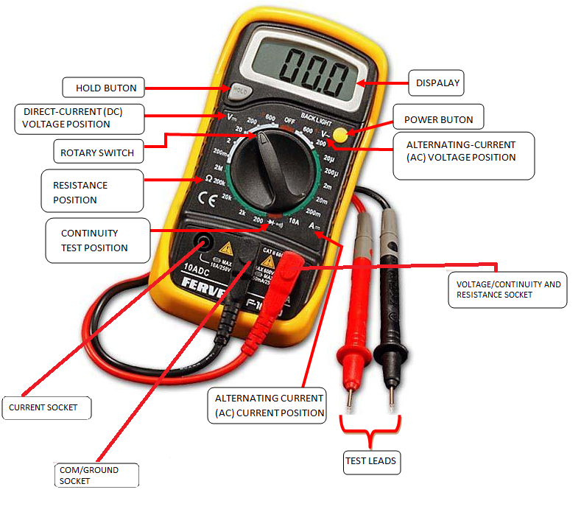
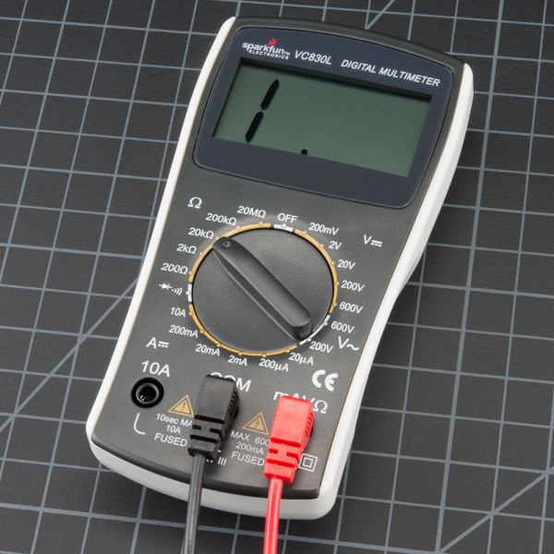
Manual Ranging Multimeter
Notes:
A multimeter is has three parts:
Display
Selection Knob
Ports
The display usually has four digits and the ability to display a negative sign. A few multimeters have illuminated displays for better viewing in low light situations.
The selection knob allows the user to set the multimeter to read different things such as milliamps (mA) of current, voltage (V) and resistance (Ω).
Two probes are plugged into two of the ports on the front of the unit. COM stands for common and is almost always connected to Ground or ‘-’ of a circuit. The COM probe is conventionally black but there is no difference between the red probe and black probe other than color. 10A is the special port used when measuring large currents (greater than 200mA). mAVΩ is the port that the red probe is conventionally plugged in to. This port allows the measurement of current (up to 200mA), voltage (V), and resistance (Ω). The probes have a banana type connector on the end that plugs into the multimeter. Any probe with a banana plug will work with this meter. This allows for different types of probes to be used.

Slide 9
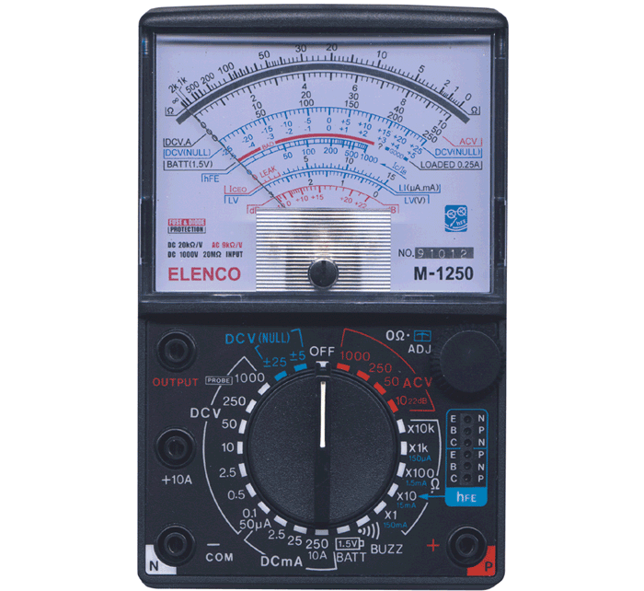
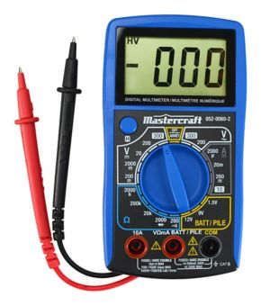
Analog vs Digital
Notes:
An analog multimeter is based on a microammeter (a device that measures amperage, or current) and has a needle that moves over a graduated scale. Analog multimeters are less expensive than their digital counterparts but can be difficult for some users to read accurately. Also, they must be handled carefully and can be damaged if they are dropped.
Digital multimeters are the most commonly available type and include simple versions as well as advanced designs for electronics engineers. In place of the moving needle and scale found on analog meters, digital meters provide readings on an LCD screen. They tend to cost more than analog multimeters, but the price difference is minimal among basic versions. Advanced testers are much more expensive.
Digital multimeters typically are better than analog in the voltmeter function, due to the higher resistance of digital. But for most users, the primary advantage of digital testers is the easy-to-read and highly accurate digital readout.

Slide 10
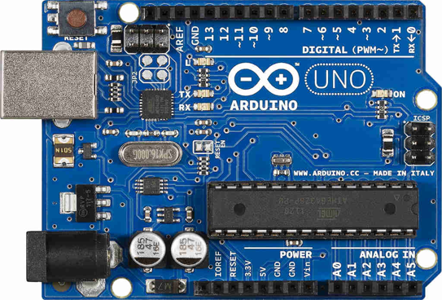
What is an Arduino?
• Microcontroller board based on Atmega328P
• 14 Digital pins / 6 Analog pins
• Designed to make electronic projects more accessible
• Programmed using Arduino IDE
• Open source

Slide 11
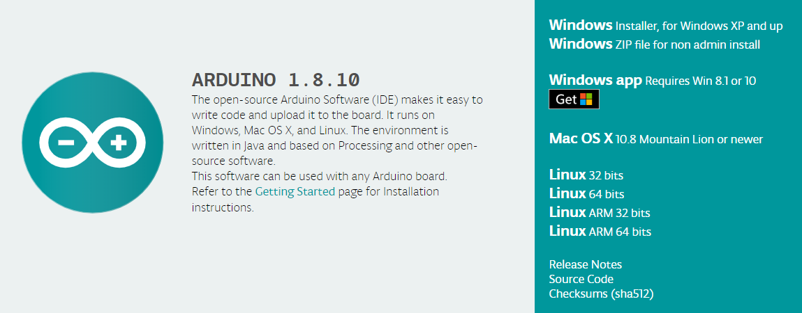
Arduino IDE
Accepts C and C++ programming.
Link: https://www.arduino.cc/en/main/software

Slide 12
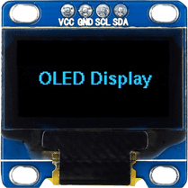
OLED (Connection)
GND should be connected to the ground of Arduino.
VCC is the power supply for the display which we will connect the 5 volts pin on the Arduino.
SCL is a serial clock pin for I2C interface, should be connected to A5 pin on the Arduino.
SDA is a serial data pin for I2C interface, should be connect to the A4 pin on the Arduino.

Slide 13
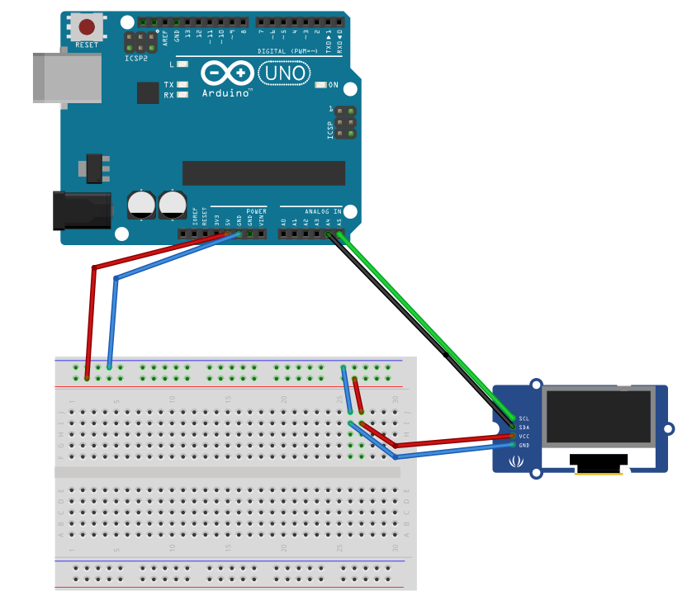
OLED (Connection)

Slide 14
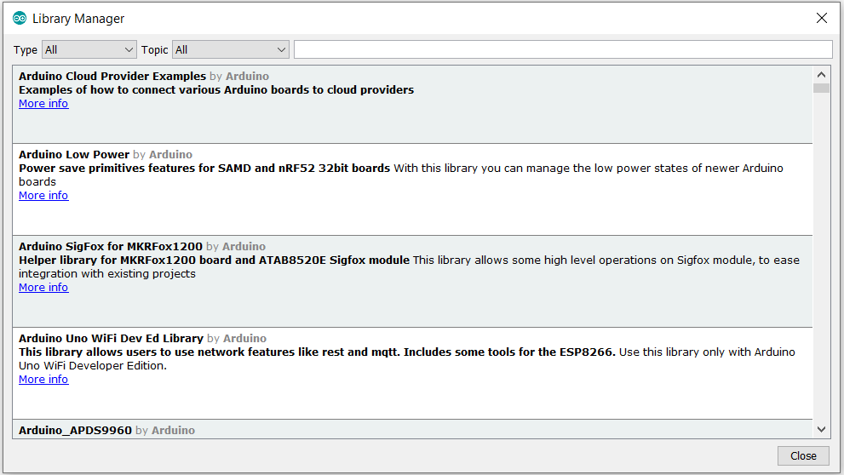
Adafruit Library
To use the OLED we will need the Adafruit Library. Open the Arduino software, click on Tools, then go to Manage Libraries, a window will pop up as shown below.
On the search box type Adafruit SSD1306 then click install.

Slide 15
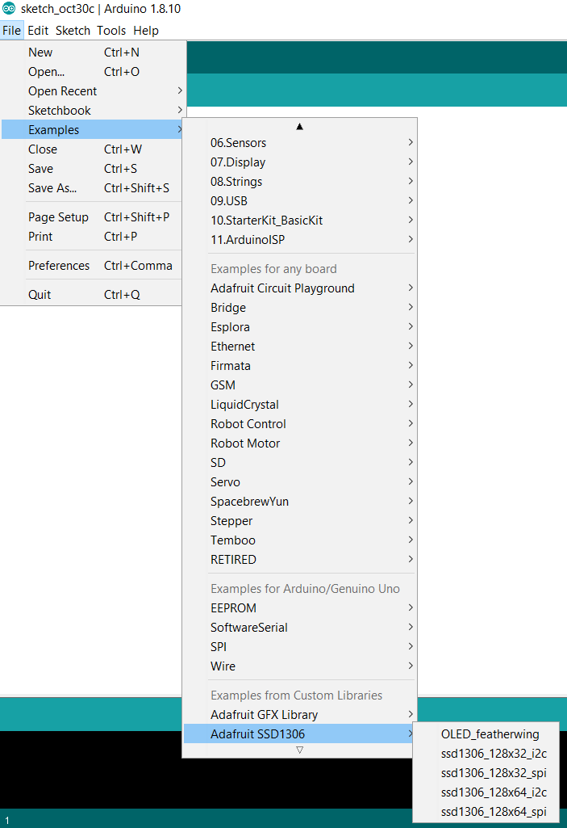
Using the Adafruit library
After you have installed the library, go to File, click on Examples, then scroll down until you see the library we just installed, then click on the first option which is OLED_featherwing.

Slide 16
Using the Adafruit library
Again, go to File, click on Examples, then scroll down until you see the library we just installed, then click on the second option which is ssd1306_128x32_i2c.
We will be printing different things on the OLED screen, to access the code, go to the following link:
https://github.com/The-Assembly/Arduino_Multimeter

Slide 17
Code Structure
Setup()
Every Arduino sketch must have a setup function. This function defines the initial state of the Arduino upon boot and runs only once.
Loop()
The loop function is also a must for every Arduino sketch and executes once setup() is complete. It is the main function and as its name hints, it runs in a loop over and over again. The loop describes the main logic of your circuit.

Slide 18

Code Structure
Pin Definitions
To use the Arduino pins, you need to define which pin is being used and its functionality. The functionality is either input or output and is defined by using the pinMode () method in the setup section (we will talk about this in the next slide).
For our code, since we are using three pins for the three buttons, one button is connected to pin 3, one is connected to pin 4 and one is connected to pin 5, therefore, this is how the code will go:

Slide 19
Tips for writing text using this library
Here’s some functions that will help you handle the OLED display library to write text or draw simple graphics.
display.clearDisplay() – all pixels are off
display.drawPixel(x,y, color) – plot a pixel in the x,y coordinates
display.setTextSize(n) – set the font size, supports sizes from 1 to 8
display.setCursor(x,y) – set the coordinates to start writing text
display.print(“message”) – print the characters at location x,y
display.display() – call this method for the changes to make effect

Slide 20
Measured Values
Contemporary multimeters can measure many values. The most common are:
Voltmeter (To measure a DC voltage on a battery.)
Resistance (Measure the value of a resistor in OHMS.)
Continuity (The checking of an electric circuit to see if current flows.)
Voltage drop (Measuring forward drop of diode junctions.)
Current (Alternating and direct, in amperes.)
Temperature in degrees Celsius or Fahrenheit, with an appropriate temperature test prob.

Slide 21
Measured Values in the multimeter we are going to build
Voltmeter
Analog
Resistance
Voltage Drop
Continuity
Pulse Width.

Slide 22
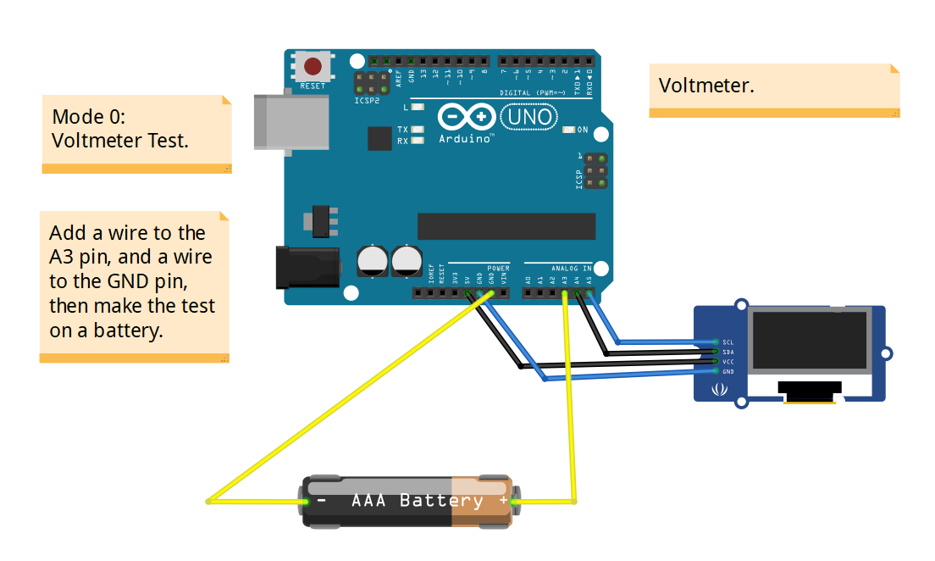
Voltmeter Testing
Notes:
If you're measuring DC voltage (such as a battery or a sensor hooked up to an Arduino) you want to set the knob where the V has a straight line. AC voltage (like what comes out of the wall) can be dangerous, so we rarely need to use the AC voltage setting (the V with a wavy line next to it). If you're messing with AC, we recommend you get a non-contact tester rather than use a digital multimeter. What happens if you switch the red and black probes? The reading on the multimeter is simply negative. Nothing bad happens! The multimeter measures voltage in relation to the common probe. How much voltage is there on the ‘+’ of the battery compared to common or the negative pin? 1.5V. If we switch the probes, we define ‘+’ as the common or zero point. How much voltage is there on the ‘-’ of the battery compared to our new zero? -1.5V!

Slide 23
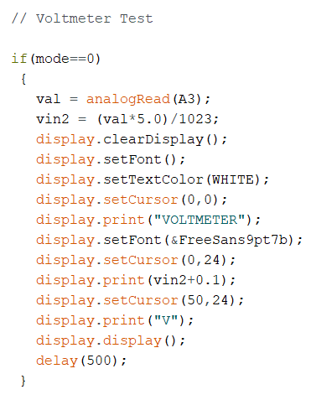
Code Structure
Voltmeter Test
The first mode is the voltmeter test, so we start at 0, the analogRead() function reads the value from the specified analog pin, which in this case is A3, then to find the actual voltage value, we multiply the value that the analogRead returns with the reference voltage, which is in this case 5, then divide it by 1023 (1023 is the discrete voltage levels the Arduino can read). We then add 0.1 to that voltage value we obtained for marginal error.

Slide 24
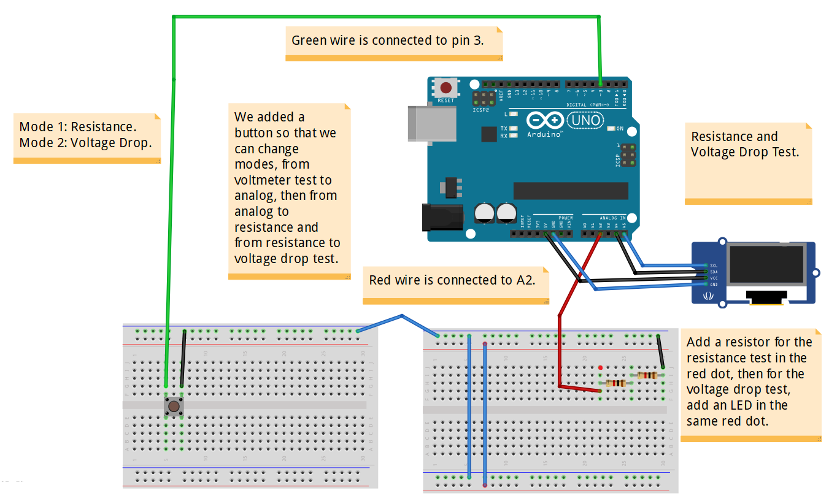
Resistance, and Voltage Drop Testing.
Notes:
Normal resistors have color codes on them. If you don't know what they mean, that's ok! There are plenty of online calculators that are easy to use. However, if you ever find yourself without internet access, a multimeter is very handy at measuring resistance.
Pick out a random resistor and set the multimeter to the 20kΩ setting. Then hold the probes against the resistor legs with the same amount of pressure you when pressing a key on a keyboard.
Because diodes drop a specific voltage across their terminals with their threshold voltage is exceeded, we can use these properties to see if a diode is reading a healthy and correct voltage across their terminals. The value displayed on your multimeter is called the forward voltage drop. This indicates the quantity of voltage used up by the LED, or dropped, when current is traveling in the appropriate direction, forward.

Slide 25
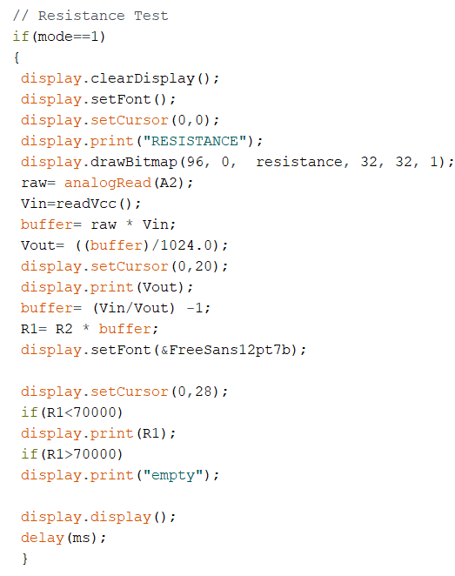
Code Structure
The second mode is the resistance testing. We used the voltage divider rule, which we will be talking about in the next slide.

Slide 26
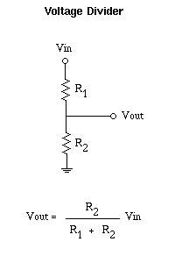

Code Structure
Resistance Test
We start with raw= analogRead(A2);, the analogRead reads the value from the A2 pin in the Arduino, for the next code we have Vin= readVcc, Vcc here is the power input. The next code buffer= raw * Vin;, the value that was read from A2 is multiplied by the power input.
Here we used the voltage divider rule, but what we are looking for is the value of R1, the value of R2 here is 2k (the two resisters in your circuit in series). Here
And as can be seen from the code R1= R2 * buffer; we are trying to get the value of R1. Now going to the if statements, if R1 is less the 7k then it will print the value of R1, and if R1 is bigger than 7k it will display empty.

Slide 27
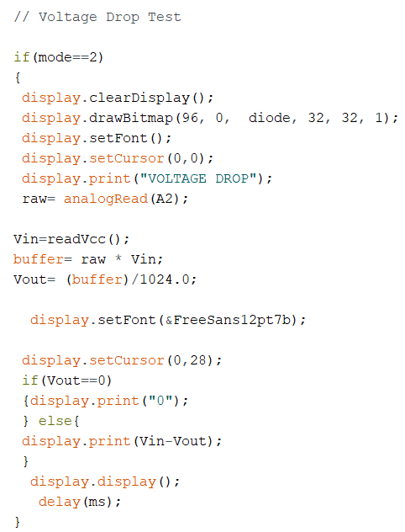
Code Structure
Voltage Drop Test
The third mode which comes after the resistance test is the voltage drop test. Here the analogRead() function reads the value from the A2 pin, this value is then multiplied by the input power, and the output voltage is divided by 1024. Then, we will substract the input voltage from the output voltage to get the voltage drop, as can be seen from the code display.print(Vin-Vout), if the input voltage Vin is 0, then the OLED screen will display 0.

Slide 28
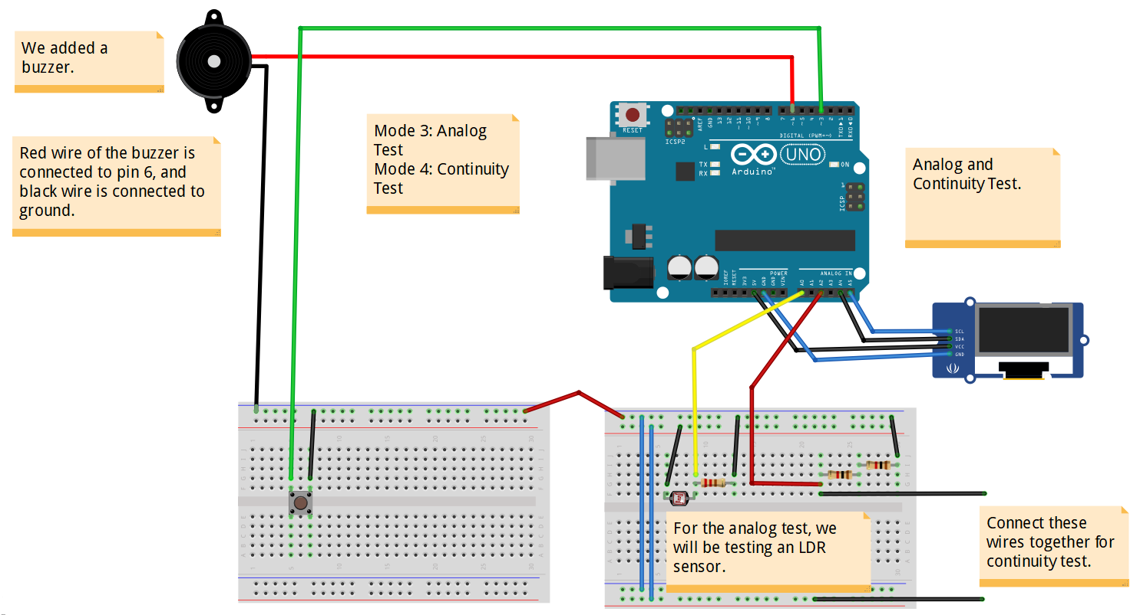
Analog and Continuity Test
Notes:
Continuity testing is the act of testing the resistance between two points. If there is very low resistance (less than a few Ωs), the two points are connected electrically, and a tone is emitted. If there is more than a few Ωs of resistance, than the circuit is open, and no tone is emitted. This test helps insure that connections are made correctly between two points. This test also helps us detect if two points are connected that should not be.
Continuity is quite possibly the single most important function for embedded hardware gurus. This feature allows us to test for conductivity of materials and to trace where electrical connections have been made or not made.
When a system is not working, continuity is one more thing to help troubleshoot the system.

Slide 29
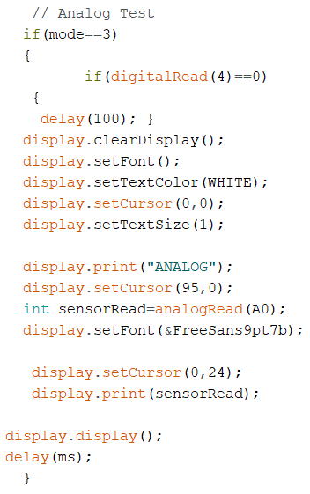
Code Structure
Analog Test
Analog test is the fourth mode, the code is pretty simple, the OLED will only show a value. In this case we are testing an LDR sensor, as can be seen from the circuit. And as can be seen, the LDR is connected to pin A0, so the analogRead function will return a value from pin A0 in the Arduino.

Slide 30
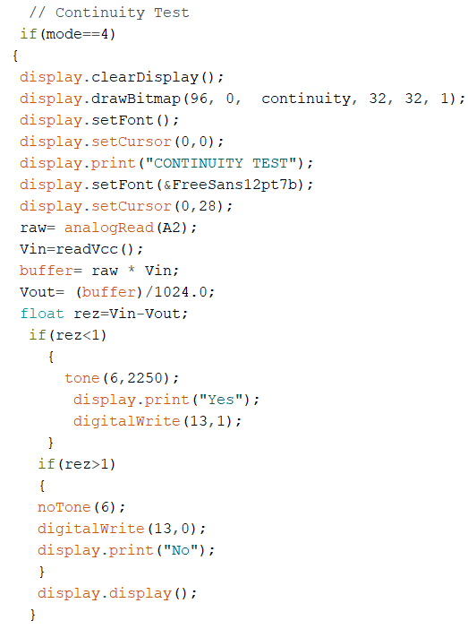
Code Structure
Continuity Test
Continuity Test is the fifth mode, the analogRead() reads a value from the pin A2, and the returned value is multipled by the input power voltage which will give us a value in which we will divide by 1024, and this will be our output voltage. The output voltage is substracted from the input voltage, if we get a value that is smaller than 1, then "Yes" will appear in your OLED screen, if we get a value bigger than 1, then a "No" will appear in your OLED screen. The tone function is just for the buzzer.

Slide 31
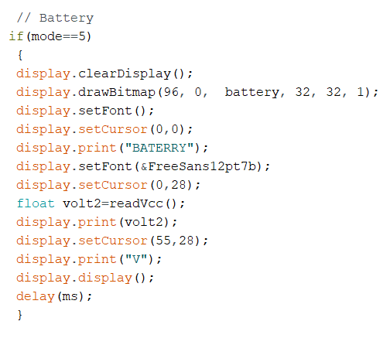
Code Structure
Battery Mode:
For the battery mode, there is nothing we will do to the circuit, it just shwos the battery status in case of a need for a recharge.

Slide 32
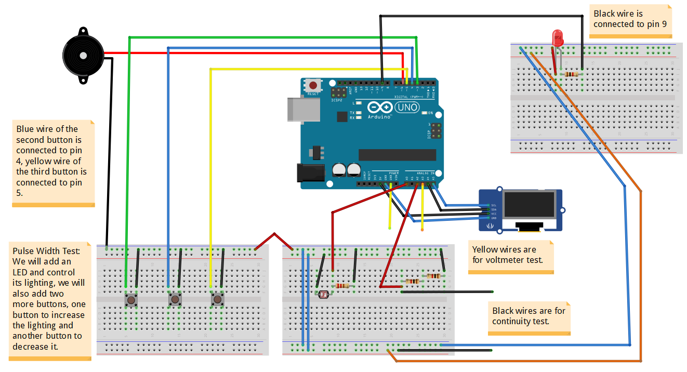
PWM Testing, and final circuit

Slide 33
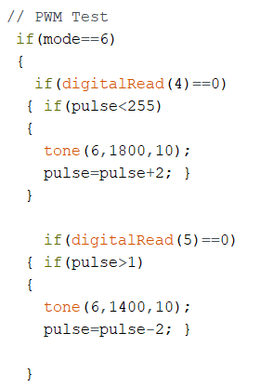
Code Structure
​
PWM Testing ​
​
We start with the if statement, if(mode==6), this is the last mode after the battery test. We initiaize the pulse value to 125 (it is the value that will first appear when you reach mode 6), the maximum value here is 255 and the miniumum value is 1, it cannot go lower than 1 or higher than 255. If the value is less than 255, in this case 125, we can either increment by 2 or decrement by 2. If you reach 1 you cannot decrement, you can only increment. And if you reah 255, you cannot increment, only decrement.

Slide 34
Other additions
Ammeter
Temperature measurement
Capacitance measurement
Inductance measurement

