Slide 1
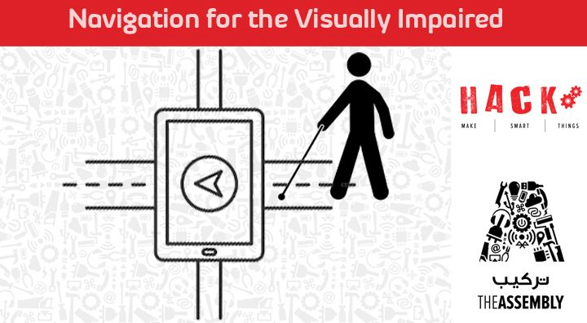
Presented By : The Assembly Team

Slide 2

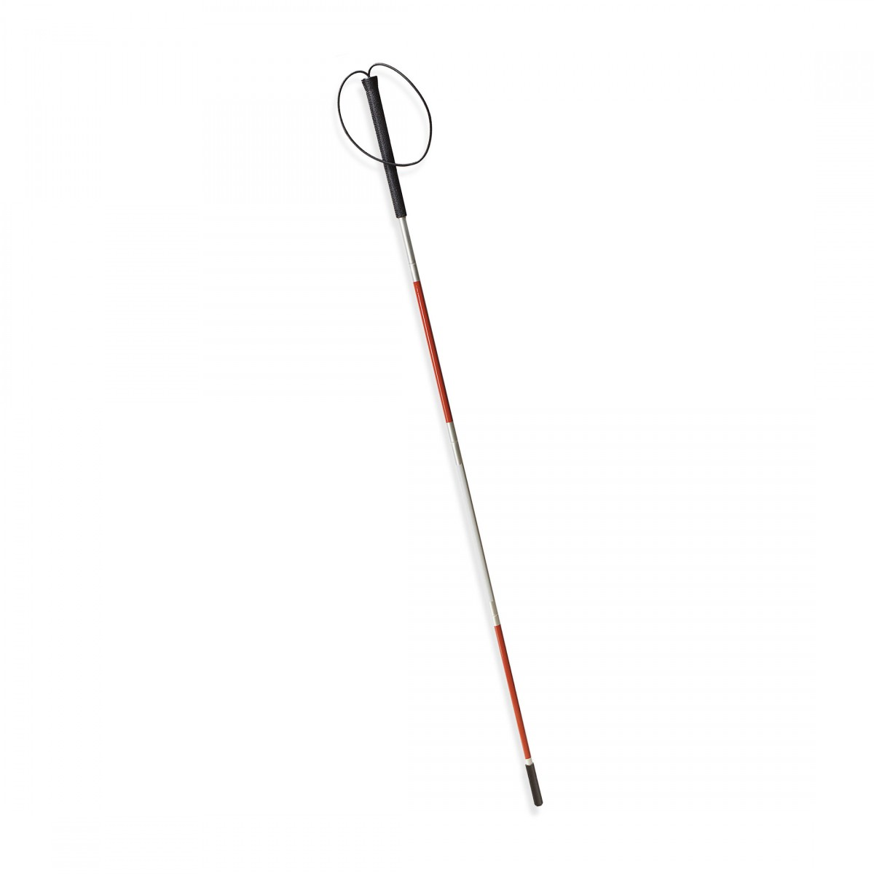
Introduction
Navigation in indoor environments is highly challenging for the severely visually impaired, particularly in spaces visited for the first time.
Several solutions have been proposed to deal with this challenge.

Slide 3
The research on outdoor environments mainly addresses the problem of users positioning during micro-navigation and macro-navigation
Micro-navigation studies the delivery of information from the immediate physical environment, and macro-navigation explores the challenges of dealing with the distant environment.

Slide 4
Future Technologies
https://www.youtube.com/watch?v=9867XDW4k98
https://www.youtube.com/watch?v=ELeNjLtPvno

Slide 5
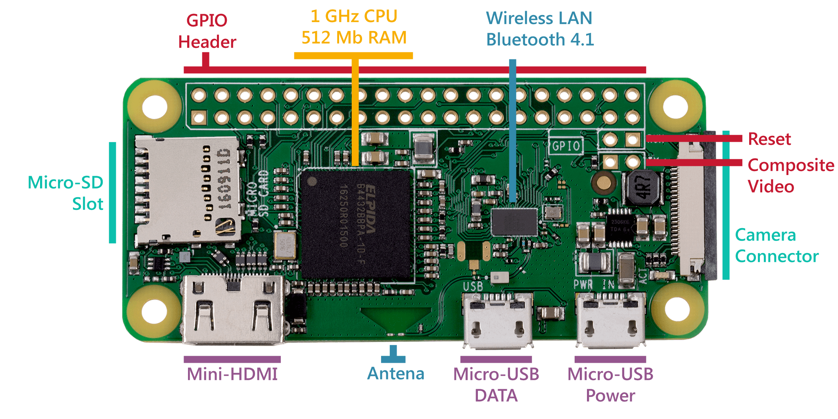
The Raspberry PI Zero W
Notes:
The introduction of the Raspberry Pi Zero allowed one to embed an entire computer in even smaller projects. This guide will cover the latest version of the Zero product line, the Raspberry Pi Zero - Wireless, which has an onboard WiFi module. While these directions should work for most any version and form factor of the Raspberry Pi, it will revolve around the Pi Zero W.
Additional Connections
Last, you may notice two sets of thruhole pads labeled TV and Run. The TV pads allow you to connect an RCA jack to the board instead of using the HDMI out. The Run pins connect to the chips reset pin and will either turn the board off or turn it back on once it has been shutdown. Connecting a button here is a good way to power cycle your board.
Main Website - https://www.raspberrypi.org/products/raspberry-pi-zero-w/
Arduino vs Raspberry PI - https://makezine.com/2015/12/04/admittedly-simplistic-guide-raspberry-pi-vs-arduino/ ; https://circuitdigest.com/article/arduino-vs-raspberryp-pi-difference-between-the-two
Raspberry PI OS - https://lifehacker.com/the-best-operating-systems-for-your-raspberry-pi-projec-1774669829
Raspberry PI Zero- https://learn.sparkfun.com/tutorials/getting-started-with-the-raspberry-pi-zero-wireless

Slide 6
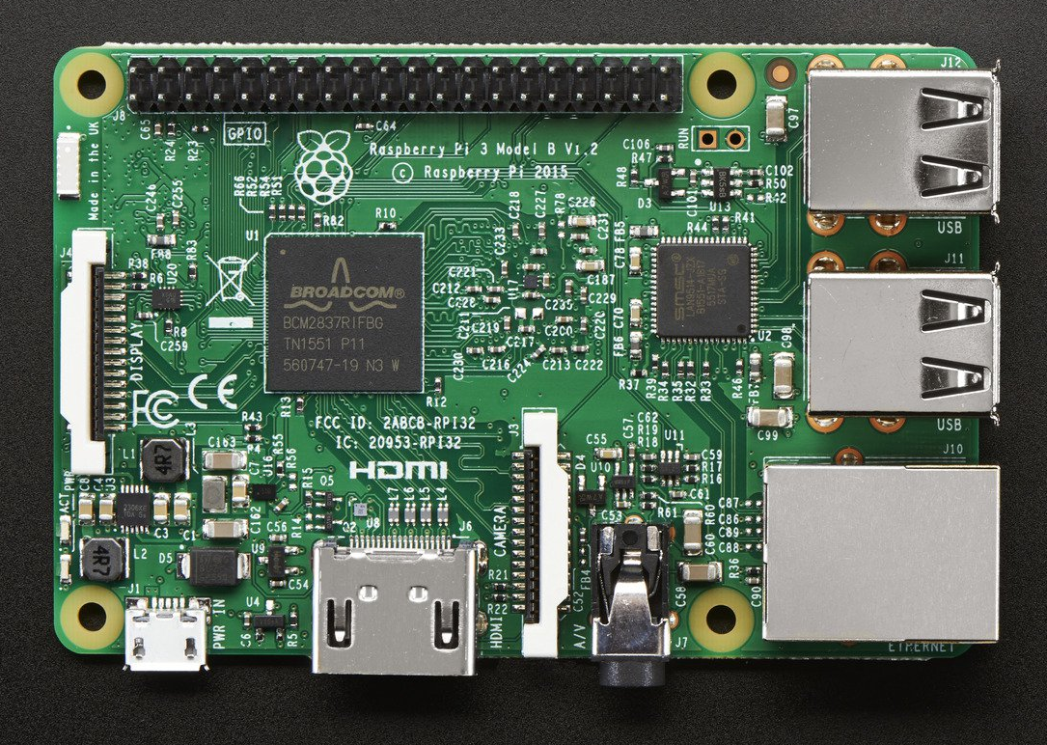
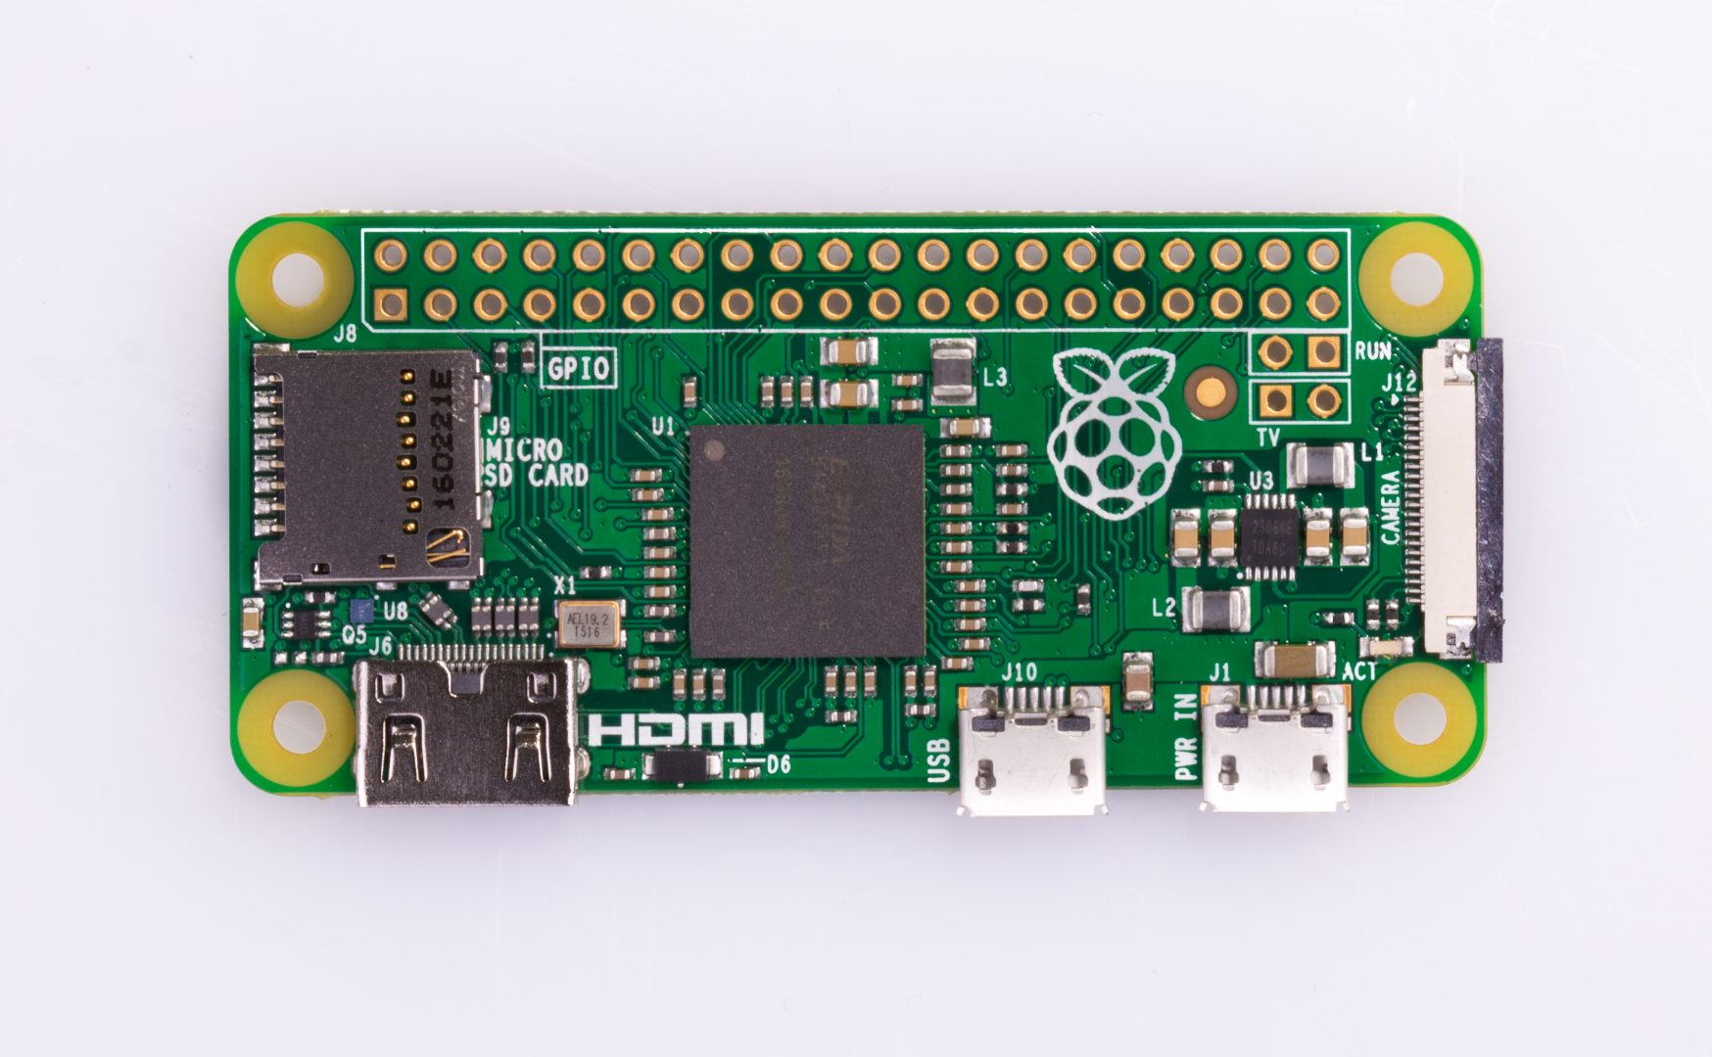
Raspberry PI Zero VS Raspberry PI 3
Notes:
Main Website - https://www.raspberrypi.org/
Arduino vs Raspberry PI - https://makezine.com/2015/12/04/admittedly-simplistic-guide-raspberry-pi-vs-arduino/ ; https://circuitdigest.com/article/arduino-vs-raspberryp-pi-difference-between-the-two
Raspberry PI OS - https://lifehacker.com/the-best-operating-systems-for-your-raspberry-pi-projec-1774669829
Raspberry PI Zero vs Raspberry PI 3 - http://socialcompare.com/en/comparison/raspberrypi-models-comparison

Slide 7
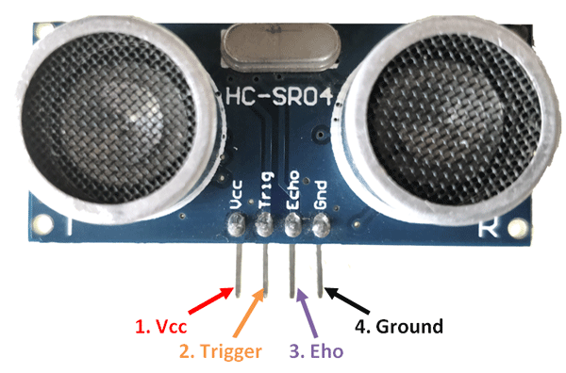
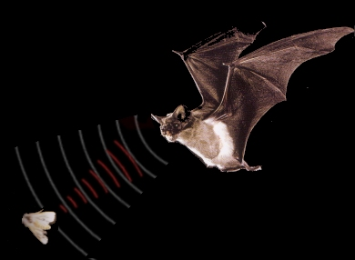
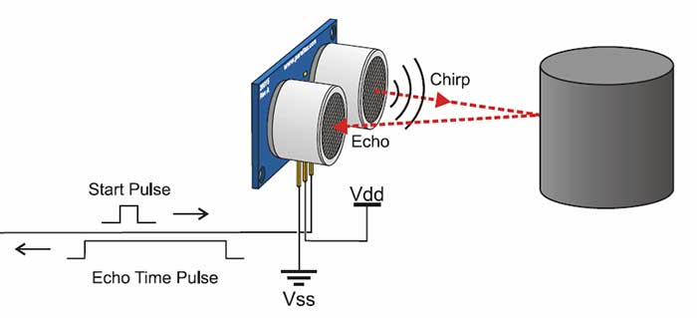
Ultrasonic Sensor
It emits an ultrasound at 40 000 Hz which travels through the air and if there is an object or obstacle on its path It will bounce back to the module. Considering the travel time and the speed of the sound you can calculate the distance.
Notes:
Read more https://www.smart-prototyping.com/DHT11-Humidity-and-Temperature-Sensor-Module
Example with Arduino: https://www.smart-prototyping.com/blog/DHT11-Temperature-and-Humidity-Sensor-with-an-Arduino-Uno

Slide 8
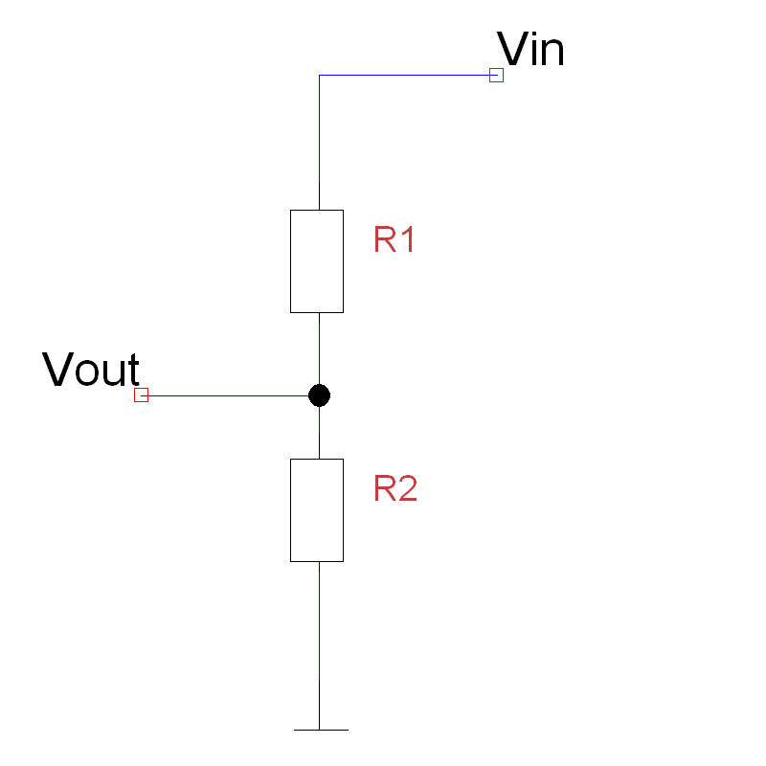

Voltage divider
Notes:
Read more: https://www.modmypi.com/blog/hc-sr04-ultrasonic-range-sensor-on-the-raspberry-pi

Slide 9
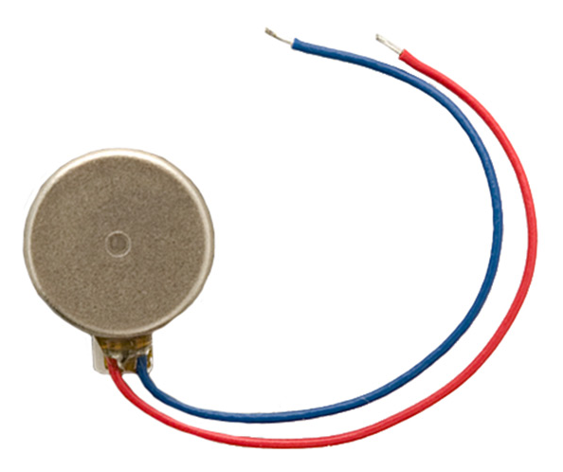
Vibration Motor
Notes:
Read more https://www.sparkfun.com/products/8449
Example with Arduino: http://learningaboutelectronics.com/Articles/Vibration-motor-circuit.php

Slide 10
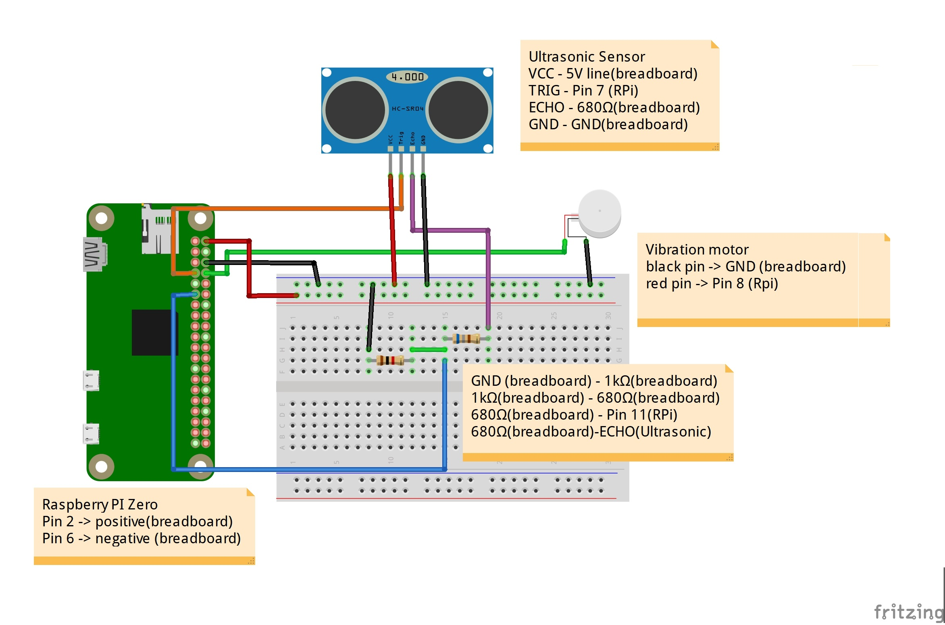
Circuit diagram
Notes:
Read more https://www.sparkfun.com/products/8449
Example with Arduino: http://learningaboutelectronics.com/Articles/Vibration-motor-circuit.php

Slide 11
GitHub repository
To get the instructions and other files go to:
https://github.com/The-Assembly/Navigation_for_visuallyimpaired

Slide 12

THANK YOU
THANK YOU

