Slide 1
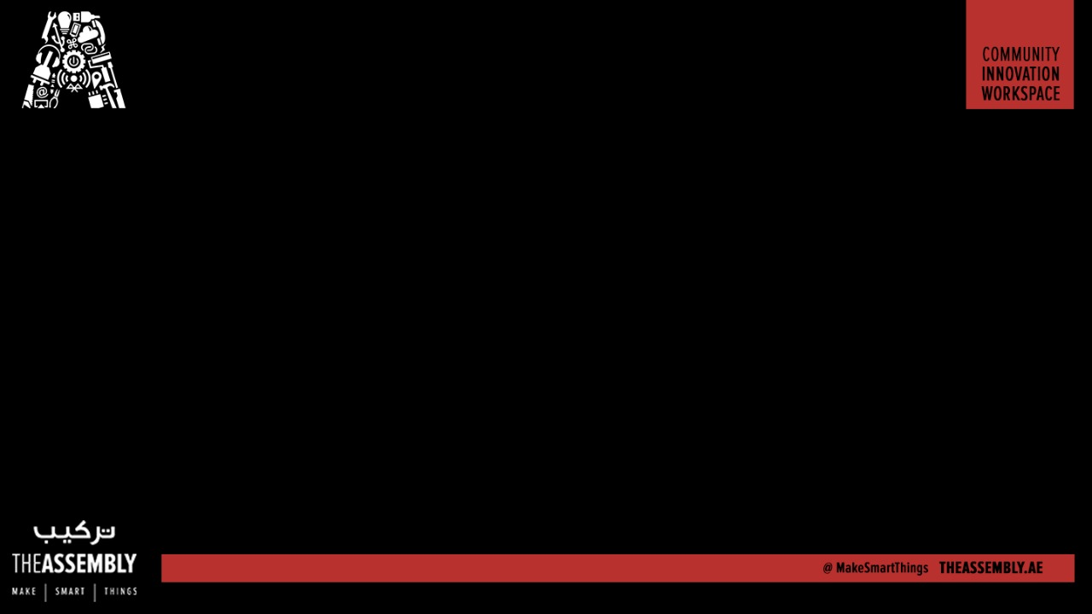
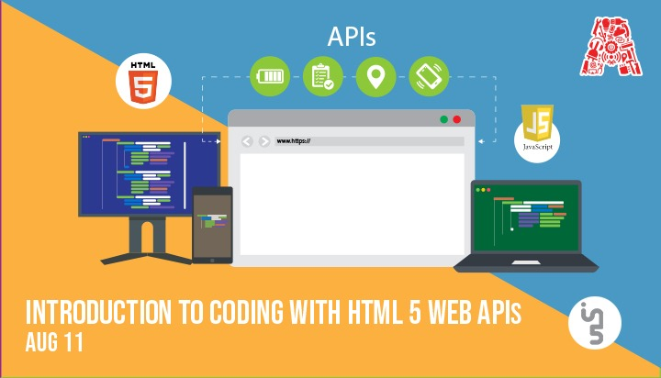
Wifi - In5-Tech [Code - WelcomeToIn5]

Slide 2
About the Assembly
A smart lab based out of In5 since Dec 2014
Over 200 free workshops done
ASSEMBLY: HACK - Embedded systems, iOT and hardware
ASSEMBLY: CODE - Software projects - APIs, frameworks, apps
Age range: 16-60 - students, professionals, entrepreneurs
Focus on smart technology and practical applications
Forum: members.theassembly.ae

Slide 3
TAG US ON SOCIAL MEDIA!
FACEBOOK - The Assembly (@MakeSmartThings)
TWITTER - @MakeSmartThings
INSTAGRAM - @MakeSmartThings
YOUTUBE - The Assembly

Slide 4
Getting started
Local server required to test on mobile phones (Nginx/lamp/wamp/xampp)
GitHub with all the code: https://github.com/The-Assembly/intro_to_coding_with_HTML5_web_API
Ask for help from the Assembly team if you get stuck with anything!

Slide 5

Introduction to HTML5
HTML5 is a new specification, with new elements, attributes, and behaviors, and a larger set of technologies
Provides a huge number of APIs like Fullscreen API, Notification API, Clipboard API, etc.
Some APIs are yet to be supported by all browsers

Slide 6

What are WebAPIs?
1. WebAPI is a term used to refer to a suite of device compatibility and access APIs that allow Web apps and content to access device hardware.
2. They can also be used to access data stored on the device.
3. No additional installations required!
https://developer.mozilla.org/en-US/docs/WebAPI

Slide 7

WebAPIs
1. Battery Status API
2. Notification API
3. Geolocation API
4. Page Visibility API
5. Screen Orientation (Mobile only)
6. Vibration API (Mobile only)
7. Clipboard API
8. WebSQL/LocalStorage/IndexedDB API
9. Device Motion (Mobile only)
https://developer.mozilla.org/en-US/docs/WebAPI

Slide 8
WebAPIs
1. Battery Status API
level
dischargingTime
chargingTime
charging
2. Notification API
Constructor to send notification
requestPermission()
granted, denied, dismissed
3. Geolocation API
getCurrentPosition()
watchPosition()
4. Page Visibility API
Visibilitychange event listener

Slide 9

WebAPIs
5. Screen Orientation (Mobile only)
Orientationchange event listener
Orientation values:
Right tilted: -90
Straight: 0
Left tilted: 90
6. Vibration API (Mobile only)
User event is required to trigger vibration
navigator.vibrate(milliseconds)
https://developer.mozilla.org/en-US/docs/WebAPI

Slide 10

WebAPIs
7. Clipboard API
document.execCommand(‘copy’)
8. WebSQL/LocalStorage/IndexedDB API
WebSQL – Relational Database
LocalStorage – Key-value pair
IndexedDB – Object Stores
https://developer.mozilla.org/en-US/docs/WebAPI

Slide 11


WebAPIs
9. Device Motion (Using p5.js)
Devicemotion event listener
p5.js a JS client-side library for creating graphic and interactive experiences.

