Slide 1
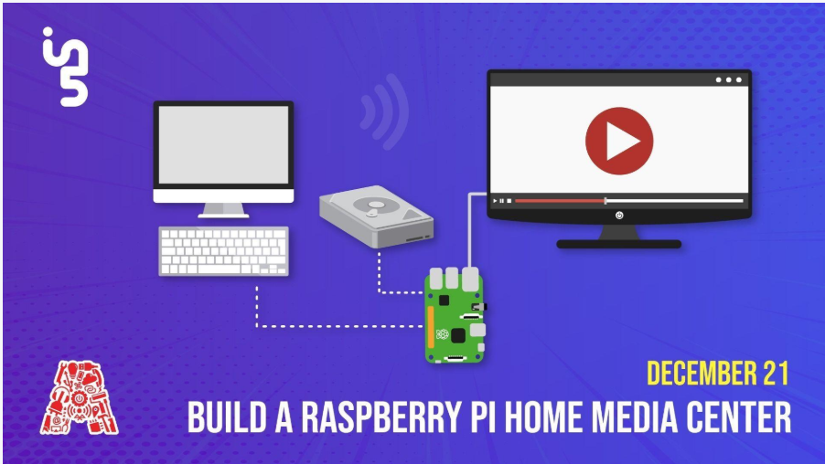

Slide 2
About the Assembly
A smart lab based out of In5 since Dec 2014
Over 250 free workshops done
ASSEMBLY: HACK - Embedded systems, iOT and hardware
ASSEMBLY: CODE - Software projects - APIs, frameworks, apps
Age range: 16-60 - students, professionals, entrepreneurs
Focus on smart technology and practical applications
Forum: members.theassembly.ae
Notes:
2

Slide 3
TAG US ON OUR SOCIAL MEDIA
FACEBOOK
TWITTER
INSTAGRAM
YOUTUBE
The Assembly (@MakeSmartThings)
@MakeSmartThings
@MakeSmartThings
The Assembly
Notes:
3

Slide 4
Overview
Purpose of this workshop
What is Raspberry Pi?
Configuring a Pi to work as a media center
Running Netflix on Pi
Watching TV shows
Transferring files from PC/mobile to Pi
Using a mobile phone as a remote
Why was Raspbian chosen and what other approaches can be used?
How can Pi be a retro gaming console along with a media center?
Notes:
4

Slide 5
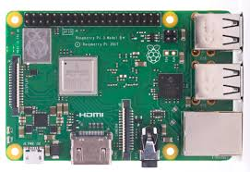
What is Raspberry Pi?
Raspberry Pi is a series of small computers developed to promote programming at schools and in developing nations.
Single-board computers with no peripherals attached but compatible with most.
First model developed in 2012 by UK-based Raspberry Pi.

Slide 6
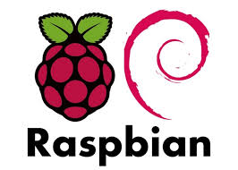
Raspbian OS
Operating system for Raspberry Pi.
Link : https://www.raspberrypi.org/downloads/raspbian/

Slide 7
Equipment required
Raspberry Pi (configured with Raspbian OS)s
MicroSD card(16GB+)
Power supply
USB Keyboard and mouse
HDMI cable
Ethernet chord or WiFi connection

Slide 8
Procedure(1).
Preparing for Netflix:
Start by updating all the packages already installed on pi. This will be done by typing sudo apt update in terminal. After this command runs it’s course, type sudo apt upgrade in the terminal window. After about 10-15 minutes this process should be done.
Next we proceed by installing Kodi on to the Pi. This will be done by typing this in the terminal window: sudo apt install kodi kodi-peripheral-joystick kodi-pvr-iptvsimple kodi-inputstream-adaptive kodi-inputstream-rtmp.
Now we will install packages required to run Netflix on this Pi. These packages will be installed by typing: sudo apt install build-essential python-pip python-dev libffi-dev libssl-dev libnss3 in the terminal window.
Rest of the required packages can be installed by typing sudo pip install setuptools wheel pycryptodomex in terminal window.
To install the Netflix plugin, type: wget https://github.com/castagnait/repository.castagnait/raw/master/repository.castagnait-1.0.0.zip

Slide 9
Procedure(2).
Watching TV shows from Kodi:
Kodi also offers a huge library of TV shows ranging from channels such as Comedy Central, Food network etc.
To watch shows on any of the channels listed in the list of repositories, just enter into add-on repository, and install any channel that maybe in the list.
These can later be viewed in the add-ons or under the videos tab.

Slide 10
Procedure(3)
Transferring files from PC to Pi:
This can be done through Kodi again.
This will require the SSH on your Pi to be enabled.
Next, head to settings and then services. Head to UPnP/DLNA and enable UPnP support, also enable Share my libraries.
Also enable ‘Allow remote control via HTTP’ in control tab.
This should now enable UPnP sharing(this will require Kodi being installed on the sending device).
Under files in the videos tab, select add videos and then browse. This should now display the option to share via UPnP on your Pi. Select your device and add the folder you wish to view on your media center.

Slide 11
Procedure(4).
Using a smartphone as a remote control:
Install Official Kodi remote on your iOS device or Kore by XBMC on your Android device.
Next connect the phone to your Pi by entering the IP address, username and password.
This should then prompt a finish option, followed by a standard remote layout on the app.

Slide 12
Why Raspbian?
Raspbian was chosen as it comes with a web browser, helping connect to the in5 network and also is more suitable if you want to use the Pi for more than just streaming media. RetroPie retro gaming solution also runs on Raspbian.
OSMC, a free and open source solution, may be a better choice as compared to Raspbian, as it comes with multiple add-ons and is designed to run media applications such as Kodi. This was not chosen as it does not support a browser out of the box.
Pi can be used as a retro gaming center as well. Users may install applications such as RetroPie or Internet Archive Game Launcher (IAGL) to turn their Pi(running Raspbian) into gaming devices, along with support for controllers.

