Slide 1
Smart Water bottle
Presented By : The Assembly Team

Slide 2
Introduction
Objective:

Slide 3
Github repository
To get the instructions and other files go to:
https://github.com/The-Assembly/smart_water_bottle

Slide 4
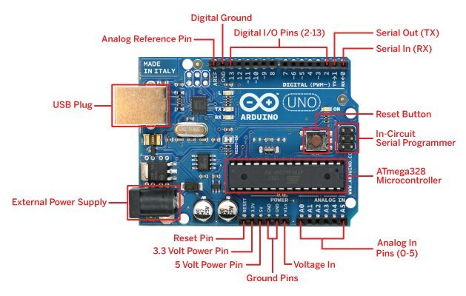
Arduino UNO
Notes:
Arduino UNO- https://www.arduino.cc/en/Main/ArduinoBoardUno/ ; http://forefront.io/a/beginners-guide-to-arduino/
There are three pools of memory in the microcontroller used on avr-based Arduino boards :
Flash memory (program space), is where the Arduino sketch is stored.
SRAM (static random access memory) is where the sketch creates and manipulates variables when it runs.
EEPROM is memory space that programmers can use to store long-term information.
Flash memory and EEPROM memory are non-volatile (the information persists after the power is turned off). SRAM is volatile and will be lost when the power is cycled.

Slide 5
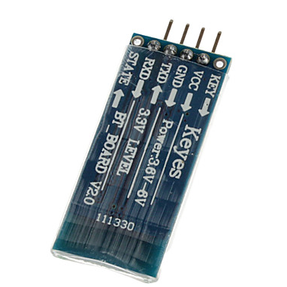
HC-06 (Bluetooth module)

Slide 6
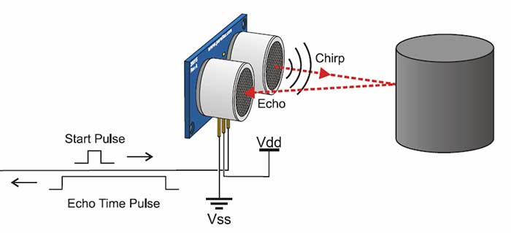
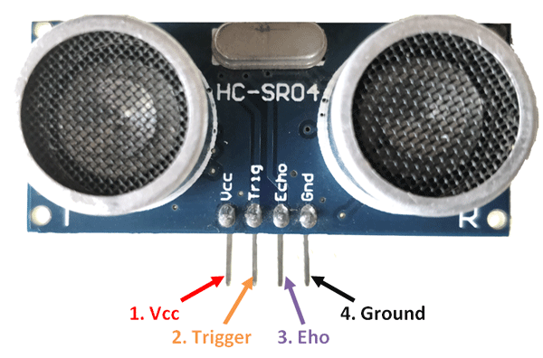
Ultrasonic Sensor
Notes:
Read more https://www.smart-prototyping.com/DHT11-Humidity-and-Temperature-Sensor-Module
Example with Arduino: https://www.smart-prototyping.com/blog/DHT11-Temperature-and-Humidity-Sensor-with-an-Arduino-Uno

Slide 7
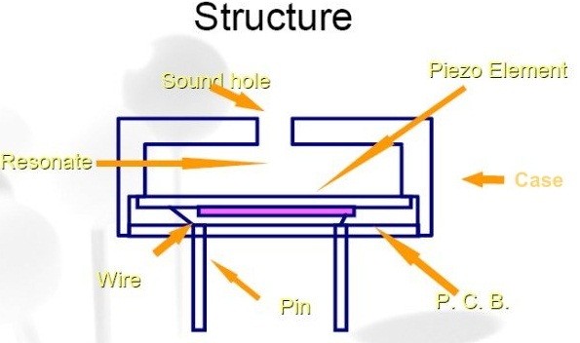
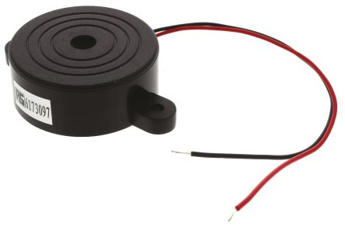
Piezo Buzzer
Notes:
Read more http://www.futureelectronics.com/en/passives/buzzers.aspx
Tutorial - http://www.instructables.com/id/How-to-use-a-Buzzer-Arduino-Tutorial/
*Piezo electricity - phenomena of generating electricity when mechanical pressure is applied to certain materials and the vice versa is also true. Such materials are called piezo electric materials. Piezo electric materials are either naturally available or manmade.
*Piezoceramic disks - Piezoceramic is class of manmade material, which poses piezo electric effect and is widely used to make disc, the heart of piezo buzzer. When subjected to an alternating electric field they stretch or compress, in accordance with the frequency of the signal thereby producing sound.

Slide 8
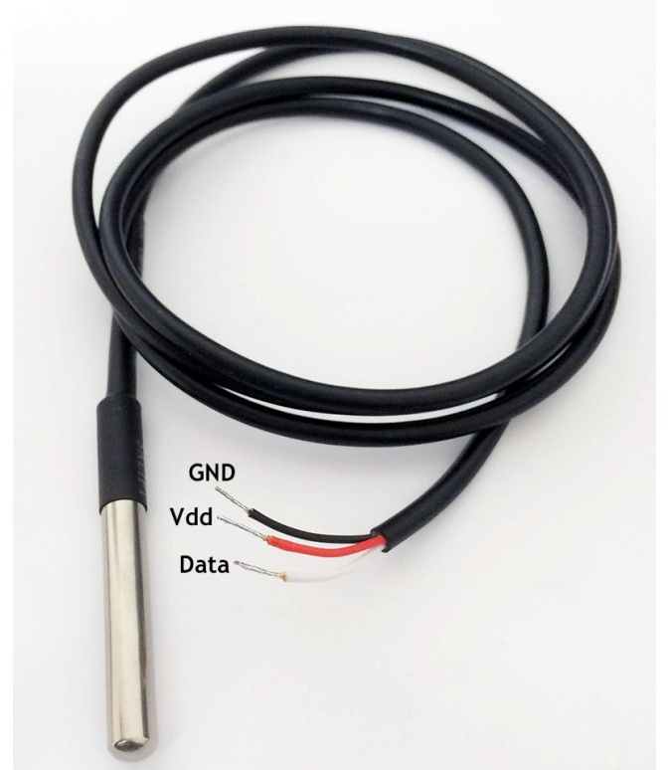
Temperature Sensor

Slide 9
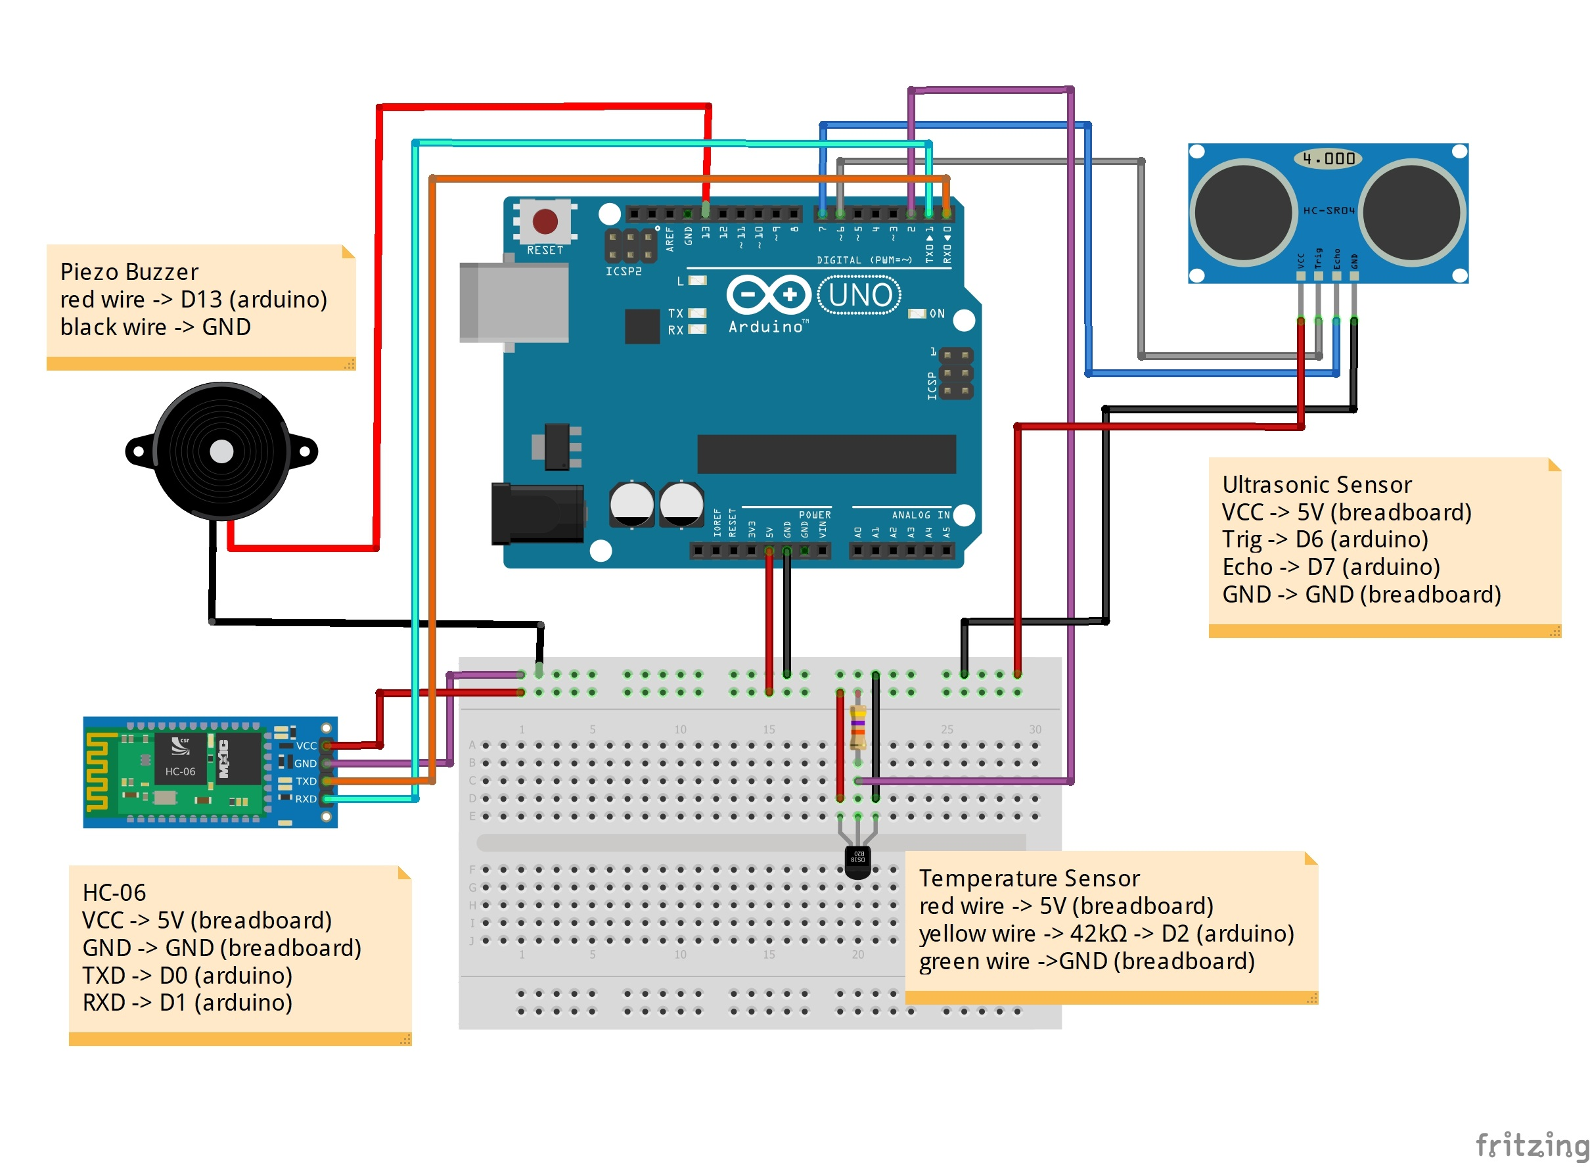
Implementing the entire system

Slide 10
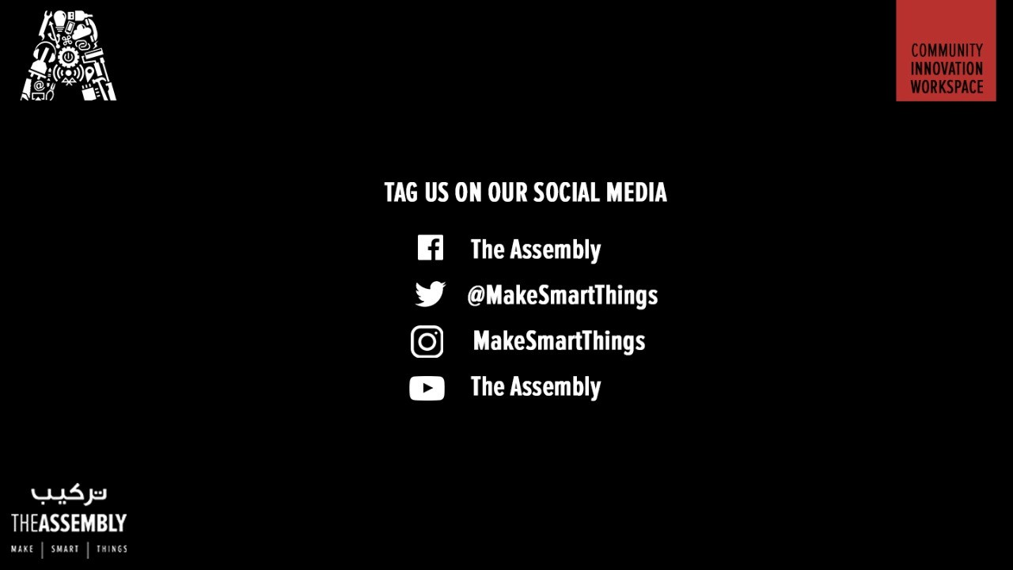
THANK YOU
THANK YOU

