Slide 1
CP3405 TR2 2026
Wenhan Hu, Yijie Kan, The Bao Le, Yu-Chu Lin, Junwen Lu, Guanyu Lu, Hamzah Nutt, Swan Htet Zaw, Hao Wang, Qinyang Wu, Zaikun Zheng, Yue Zhou

Slide 2
R1 Product Owner
Sprint goal: Produce a disciplined market prediction using seasonal, macro, technical, multi-LLM, and human judgment evidence.
Last week score: No previous calibration yet. This sprint establishes the benchmark for future weeks.
Key question: can momentum continue despite elevated yields and PCE inflation risk?
Notes:
***
Not much to present for this week as the Product Owner since there is no calibration score to state or comment on.
***
Good morning everyone. My name is The Bao and I’m the Product Owner for this week.
For this sprint, our goal is to produce disciplined market prediction using seasonal, macro, technical, multi-LLM, and human judgment evidence.
Since this is our first sprint, we do not have a calibration score, so this week result is the baseline for our future sprints.
The main question we’re trying to answer this week is whether the market can continue its upward momentum despite elevated yields and the risk from PCE inflation.

Slide 3
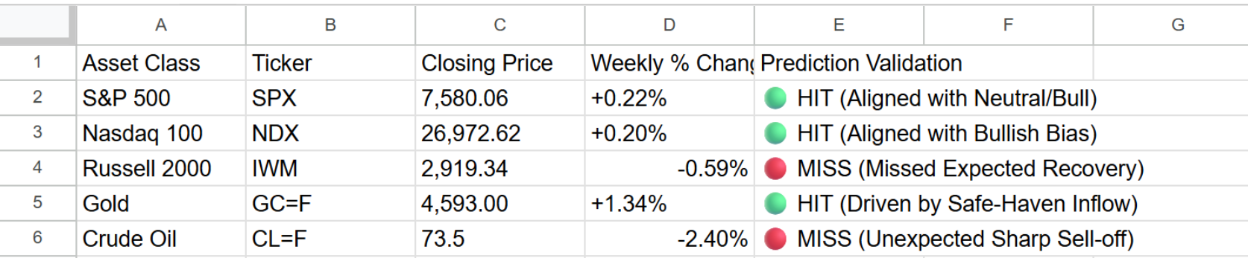
R8 Data Lead
Week 22 Market Actuals & Data Evidence Audit
Right Column: Sector Performance & Repository Compliance
S&P 500 11 Sectors Leaderboard:
🏆 Top 3 Leaders: Utilities (XLU +2.15%), Communication Services (XLC +1.58%), Technology (XLK +1.12%)
❌ Bottom 3 Laggards: Energy (XLE -2.40%), Financials (XLF -1.25%), Materials (XLB -1.10%)
Data Integrity & Audit Trail:
📸 Visual Evidence: Finviz 1W futures chart and Yahoo Finance 5D sector heatmap successfully captured post-market close.
🗂️ GitHub Repository: Screenshots archived under /evidence/screenshots/. The data file actuals_2026-W22.md has been created and locked in the root directory.
Notes:
First, looking at the major indices on the left: Our directional call for mega-caps was accurate. Both the S&P 500 and Nasdaq 100 closed slightly higher, up 0.22% and 0.20% respectively. Gold also hit our target as safe-haven demand increased.
However, we observed two significant outliers: Crude Oil slumped 2.40% due to demand worries ahead of the non-farm payrolls, and small-caps failed to recover, with the Russell 2000 dropping 0.59%. This indicates a clear market shift toward defensive positioning. This rotation is further proven by our sector leaderboard on the right, where Utilities led the market at plus 2.15%, while Energy significantly lagged.

Slide 4
Seasonal Context for This Week (Almanac)
Seasonal Patterns:
Memorial Day week: Dow down 17 of last 29. Bearish lean. Pattern strength: MODERATE.
Day after Memorial Day (Tue 26 May): Dow down 8 of last 10. Recent trend bearish.
Week after options expiration: S&P up 30 of 45, avg +0.40%. Bullish lean. Pattern strength: MODERATE.
These two patterns contradict each other. Net: mixed / slight bearish lean.
Sector Signals:
Banking: seasonal SHORT window (May–July). Avoid Financials seasonally.
Technology: still in seasonal LONG window (March–July). Supports tech/Nasdaq.
Gold/Silver: seasonal SHORT begins mid-May. Contradicts current elevated gold price.
Materials: seasonal SHORT (May–October). Consistent with last week's poor sector performance.
Notes:
Seasonality suggests cautious/bearish-neutral for late May in a midterm year. Technology is the seasonal bright spot that gives a bullish offset. Banking and Materials face seasonal headwinds. The Memorial Day week bearish tendency adds to the macro pressure from elevated yields. However, the week-after-options-expiration bullish pattern provides some offset. Confidence is low due to conflicting signals.

Slide 5
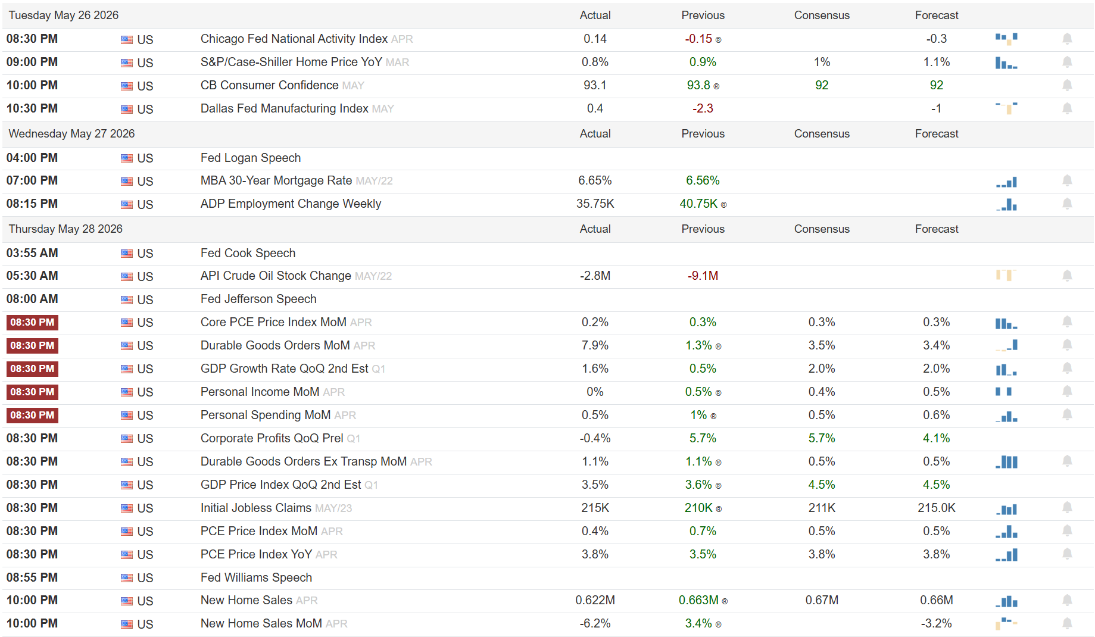
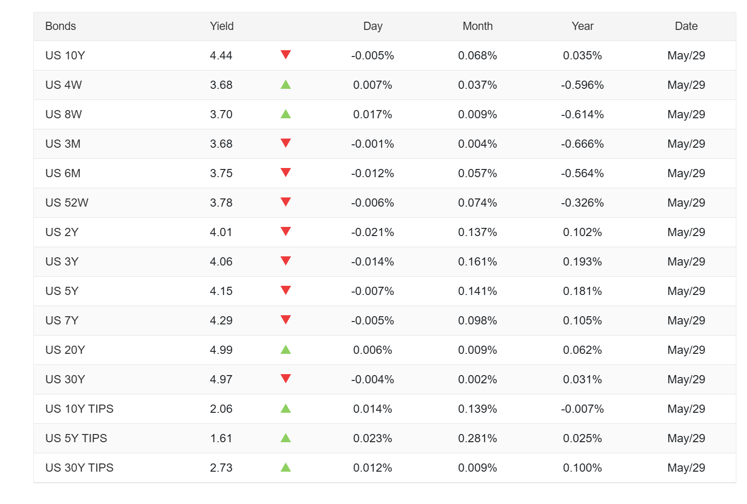
R4 Macro Lead
TradingEconomics PCE Data
PCE Result (Confirmed)
• Core PCE MoM = 0.2%
• Headline PCE MoM = 0.4%
• Inflation pressures continue to moderate
Iran Status (Unverified)
• No confirmed escalation affecting global markets
• Energy supply disruption risk remains limited
US 10Y Treasury Yield (Confirmed)
• US 10Y Yield = 4.44%
• Elevated yields continue to pressure valuations
Week 23 Primary Driver (Confirmed)
• Non-Farm Payrolls (NFP)
• Key catalyst for Fed expectations
• Strong NFP = bearish for rate cuts
• Weak NFP = supportive for equities
US Treasury Yield Curve
Notes:
Part 1:
Hi everyone.
I am responsible for the macro analysis.
First, PCE inflation came in lower than before.
Core PCE was 0.2 percent and headline PCE was 0.4 percent.
This suggests inflation is cooling down slowly.
Second, Iran-related news is unverified.
There was no major event that significantly affected the market this week.
Overall, inflation looks better, and there was no major geopolitical shock.
Part 2:
I will cover the market outlook.
The US 10-year Treasury yield closed at about 4.44 percent.
Although inflation is improving, yields remain high and continue to affect stock valuations.
For next week, the most important event is the Non-Farm Payrolls report.
If job growth is strong, the Fed may keep rates higher for longer.
If job growth is weak, markets may expect future rate cuts.
Therefore, NFP is our primary market driver for Week 23.

Slide 6
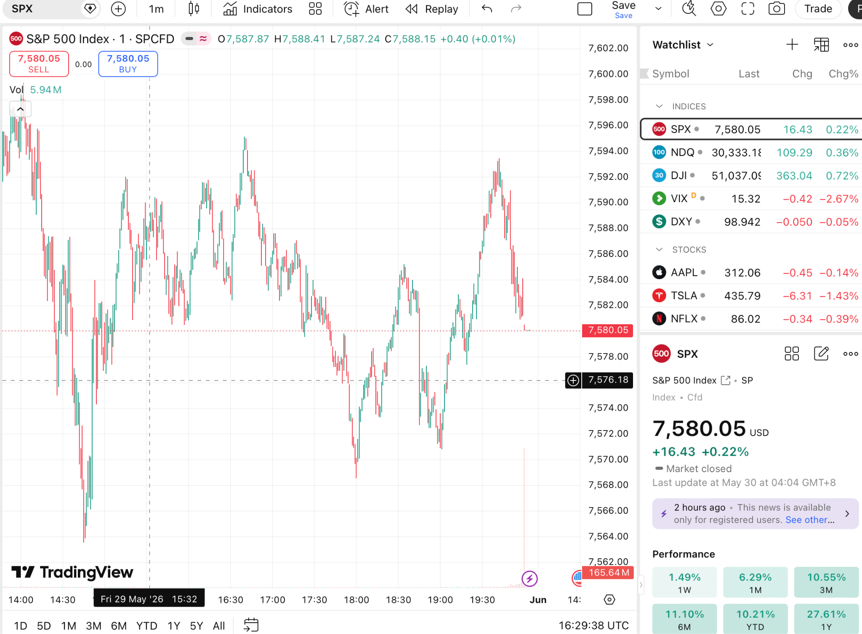
R5 Technical Lead
Annotated SPX chart screenshot. EMA zone. Key levels.
Speaker note must include:
State specific invalidation level
The SPX remains above the EMA support zone, indicating a bullish trend.
Key resistance is located at 6500 while support is located at 6300.
My trade thesis remains valid as long as price stays above 6300.
Invalidation level: 6300.
If price closes below 6300, the bullish setup is invalidated and the analysis will need to be reassessed.

Slide 7
R6 LLM Operator
Weekly Market Intelligence Comparison | S&P 500
AI Model | Direction | Bias | Primary Macro Driverro | Technical Signal | Exp. Range
ChatGPT | Up | Neutral-Bullish | Core PCE Inflation Report | S&P > 8/21 EMA | 7,330 - 7,600
Claude | Sideways → Up | Neutral-Bullish | Core PCE Inflation Report | S&P > 8/21 EMA | 7,330 - 7,600
Gemini | Up | Neutral-Bullish | Core PCE Inflation Report | S&P > 8/21 EMA | 7,330 - 7,600
DeepSeek | Sideways | Neutral-Bearish | Core PCE Inflation Report | S&P > 8/21 EMA | 7,330 - 7,600
Core Consensus
Macro Pivot: Core PCE acts as the absolute binary risk catalyst for yields.
Trend Support: Remaining above 8/21 EMA protects the short-term uptrend.
Trading Space: Shared support (7,330) and resistance (7,600) with Medium confidence.
Cycle Drag: Shared warning on Midterm Election Year Q2–Q3 "Weak Spot" headwinds.
Strategic Divergence
Stance Dissonance: DeepSeek uniquely shifts to Neutral-Bearish, placing higher risk weight on macro yield pressures and seasonal weakness over technical momentum.
Momentum Appetite: Majority models prioritize immediate EMA trend tracking and Tech sector seasonal long windows over cycle historical drags.
Notes:
Hi,everyone! We have a clear 75% bullish majority. ChatGPT, Claude, and Gemini focus on immediate technical momentum, noting that the index remains structurally sound above core exponential moving averages. In contrast, DeepSeek serves as the strategic outlier, adopting a Neutral-Bearish outlook due to broader macro and seasonal constraints.
Crucially, the engines achieve 100% consensus on three boundaries:
The Macro Pivot: The inflation report serves as the binary risk catalyst for Treasury yields.
The Technical Support: The short-term uptrend is protected as long as the index holds above the 8 and 21 EMAs.
The Trading Space: All models flag an identical expected range of 7,330 to 7,600 with Medium confidence.

Slide 8
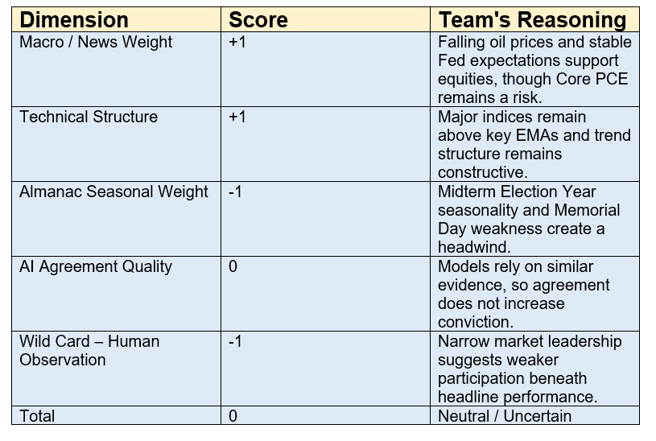
R7 Human Score
The Human Score is more cautious than the Neutral-Bullish AI consensus. While technical conditions remain supportive, the team believes seasonal weakness and narrow market leadership were underweighted by the AI models. These factors offset the positive trend signals and support a Neutral outlook ahead of the Core PCE report.
Notes:
Our key human insight was that market leadership appeared relatively narrow. While the major indices remained positive, Utilities significantly outperformed while Energy, Financials, and Materials lagged. Combined with Midterm Election Year seasonal weakness, we believe this creates a more balanced risk-reward profile than the AI consensus suggests. This was the primary reason we maintained a Neutral rather than Neutral-Bullish outlook.

Slide 9
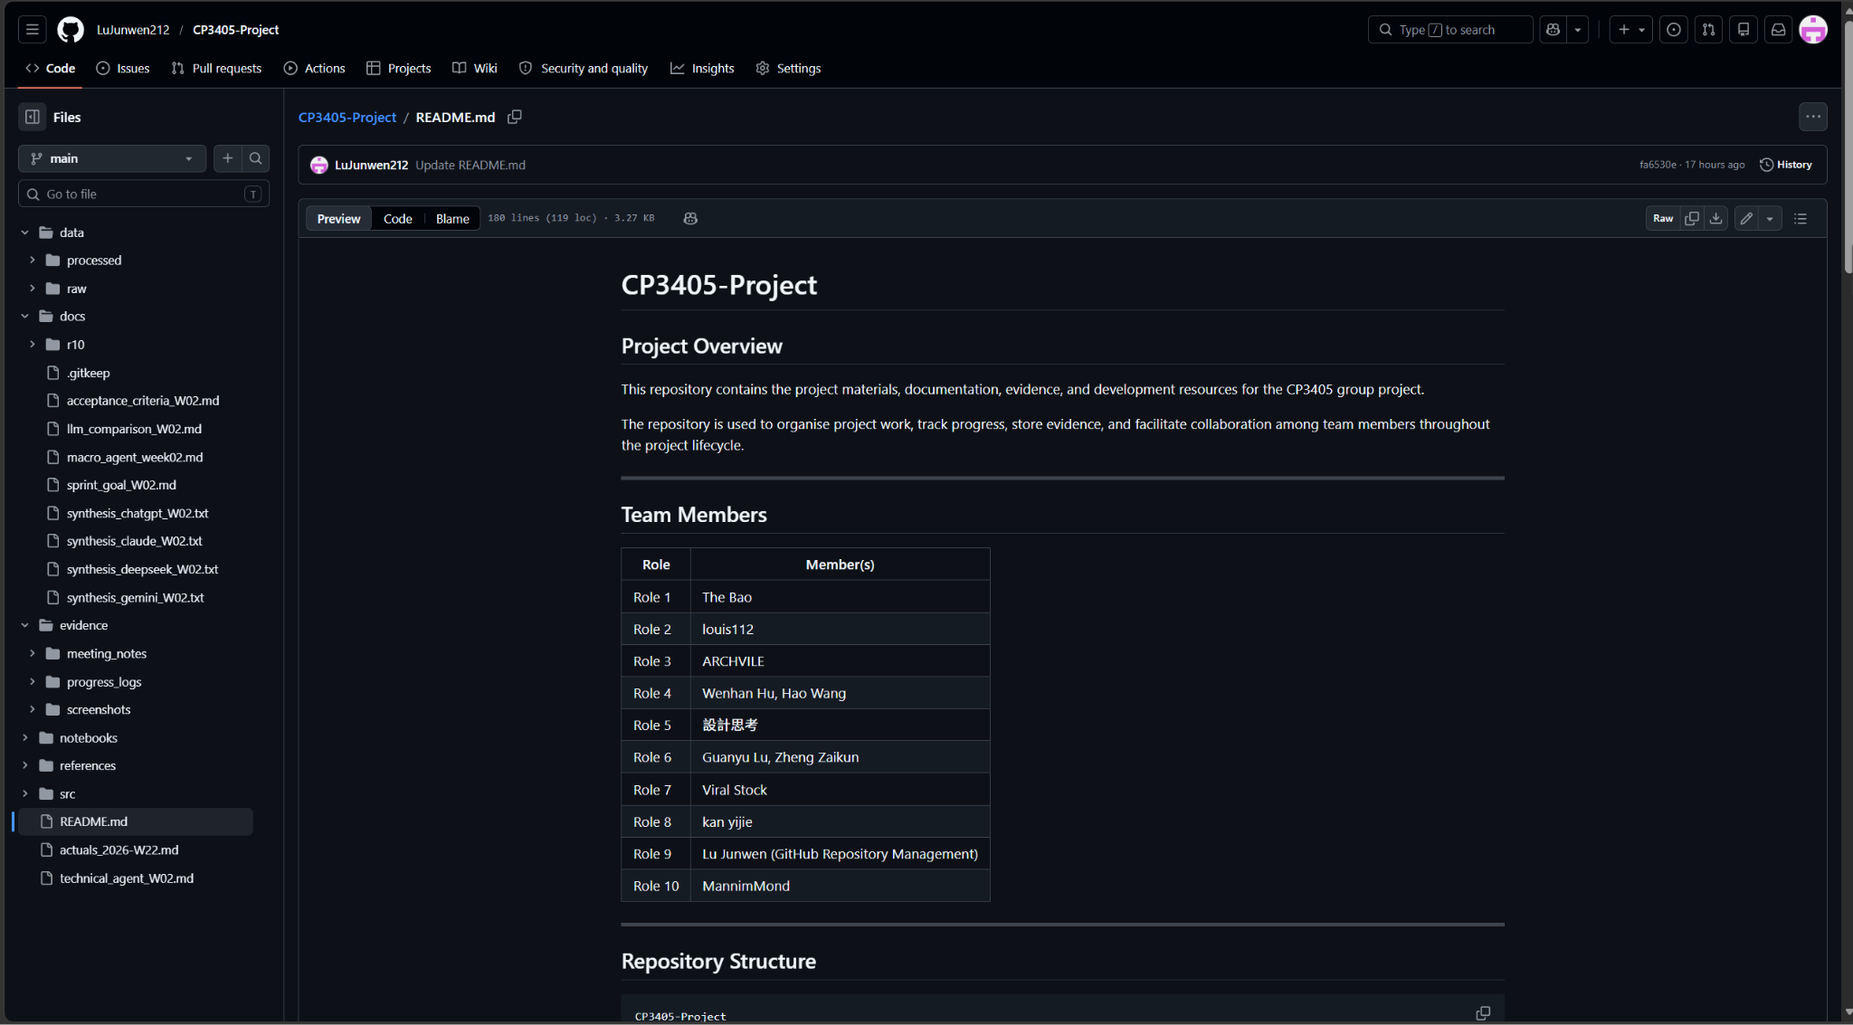
R9 GitHub Lead
URL ： LuJunwen212/CP3405-Project
Speaker note must include:
Confirm release tag vW22 created and README updated

Slide 10
R10 QA Lead
The learning:
Calibration Score
• Actuals: SPX +0.22%, NDX +0.20%, IWM -0.59%
• Result: 2 HIT, 1 MISS
• IWM missed the expected recovery
LLM Horse Race Update
• Closest model: Claude
• Claude’s Sideways → Up view best matched the slight SPX gain
One Change Next Sprint
• Compare AI consensus with Human
Score before finalising
• Give more weight to market breadth
and small-cap weakness
In Sprint 2, we will not rely only on AI consensus. We will use Human Score and market breadth to check the final forecast.
Notes:
I am R10, the QA and Learning Log Lead.
This week, my job was to check our prediction quality through the calibration result and the LLM horse race.
For calibration, the actual results were SPX plus 0.22 percent, NDX plus 0.20 percent, and IWM minus 0.59 percent. SPX and NDX were hits, while IWM was a miss because the expected recovery did not happen.
For the LLM horse race, Claude was the closest model. Its Sideways to Up prediction best matched the slight SPX gain.
The main learning for Sprint 2 is that we should not rely only on AI consensus. Next sprint, we will compare AI consensus with the Human Score before finalising the forecast, and give more weight to market breadth and small-cap weakness.

