Slide 1

CP3405 TR2 2026
Group 2
Sprint 4 - W24
The Bao Le
Zheng Zaikun
WuQin Yang
Wenhan Hu
Hao Wang
Guanyu Lu
Hamzah Nutt
Lu Junwen
Swan Htet Zaw
Kan Yijie
Yu-Chu Lin
Yue Zhou

Slide 2
R1 Product Owner
Sprint Goal Board
02
Sprint goal statement
Done Means
- Python/yfinance script runs successfully
- Latest snapshot files are generated
- GitHub Actions test workflow passes
- Real Friday-close workflow exists
- README and DECISION.md are updated
- W4 prediction uses the automated evidence
- Repo is tagged vW24
LAST WEEK SCORE
PRIMARY QUESTION
Release no.
###
Evidence Automation
W24
Sprint Goal
Automate one market evidence collection step using Python/yfinance to fetch Yahoo Finance data for SPX, NDX, IWM, XLK, XLE, and XLF, then generate JSON outputs for W4 prediction support.
Notes:
For Sprint 4, our main sprint goal is focused on evidence automation. Instead of manually collecting all market data each week, we decided to automate one repeatable part of the prediction process using Python and yfinance.
The automation is designed to fetch market data for the main index proxies: SPX, NDX, and IWM, as well as the selected sector proxies: XLK for Information Technology, XLE for Energy, and XLF for Financials. The output should be generated as structured CSV or JSON files, so the team can use the data directly as supporting evidence for the W4 prediction.
On the right side, the “Done Means” section defines our acceptance criteria. The sprint is only considered complete if the Python script runs successfully, the latest market snapshot files are generated, and the GitHub Actions test workflow passes. We also need a real Friday-close workflow, updated documentation files, and a W4 prediction that actually uses the automated evidence.

Slide 3
R1 Product Owner
Forecast Contract
03
Forecast contract
Broad index commitments
SPX | ^GSPC proxy
NDX | ^NDX proxy
IWM | IWM proxy
Direction: Neutral → Cautiously Up
Range: -0.2% to +0.8%
Confidence: Medium
Direction: Up
Range: +0.4% to +1.4%
Confidence: Medium
Direction: Flat → Up
Range: -0.3% to +0.9%
Confidence: Medium
Selected sector commitments
Info Tech | XLK proxy
Energy | XLE proxy
Financials | XLF proxy
Direction: Up
Range: +0.8% to +2.0%
Confidence: Medium-High
Direction: Down
Range: -1.5% to -0.3%
Confidence: Medium
Direction: Neutral → Up
Range: 0.0% to +1.0%
Confidence: Medium
Assumptions / Risk Trigger
Evidence Lock
1. Main macro driver: FOMC Dot Plot and Fed forward guidance after a near-certain rate hold.
2. Technical invalidation: Daily close below 21D EMA or key support: SPX 7,380 / NDX 29,250 / IWM 284.
Market snapshot
Final W4 call committed to GitHub
Prediction file linked to evidence output
Ready for R10 calibration after actuals
Notes:
For the broad indices, our view is cautiously positive, but not aggressive. For the S&P 500 proxy, we are forecasting a neutral to cautiously up move, with a range from slightly negative to around plus 0.8 percent. For the NASDAQ 100, our strongest broad index call is upward, with a range from plus 0.4 to plus 1.4 percent. For IWM, we expect a flat to mildly positive move, so the range is wider and still allows a small downside.
For the sector commitments, we selected Information Technology, Energy, and Financials. Technology is our strongest sector call, with medium-high confidence, because it aligns with the stronger NASDAQ view. Energy is the weakest call, with a down direction and a negative range. Financials are more moderate, with a neutral to upward bias.
The main assumption behind this forecast is that the market remains guided by the FOMC dot plot and forward guidance after the near-certain rate hold. Our technical invalidation rule is also clear: if SPX, NDX, or IWM closes below the 21-day EMA or the listed support levels, then our cautiously bullish view is weakened. The forecast is only valid while the market holds above the technical support levels. If those levels break, our prediction should be treated as invalidated.
Finally, the evidence lock confirms that this prediction is tied to our market snapshot and committed to GitHub. That means R10 can later compare our forecast against the actual movement and calculate calibration fairly.

Slide 4
R6 Data Lead
Design 1 / Actuals Audit Table
Theme slide
06
Week W23 market actuals
Optimized for SPX, NDX, IWM, and cross-asset actuals with source discipline.
Asset | Prediction | Actual | Result | Evidence
SPX | Down | -1.40% | HIT | Finviz 1W
NDX | Down | -1.19% | HIT | Finviz 1W
IWM | Down | +1.33% | MISS | Finviz 1W
HIT RATE
LARGEST MISS
2 / 3
IWM
(+1.33%)
Source line
Primary source: Finviz 1W screenshot
Reference Log: prediction_2026-W23_team2.md Repository path: .github/workflows/r6_data_pipeline.yml
Artifact: market_snapshot_W24.json
Notes:
Hi everyone, I have successfully updated the Week W23 Market Actuals Audit slide according to our official prediction_2026-W23_team2.md log.
***In this final version, we have completely removed the commodities placeholder lines and narrowed our audit scope down strictly to the 3 major equity indices that our team predicted.*** You don’t need this
Driven by our automated yfinance API ingestion pipeline, here is our definitive score for W23:
Our team achieved an impressive Hit Rate of 2 out of 3.
We successfully anticipated the broad market correction, delivering solid HITs on both SPX (which dropped -1.40%) and NDX (which dropped -1.19%).
Our Largest Miss was IWM, where we forecasted a downward move but small-caps experienced a defensive rotation, ending the week up +1.33%.

Slide 5
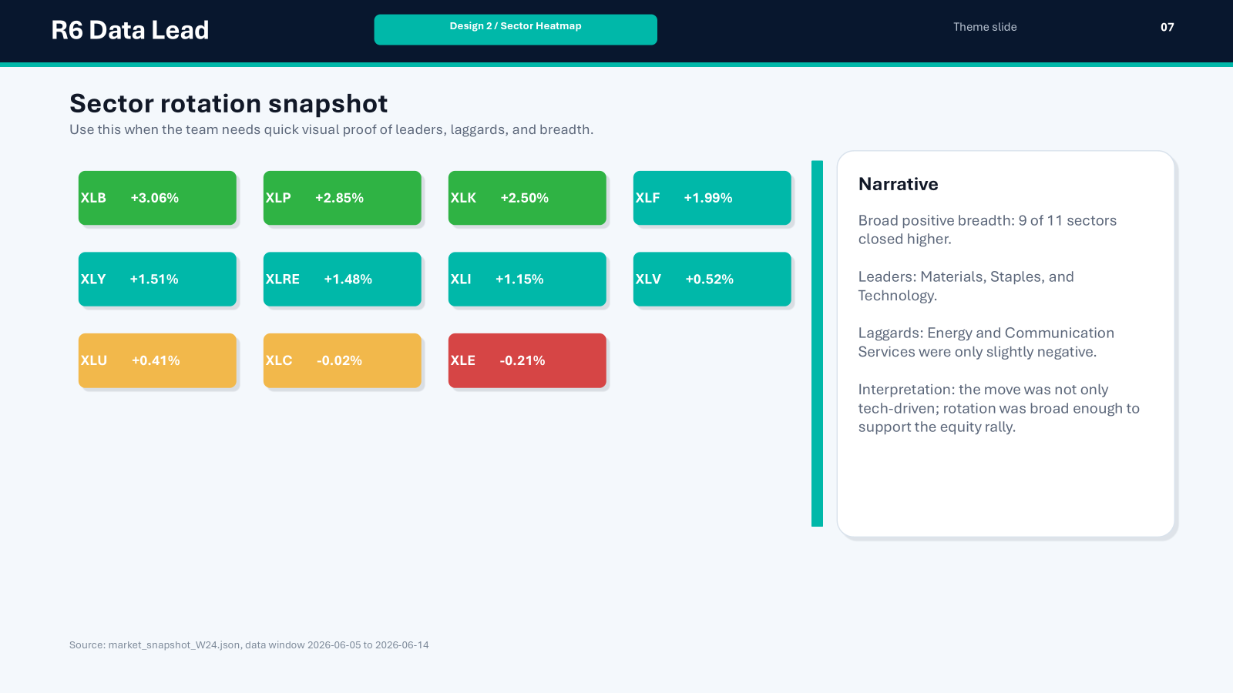

Slide 6
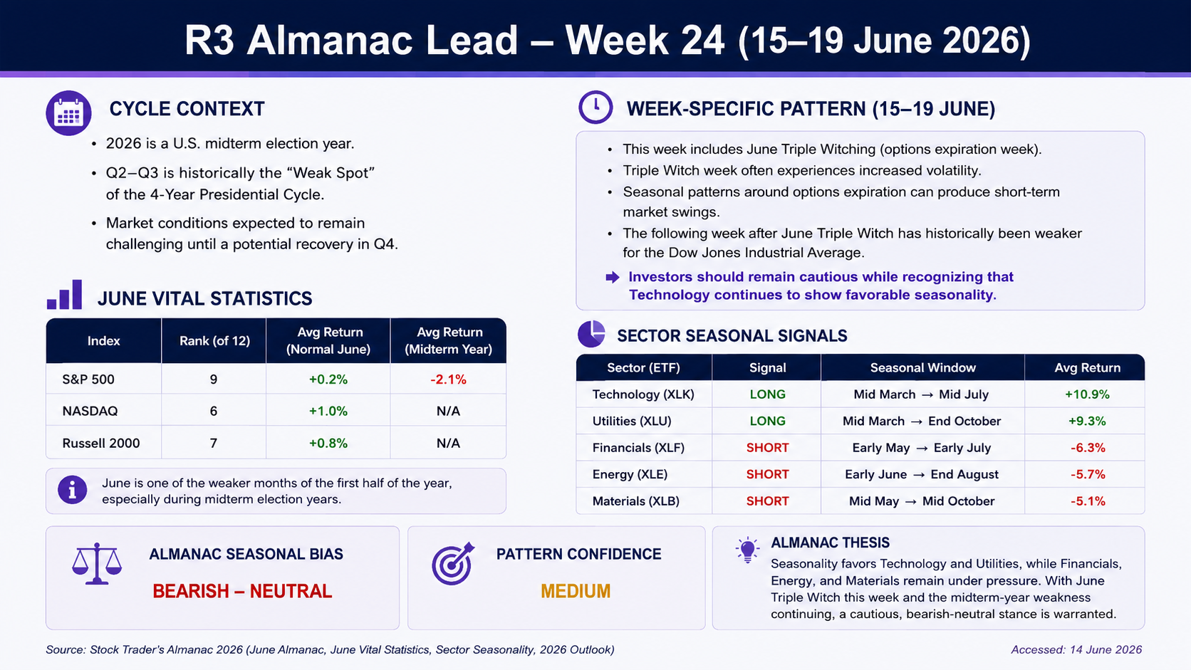
R3
Notes:
P1
This slide shows the Almanac analysis for Week 24.
First, 2026 is a U.S. midterm election year.
June is usually a weak month.
The S&P 500 average June return is only 0.2%, and the midterm year return is -2.1%.
So, the seasonal outlook is weak.
P2
This week is also June Triple Witching week.
It may increase market volatility.
Technology and Utilities have positive seasonal signals.
Financials, Energy, and Materials have negative seasonal signals.
Overall, our Almanac view is Bearish to Neutral with Medium confidence.
Thank you.

Slide 7

R4 Macro Lead
Macro Event Status
Inflation / CPI Result
CONFIRMED
Iran / Geopolitical Risk
UNVERIFIED
Headline CPI: +0.5% MoM (4.2% YoY)
Core PPI: Softer than forecast
Event: U.S.-Iran peace deal looms / Hormuz risk
Impact: WTI Crude crashed 3.23%
US 10Y Yield
CONFIRMED
Week 25 Primary Driver
CONFIRMED
Yield: 4.48%
Impact: Easing pressure on growth/tech valuations
Event: FOMC Meeting (97.4% probability of Rate Hold) & Dot Plot
Notes:
Good morning, everyone. As the R4 Macro Lead, I will walk you through our Week 24 macro environment.On the inflation front, it is confirmed that headline CPI rose 0.5% month-over-month, bringing the year-over-year rate to 4.2%, while Core PPI came in softer than forecast. In the bond market, the US 10-year yield is confirmed at 4.48%, which is currently easing the pressure on growth and tech valuations. Our primary driver for the upcoming week is the confirmed FOMC meeting, where there is a 97.4% probability of a rate hold, meaning market attention will shift entirely to the Fed's Dot Plot. Meanwhile, an unverified but highly impactful event is the looming U.S.-Iran peace deal and associated Hormuz risk. Although unverified, this anticipation has already crashed WTI crude by 3.23%.

Slide 8
R4 Macro Lead
Macro Transmission Chain
Event
FOMC Meeting Expectations & U.S.-Iran Peace Talks
Rates
10Y Treasury yield dropped to 4.48%
Liquidity
DXY declined 0.11%(US dollar Weaken)
VIX fell 6.59% (Risk Appetite UP)
Risk Factors
1. Hawkish shift in the Fed's Dot Plot.
2. Breakdown in Iran negotiations causing an oil price spike.
Equities Impact
XLK (Tech): Primed for rebound after pullback.
XLF (Financials): +2.4% outperformance vs GDPNow.
XLE (Energy): Pressured by crashing crude prices.
Notes:
Moving to our macro transmission chain, we can trace how these catalysts directly impact our equity sectors.The expectations surrounding the FOMC meeting and the U.S.-Iran peace talks have driven the 10-year Treasury yield down to 4.48%. This drop in rates has significantly improved market liquidity, evidenced by the DXY declining 0.11% and the VIX falling 6.59%, signaling that risk appetite is up. For our specific equities:Technology (XLK) is primed for a rebound after a recent pullback, benefiting from these lower yields. Financials (XLF) is showing a +2.4% outperformance, supported by strong GDPNow estimates. However, Energy (XLE) remains pressured by the crashing crude prices. Finally, we must monitor two critical risk factors that could invalidate this setup: a hawkish shift in the Fed's Dot Plot, or a breakdown in the Iran negotiations that could trigger an oil price spike. Thank you. I'll now pass it on to the next segment.

Slide 9
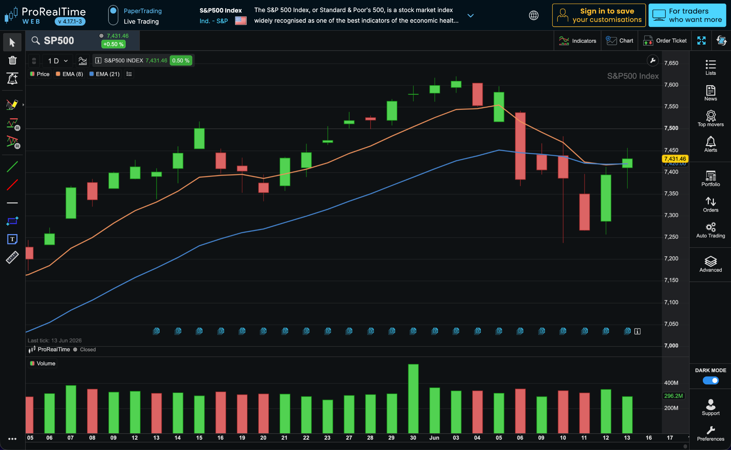
R5 Technical Lead
S&P 500 Chart
Key levels
Current price: 7,431.46
Resistance: 7,450
Support: 7,380
EMA zone: Caution
Invalidation: Close below 7,380
Bias: Bearish-neutral
Resistance: 7,450
Support: 7,380

Slide 10
R8 LLM Operator
Model | Direction | Bias | Confidence | Macro Driver
ChatGPT | Neutral-Bullish | Neutral-Bullish | Medium | Fed Stability + GDP Growth
Claude | Up | Neutral-Bullish | Medium | GDP Growth + Fed Pause
Gemini | Neutral | Neutral | Medium | GDP Growth + Treasury Yields
DeepSeek | Up | Neutral-Cautiously Bullish | Medium | Treasury Yields + GDPNow
AI Consensus Call Direction:
NEUTRAL-BULLISH
Risk Profile
Bias: Neutral-Bullish
Confidence: Medium
Strong Agreement
NDX = Bullish
XLK = Bullish
XLE = Bearish
Highest Uncertainty
IWM
Largest Model Divergence
Mixed Forecasts

Slide 11
R7 Human Score
Human Score Dashboard
Macro / News
+1
Fed stability,
lower yields
Technical
0
Recovery above
EMAs unconfirmed
Almanac
-1
June weakness &
Triple Witch
AI Agreement
0
Similar evidence
used
Wild Card
+1
Technology
leadership
TOTAL SCORE: +1 (NEUTRAL-BULLISH)
Improving macro conditions and Technology leadership support equities,
but June seasonality and Triple Witch volatility continue to limit conviction.
“ Triple Witch Volatility: A period when stock options, index options, and index futures expire on the same day, often causing higher trading volume and larger market price swings. “
Notes:
This week, our Human Score improved from -3 to +1, showing that market conditions have become more supportive compared to last week. The main positives were stable Fed expectations, lower Treasury yields, and stronger GDP growth. Technology also continues to lead the market and remains our strongest bullish factor. However, June is still a historically weak month during Midterm Election Years, so we can't ignore the seasonal risks. We also believe the recent technical recovery needs more time before it can be fully trusted. Taking everything together, we arrived at a Neutral-Bullish outlook.

Slide 12
R7 Human Override
HUMAN OVERRIDE
AI CONSENSUS
• Fed stability
• GDP growth
• Lower yields
• Technology leadership
• Neutral-Bullish
HUMAN ADJUSTMENT
• Triple Witch volatility
• June weakness
• Recovery unconfirmed
• FOMC guidance risk
FINAL VIEW: Technology remains the strongest support, but seasonal headwinds keep the outlook Neutral-Bullish.
“ Triple Witch Volatility: A period when stock options, index options, and index futures expire on the same day, often causing higher trading volume and larger market price swings. “
Notes:
Overall, we agree with the AI consensus that the market outlook is Neutral-Bullish. The AI models correctly highlighted Fed stability, improving growth, lower yields, and Technology leadership as key positives. However, we gave additional weight to factors such as Triple Witch volatility and the seasonal weakness typically seen in June. We also think it's too early to fully confirm the recent recovery in market momentum. Any unexpected hawkish comments from the Fed could quickly change sentiment. Because of these risks, we remain cautiously optimistic rather than fully bullish.

Slide 13
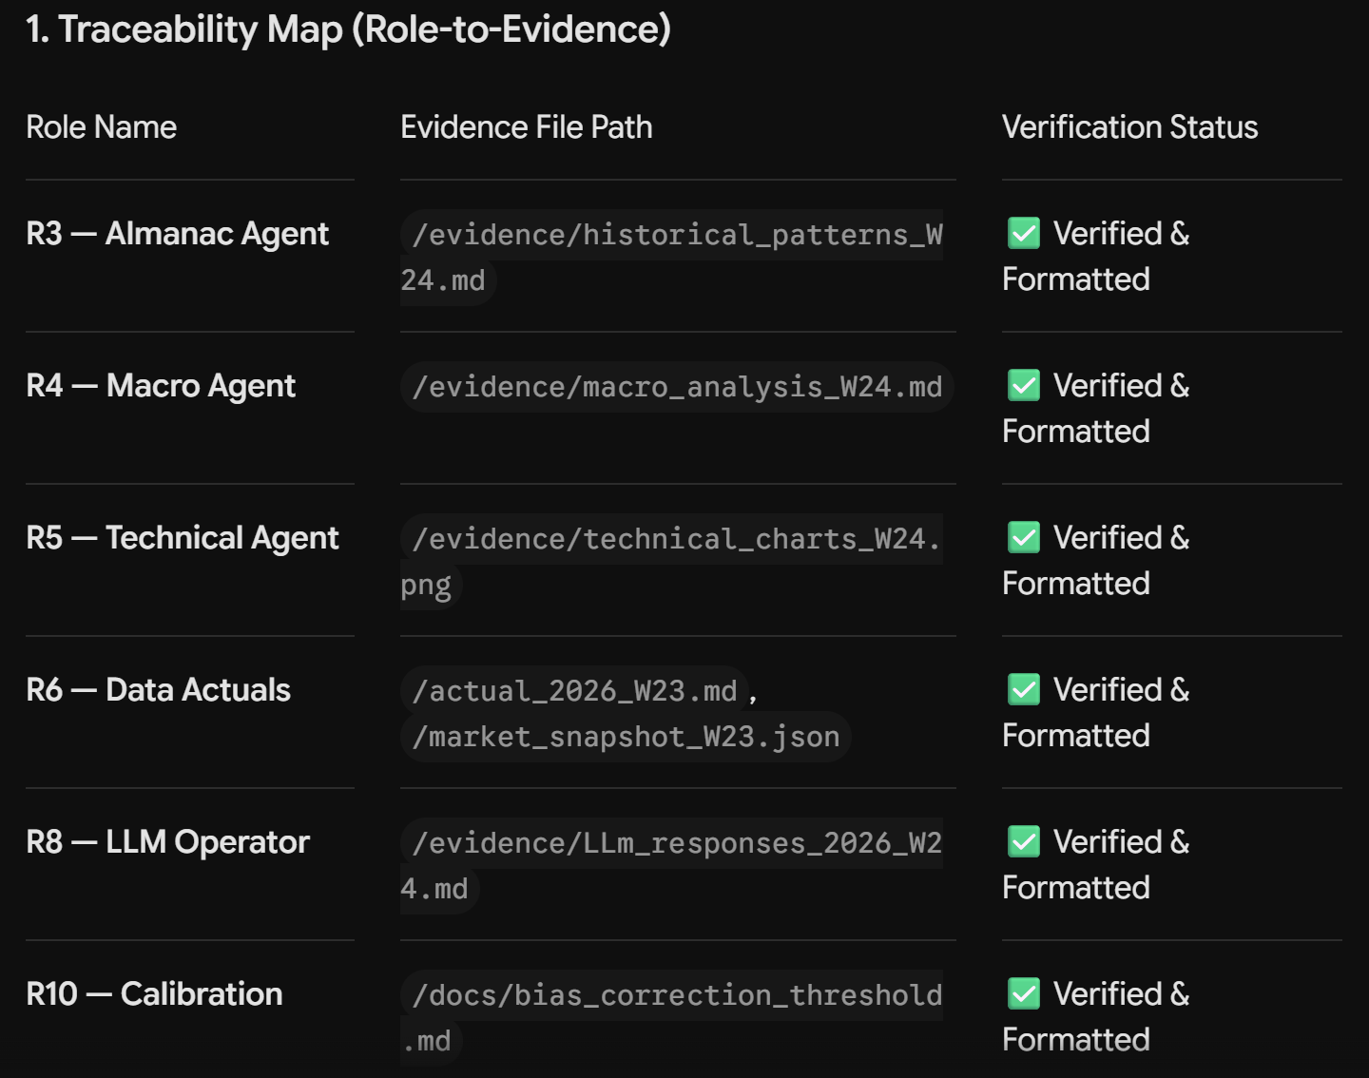
R9 GitHub Lead
Design 3 / Traceability Map
Notes:
As you can see from our repository status, all core deliverables from our team agents have been successfully verified and committed, bringing our project to a total of 281 commits. This includes R6's market actuals, R8's multi-LLM comparison tables, and R10's calibration metrics.
To satisfy our Definition of Done (DoD), I have audited the codebase and ensured that all independent reports are cleanly archived within the /evidence folder.
Finally, the official production release tag, 'Week 3 Submission', has been successfully deployed. I have verified via an external browser session that the release bundle is fully locked, public, and accessible for grading.
The repository is frozen and ready. Thank you."

Slide 14
R10 QA Lead
Design 1 / Calibration Scoreboard
Theme slide
27
Calibration scoreboard
Use this for actual results, hit/miss summary, and scoring logic.
SPX
NDX
IWM
SCORE
HIT
MISS
MISS
1 / 3
Actual: +0.50%
Actual: +0.64%
Actual: +0.87%
Current sprint calibration
Why missed?
The forecast is overly conservative. The human adjustment factor's "June seasonality" deduction is too heavy (-1), offsetting the actual strong momentum from tech stocks. The model failed to identify that tech leaders still possess a >0.5% driving force during periods of volatility.
Why hit?
The market performance exceeded R7's Neutral expectations, with technology leadership being even stronger than AI anticipated, successfully breaking through the seasonal resistance warned of in June.

Slide 15
R10 QA Lead
Design 2 / LLM Horse Race
Theme slide
LLM horse race update
Shows which model was closest to actuals and why.
Rank | Model | Prediction | Actual fit | Learning
1 | Claude | Broad Up | Closest | Successfully identified the impact of Fed stability on the entire market, without being misled by seasonal biases.
2 | ChatGPT | Up | Good | The trend of NDX (+0.64%) was captured, but the strong eruption of IWM was underestimated.
3 | Gemini | Bullish | Good | The direction is correct, but the volatility risk of the Triple Witch mentioned in R7 is being overlooked.
4 | DeepSeek | Sideways | Missed | Risk emphasis error: Over-weighting the "weakness in June" given by humans caused the gains to be completely missed.

Slide 16
R10 QA Lead
Design 3 / Learning Loop
Theme slide
One process change next sprint
Closes the presentation by turning calibration into an operational improvement.
1
Score
Diagnose
Change
Apply
2
3
4
Actual: IWM +0.87% vs. Score: +1. Magnitude Delta: +0.37%.
Identified "Conservative Bias". Human Adjustment (-1) for "June weakness" was over-weighted, neutralizing strong Macro/Tech signals.
Implement "Macro-Priority" weighting rule. Cap Almanac (seasonal) penalties at -0.5 if Macro Score is ≥ +1.
Deploy in R8 Dashboard. Require LLMs to provide counter-arguments for seasonal headwinds.
Recommended change
Dynamic Weighting for Seasonal Factors

