Slide 1
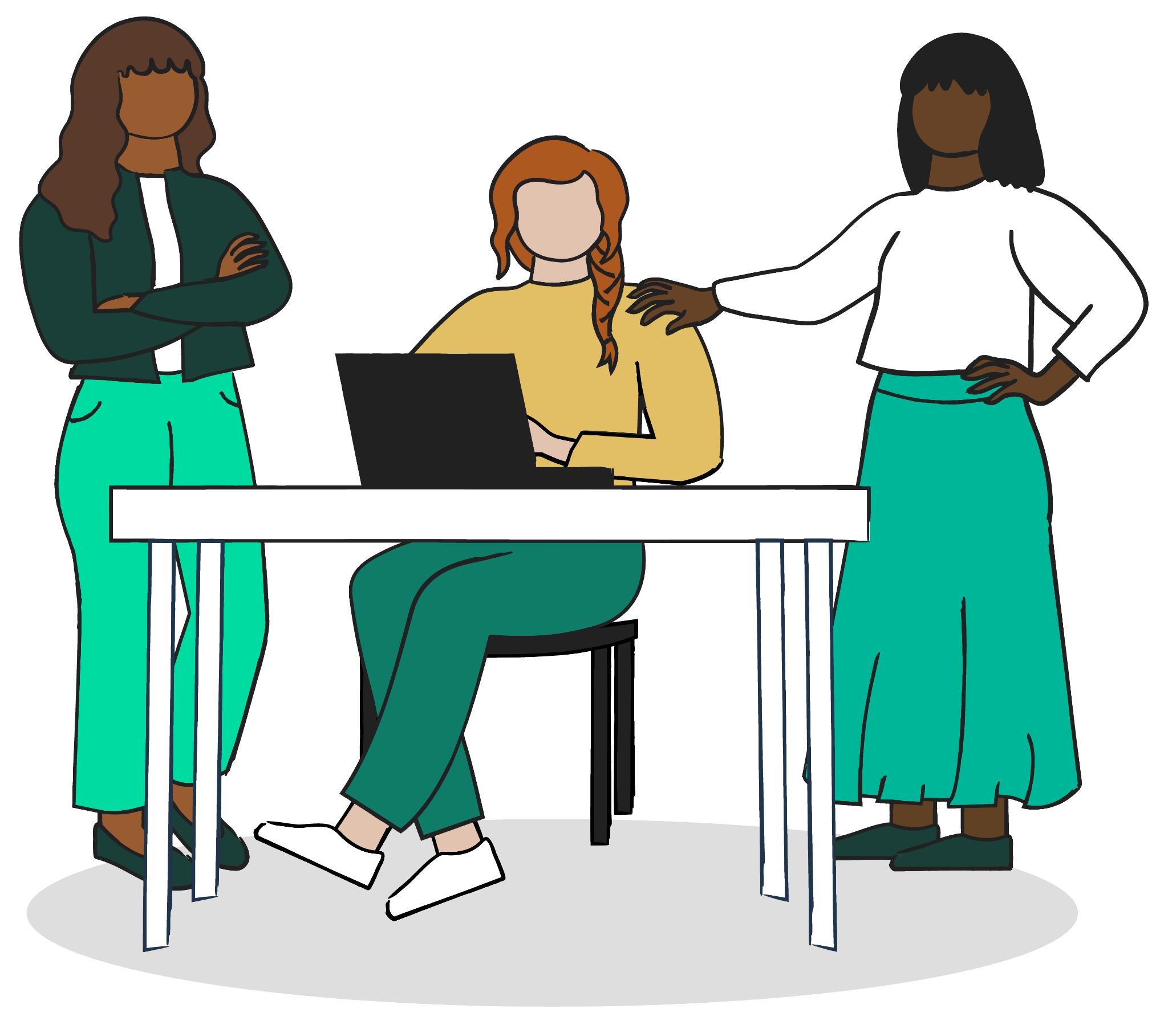

How to Win a Hackathon
Workshop + Team Workbook
Jenna Ritten · @jritten
Notes:
WELCOME (0:00, 1 minute)
Welcome! Today is a 60-minute workshop on how to win a hackathon.
This deck is also your team's workbook. Every slide marked with the gold Workbook tag is a question your team answers.
By the end you'll have a head start on your idea, your plan, and your pitch.

Slide 2
Make Your Team’s Copy
1 Open the workbook link
[ Workbook QR code ]
[ workbook link ]
2 File → Make a copy
3 Name it with your team name
4 Share it with your teammates
5 Fill in every slide marked ✏️ Workbook
One copy per team. Keep it open all hackathon.
@jritten
Notes:
MAKE A COPY (0:01, 2 minutes)
Scan the QR code or open the link, then File > Make a copy. One copy per team; share it with everyone on the team.
Every gold Workbook slide is a question for your team. You won't finish them all today, and that's fine: keep going during the hackathon.
[Add the workbook link and QR code here once the workbook is published.]

Slide 3
Event Info
✏️ Workbook
What | Details
Event
Dates
Location
Tracks / themes
Sponsor tools + credits
What to submit
Where to submit
Deadline
Presentation length
Judging criteria
@jritten
Notes:
EVENT INFO (reference)
Fill this in from the event rules and website. Everything else in the workbook points back here.
The two lines that matter most: what to submit and the deadline. Put the deadline in your phone too.

Slide 4
Today’s 60 Minutes
Time | What we’re doing
0:00 | Welcome + make your copy
0:03 | Who I am + what I do
0:07 | Meet your team
0:10 | Hackathon breakdown
0:12 | Come up with an idea
0:20 | Research the idea
Time | What we’re doing
0:28 | Finalize your idea
0:36 | Determine the MVP + hack it out
0:43 | Pitch deck + demo
0:52 | Submit on time
0:55 | Q&A
@jritten
Notes:
AGENDA (30 seconds)
The flow follows the eight steps of a hackathon. Each step has a few workbook questions.
We'll answer one or two together in the room; the rest are for your team during the event.

Slide 5






Who I Am
Jenna Ritten (she/her)
Chief Developer Advocate & Architect, IBM Research
Founding Executive Director, Compass Detroit
Co-lead, GDG Detroit
Organizer, Michigan DevFest
@jritten · linktr.ee/jritten
@jritten
Notes:
WHO I AM (0:03, 2 minutes)
Turn off notifications. DBC-style intro: name + pronouns, title/company/program, where you're from, something you love, and a quirk.
Title/company: developer advocate at IBM Research; Dev Bootcamp SF grad; came into IBM through IBM's Tech Re-Entry program. Also Compass Detroit, GDG Detroit, and Michigan DevFest.
Something I love: my dog Giselle. Quirk: [your quirk].
Find me everywhere at @jritten or linktr.ee/jritten.

Slide 6
What I Do
Help developers grow
Don’t reinvent the wheel
Build community
My job is to help IBMers become better developers through the InnerSource@IBM ecosystem.
Cross-team collaboration: find what already exists, reuse it, and build on it.
Compass Detroit, GDG Detroit, and Michigan DevFest: spaces where anyone can learn to be technical.
@jritten
Notes:
WHAT I DO (0:05, 2 minutes)
Everyone has the potential to learn and be technical. Community first, collaborative, no such thing as a dumb question.
InnerSource: prevent reinventing the wheel by breaking down silos so anyone can be part of any project. Before you build, ask: does this already exist? Can I contribute to it or start from a template?
That same habit wins hackathons: find what's out there, then build the part nobody has.

Slide 7
Meet Your Team
✏️ Workbook
Take 30 seconds each. One row per teammate (teams of up to 5).
Name + pronouns | Program / role | Skills you bring | Something you love | Quirk
@jritten
Notes:
MEET YOUR TEAM (0:07, 3 minutes)
Hackathons aren't just about coding; they're about the people you build with. Give everyone 30 seconds: name, pronouns, program, something you love, and a quirk.
Add "skills you bring" so you can split up the work later. Fill the table as you go.

Slide 8
Hackathon Breakdown
1 come up with an idea
5 hack it out
2 research the idea
6 build a pitch deck
3 finalize your idea
7 practice the demo
4 determine the MVP
8 submit on time
@jritten
Notes:
HACKATHON BREAKDOWN (0:10, 2 minutes)
Hackathons can feel like a marathon, especially your first. It doesn't have to be overwhelming.
Eight steps: find the idea, research it, lock it in, scope the MVP, build, pitch, demo, and submit on time. The rest of the workbook follows these steps in order.

Slide 9

Step 01
Come Up With an Idea
@jritten
Notes:
STEP 1: COME UP WITH AN IDEA (0:12, 8 minutes for this step)
Start with the theme and a real person, not the tech. Five questions; we'll do the first two together.

Slide 10
What’s the Theme?
✏️ Workbook
Which track or theme are you building for? Say it in your own words.
Our answer:
Type your answer here…
@jritten
Notes:
WHAT'S THE THEME? (1 minute)
Pick your track first; it tells you who judges expect you to help. Write it in your own words, not the sponsor's.
Check the Event Info slide for the tracks.

Slide 11
Who’s the User?
✏️ Workbook
Name one real person or role. What does their day look like? What frustrates them?
Our answer:
Type your answer here…
@jritten
Notes:
WHO'S THE USER? (2 minutes)
Be specific: "a first-year student who commutes by bus," not "students." A real person makes every later answer easier.
Do this one together in the room now.

Slide 12
Why Does This Matter?
✏️ Workbook
What happens if nobody solves this? Who is affected, and how often?
Our answer:
Type your answer here…
@jritten
Notes:
WHY DOES THIS MATTER? (1 minute)
This becomes the first 20 seconds of your pitch. Think about scale and frequency: how many people, how often.

Slide 13
Why Do I Care?
✏️ Workbook
Why does your team care about this problem? Judges only get as excited as you are.
Our answer:
Type your answer here…
@jritten
Notes:
WHY DO I CARE? (1 minute)
Personal connection is the most memorable part of any pitch. If someone on the team lived this problem, that's your opener.

Slide 14
Problem Statement
✏️ Workbook
Fill in the blanks: “[User] struggles to [task] because [reason], which costs them [impact].”
Our answer:
Type your answer here…
@jritten
Notes:
PROBLEM STATEMENT (2 minutes)
One sentence that pulls the last four answers together. Your submission and your pitch both start here.
Example: "Commuting students struggle to catch the right bus because they can't tell when it's full, which costs them late arrivals to class.

Slide 15

Step 02
Research the Idea
@jritten
Notes:
STEP 2: RESEARCH THE IDEA (0:20, 8 minutes for this step)
Before you build, find out how big the problem is and what already exists. Judges will ask.

Slide 16
What Is The Impact?
✏️ Workbook
Find two data points that show how big this problem is. Always note the source.
Data point | Source (link)
@jritten
Notes:
WHAT IS THE IMPACT? (2 minutes)
Two numbers is the sweet spot for a pitch: one for scale, one for cost or pain. Use the dataset links at the end of the deck.
Always keep the source; judges notice.

Slide 17
What Solutions Already Exist?
✏️ Workbook
List apps, tools, or services people use today. Search before you build.
Existing solution | What it does | Link
@jritten
Notes:
WHAT SOLUTIONS ALREADY EXIST? (2 minutes)
Something almost always exists. That's good news: it proves the problem is real and shows you where the gaps are.

Slide 18
Where Are They Failing?
✏️ Workbook
Where do the existing solutions fall short for your user? Cost, access, speed, trust, language?
Our answer:
Type your answer here…
@jritten
Notes:
WHERE ARE THEY FAILING? (1 minute)
The gap you find here is your opportunity. Tie it back to the specific user you named.

Slide 19
Do It Better.
✏️ Workbook
In one sentence: how is your solution better for your user?
Our answer:
Type your answer here…
@jritten
Notes:
DO IT BETTER (1 minute)
This one sentence is your value proposition. You'll reuse it in the pitch, the submission, and the video.

Slide 20

Design for AI
Tech is impressive. Tech that fits real human needs is impactful.
Keep the user in mind: who are you building for, and what problem are you solving?
AI brings responsibility: think about bias and how people will interact with it.
ibm.com/design/ai/team-essentials
@jritten
Notes:
DESIGN FOR AI (2 minutes)
Design thinking keeps the user at the center. With AI, add ethics: where could bias come in, and how will people interact with it?
Take time to be thoughtful here; this is what separates good ideas from great ones. The next three slides are the questions. IBM's Design for AI team essentials is linked on the resources slide.

Slide 21
How Does Your AI Impact Users?
✏️ Workbook
What will your AI do for users, and what could go wrong for them if it gets something wrong?
Our answer:
Type your answer here…
@jritten
Notes:
HOW DOES YOUR AI IMPACT USERS? (during the hackathon)
Think about both sides: the benefit, and the harm of a wrong answer. Skip this and the next two if you're not using AI.

Slide 22
What Biases Might Come In?
✏️ Workbook
Think about your data, your model, and who is missing from both.
Our answer:
Type your answer here…
@jritten
Notes:
WHAT BIASES MIGHT BE INTRODUCED? (during the hackathon)
Bias usually comes from the data. Who is under-represented? Who did you not test with?

Slide 23
How Will You Reduce Bias?
✏️ Workbook
What will you do about it? Test with different users, add human review, show sources, let users correct it.
Our answer:
Type your answer here…
@jritten
Notes:
HOW CAN YOU MITIGATE THESE BIASES? (during the hackathon)
Even one concrete step is a strong answer for judges. Mention it in the pitch.

Slide 24
Step 03
Finalize Your Idea
@jritten
Notes:
STEP 3: FINALIZE YOUR IDEA (0:28, 8 minutes for this step)
You should have a clear answer to each of these questions before you start building.

Slide 25
What’s the Business Value?
✏️ Workbook
Who would pay for, fund, or adopt this, and why?
Our answer:
Type your answer here…
@jritten
Notes:
WHAT'S THE BUSINESS VALUE? (1 minute)
Business value doesn't have to mean profit. Adoption by a school, city, or nonprofit counts.

Slide 26
What’s the Impact?
✏️ Workbook
If this works, what changes for your user? How would you measure it?
Our answer:
Type your answer here…
@jritten
Notes:
WHAT'S THE IMPACT? (1 minute)
Earlier you measured the size of the problem. Now: what changes if your solution works? Pick one thing you could measure.

Slide 27
Is It Realistic?
✏️ Workbook
Can your team build a working version in the time you have, with the skills and tools you have?
Our answer:
Type your answer here…
@jritten
Notes:
IS IT REALISTIC? (1 minute)
Did you factor in the time and resources you actually have? If not, shrink the idea now, not at 3 a.m.

Slide 28
Did You Innovate?
✏️ Workbook
What is new here? What does your solution do that others don’t?
Our answer:
Type your answer here…
@jritten
Notes:
DID YOU INNOVATE? (1 minute)
How strong is your awareness of how others are solving the same problem? Innovation can be a new user, a new combination, or a better experience.

Slide 29
Size Your Target Market
✏️ Workbook
Market Valuation (1 of 2): who is your market, about how many people or organizations, and where are they?
Our answer:
Type your answer here…
@jritten
Notes:
MARKET VALUATION, PART 1 (1 minute)
You have a great idea; what's the potential out there? Who needs this, and how many of them? A rough, sourced estimate beats no estimate.

Slide 30
Revenue Potential and Scale
✏️ Workbook
Market Valuation (2 of 2): what would people pay or save? How would this grow beyond your first users?
Our answer:
Type your answer here…
@jritten
Notes:
MARKET VALUATION, PART 2 (1 minute)
What are they willing to pay, and what makes this sustainable? Show you've thought beyond the weekend.

Slide 31
Top Competitors
✏️ Workbook
Competitive Analysis (1 of 2): competitors aren’t bad. They show you where to go further.
Competitor | Key features | Where it falls short
@jritten
Notes:
COMPETITIVE ANALYSIS, PART 1 (1 minute)
Every great idea has competitors. Reuse what you found in Research. Ask: what's missing in the current solutions?

Slide 32
Gaps You Can Fill
✏️ Workbook
Competitive Analysis (2 of 2): what is your edge? Why would a user switch to you?
Our answer:
Type your answer here…
@jritten
Notes:
COMPETITIVE ANALYSIS, PART 2 (1 minute)
This is where you show why your idea has a unique edge. One or two gaps is plenty.

Slide 33
Choose a Monetization Strategy
✏️ Workbook
Monetization (1 of 2): freemium, subscription, ads, one-time purchase, licensing, grants? Pick what fits your users.
Our answer:
Type your answer here…
@jritten
Notes:
MONETIZATION, PART 1 (1 minute)
How does it make money or sustain itself? Whatever you choose, it should fit what your users need and can afford. It tells judges you're building something sustainable.

Slide 34
Costs and Revenue
✏️ Workbook
Monetization (2 of 2): rough numbers are fine. List what it costs to run and what it could bring in.
Item | Cost or revenue? | Estimate
@jritten
Notes:
MONETIZATION, PART 2 (during the hackathon)
Think hosting, AI usage, and data costs vs. revenue or savings. Sponsor credits cover a lot of the weekend's costs.

Slide 35

Step 04
Determine the MVP
@jritten
Notes:
STEP 4: DETERMINE THE MVP (0:36, 7 minutes with Hack It Out)
Why build from scratch? If someone already solved 70% of the problem, use that to solve the next 30% in a new way.

Slide 36
Which AI Frameworks?
✏️ Workbook
Models, APIs, or frameworks you might use. Check the sponsor tools on the Event Info slide and the AI links at the end.
Our answer:
Type your answer here…
@jritten
Notes:
AI FRAMEWORKS (1 minute)
AI and open source aren't buzzwords at a hackathon; they're leverage. Start with sponsor tools since they come with credits and often a prize.

Slide 37
Which Open-Source Tools?
✏️ Workbook
Libraries, templates, datasets, or starter projects you can build on.
Our answer:
Type your answer here…
@jritten
Notes:
OPEN-SOURCE TOOLS (1 minute)
Check the license and the event rules on outside code. Credit what you use in your README.

Slide 38
What’s the Scope?
✏️ Workbook
Your MVP is the smallest thing that proves your idea works. Everything else goes on the later list.
In the MVP (this weekend) | Later (document it, don’t build it)
@jritten
Notes:
WHAT'S THE SCOPE? (2 minutes)
One core flow, done well, beats five half-built features. The "later" column becomes your next-steps slide.

Slide 39
KISS Method
Keep it simple.
1 skip the login / auth
4 add ≤ 1 extra feature
2 focus on the main function
5 document future features
3 build out the main view
6 solving the problem, or a symptom?
@jritten
Notes:
KISS METHOD (1 minute)
Skip login and auth; judges don't care. Build the main function and main view, add at most one extra feature, and write the rest down as future features.
Last check: are you solving the problem, or just a symptom?

Slide 40
Step 05
Hack It Out
@jritten
Notes:
STEP 5: HACK IT OUT
Split the work early, plan the time, and know the rules before you write code.

Slide 41
Team Roles
✏️ Workbook
Delegate the work. One name per row; people can hold more than one role.
Role | What they own | Who
Team lead | Decisions, timeline, and the final submission
Builder(s) | Tech stack, repo setup, APIs, and the working MVP
Design / UX | The main view and the user flow the demo walks through
Research + pitch lead | Problem research, impact data, pitch deck, and presenting
@jritten
Notes:
TEAM ROLES (2 minutes)
Delegate roles, not just tasks. Name a team lead first; they own the timeline and the submission.
Builders own the repo and MVP, design/UX owns the flow, and the research + pitch lead owns the story. People can hold more than one role on small teams.

Slide 42
Build Plan
✏️ Workbook
Fill in real times from the event schedule. Protect the last hours for the pitch and the video.
Checkpoint | Time | Owner | Done?
Idea locked (roles assigned, repo set up) |  |  | ☐
MVP working end to end |  |  | ☐
Feature freeze: stop adding, start polishing |  |  | ☐
Demo video recorded |  |  | ☐
Submitted | (see Event Info) |  | ☐
@jritten
Notes:
BUILD PLAN (2 minutes)
Work backwards from the deadline. The biggest mistake is building until the last minute with no pitch and no video.
Feature freeze is a real line: after it you only fix bugs and polish.

Slide 43
Tech and Data Rules
✏️ Workbook
Check the event rules before you write code. Answer each one.
Rule | ✓ | Our notes
Use only data we’re allowed to use (source + license) | ☐
No personal information in our data or demo | ☐
No API keys in our repo (use environment variables) | ☐
Note which AI tools we used, and for what | ☐
@jritten
Notes:
TECH AND DATA RULES (1 minute)
Four rules that keep you out of trouble: only data you're allowed to use, no personal information, no API keys in the repo, and be upfront about which AI tools you used.
Put keys in environment variables or a .env file listed in .gitignore. Also check the event rules for anything extra, like code written before the event.

Slide 44
Step 06
Build a Pitch Deck
@jritten
Notes:
STEP 6: BUILD A PITCH DECK (0:43, 9 minutes with the demo)
A solid pitch deck tells your story with clarity and confidence: team, problem, impact, solution, demo. Judges need to see the problem it solves and why that matters.

Slide 45
Pitch Breakdown
1 introduce the team
6 problem it solves
2 tell a story
7 potential impact
3 problem statement
8 demo
4 2 data points of impact
9 next steps
5 introduce the solution
@jritten
Notes:
PITCH BREAKDOWN (2 minutes)
This is the order of your slides. You already wrote most of it: problem statement, impact data, and "do it better."
Pitch deck outline template: https://ibm.biz/pitch-deck-outline (QR on the resources slide).

Slide 46
Be Passionate
✏️ Workbook
Finish the sentence: “The problem we are solving is important to us because…”
Our answer:
Type your answer here…
@jritten
Notes:
BE PASSIONATE (1 minute)
Why did you join this hackathon? Why this problem? Judges will only be as excited about your solution as you are.

Slide 47
Tell a Story
✏️ Workbook
Your pitch is a story. One line for each part.
Story beat | Our line
Hero: who is your user, and why are they here?
Problem: the crisis
Solution: the resolution
Demo: the adventure
Next steps: look into the future
@jritten
Notes:
TELL A STORY (1 minute)
Think Bilbo Baggins or Luke Skywalker: a hero, a crisis, a resolution, an adventure, and a look ahead.
Your user is the hero, not your team.

Slide 48
Do Your Research
Who’s your market? How big is it, and where?
Who are your competitors?
How are you different? What’s your competitive advantage?
You already answered these in Step 3. Pull them into your deck.
@jritten
Notes:
DO YOUR RESEARCH (30 seconds)
Who's your market, how big is it, and where (region, platform)? Who are your competitors, how are you different, and what's your advantage?
These come straight from the Finalize Your Idea slides.

Slide 49

Start Early
Write ideas down as you ideate and build.
Keep iterating on your pitch and value proposition.
Decide early who is going to pitch.
@jritten
Notes:
START EARLY (30 seconds)
Don't leave the deck for the last hour. Start it right after you lock the idea and update it as you build.

Slide 50
Don’t Memorize, Write It Down
Bullet points, not a script.
Know your first and last line cold.
Practice out loud, then trust your notes.
@jritten
Notes:
DON'T MEMORIZE, WRITE IT DOWN (30 seconds)
Memorized pitches sound robotic and fall apart when you lose your place. Talking points keep you natural.

Slide 51
Step 07
Practice the Demo
@jritten
Notes:
STEP 7: PRACTICE THE DEMO
It's not enough to build something great if it doesn't come across in the demo. Practice, get feedback, and anticipate questions. Demos don't have to be perfect; they have to be effective.

Slide 52
Demo Breakdown
1 one person presents
4 practice it out loud
2 one person demos
5 demo to other teams
3 everyone should test
6 apply their feedback
@jritten
Notes:
DEMO BREAKDOWN (1 minute)
Split presenting and demoing so nobody is talking and typing at once. Everyone tests, practice out loud, demo to another team, and apply their feedback.

Slide 53
60-Second Demo Video Script
✏️ Workbook
Record this before the final morning so a flaky demo can’t sink you.
Time | Beat | What we show and say
0:00–0:10 | User | Who this is for
0:10–0:20 | Problem | What gets in their way
0:20–0:50 | Three clicks through the solution | Click 1, click 2, click 3
0:50–1:00 | Impact | What changes for them
@jritten
Notes:
60-SECOND DEMO VIDEO SCRIPT (2 minutes)
Many hackathons ask for a short demo video. Even if yours doesn't, a recording is your backup if the live demo breaks.
Structure: user, problem, three clicks through the solution, impact. Show the product, not your slides; one screen recording with voiceover is enough.

Slide 54
Everyone Should Test the Demo
Every teammate clicks through the full demo.
Test on the laptop you’ll present from.
Test on the event Wi-Fi, or plan to run offline.
@jritten
Notes:
EVERYONE SHOULD TEST THE DEMO (30 seconds)
The person who built a feature is the worst tester of it. Fresh eyes find the bugs judges will hit.

Slide 55
Practice With Another Team
Trade a 5-minute run-through with a nearby team.
Ask: what was confusing? What would you ask?
Time it. Every time.
@jritten
Notes:
PRACTICE WITH ANOTHER TEAM (30 seconds)
Another team is the closest thing to a judge you have. Offer to return the favor.

Slide 56
Apply Their Feedback
✏️ Workbook
Write down what you heard, then decide what you’ll change.
Feedback we got | What we’ll change | Owner
@jritten
Notes:
APPLY THEIR FEEDBACK (1 minute)
You won't fix everything. Pick the one or two changes that make the story clearer.

Slide 57
Anticipate Questions
✏️ Workbook
Prepare short answers. Add questions you think your judges will ask.
Question | Our answer
What did you build your app on?
How are you different from what’s already out there?
How do you plan to make money or sustain it?
@jritten
Notes:
ANTICIPATE QUESTIONS (1 minute)
Expect: what did you build it on, how are you different, and my personal favorite, how will you monetize?
Before moving on, ask the room: what's the most important rule of any hackathon that always gets broken? (Submit on time.)

Slide 58
When Things Go Wrong
Only your team knows “that wasn’t supposed to happen.”
Keep screenshots and a recorded demo on hand.
If it breaks, keep pitching. Talk through what should happen.
People love humility and tenacity.
@jritten
Notes:
WHEN THINGS GO WRONG (1 minute)
Code breaks, Wi-Fi drops, a teammate leaves early. It happens to the best of us. Our advice: just keep pitching.
Have click-by-click screenshots and a 1-minute video of the app working. If it goes down on stage, pitch as if it still works; you can even keep it light and remind people you built it in a weekend.

Slide 59
Step 08
Submit On Time!
@jritten
Notes:
STEP 8: SUBMIT ON TIME (0:52, 3 minutes)
The most important rule of any hackathon, and the one that always gets broken. Sometimes the best ideas don't win; the best-presented ideas do. Check the deadline on the Event Info slide.

Slide 60
Judging Criteria Map
✏️ Workbook
Copy each criterion from the rules. Teams who design toward the rubric win more often.
Criterion | What judges want | How our project shows it
@jritten
Notes:
JUDGING CRITERIA MAP (1 minute)
Judges score against a rubric. If a criterion isn't clearly visible in your pitch or demo, you get no points for it.
Common criteria: impact, technical difficulty, use of sponsor tech, design/UX, and presentation.

Slide 61
Submission Checklist
✏️ Workbook
Check off each item. The team lead submits; everyone double-checks.
✓ | Item | Owner
☐ | Repo URL (public, with README)
☐ | Demo video URL
☐ | Problem and solution statements
☐ | Technologies used (including AI tools)
☐ | Submitted before the deadline (see Event Info)
@jritten
Notes:
SUBMISSION CHECKLIST (1 minute)
Submit early, then edit. Most platforms let you update until the deadline, but not after.

Slide 62
You Can Do It!
Let’s stay connected:
linktr.ee/jritten
youtube: bit.ly/jritten_youtube
linkedin.com/in/jritten
@jritten
Notes:
YOU CAN DO IT! (30 seconds)
Hackathons are as much about learning and connecting as building. Don't worry about perfection; embrace the chaos and make the most of it.
Stay connected: https://linktr.ee/jritten · https://bit.ly/jritten_youtube · https://www.linkedin.com/in/jritten

Slide 63
Q & A
Resources on the next three slides
@jritten
Notes:
Q&A (0:55, 5 minutes)
Take questions. Remind teams to make their copy of the workbook and keep filling it in.
Resources follow: datasets, AI tools, and design + pitch + developer links.

Slide 64
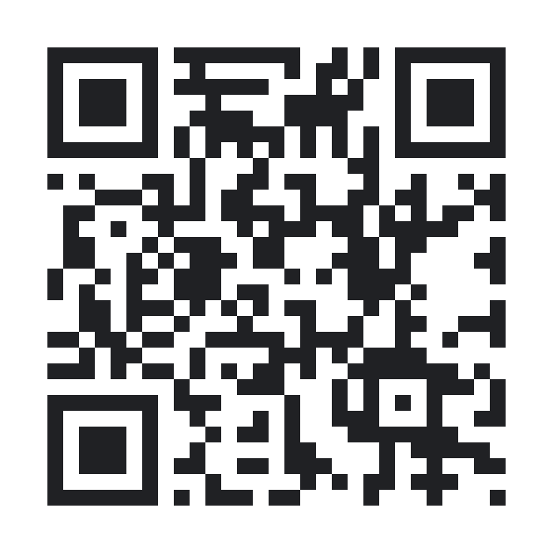
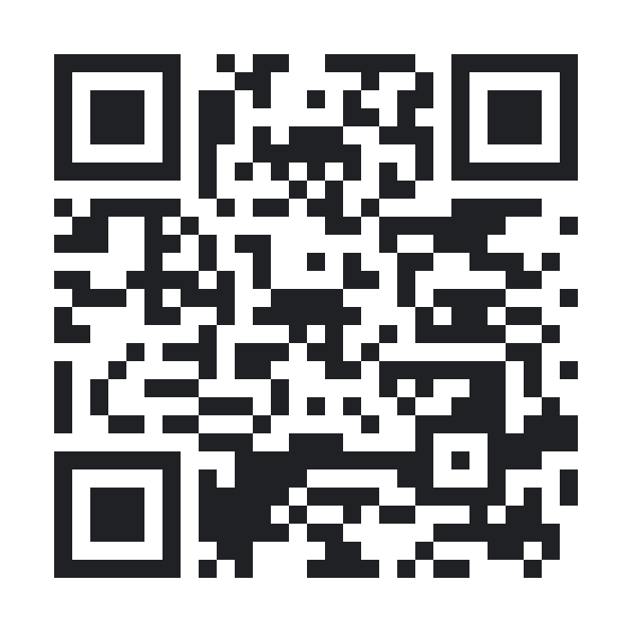
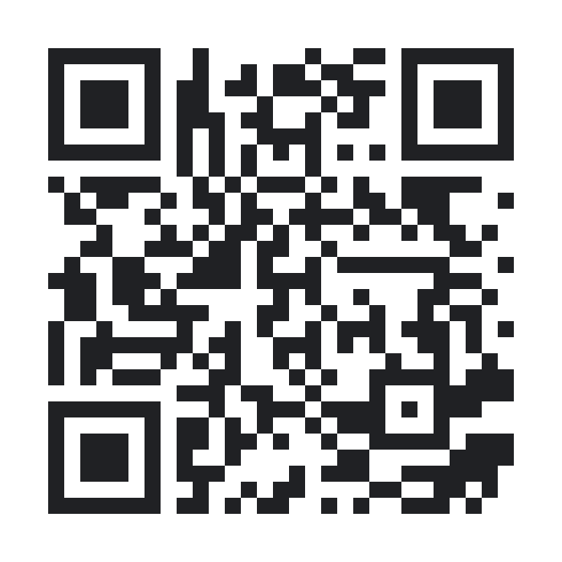
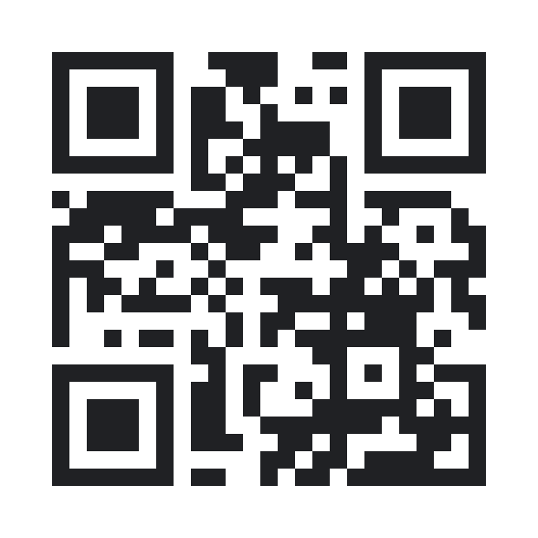
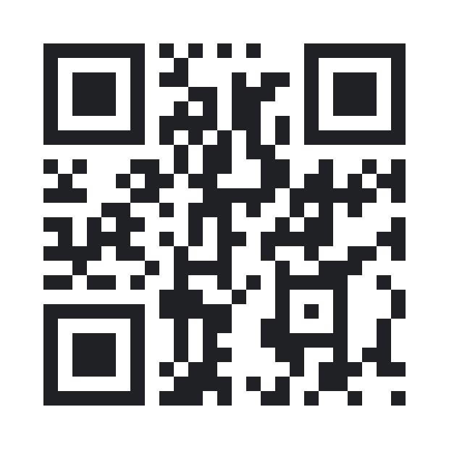
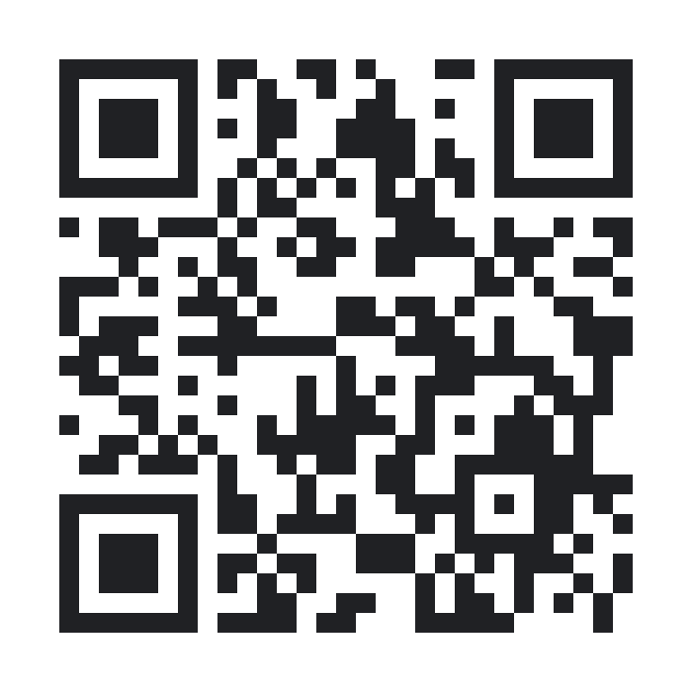
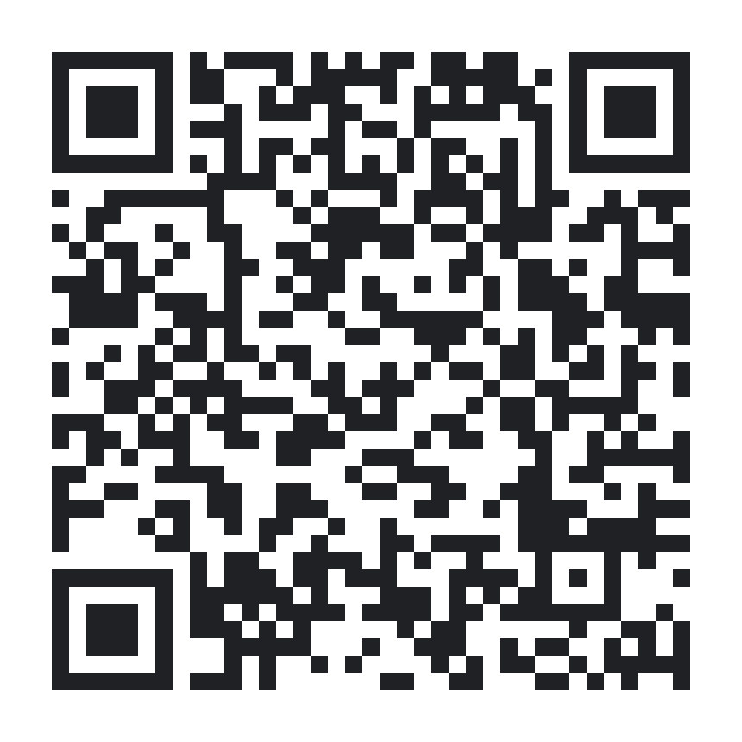
Resources: Public Datasets
Kaggle
Hugging Face Datasets
Google Dataset Search
Data.gov
kaggle.com/datasets
huggingface.co/datasets
datasetsearch.research.google.com
data.gov
Michigan Open Data
GitHub datasets
Free datasets guide
data.michigan.gov
github.com/search?q=datasets
atlassian.com/data/business-intelligence/free-datasets
@jritten
Notes:
RESOURCES: PUBLIC DATASETS
Kaggle: https://www.kaggle.com/datasets
Hugging Face Datasets: https://huggingface.co/datasets
Google Dataset Search: https://datasetsearch.research.google.com
Data.gov: https://data.gov
Michigan Open Data: https://data.michigan.gov
GitHub datasets: https://github.com/search?q=datasets
Atlassian free datasets guide: https://www.atlassian.com/data/business-intelligence/free-datasets

Slide 65
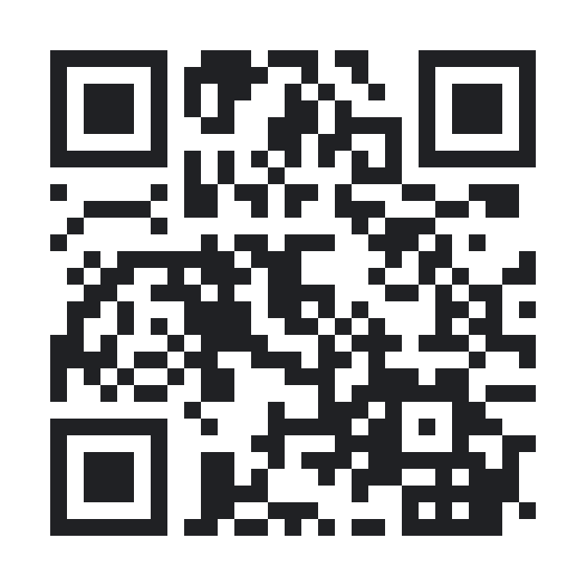
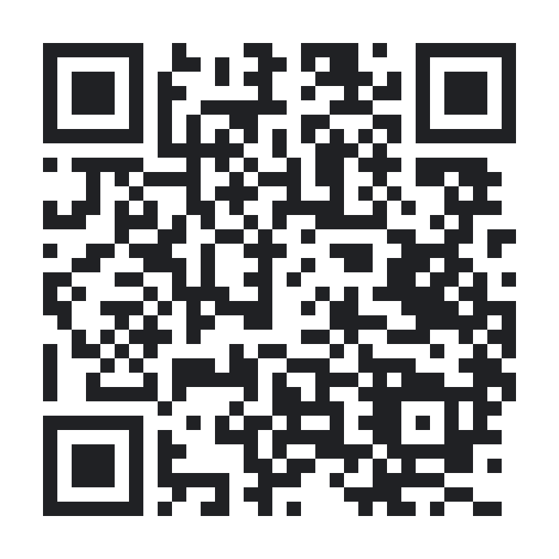
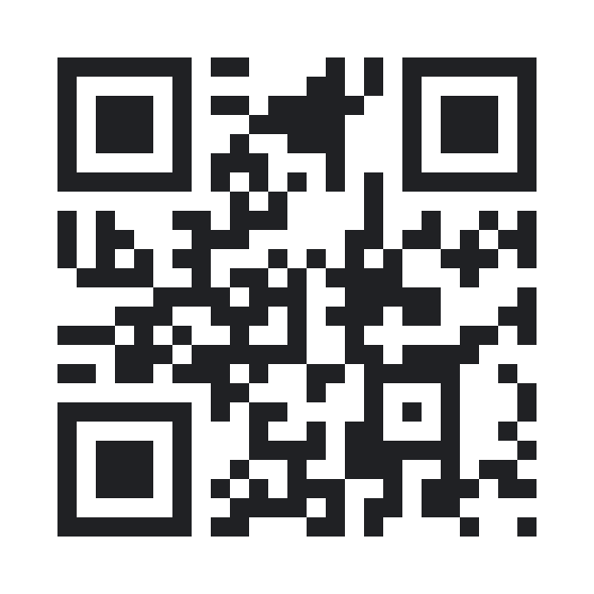
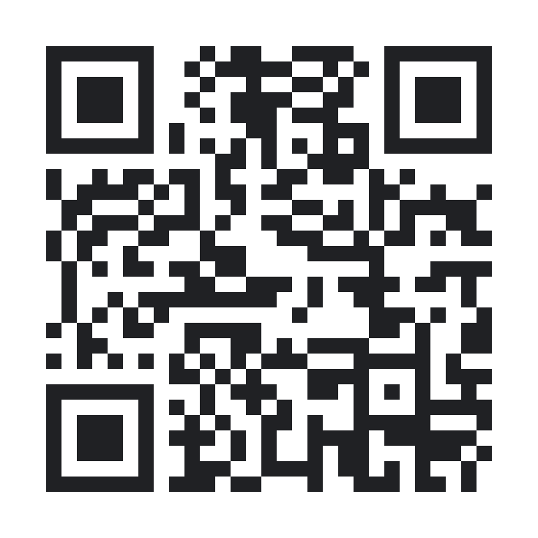
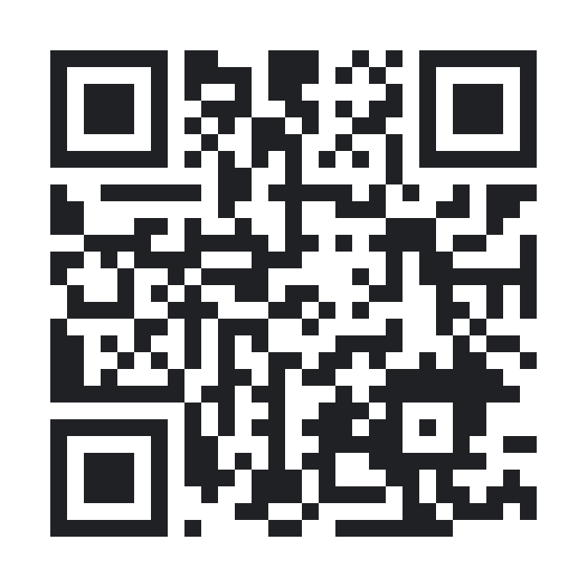
Resources: AI Models and Tools
IBM Granite
IBM watsonx
Google AI (Gemini)
Google Vertex AI
Hugging Face Models
ibm.com/granite
ibm.com/watsonx
ai.google.dev
cloud.google.com/vertex-ai
huggingface.co/models
@jritten
Notes:
RESOURCES: AI MODELS AND TOOLS
IBM Granite (open models): https://www.ibm.com/granite
IBM watsonx: https://www.ibm.com/watsonx
Google AI for Developers (Gemini API): https://ai.google.dev
Google Vertex AI: https://cloud.google.com/vertex-ai
Hugging Face Models: https://huggingface.co/models

Slide 66
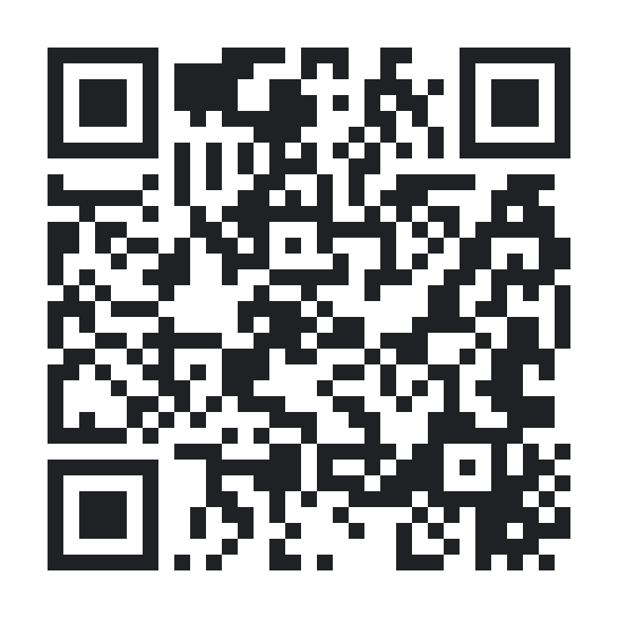
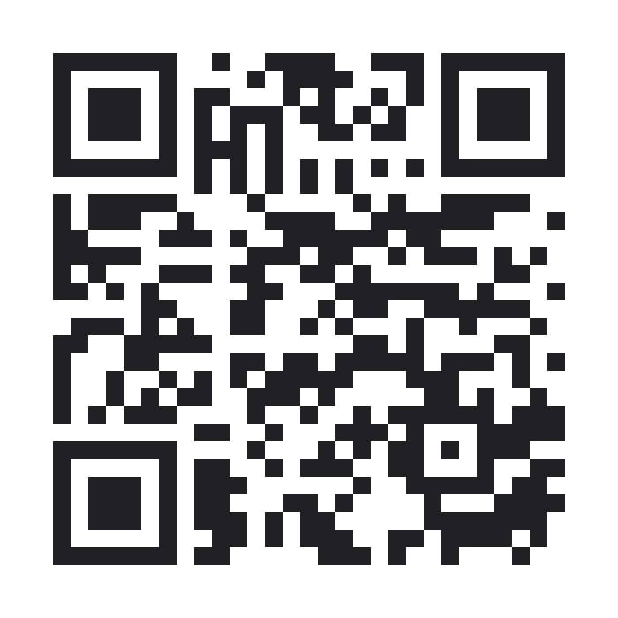
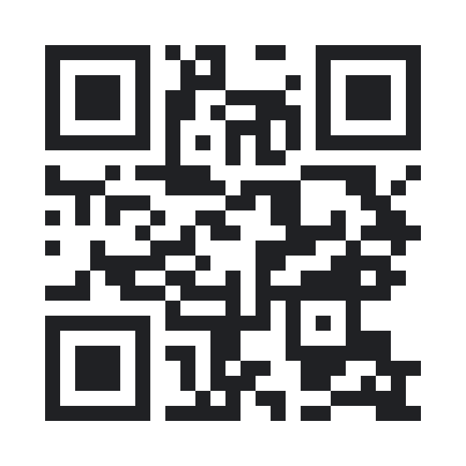
Resources: Design, Pitch, Dev
IBM Design for AI
Pitch deck outline
IBM Developer
ibm.com/design/ai/team-essentials
ibm.biz/pitch-deck-outline
developer.ibm.com
@jritten
Notes:
RESOURCES: DESIGN, PITCH, AND DEVELOPER
IBM Design for AI team essentials: https://www.ibm.com/design/ai/team-essentials
Pitch deck outline: https://ibm.biz/pitch-deck-outline
IBM Developer: https://developer.ibm.com

