Slide 1

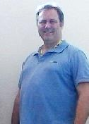
COM504 Systems Analysis and Design Week 2
Dr Craig Gallen Eng.D MIEE, C.Eng
Craig Gallen
Email : craig.gallen@solent.ac.uk
Desk : JM506 ( Mondays / Tuesdays)
Mobile: +44 (0) 7789 938012
Craig

Slide 2
Recap Week 1
GIT
github – fork
git clone
git merge
https://github.com/gallenc/solent2Public/blob/master/README.md
Do all of your work /myPracticeCourseWork
Maven
https://github.com/gallenc/solent2Public/tree/master/maven-setup
downloading and configuring maven on class PCs
maven automatically downloads and includes jars on java class path
mvn archetype:generate – can generate prototype projects
mvn clean install – clean, comple, test and package your project as a jar
<your home>/.m2 – where mvn downloads your maven repository and puts your generated artefacts
Java command line
java and javac
javadoc
jar
including jar’s on java class path
https://github.com/gallenc/solent2Public/tree/master/week1/command-line-exercise
Log4J
Logging framework used widely to debug code ( rather than System.out.println() )
Junit testing
tests which can be automatically run as part of your build by maven
Netbeans
importing a maven project

Slide 3
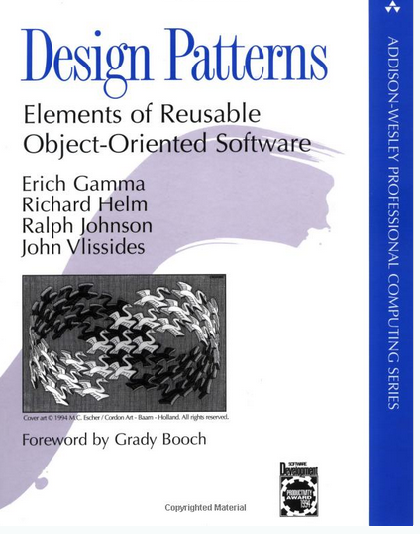
Week 2
Gang of Four
Design patterns : elements of reusable object-oriented software Gamma, Erich.; Helm, Richard.; Johnson, Ralph.; Vlissides, John 1994
https://catalogue.solent.ac.uk/discovery/fulldisplay?docid=alma990043660930204796&context=L&vid=44SSU_INST:VU1
Creational Object Design Patterns
Factory Pattern
Prototypes, Singletons
Structural Object Design Patterns
Façade Pattern
Dependency Injection
Why it is a good idea
Using the Spring Framework
Examples: See https://github.com/gallenc/solent2Public/tree/master/week2

Slide 4
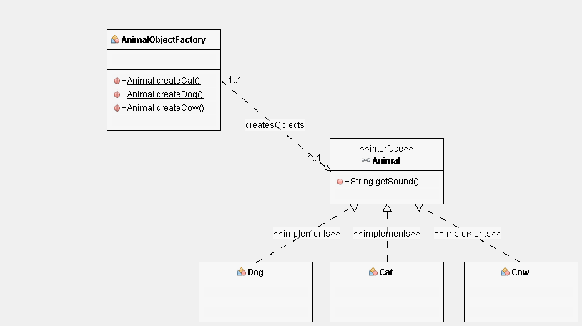
ObjectFactory
The abstract factory pattern
Is a design pattern that allows for the creation of groups of related objects without the requirement of specifying the exact concrete classes that will be used. One of a number of factory classes generates the object sets.
Creating Animal Prototypes

Slide 5
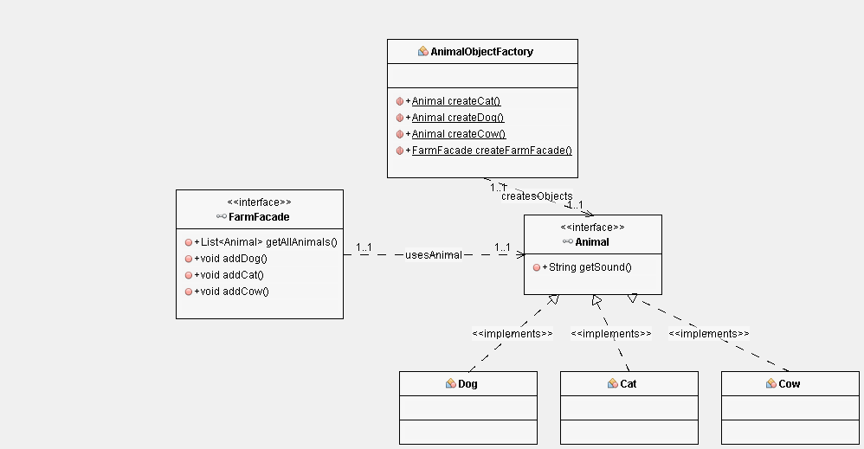
Creating a Façade for services
Creating Animal Prototypes
Creating Façade Singleton

Slide 6
Typical structure of applications
ReST
Representational
State
Transfer
Json, xml
Browser/App
view
Java Script
Interpreter
HTTP Request
GET, POST, DELETE, PUT etc
HTTP Response
Content: HTML, javascript, json/XML
Server
Web Server
Page Generation
ReST
Programming API
controller
Business Logic
SQL
model
(Persistence)
Database

