Slide 1
Short INDELs: genetic markers for divergence
Team meeting Oct 27 2020
Samuel Perini

Slide 2
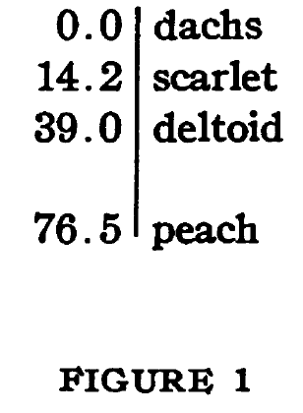
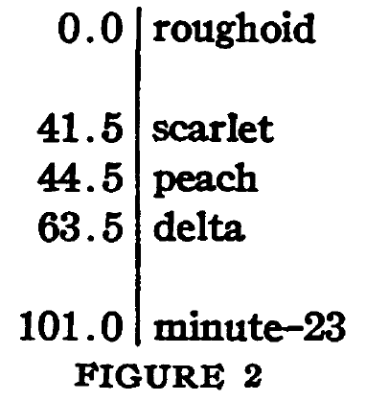
Drosophila simulans
Drosophila melanogaster
Sturtevant 1921

Slide 3
Inversions
Allozymes
RFLPs
AFLPs
…
Microsatellites
SNPs
time

Slide 4
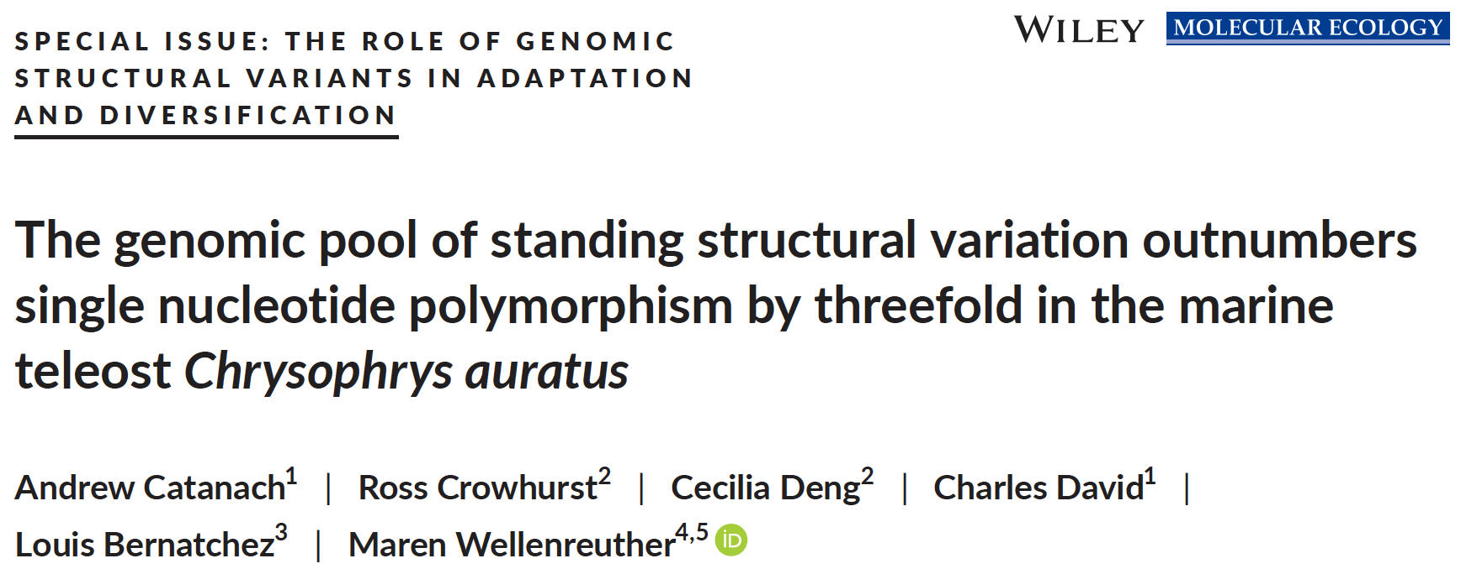

Slide 5
To study divergence…
Should we exclude short INDELs?
a. What is their frequency?
b. Are they neutral, deleterious, adaptive?
c. How do they differ from SNPs?

Slide 6
INDELs vs SNPs
Summary statistics D and H
Outliers
Hybrid zone parameters
Littorina saxatilis
CZB
CZA
CZD
Westram et al. submitted

Slide 7
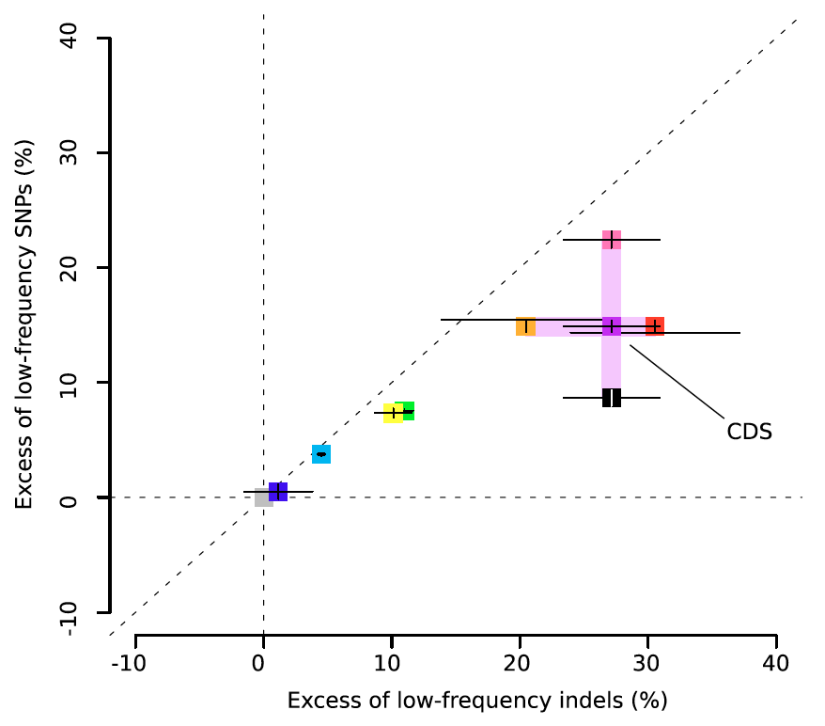
Summary statistics
Human
Montgomery et al. 2013

Slide 8
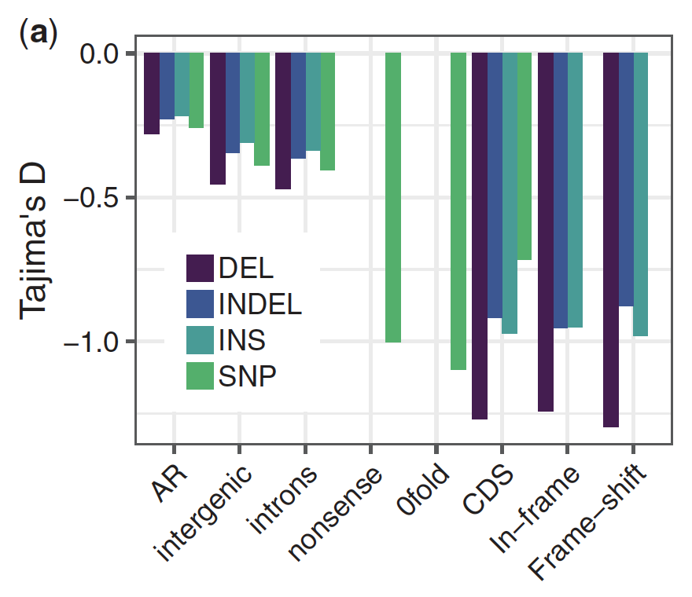
Summary statistics
Tajima’s D < 0: excess of low frequencies
Great tit
Barton and Zeng 2019

Slide 9
Summary statistics D and H
Tajima’s D < 0: excess of low frequencies
Fay and Wu’s H > 0: deficit of moderate- and high-frequencies
L. saxatilis
Purifying selection

Slide 10
Can we detect outliers?

Slide 11

2. Outliers
L. saxatilis
High correlation
$$r=0.88$$

Slide 12
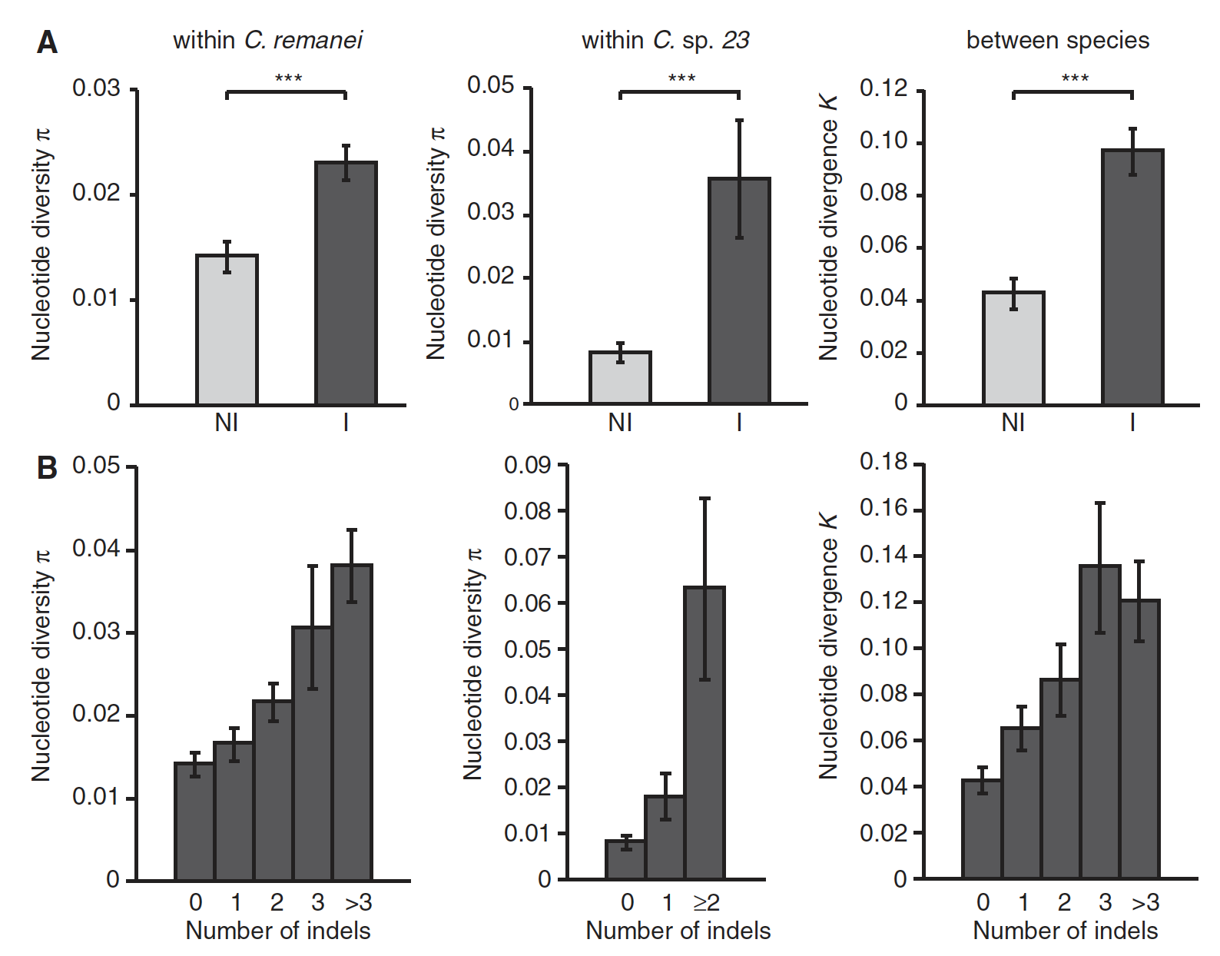
Nematodes
Jovelin and Cutter 2013
Clustering

Slide 13
3. Hybrid zone parameters
L. saxatilis
Neutral variants
Equal distributions
P-value >> 0.05
Same for non-neutral

Slide 14
To study divergence…
Should we exclude short INDELs?
Not necessarily

Slide 15
Unfolded allele frequency spectra – GC-biased gene conversion
S = Strong = G or C
W = Weak = A or T
WS = Weak ancestral, Strong derived
SW = Strong ancestral, Weak derived
D: WS > SW
H: WS < SW
WS = less low and more high frequencies
SW = more low and less high frequencies

Slide 16
Unfolded allele frequency spectra – GC-biased gene conversion
CZA WAVE LEFT just as an example
U-norm = normalised U statistic as in Katzman et al 2011 and Lachance and Tishkoff 2014

Slide 17
Unfolded allele frequency spectra – GC-biased gene conversion
D: WS > SW
H: WS < SW

Slide 18
Unfolded allele frequency spectra – GC-biased gene conversion
D: WS > SW WW SS
H: WS < SW WW SS

Slide 19
Distribution of cline parameters

Slide 20
Original aspects:
Divergent natural selection vs neutral processes
Species with high diversity
Systems with imperfect genomes can still contain useful functional information
INDEL-SNP comparisons:
Clustering of INDEL and SNP markers
Unfolded allele frequency spectra (uAFS)
Outlier sharing
Distribution of cline parameters

Slide 21
For each island and each ecotype:
1. between different categories of INDELs (e.g., coding INDELs vs non-coding INDELs) and SNPs (e.g., synonymous SNPs vs non-synonymous SNPs).
2. between INDELs and SNPs of the same category of annotation (e.g., coding INDELs vs coding SNPs).
3. between different categories of deletions and insertions (e.g., coding deletions vs non-coding deletions, frameshift insertions vs inframe insertions).
4. between deletions and insertions of the same category of annotation (e.g., non-coding deletions vs non-coding insertions).
And then also between ecotypes.

Slide 22



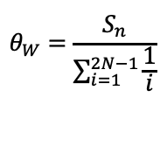

$$D=\frac{Π−θ_{W}}{\sqrt{var(d)}}$$
$$Π=Σ\frac{2j(c−j)}{c(c−1)}$$
where
j = the derived allele count at a single SNP position
c = the number of chromosomes (same as 2N) at a single SNP position
$$θ_{W}=\frac{S_{n}}{\sum_{i=1}^{2N−1}{\frac{1}{i}}}$$
Including fixed variants and also the ones without map position
$$D_{indels}=−0.4558399$$
$$D_{snps}=−0.1646385$$

Slide 23
Ontology | Coding | Non-coding | Syn | Non-syn | Insertion | Deletion
Coding sequence variant | TRUE | FALSE | FALSE | FALSE | FALSE | FALSE
chromosome | FALSE | TRUE | FALSE | FALSE | FALSE | FALSE
duplication | FALSE | TRUE | FALSE | FALSE | FALSE | FALSE
inversion | FALSE | TRUE | FALSE | FALSE | FALSE | FALSE
Inframe insertion | TRUE | FALSE | FALSE | TRUE | TRUE | FALSE
Disruptive inframe insertion | TRUE | FALSE | FALSE | TRUE | TRUE | FALSE
Inframe deletion | TRUE | FALSE | FALSE | TRUE | FALSE | TRUE
Disruptive inframe deletion | TRUE | FALSE | FALSE | TRUE | FALSE | TRUE
Downstream gene variant | FALSE | TRUE | FALSE | FALSE | FALSE | FALSE
Exon variant | TRUE | FALSE | FALSE | FALSE | FALSE | FALSE
Exon loss variant | TRUE | FALSE | FALSE | TRUE | FALSE | TRUE
Frameshift variant | TRUE | FALSE | FALSE | TRUE | FALSE | FALSE
Gene variant | FALSE | TRUE | FALSE | FALSE | FALSE | FALSE
Feature ablation | FALSE | TRUE | FALSE | TRUE | FALSE | TRUE
Gene fusion | FALSE | TRUE | FALSE | TRUE | FALSE | FALSE
Bidirectional gene fusion | FALSE | TRUE | FALSE | TRUE | FALSE | FALSE
Rearranged at DNA level | FALSE | TRUE | FALSE | TRUE | FALSE | FALSE
Intergenic region | FALSE | TRUE | FALSE | FALSE | FALSE | FALSE
Conserved intergenic variant | FALSE | TRUE | FALSE | FALSE | FALSE | FALSE
Intragenic variant | FALSE | TRUE | FALSE | FALSE | FALSE | FALSE
Intron variant | FALSE | TRUE | FALSE | FALSE | FALSE | FALSE
Conserved intron variant | FALSE | TRUE | FALSE | FALSE | FALSE | FALSE
miRNA | FALSE | TRUE | FALSE | FALSE | FALSE | FALSE
Ontology | Coding | Non-coding | Syn | Non-syn | Insertion | Deletion
Missense variant | TRUE | FALSE | FALSE | TRUE | FALSE | FALSE
Initiator codon variant | TRUE | FALSE | FALSE | TRUE | FALSE | FALSE
Stop retained variant | TRUE | FALSE | FALSE | TRUE | FALSE | FALSE
Protein protein contact | TRUE | FALSE | FALSE | FALSE | FALSE | FALSE
Structural interaction variant | TRUE | FALSE | FALSE | FALSE | FALSE | FALSE
Rare amino acid variant | TRUE | FALSE | FALSE | FALSE | FALSE | FALSE
Splice acceptor variant | FALSE | TRUE | FALSE | FALSE | TRUE | TRUE
Splice donor variant | FALSE | TRUE | FALSE | FALSE | TRUE | TRUE
Splice region variant | FALSE | TRUE | FALSE | FALSE | TRUE | TRUE
Stop lost | TRUE | FALSE | FALSE | TRUE | TRUE | TRUE
5prime UTR premature start codon gain variant | FALSE | TRUE | FALSE | TRUE | TRUE | TRUE
Start lost | TRUE | FALSE | FALSE | TRUE | TRUE | TRUE
Stop gained | TRUE | FALSE | FALSE | TRUE | TRUE | TRUE
Synonymous variant | TRUE | FALSE | TRUE | FALSE | FALSE | FALSE
Start retained | TRUE | FALSE | TRUE | FALSE | FALSE | FALSE
Stop retained variant | TRUE | FALSE | TRUE | FALSE | FALSE | FALSE
Transcript variant | FALSE | TRUE | FALSE | FALSE | TRUE | TRUE
Regulatory region variant | FALSE | TRUE | FALSE | FALSE | TRUE | TRUE
Upstream gene variant | FALSE | TRUE | FALSE | FALSE | TRUE | TRUE
3prime UTR variant | FALSE | TRUE | FALSE | FALSE | TRUE | TRUE
3prime UTR truncation + exon loss | TRUE | FALSE | FALSE | TRUE | FALSE | TRUE
5prime UTR variant | FALSE | TRUE | FALSE | FALSE | TRUE | TRUE
5prime UTR truncation + exon loss variant | TRUE | FALSE | FALSE | TRUE | FALSE | TRUE
Sequence feature + exon loss variant | TRUE | FALSE | FALSE | TRUE | FALSE | TRUE

Slide 24
Clustering of INDELs and SNPs

Slide 25
Summary statistics D and H
INDELs
SNPs
Non-genic
Genic
Intergenic
Synonymous
Non-synonymous
Intron
UTR
Inframe
Frameshift
Regulatory
Upstream
Downstream

Slide 26
Unfolded allele frequency spectra
... And test for similarity of the patterns
SNPs
INDELs | D,H | All | Non-coding | Coding | Non-synonymous
 | All | *,
 | Non-coding |  | *,
 | Coding |  |  | *, *
 | Non-synonymous |  |  |  | *, *
One linear model for each of the four category where
y = D or H
x = factor with two levels, INDELs and SNPs
* = slope is significantly different from 0
INDELs and SNPs differed significantly for D and/or H

Slide 27
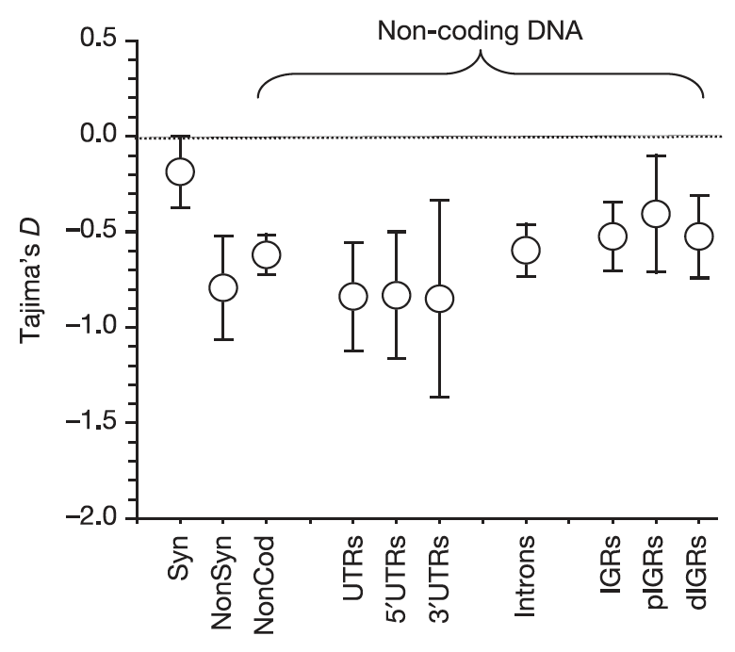
Summary statistics
Drosophila
Andolfatto 2005

