Slide 1
Electronic Voting System
Project Report Presentation
Database System — SWEG2108
Submitted to: Dr. Yaynshet Medhin
May 2026

Slide 2
The Problem We Are Solving
The National Election Board of Ethiopia (NEBE) currently relies on manual, paper-based election processes
Key problems identified: Long waiting times during voter registration and voting
Human errors in vote counting and result compilation
Risk of duplicate voting and voter fraud
High operational costs due to paper and manual labor
Delays in announcing election results
Limited data security and difficulty maintaining accurate records
These challenges undermine the efficiency, transparency, and integrity of the election process

Slide 3
Why This System and What It Aims to Do
Motivation:
Growing electorate demands a modern, reliable system
Public trust in elections depends on accuracy and transparency
Digital transformation is essential for credible governance
General Objective:
To design and develop a secure, reliable, and efficient Electronic Voting System for NEBE
Key Specific Objectives:
Automate voter registration and vote casting
Prevent duplicate voting through database constraints
Automate vote counting and result generation
Reduce paperwork and operational costs
Maintain confidentiality and integrity of election data

Slide 4
What the System Covers and How It Was Built
Scope covers 6 functional areas:
Voter Management
Candidate and Party Management
Polling Station Management
Voting Process
Result Management and Reporting
Administrative Functions
Tools and Technologies Used:
Tool | Purpose
MySQL | Relational database implementation
MongoDB | NoSQL flexible data storage
Draw.io | ER diagram design
GitHub | Version control and collaboration
Google Docs | Documentation and report preparation

Slide 5
Database Design — The Blueprint
The system uses a dual-database approach:
MySQL — structured relational data with strict integrity constraints
MongoDB — flexible document-oriented storage
The database consists of 7 core entities:
Region
Voter
Party
Candidate
Polling Station
Vote
Admin
Design follows three layers:
Conceptual Design — ER Diagram
Logical Design — Schema with data types and constraints
Physical Design — SQL and MongoDB implementation

Slide 6
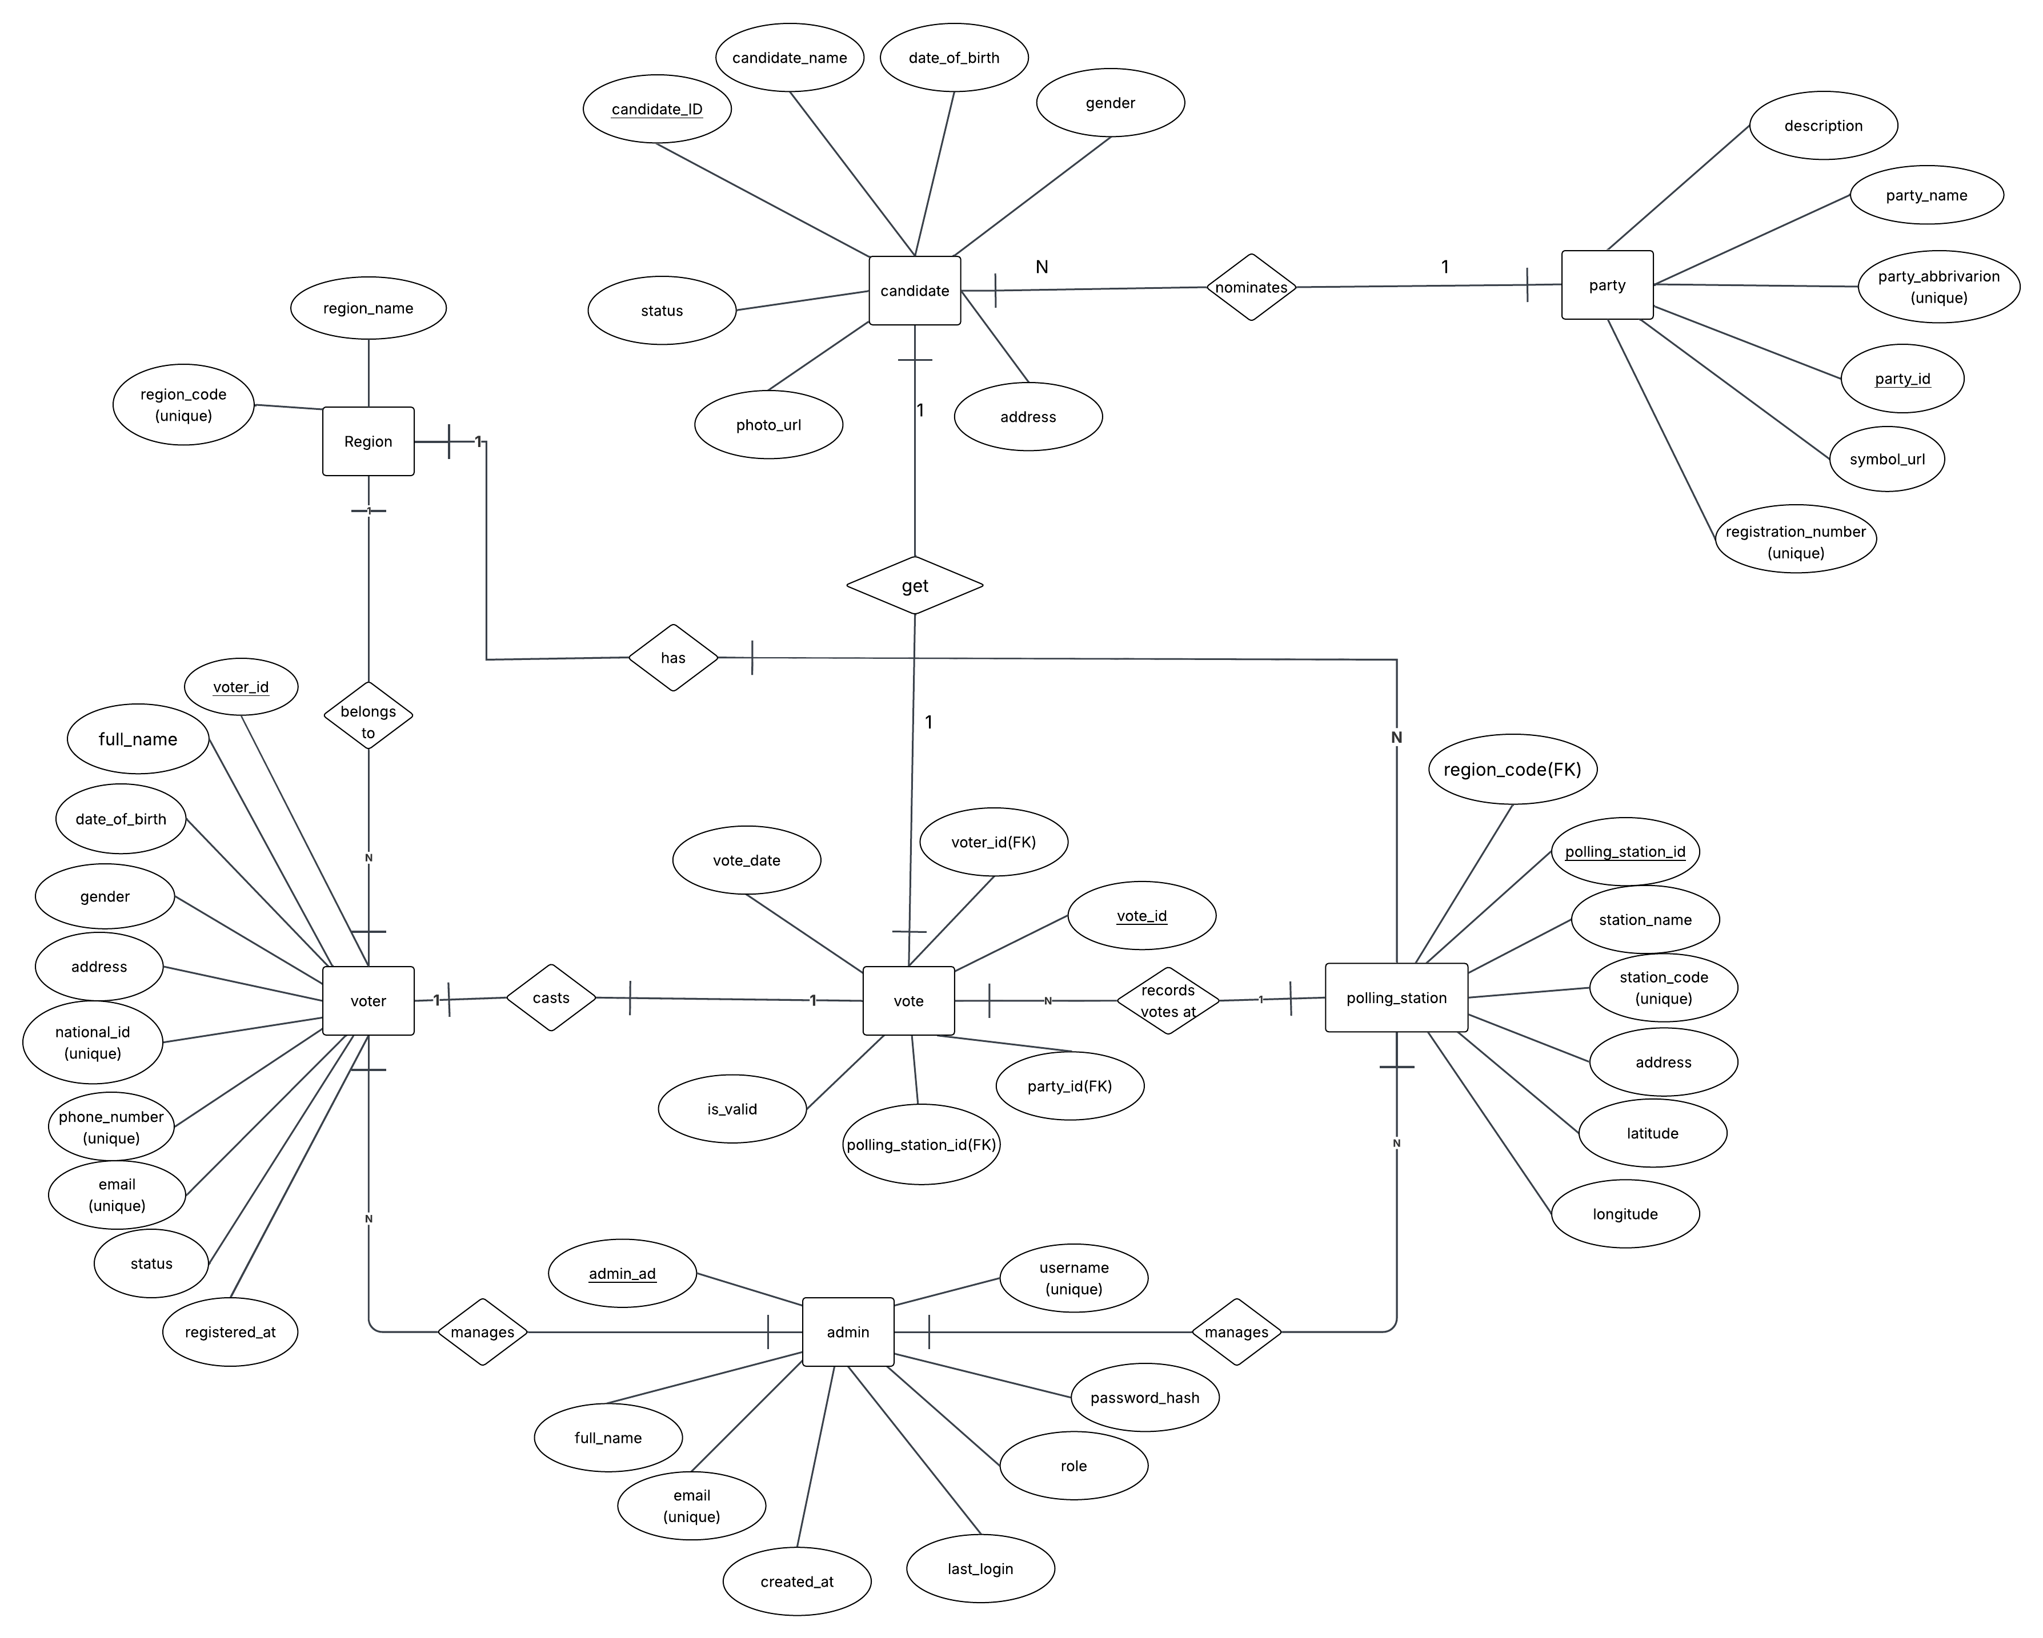
ER Diagram
Key relationships visible in the diagram:
Voter casts Vote (1:1)
Candidate receives Vote (1:N)
Party nominates Candidate (1:N)
Region has Voter (1:N)
Polling Station records Vote (1:N)
Admin manages Voter and Polling Station

Slide 7
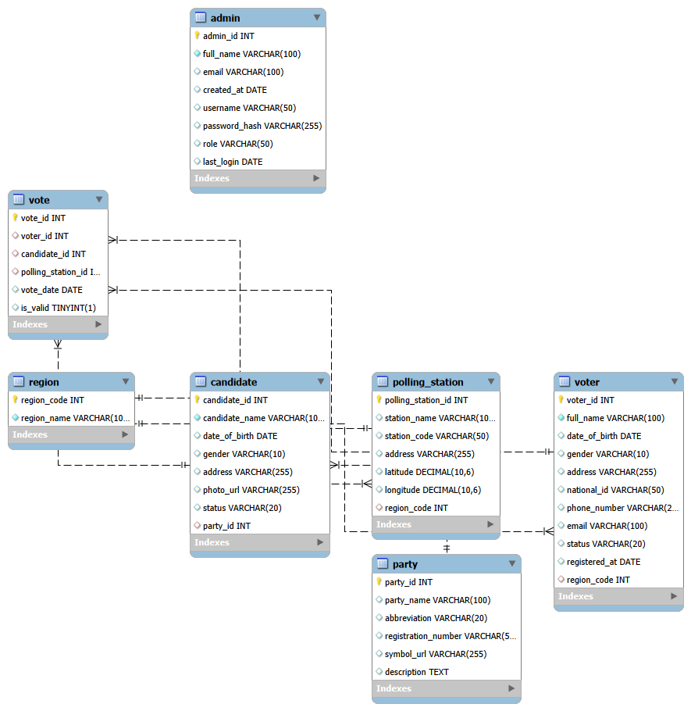
Logical Design
Key design decisions:
Each entity becomes a relational table
Primary keys uniquely identify each record
Foreign keys enforce relationships between tables
UNIQUE constraints prevent duplicate data
Critical constraint:
voter_id in Vote table is UNIQUE — enforces one vote per voter at database level

Slide 8
Entities and Their Relationships
Table summarizing all relationships:
Relationship | Entity 1 | Entity 2 | Cardinality
Belongs to | Voter | Region | Many-to-One
Located in | Polling Station | Region | Many-to-One
Nominates | Party | Candidate | One-to-Many
Casts | Voter | Vote | One-to-One
Receives | Candidate | Vote | One-to-Many
Records votes at | Polling Station | Vote | One-to-Many
Manages | Admin | Voter | One-to-Many
Manages | Admin | Polling Station | One-to-Many

Slide 9
Implementation — MySQL Database
Database created: Voting_System
7 tables created successfully:
region, voter, party, candidate, polling_station, vote, admin
SQL Constraints applied:
Constraint | Purpose
PRIMARY KEY | Uniquely identifies each record
FOREIGN KEY | Creates relationships between tables
UNIQUE | Prevents duplicate data
AUTO_INCREMENT | Automatically generates IDs
DEFAULT | Assigns default values
Sample data inserted into all 7 tables to simulate a real election environment

Slide 10
Implementation — Vote Counting Query
A SQL query was implemented to calculate election results:
Key SQL operations used:
LEFT JOIN — connects candidate, party, and vote tables
COUNT — calculates total votes per candidate
GROUP BY — groups records by candidate and party
ORDER BY DESC — sorts results from highest to lowest votes
SELECT c.candidate_name,
p.party_name,COUNT(v.vote_id) AS total_votes
FROM candidate c
LEFT JOIN party p ON c.party_id = p.party_id
LEFT JOIN vote v ON c.candidate_id = v.candidate_id
GROUP BY c.candidate_id, c.candidate_name, p.party_name
ORDER BY total_votes DESC;

Slide 11
MongoDB NoSQL Database
6 collections created mirroring MySQL tables:
regions, parties, polling_stations, voters, candidates, votes
4 queries implemented:
MongoDB provides flexible, schema-free document storage as a complement to the structured MySQL database
Query | Operation | SQL Equivalent
insertOne | Insert new voter document | INSERT INTO
$lookup on candidates | Join candidates with party details | LEFT JOIN
$group and $lookup on votes | Count total votes per candidate | COUNT and GROUP BY
find by region_code | Filter voters by region | SELECT WHERE

Slide 12
Input, Output and Reports
5 Input Forms designed:
Voter Registration, Candidate Registration, Political Party, Polling Station, Voting Form
5 Output Displays designed:
Voter Information, Candidate Information, Election Results, Polling Station, Notification Messages
6 Reports designed:
Report | Purpose
Registered Voters Report | Displays all registered voters
Election Result Report | Shows votes and percentages per party
Candidate Report | Lists all candidates and their status
Polling Station Report | Shows all station locations
Invalid Vote Report | Flags duplicate or invalid votes
Admin Activity Report | Tracks all admin actions

Slide 13
Normalization — From UNF to BCNF
Normalization was applied across all 7 tables
Stages completed:
All 7 tables confirmed to be in BCNF:
Region, Voter, Party, Candidate, Polling Station, Vote, Admin
Key outcome — data redundancy eliminated, integrity enforced, anomalies prevented
Stage | What Was Achieved
UNF | Identified redundancy in flat single table
1NF | All attributes made atomic, primary keys assigned
2NF | Partial dependencies removed, single-attribute PKs used
3NF | Transitive dependencies eliminated from all tables
BCNF | Every determinant confirmed as a candidate key

Slide 14
What Was Achieved
Implementation Summary:
Component | Status
MySQL Database (7 tables) | ✔ Completed
SQL Constraints | ✔ Completed
Sample Data Insertion | ✔ Completed
Vote Counting Query | ✔ Completed
MongoDB (6 collections) | ✔ Completed
MongoDB Queries (4) | ✔ Completed
Input Design (5 forms) | ✔ Completed
Output Design (5 displays) | ✔ Completed
Report Design (6 reports) | ✔ Completed
Normalization up to BCNF | ✔ Completed
The system successfully prevents duplicate voting, automates vote counting, and generates accurate election results

Slide 15
Conclusion
The Electronic Voting System database was successfully designed, implemented, and normalized
The system addresses all identified problems of the manual election process
Both MySQL and MongoDB implementations are functional and verified
The one-voter-one-vote rule is enforced at the database level
The system strengthens democratic governance in Ethiopia

Slide 16
Thank you!!
GROUP MEMBERS ID
1.ABEL ALEM ETS0022/17
2. ALAZAR WALLE ETS 0127/17
3. AYMEN NIGUSSIE ETS 0211/17
4. BIRUK ABRHAM ETS 0324/17
5. DAWIT AREGAWI ETS 0418/17
6. EDILAWIT SAFEWORK ETS0464/17

