Slide 1
Link-State Routing
Krishnamurthy, Karthik (A20344464) Main Campus: (Section 02)
CS542 – Fall 2015

Slide 2
Introduction
Link – State Routing also known as shortest path first algorithm.
The shortest path to a destination is not necessarily the path with the least number of hops.
In link state routing, each node has a complete map of the topology.
If a node fails, each node can calculate the new route.

Slide 3
Continued...
Link State routing protocols do not view networks in terms of adjacent routers and hop counts, but they build a comprehensive view of the overall network which fully describes the all possible routes along with their costs.
Link state routers has two phases:
First - Reliable flooding which tells all the routers about the local topology.
Second - Path calculation (Dijkstra's algorithm) to calculate best path over complete network.

Slide 4
Link State Routing Protocol: Process
The routers learn about the directly connected networks.
Routers exchange hello packets to neighbors – To discover neighbors that use the same link state routing protocol on its link.
Routers then build Link State Packets (Link State Packets contains the link id, link state, cost).
Routers then flood LSPs to all neighbors.
Routers calculate the best path to each destination with the help of the LSP database to build the network topology.

Slide 5
Link State Routing Protocol: Advantages
Router can independently determine the shortest path to every network.
Smaller routing tables.
A periodic/ event driven routing updates.
Faster convergence.

Slide 6
Link State Routing Protocol: Disadvantages
Link State Routing Protocol require higher processing power when compared Distance Vector Protocols.
Link State Routing Protocol require more memory.
Initial flooding may degrade the performance of the network.

Slide 7
Dijkstra’s Algorithm
It is also called as the single source shortest path algorithm.
It is one of the classic examples of the application of greedy programming technique.
Dijkstra’s algorithm finds the shortest paths to a graphs vertices in order of their distance from a given source.
It finds the shortest path from the source to a vertex nearest to it, then to a second nearest and so on.

Slide 8
Dijkstra’s Algorithm
Single Source Shortest Path.
For a weighted directed/ undirected graph G (V, E) -
V: Set of Vertices, E: Set of Edges
Let s be the source vertex.
The algorithm will return the shortest path from s to all vertices in V

Slide 9
Pseudocode
dist[s] ←0 for all v ∈ V–{s} do dist[v] ←∞ S←∅ Q←V while Q ≠∅ do u ← mindistance(Q,dist) S←S∪{u} for all v ∈ neighbors[u] do if dist[v] > dist[u] + w(u, v) then d[v] ←d[u] + w(u, v)
return dist

Slide 10
Time Complexity
The worst-case running time for the Dijkstra algorithm on a graph with n nodes and m edges is O(n*2) because it allows for directed cycles.
It even finds the shortest paths from a source node to all other nodes in the graph. This is basically O(n*2) for node selection and O(m) for distance updates.
While O(n*2) is the best possible complexity for dense graphs, the complexity can be improved significantly for sparse graphs

Slide 11
Dijkstra’s Algorithm: Applications
Mapping (Google Maps)
Traffic Information Systems
Routing Systems

Slide 12
Instructions to run the code
Keep the “**.txt” test file ready in the same directory of source file or the Executable file is present
Ensure that a “.txt” file format is chosen and a square matrix is entered with the values separated by a single space.
Run the Dijkstra java file or executable Jar through command line by typing following command “java Dijkstra” from the Source folder –or-- run “java –jar DijkstraExecutable.jar” – From the Executable folder where it is present.
The Application Simulation will start running in the terminal

Slide 13
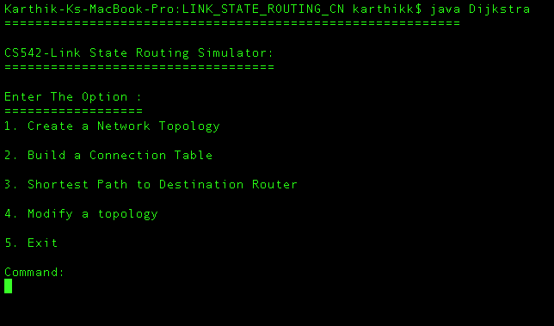
SNAPSHOTS: Interface Design - Initial Screen

Slide 14
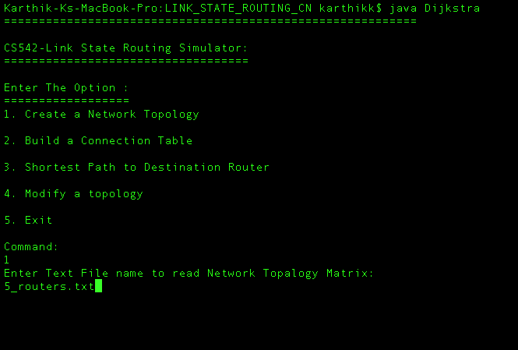
Input to the application – Command received

Slide 15
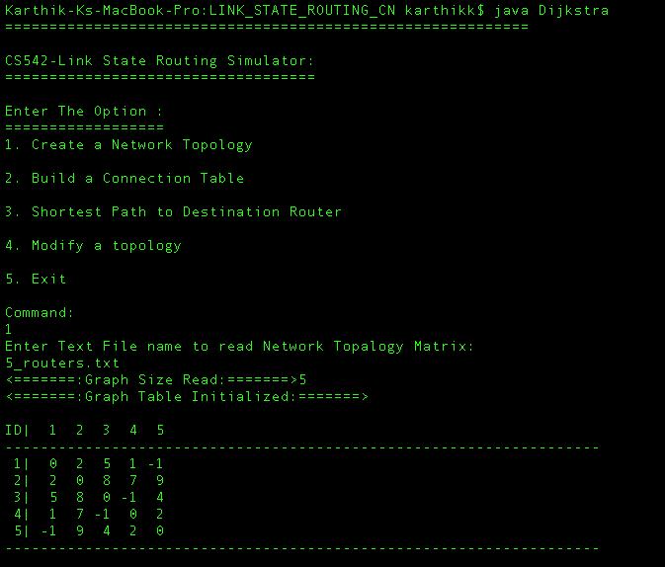
Review of input & Build Table

Slide 16
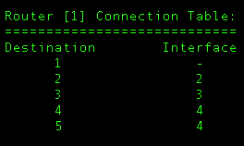
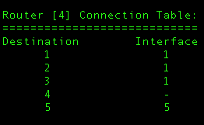
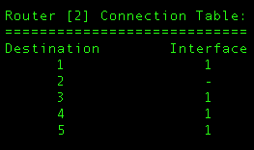
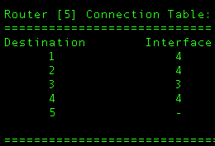
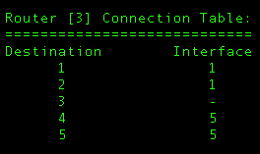
Connection Table of all routers

Slide 17
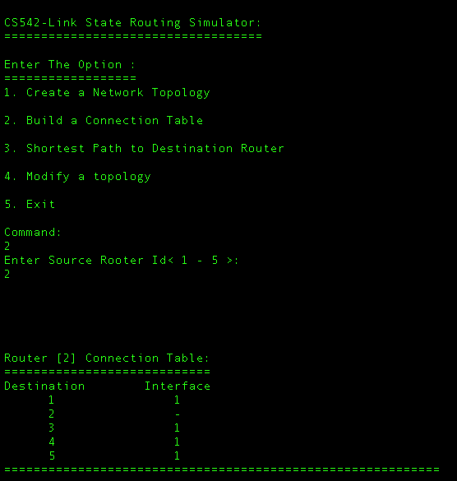
Building a connection table

Slide 18
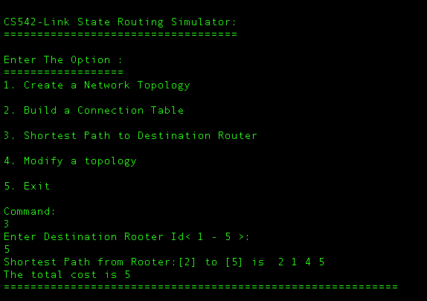
Dijkstra – Shortest Path

Slide 19
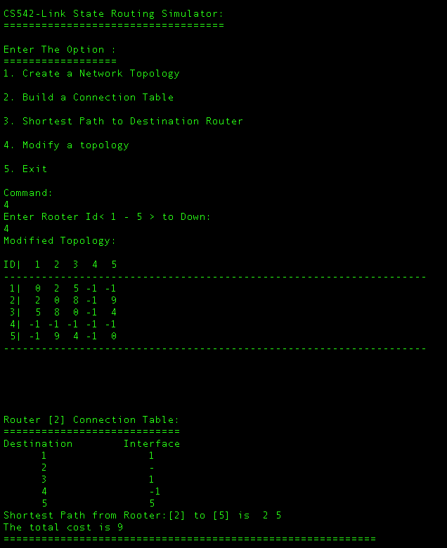
Remove a Node from the network

Slide 20
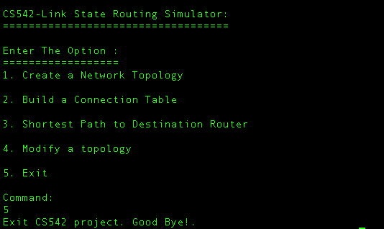
Closing the simulator

Slide 21
References
https://en.wikipedia.org/wiki/Dijkstra's_algorithm
https://en.wikipedia.org/wiki/Link-state_routing_protocol
http://hnd-computing.com/routingtech/?page_id=128

Slide 22
Thank You!

