Slide 1
Git Workshop
Joseph Haun
Notes:
Welcome to the Git and GitHub workshop developed by members of the Blueprints Engineering Workshops group. Blueprints Engineering Workshops is a group focused on the development of
skills for Sonoma State University students as well as interested community members. My name is Joseph Haun, I will your presenter for today.

Slide 2
Overview
Terminology
Git
What is it?
Why use it?
How to use it?
GitHub
What is it?
Why use it?
How to use it?
Examples
Basic
Advanced
Notes:
Today we are going to talk about a few separate topics. The first is a semi-generalized list of terminology that applies to Git, GitHub, and other version control softwares. Next, we will go into the details of Git and GitHub. Then we will move into an interactive portion where you will be encouraged to follow along with the steps that interface with GitHub.

Slide 3
Terminology
Local/Remote
Where the files are located
Repository (Repo)
A directory where files are stored
Clone/Cloning
Copy a remote repository
Commit/Committing
Save changes in the repository
This is sometimes called “checking-in”
Push/Pull
Upload/download changes made to the repo
Branch
Create a version of files in the repository
Merge
Combine branches
Notes:
A repository, or repo, is just a directory managed by the version control software. Local and remote are relative. Local is within the repository on your machine. Remote is everywhere else. This could be a different file, on a different disk, or somewhere on the internet. To clone, or cloning, is the act of copying a remote repository. Commit or committing is the act of saving your changes to the repository. To push or pull is to upload or download changes made to the repository. To branch is to create a version of the files within your local copy of the repository. Finally, to merge is to combine separate branches. We will go over this a bit more later, so do not feel as if you need to understand these terms right away.

Slide 4



Git
What is it?
Version control software
Software engineering tool
Created by Linus Torvalds in 2005
Initially created to enable Linux kernel developers
Focused on speed, data integrity, non-linear workflows
Distributed clients, no centralized repository
Operates on any file type, any operating system
Images taken from Wikipedia
Notes:
Now that some base terminology is covered, what is git? Git is a software engineering tool that enables remote developers to safely interact and build systems. It was created by Linus Torvalds to enable Linux kernel developers, but has since ballooned into a technology that is used by many others on the common operating systems and on virtually any file. Git is notable as it was designed with speed, data integrity, and non-linear workflows in mind. This means that development can happen at different paces, sometimes backwards. Examples of other version control software include Rational Software from IBM and Mercurial from Matt Mackall. There are many more version control softwares out there, git is likely going to be the one you hear about the most due to the large hosting platform GitHub.

Slide 5
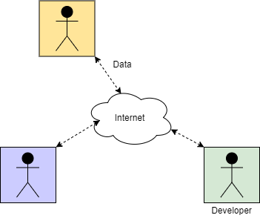
Git
Why use it?
Developers
One
Two
The planet
Maintain software versions
Production-level product
Customers
Developmental product
Overhauls
Features
Testing
Bug-fixes
Legacy product
Previous solutions
Sentimentality
Multiple Remote Developers
Notes:
Now that we have a slightly better idea of Git’s background, we can move on to why, and when, should you use it. The key thing, as previously mentioned, is that Git enables multiple developers to work together without taking copious amounts of time to manually check files for inconsistencies. While Git, or any version control software, is really intended to be used by multiple people, it can be used by one developer to keep track of changes across multiple machines. Most importantly, Git is free to download and use. So, how do I use it?

Slide 6
Git
How to use it?
Clone
Get a version-controlled copy of the remote repository
Add Changes
Prime Git to store the selected files
Commit
Store the file changes in the local repository
Pull/Fetch
Get any new changes from the remote repository
Error Check
Make sure Git does not spot any major conflicts that need to be fixed
Push
Put error checked code into the remote repository
Notes:
For any remote repository, a clone is necessary to get a version-controlled copy. Once cloned, the repository can be changed at will. This could be removing, adding, or changing files. Once changes are made, the changes have to be added to the repository version control. This allows the Git commit functionality to save the particular changes in the version history. Often, all modified files will be added, but sometimes only a selection of files need to be added. This could be to exclude temporary files or just because a feature in another file is not quite complete. Now that files are added, the next step is to commit the changes. As previously stated, this just makes sure that the changes are saved in the version history. Git wants a user to supply a message during commits, this is to allow other developers to determine what was changed or why it was changed. Maybe this is a bug-fix or you just did not like the color choice that Tim in accounting made. Regardless, it is good practice to make it specific and descriptive. After a commit, the recommended thing to do is to pull or fetch. This grabs all remote changes and populates them inside the local repository which allows you to error check. Git spots major differences between your files and the remote files and will populate the file with anything where it wants the user to make a choice. Once you have error-checked, the final step is to push your changes to the remote repository. You are unable to skip some error checking. If Git is unclear about which piece of the file to use, it places a structure inside the file that it can detect before pushing. This must be removed before any push will be allowed. That pretty much covers Git, now we will move on to GitHub.

Slide 7





GitHub
What is it?
Images taken from Wikipedia
Repository hosting service
Cloud-based
Started in 2007
Now owned by Microsoft
Large amount of repositories
Public, open-source
Private, proprietary
Competitors
SourceForce
BitBucket
Image taken from Microsoft.com
Images taken from Wikipedia
Notes:
GitHub is an internet-based repository hosting service that was started in 2007. Per the name, the underlying operations are using the Git utility with some web-dev flair thrown in to allow easy communication to the internet. Recently, it was purchased by Microsoft as it was doing a way better job that even Microsoft’s code hosting service. It has beaten out some competitors, Google Code being a notable example, but it still has some competitors in Bitbucket and SourceForge. There are many other code hosting services, some that use Git as well.

Slide 8
GitHub
Why use it?
Every reason you would use Git
Free code hosting (with limits)
Paid plans available, but mainly geared towards commercial entities
Allows multiple remote developers to collaborate easily
Easily add new developers
Pass off projects to others
Web interface
More appealing than pure text interface for beginners
Free static website hosting through GitHub Pages
Show off your projects
Create a web-resume to attach to LinkedIn
Notes:
So, why use it over Git? Pretty much every reason you would use Git. In addition, you get a slick web-interface, free web-hosting of files, and a few other benefits. Organizations or people can pay for more perks on GitHub, but the free options are still currently very generous. Since GitHub is already configured, you as the user do not need to delve into the same difficult networking steps to have the same functionality. Git itself can copy files over a network, but this can require a bit of configuration. GitHub does this for you, gives you a tidy link, and has a funny octopus-cat mascot to boot.

Slide 9
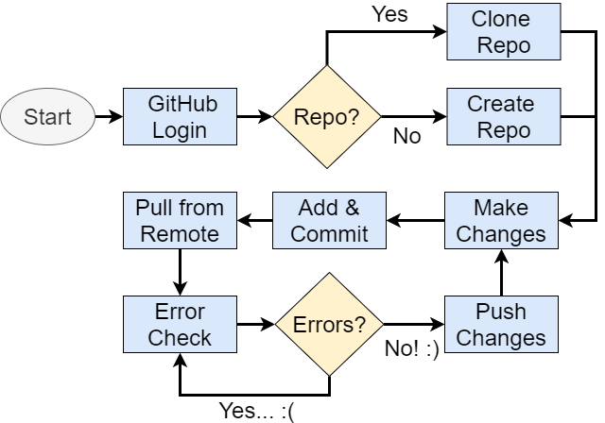
GitHub
How to use it?
Notes:
So, how to use it? Same way you would use Git. Instead of throwing the text same slide at you, here is a flowchart that represents the same steps visually. First, the user needs a login. If you have a repo in mind, you can clone it, otherwise you can create your own. Then, make your changes. Add and commit the changes. Pull from the remote to update your local repository, error check, push your changes back up, then keep making edits. We are going to attempt to go through these basic steps today.

Slide 10
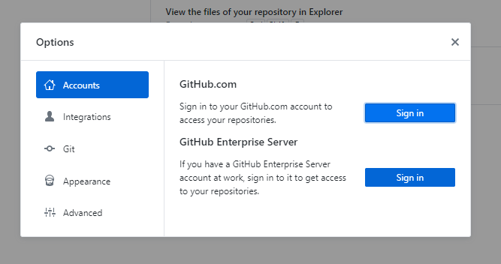
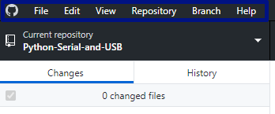
GitHub
Setup
GitHub Account
Create at github.com
Download GitHub Desktop
desktop.github.com
Notes:
So, on to the interactive portion of the workshop. We have covered the background and basics of Git as well as GitHub, so now we can actually start doing something with it. What we are going to do for today is create a custom repo and also clone the repository where the information for this workshop is stored. Not a huge repo in either case, but once you have done both of these you can create or clone anything on GitHub easily. So, first step, create a GitHub account if you do not have one and then download the GitHub Desktop client. There are other clients if you would like, but stick with this one for now.
<FIVE MINUTE BREAK>
Now that you have it downloaded, go ahead and log-in by going to File->Options->Accounts. You should be greeted by the image on the right. If not, let me know and we can figure it together.

Slide 11
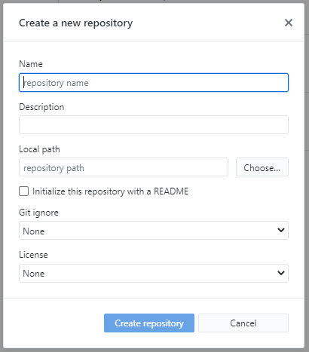
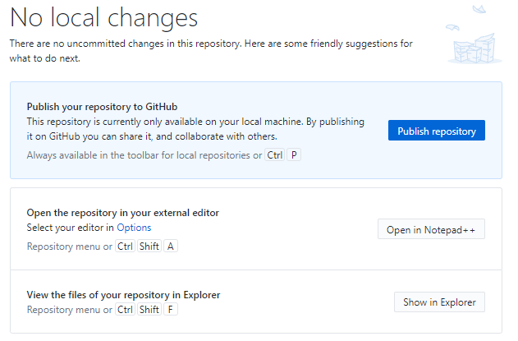
GitHub
Create
Create a new repo
File -> New Repository
Notes:
As you have logged in, we can create a brand new repository on your computer. Head to File -> New Repository which will pop up the window on the left. Once you have entered in the relevant information and clicked “Create repository” the screen on the right will be displayed. This informs you that this repository only exists on your local machine, GitHub has no idea it exists yet. Once you publish it, your user account on the website will reflect that this repository exists in a private or public state. Go ahead and create a test repository for now.
<FIVE MINUTE BREAK FOR CREATION>
Okay, let us move on to cloning a repo.

Slide 12
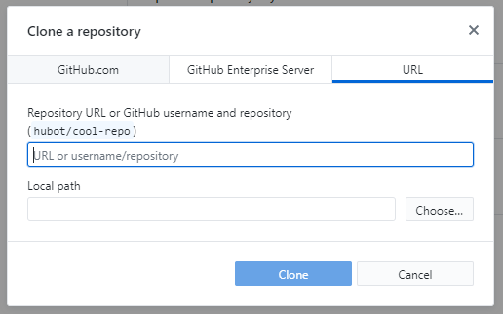
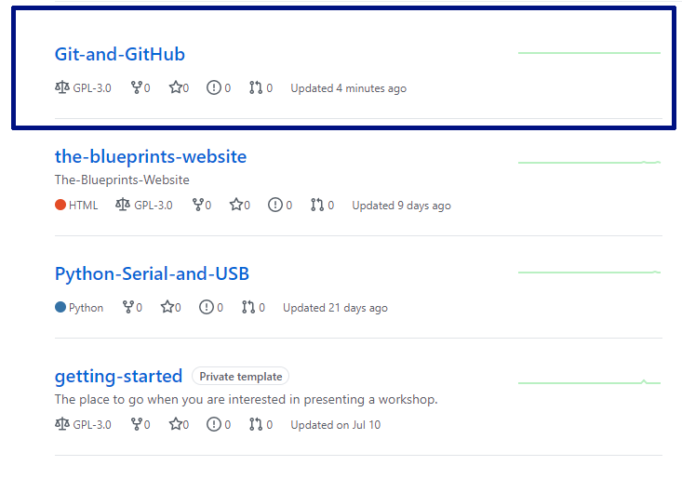
GitHub
Clone
Clone a repo
File -> Clone Repository
github.com/The-Blueprints-Engineering-Workshops
Notes:
Now that you have created and published your own repo, we can clone the repo for this workshop. To do so, go to File->Clone Repository. The window shown on the left will pop up, once it does switch over to the URL tab.
From there, we are in a bit of a pickle. We need a URL to clone the repo from GitHub. The easiest way to find this, shocker, is to go to GitHub. For the purposes here, I have the link on the slides. Once you go there, you will several repositories. Click on the Git-and-GitHub repository. For other public repositories that you wish to clone, you can follow these same steps. Keep in mind that you will not likely be able to push any of your changes to the repository without approval from the managers of that repo.
<ONE MINUTE BREAK>

Slide 13
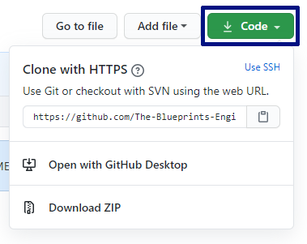
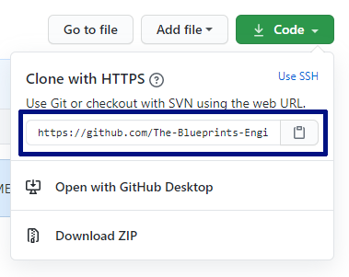
GitHub
Clone
Clone a repo
Hit the green Code button
Copy the link shown
Notes:
Once you have clicked on the repo, look up in the top right for a green button labeled “Code.” Give that a click and the window shown will pop up. From there, you can copy the HTTPS URL which can then be used in the desktop client.
<ONE MINUTE BREAK>

Slide 14
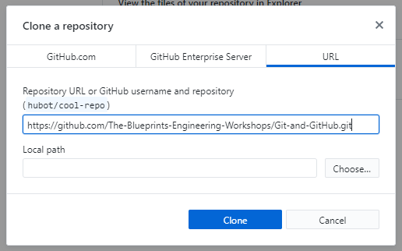
GitHub
Clone
Clone a repo
Paste the link into the Repository URL field
Change local path as desired
Notes:
So, simply paste the link into the Repository URL field and change your local path to whatever you desire. Generally the default will be a folder in your documents file named “GitHub.” Then, hit clone and the repo will be downloaded with Git version control onto your machine.
<TWO MINUTE BREAK>
Alright, now we can move into a slightly more advanced topic: branching.

Slide 15
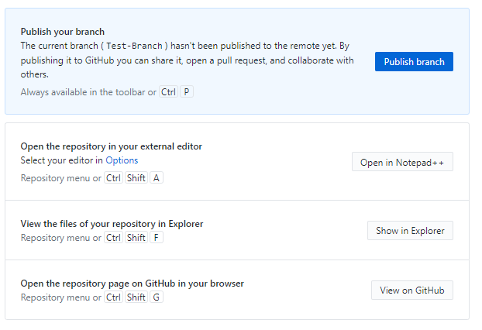
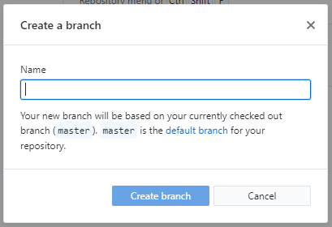
GitHub
Branch
Branch a repo
Branch -> New Branch
Publish Branch to GitHub
Notes:
Branching is something that is slightly strange, within the repository there is always one branch: master. You can create others, by going to Branch -> New Branch in the top menu. Once you have entered a name, you are greeted with a similar “Publish branch” option. This is entirely the same process as creating a new repo, it just makes the branch edits available on GitHub. In your newly created branch, you can change anything you want and it will not be reflected in the main branch: master. That is, until you merge over the changes. This process is preceded by an add and a commit. So, why branch? Well, when you have multiple developers working on different aspects, they can get in the way of their each other by manipulating core files or creating something that overrides whatever another person is doing. Branching gets around this by giving each developer their own section of the sandbox to play with. Once they are done playing, they can merge their changes back together. Go ahead and create a branch on your test repo.
<TWO MINUTE BREAK>
Now, with a branch in hand, we can begin making changes.

Slide 16
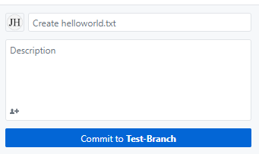
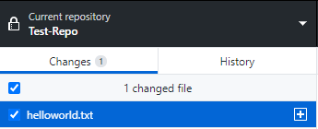
GitHub
Add & Commit
Add & Commit
Add some text file to your repository (helloworld.txt)
Add description in file and hit commit
Notes:
The change in this case: a new file. To find your repository on your computer, you can click on the “Show in explorer” button which will open up the file explorer in your repository. From there, just create a text file in the directory. “helloworld.txt” is always a Computer Science favorite, but it is up to you.
<TWO MINUTE BREAK>
Once you have added your file, it will pop up on the left-hand sidebar. Once you see it there, at the bottom left-hand corner there is a “Commit” button. The top field on the right-hand image is the message for the commit. You can also add a description for the commit, but the message is the only thing required. The client populates with a basic message, but for large commits this will need to be customized. Add some message, then hit commit.
<TWO MINUTE BREAK>
Now, everything should be hunky-dory in the branch. Now, how do we update the master branch with our very vital additions?

Slide 17
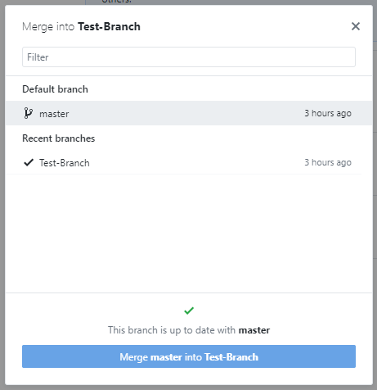
GitHub
Merge
Merge a branch
Change to the desired branch
Branch -> Merge Into Current Branch
Notes:
Merging. From the branch menu, hit Merge into Current Branch will will pop up the window below. Keep in mind that merging is always done from one branch to another, so the general rule is merge the new into the old. If you merge the old into the new, you could wipe out changes and then you have to embark upon the fun process of resetting the version control to a previous commit. That can be a pain and should be avoided. Merge your test branch into the master branch. This will update the master branch with your text file.
<TWO MINUTE BREAK>
Now, if you switch between the branches, they should show no difference. However, if you make a change to the file in one branch it will not be updated in the other until you do another commit and merge.

Slide 18
Notes:
With that, we have gone through the basic steps for anyone to manage code and other files with Git and GitHub. There are, of course, more advanced ways to use GitHub. As mentioned before, there are security measures that can be put in place for public repositories. This prevents non-trusted developers from immediately polluting the repo with bad commits. What this means is that the manager of the repository is required to look over any changes that a non-trusted user wishes to add. This takes the form of a pull-request, but for repositories that you yourself create, you can avoid this by added other GitHub users as developers. Then, they are able to commit files at will. With that, this workshop has concluded. If you have any further questions, I will stay on the line for awhile.

