Slide 1
Python & Hardware
Engineering Enrichment Workshop
Joseph Haun
Notes:
Welcome, my name is Joseph Haun and today I will be discussing a few applications of Python in this Engineering Enrichment Workshop.

Slide 2
Overview
Concepts
Imports
Functions
Libraries
Python Serial (PySerial)
Requirements
Parameters
Constructors
Python USB (PyUSB)
Requirements
Interfacing Simple Devices
Notes:
For a brief overview, today I will be discussing some basic Python concepts and then move into the Python Serial and Python USB libraries.

Slide 3
Python Concepts
import
Used to tell the Python interpreter to grab a specific library
def
Used to tell the Python interpreter to create a function that can be called later
print
Used to tell the Python interpreter to display values given to the console
Notes:
Here are some basic Python concepts that you will need to know, hopefully this is a refresher for most people here as I am assuming that you are at least somewhat familiar with Python from classwork or tinkering. If not, this will give a foundation for what is discussed later. The keyword import allows a Python program to get installed libraries, Java uses this keyword as well or you can think of #include from C/C++. The keyword def allows a user to define a function within the Python program, similar to how C++ uses the return datatype as a signifier. The keyword print allows the user to print values to the standard output for their particular operating system, very similar in functionality to printf or cout in C++. If using an IDE, this will be somewhere in the IDE. Otherwise, it will likely be a terminal window.

Slide 4
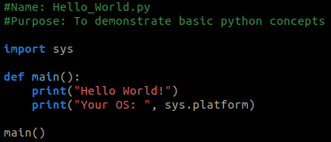
Concept Sample Hello_World.py
s
Notes:
Here is a sample of the three concepts we discussed. The sys library is imported which allows the program to access specific functions and parameters. The def statement creates a function called main that is later called. Within the function there are two print statements: one that shows a simple string and the other that prints a string with a dynamic parameter, your operating system.

Slide 5
Requirements Python Serial Class
PyCharm / IDLE installed
https://www.jetbrains.com/pycharm/download/
PySerial library installed
https://pypi.org/project/pyserial/
Binascii library installed
FTDI (or equivalent) chip and USB cable
Windows 10 Debugging Tools (Windows Only)
https://developer.microsoft.com/en-us/windows/downloads/windows-10-sdk/
Notes:
With the basics covered, let us move into PySerial. Some basic requirements first. You will need a way to edit and run Python scripts. This is where PyCharm or IDLE come into play, IDLE is the default editor when a user installs Python on a windows machine and PyCharm is an Integrated Development Environment (IDE) that allows a user to edit Python while providing more features. Once either of those are available, you will need the Python Serial Library, which can be found at the link, installed. This can also be installed through PyCharm without much hassle. Every instance of Python should come with the Binascii library installed, but just in case you are running a wacky version of Python you will need it. Finally, you will need an FTDI, or equivalent, chip with a USB cable to send/receive serial data. On either operating system you will need a way to discover the virtual port for your device. For Linux/MacOS this can be done in a terminal window. For Windows, this can be done fairly easily with the Windows 10 Debugging Tools.

Slide 6
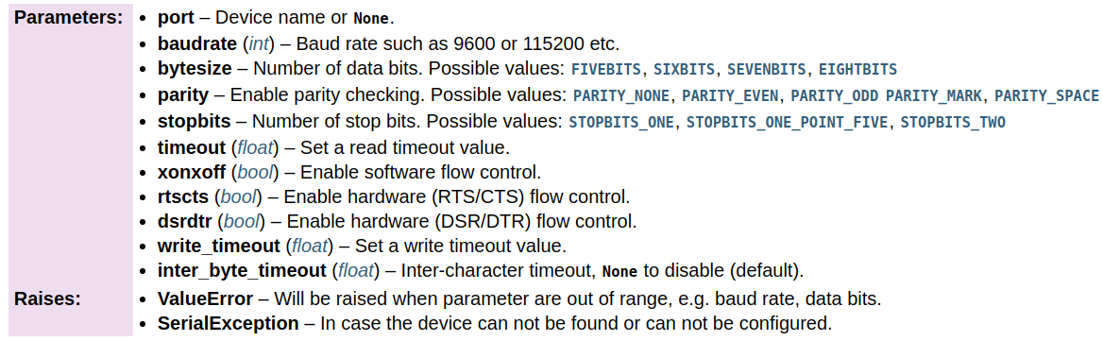
Python Concepts
Serial Class
Initialization Parameters
Notes:
As we will be using a specific library, some basic class parameters are necessary. For those of you who do not know, in essence, a class is an easy way to package and maintain relevant data. This can be anything desired, but in this case revolves around various serial parameters which can be used to initialize a virtual communication port variable within Python. This image taken directly from the PySerial documentation website. I would recommend that any programmer look at their documentation when they need to know something. Since you may be unfamiliar with this particular documentation, I will gladly help you work through anything that I do not directly explain because there are many functions within the PySerial library. Today is simply the basics, so many of this functionality will not be covered.

Slide 7
Class Functions General
open()
Opens the port
close()
Closes the port
read(n)
Reads n bytes of data
write(data)
Sends data through the port
Notes:
The main functions we will be using today I have listed here with a brief description. Once again, this is all in the PySerial documentation so you can always reference it later. The open function is pretty self-explanatory, it opens a port once you have performed some configuration. Likewise, close does the opposite. The two main functions within PySerial are read and write. They are the main way that a user-program will be able to communicate with a device. Read allows a program to grab n bytes of data, where n is an integer and write allows you to send some data through the port connection you have established. The write function is where the Binascii library comes in as you need to encode data into binary so that the library is able to send it to a device.

Slide 8
Class Functions Setters/Getters
port
(string) Set/Get port name value
baudrate
(int) Set/Get baudrate value
bytesize
(int) Set/Get bytesize value
timeout
(float) Set/Get read timeout value
Notes:
These four functions are known as setters/getters and in other languages. They are used by the class to assign or read values within the class object. I previously called this a variable because that is what a user declares, but the terminology here is actually object. The port setter/getter allows a user to set a new port value, either a COM (CHARLIE-OSCAR-MIKE) or /dev/ttyUSB (/DELTA-ECHO-VICTOR/TANGO-TANGO-YANKEE-UNIFORM-SIERRA-BRAVO) value depending on your operating system. Baudrate controls, obviously, the baudrate value for the port. This is important as the serial standard allows for a variety of baudrates (9600, 115200, etc) that will impact how your devices communicate. With two different baudrates, your devices will have errors communicating because one is attempting to interpret data faster than the other. The bytesize getter/setter allows the user to determine the number of bits that will be sent for each packet, usually this is set to eight bits but it can be changed. Finally, one of the most important, the timeout and write_timeout, not shown here, setters/getters allow the control of how long the read or write functions wait when attempting their respective operations. If not set, PySerial defaults to indefinitely which will cause your program to stall, otherwise known as hang, and prevent further operations. This could be bad if the program needed to perform other functions. However, stalling is usually an issue for reads as the write function generally does not need to wait for remote hardware.

Slide 9

Initializing Port
Two methods with identical results
Initializing with constructor and all relevant values
Initializing an empty port object and using setters to initialize various values
Notes:
Alright, let’s move on to actually initializing a port. There are two methodologies within the PySerial library: initializing a constructor with all relevant values or initializing an empty port object and using the setters to initialize various values. The image here is an example of a blank object being created and we will go into that one first as it is slightly more involved, but provides a better step-by-step description of what you are doing.

Slide 10

Initializing Port Method 1
Using the setters provided
Initialize blank serial object
Assign port name
Note: This name is for Linux/MacOS. For Windows it will be in the format COMx instead.
Notes:
Step 1: Create the blank object with a variable name of your choice, here I chose “OpenPort”
Step 2: Assign a port name. Here I chose the Linux/MacOS variant as my machine is running a Linux Operating System.
You can see here that the first step is using a general function which has parentheses after the serial.Serial. This normally indicates that a def statement was used to create that function. On the second step, the left side of the equality does not have parentheses which means that the user is directly changing the class object associated with that variable, OpenPort. So, what this means is that the user has access to the port variable that is contained within this specific serial class object, OpenPort. However, this is not something you need to worry directly about right now, I am simply providing more information in case you encounter these terms within documentation or hear another programmer talk about objects or classes.

Slide 11


Initializing Port Method 1
Using the setters provided
Set baudrate
Set read timeout value (in seconds)
Notes:
Step 3: Set the baudrate, in this example it is set to 9600 which is a low baudrate.
Step 4: Set the timeout value for reads. This is measured in seconds.
The only thing to note here is that your device will likely have a specific baudrate that it is programmed to use. It might be higher than this value. The timeout value is however long you are willing to delay your program to receive data. For some applications, it might be better to have a really short timeout. For others, a very long timeout.

Slide 12


Initializing Port Method 1
Using the setters provided
Set the byte size to be sent/received
Set the parity (if any) for transmission
Note: This will add extra bits sent for data integrity
Notes:
Step 5: Set the byte size. This controls how many bytes the serial port will send and how data received is interpreted. Note this is using an enumeration, meaning that a keyword translates to a number.
Step 6: Set the parity. This is largely a data integrity tool which allows the detection of corrupted data sent.
The size of the expected bytes, whether it is eight, seven, or some other size, will determine how the devices communicate. If your device expects 8 bits and your program sends six, you will encounter errors of operation as the data sent did not reflect your intended message. The parity bits are a tools used to also help limit errors in communication. They do this by adding one more bit the end of your data communication that can be used to conform the data to an even or odd parity. These refer to the number of 1 bits within the data. So, an odd parity will be verified if and only if there are an odd number of 1-bits received. Usually, this is only one bit so the protection is limited to only single-bit error detection which will require the sender to resend the corrupted message. Parity needs to be agreed upon by both devices, if one device expects even parity the other device needs to send even parity.

Slide 13
Initializing Port Method 1
Using the setters provided
Set the number of stop bits to be sent
The port is now configured for data transfer
Call the open function to begin operations
Notes:
Step 7: Set the number of stop bits to be sent.
Step 8: Now, use the open function to allow the reading and writing of data.
After step seven, the serial object is configured for the particular port. Once opened, the port will be able to read and write data until closed with the close function or your program exits. That is the end of method one.

Slide 14

Initializing Port Method 2
Use the constructor and set all parameters desired at once
The port is now setup for the transfer of data
Notes:
Method two has all the same details as method one, but it comes in a much more compact form. Instead of the blank constructor from method one, method two uses a constructor with parameters. In particular, the parameters we just listed. So, the port name is still /dev/ttyUSB0, the baudrate is still 9600, the byte size is eight bits, the parity is even, the stop bits are 1, and the timeout is 1 second. The beautiful thing about this method is that the user does not need to call the open function as PySerial automatically opens the port so long as you supply it with a valid port. If an invalid port is given, you’ll receive an error. This parameterized constructor can have less of these parameters, with the only required parameter being the port name. All other parameters will be assumed to be the defaults set by PySerial, but these may not be applicable to your particular device. This means that declaring them is a better idea as it also helps those who read your code later to understand what you were aiming at accomplishing.

Slide 15
Port Discovery Using Windows USB Device Viewer
Download and install the Windows 10 Debugging Tools
Navigate to:
32-Bit: C:\Program Files (x86)\Windows Kits\10\Debuggers\x86
64-Bit: C:\Program Files (x86)\Windows Kits\10\Debuggers\x64
Launch the USB Device Viewer
Double click usbview
Notes:
Tech Republic Article: https://www.techrepublic.com/article/tracking-down-usb-devices-in-windows-10-with-microsofts-usb-device-viewer/
Windows Debugging Tools: https://developer.microsoft.com/en-us/windows/downloads/windows-10-sdk/
Once the Windows 10 USB Device Viewer window opens, make a note of the COM ports that have a red/blue icon and a name associated with them. Once noted, simply plugin/unplug your target device from the USB port and note which one appears/disappears. Once you have the specific COM port, you can use it in a program.

Slide 16
Port Discovery Using MacOS/Linux Terminal
Open a terminal instance
On MacOS use the program finder
On Linux distributions use the program finder or press Ctrl-Alt-T
Use the ls terminal function
Call ls /dev/
Note what is different after removing/adding your device
Notes:
A similar procedure to the Windows USB Device Viewer: call ls /dev/ and note down what is present, unplug/plugin your device, call ls /dev/ once more and see what has changed.
(VAMP 10 SEC)
Now, on to PyUSB.

Slide 17
Requirements Python USB Class
PyCharm / IDLE installed
https://www.jetbrains.com/pycharm/download/
OS with libusb Configured
PyUSB library installed
https://pypi.org/project/pyusb/
Wired USB device
Mouse, Keyboard, etc.
Windows 10 Debugging Tools (Windows Only)
https://developer.microsoft.com/en-us/windows/downloads/windows-10-sdk/
Notes:
Similar to the serial class, you will need a way to edit and run Python scripts. Once either of those are available, you will need to install the Python USB Library, which can be found at the link, installed. Your operating system will need to have libusb configured to work with PyUSB. For Linux users, this is out of the box. For Windows users, configuration is required. Finally, you need a wired USB device of your choosing. If you are on Windows, the Windows 10 Debugging Tools are recommended. If you are on MacOS or any Linux distribution, you should have access to the terminal program and the lsusb (LIMA-SIERRA-UNIFORM-SIERRA-BRAVO) utility.

Slide 18

Python USB
Finding Devices
Device ID Values
Find device by ID Values
Notes:
So, a disclaimer, the USB library is slightly magical in that it simply works. As USB is a widely used standard, much of the heavy lifting is handled for the user by the library. The first thing necessary to find a USB device is the Vendor and Product ID values. These can be found with utilities such as lsusb or the Windows 10 Debugging Tools. Once you have these values in hand, the find utility within the usb.core class is used to locate your device on the bus.

Slide 19

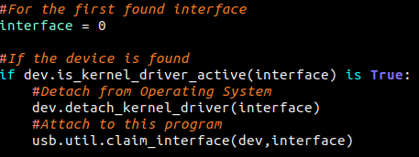
Python USB
Claiming Device
Get the first found endpoint
Detach device from Operating System and claim
Notes:
Once discovery is complete, the user needs to grab the first endpoint. This is similar to the virtual communication port created by the Serial class as it allows reading/writing of data. Once the endpoint is copied, the device will likely need to be detached from the operating system. This removes the operating system’s control over the device, but also allows any user program to claim the interface and access the data stream.

Slide 20
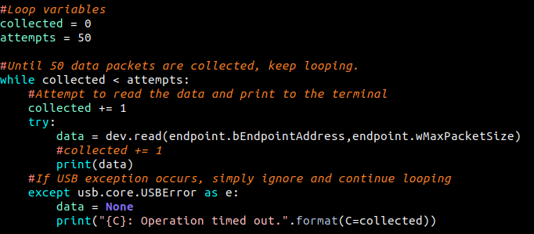
Python USB
Get Device Data
Get the first found endpoint
Notes:
Now, the user program has control over the data. The penultimate step is to read something. This loop will run fifty times. If data is received, it will print the data, otherwise it will print an operation timeout. I have to stress again, this only currently works for WIRED devices. USB Wireless dongles require more setup, I encourage you to investigate on your own.

Slide 21

Python USB
Release and Reattach Device
Release Device
Attach device to the Operating System
Notes:
The final step is to release the interface and reattach to the operating system. This will insure that your device continues to operate once the program is done.

Slide 22

Questions/Comments Feedback Welcome!
Please feel free to give us feedback on any aspect of the workshop
Notes:
Questions and Feedback Welcome!
FORM LINK: https://forms.gle/wPMjKbuNS5bLXmqX9

