Slide 1
Closing the street
to a robotaxi
31
reports filed by San Francisco
firefighters since April 2025,
documenting robotaxis obstructing
emergency operations
A common format for geofence notices, so one message from your dispatcher reaches every automated vehicle operating in your jurisdiction.
Briefing for fire, law enforcement, EMS and emergency management command
Draft for comment · 3 September 2026 · GFN v0.1
Notes:
Open with the number, not the technology.
31 reports since April 2025, from one city's fire department. That is not a technology forecast, it is a filed record.
This briefing is about a proposed message format, not a product and not an adopted standard. Say that up front so nobody thinks they are being sold something.
Ask the room before you go on: how many of you have had an AV in the way of an apparatus placement in the last year?

Slide 2
THE PROBLEM
It is already happening, and the workaround is manual
2025-12 · 15TH STREET
2026-02-21 · SANCHEZ ST
2026-06-20 · FIRE GROUND
Engine blocked, stabbing call
Engine blocked, respiratory call
Vehicle drove into heavy smoke
Crews knocked on the window for customer service. Remote repositioning failed. Firefighters operated the vehicle themselves and it malfunctioned in reverse. Fifteen minutes. Another crew arrived first.
A three-point turn put the vehicle across the engine's path. Clearing it took SFPD and a tow truck.
An unoccupied vehicle entered an active fire scene obscured by smoke, braked hard, and stopped. It produced a 105-vehicle recall.
The same lieutenant filed the same complaint about a vehicle blocking aerial positioning eleven months apart. Nothing between those two reports changed the outcome. Separately, the department has responded to over 100 vehicle-initiated 911 calls to wake sleeping passengers.
Source: San Francisco Standard, 10 July 2026, reviewing SFFD incident reports. Recall figure: NHTSA via Al Jazeera, 17 July 2026.
Notes:
Three cards, three failure modes: the vehicle blocks and the remote fix does not work; the vehicle blocks and it takes police plus a tow; the vehicle drives itself into the hazard.
The bottom line is the one that should land. The same officer, the same complaint, eleven months apart. There was no mechanism to make the second one not happen.
If someone asks whether this is one city or one company: the NHTSA letter on the next slide calls it an industry-wide functional insufficiency, not a company problem.

Slide 3
WHERE THINGS STAND
California already requires it. Nobody has written what it is.
28 APR 2026
California DMV rules take effect
New testing and deployment regulations. First responder interaction plans reviewed annually, remote support reachable in 30 seconds.
1 JUL 2026
A two-minute duty becomes law
Vehicle Code 38751: an emergency response official may issue an emergency geofencing message, and the manufacturer must direct its fleet to leave or avoid the area within two minutes. In force today.
8 JUL 2026
NHTSA calls it a functional insufficiency
To AV developers: a vehicle that cannot safely interact with first responders is a danger to the general public. Remediation plans due in three weeks.
28 JUL 2026
H.R. 10033 introduced
The AV Emergency Response Coordination Act would take the same idea national. Introduced, not passed.
This is no longer a question of whether the authority arrives. In California it arrived on 1 July. What a geofencing message actually is remains undefined, and that is what is being decided now.
Notes:
The 1 July line is the one that changed this briefing. Slow down on it. This is not a proposal any more, it is California law, and the duty is on the manufacturer.
Read the number out loud: two minutes. Then say the part that matters to this room, which is that the law does not say how the manufacturer knows the message came from you.
H.R. 10033 was introduced 28 July 2026 and has not passed. Do not overstate it. If asked when federal rules land: the bill gives NHTSA 180 days after enactment, and NHTSA rulemaking averages about five years. Do not wait for it.

Slide 4
THE GAP
The law grants the authority. It does not say what a notice is.
“a message using commonly available communication methods to identify a location using a street address, intersection, coordinates, or any other reasonable and customary way of identifying a location, that directs an autonomous vehicle to leave or avoid an area because of an emergency”
Without a defined message
Every operator builds its own intake form.
A battalion chief negotiates separately with every company running vehicles in the city.
Each arrangement has a different contact, a different form, a different idea of what “avoid” means.
At 04:00 on a working fire, that is a phone tree.
13 CCR 227.02(cc). The federal bill's definition is no more specific.
That is the entire definition, and a two-minute mandatory action hangs off it. It does not say how an operator knows the message is really from you, what “avoid” requires a vehicle to do, what happens to the vehicles already inside, or how big an area “Valencia and 19th” is.
Every one of those is a question your incident commander will have to settle on scene, once per operator, unless somebody writes it down first.
The IAFC's current guidance to chiefs is to study the federal strategy and read manufacturer response guides. Useful background. Not a mechanism.
Notes:
This is the slide the whole briefing turns on. Slow down here.
The law gives you authority. Authority without a defined message means every operator implements it differently, and the burden of reconciling that lands on the incident commander.
If someone asks about the street address clause: yes, an address is a legal way to identify the area, and no, it is not a boundary. Somebody has to decide how big a circle that means, and right now that somebody is the manufacturer.
The footnote is worth reading aloud. The fire service's own guidance today is informational. Nobody has handed departments a mechanism.

Slide 5
THE PROPOSAL
One signed message. Five questions. Every operator.
1
2
3
4
5
WHEN
WHO
WHY
WHERE
WHAT
Start and end
Agency and authority
Reason code
The boundary
Required behavior
Every notice carries an end time. There is no open-ended form.
Your agency, your incident number, your callback line. Signed, so it cannot be forged.
Fire, crime scene, flooding, outage, evacuation, protective movement.
A polygon, a radius, or a corridor along a street. Drawn on a map, not described in words.
Which restriction applies, and what a vehicle already inside must do.
The same notice travels two ways: straight to operators over a direct connection, or through IPAWS as a CAP message, using the alerting tool your emergency manager already has.
Notes:
Five questions, in the order a dispatcher would ask them. Nothing here is exotic. It is the information you already put in a CAD entry.
The IPAWS point matters for small agencies. If your county already has an alert origination tool and a COG ID, you can issue one of these without any new credentialing process.
Do not get drawn into the data format on this slide. If someone asks, the answer is: it is JSON, and it also renders as CAP 1.2. Move on.

Slide 6
DESIGN DECISION 1 OF 4
The restriction is graduated, not a switch
HOW MUCH STREET IT TAKES
WHAT THE VEHICLE MUST DO
TYPICAL USE
PROHIBITED
Do not enter, do not route through
Fire ground, active threat, collapse, flood water
AVOID
Enter only if there is no alternative
Congested perimeter, weather, utility work
NO DRIVERLESS
Safety operator aboard, or stay out
Signals dark, officers directing traffic
NO STOP
Drive through, do not stop or wait
Parade staging, motorcade, narrow work zone
SPEED LIMITED
Reduced speed through the area
Debris field, degraded pavement
NO PICKUPS
No passenger pickup or drop-off
Event egress, temporary curb conflict
Closing more street than the incident needs is not free. It pushes traffic onto residential blocks and strands riders who depend on the service. The format makes it easy to close exactly what you need, and no more.
Notes:
The bar widths encode severity. That is the whole visual.
The argument for a chief: a blanket no-vehicles rule is right for a fire ground and wrong for a parade route. If the only tool is total closure, people will either over-close, or stop using it.
NO DRIVERLESS is the interesting one for a signals-dark intersection where an officer is hand-directing traffic. A human in the vehicle can read a hand signal.

Slide 7
DESIGN DECISIONS 2, 3 AND 4
The three rules that protect your people
EXIT, NEVER FREEZE
EVERY NOTICE EXPIRES
SAFETY OUTRANKS THE NOTICE
Vehicles drive out, they do not stop where they stand
The restriction lifts on its own
It is a routing constraint, not a kill switch
The default instruction to a vehicle caught inside a new zone is to leave by the shortest lawful path without stopping. A vehicle that halts the instant a geofence turns on is a vehicle abandoned in a fire lane, which is the exact behavior NHTSA cited.
There is no open-ended form. A stuck geofence fails silently: nothing alarms, service just quietly stops being available in a neighborhood. Extending takes one click. Forgetting cannot happen.
No notice can make a vehicle brake in a travel lane, reverse, make an illegal turn, or ignore an officer directing traffic. Your people on scene outrank the message. Nobody should ever sell this as remote control.
Together with graduated restriction, these are the four decisions that make the format safe to hand to an incident commander at 04:00.
Notes:
If you only have time for one card, use the first. Exit, never freeze.
The second card is the one that protects the public and your relationship with the city. A geofence nobody canceled is a neighborhood quietly losing service, and nobody finds out for a week.
The third card is what you say when someone in the room asks whether this lets you shut down cars remotely. It does not, deliberately, and that is a feature. An advisory that never causes an unsafe maneuver is a thing an operator can accept immediately.

Slide 8
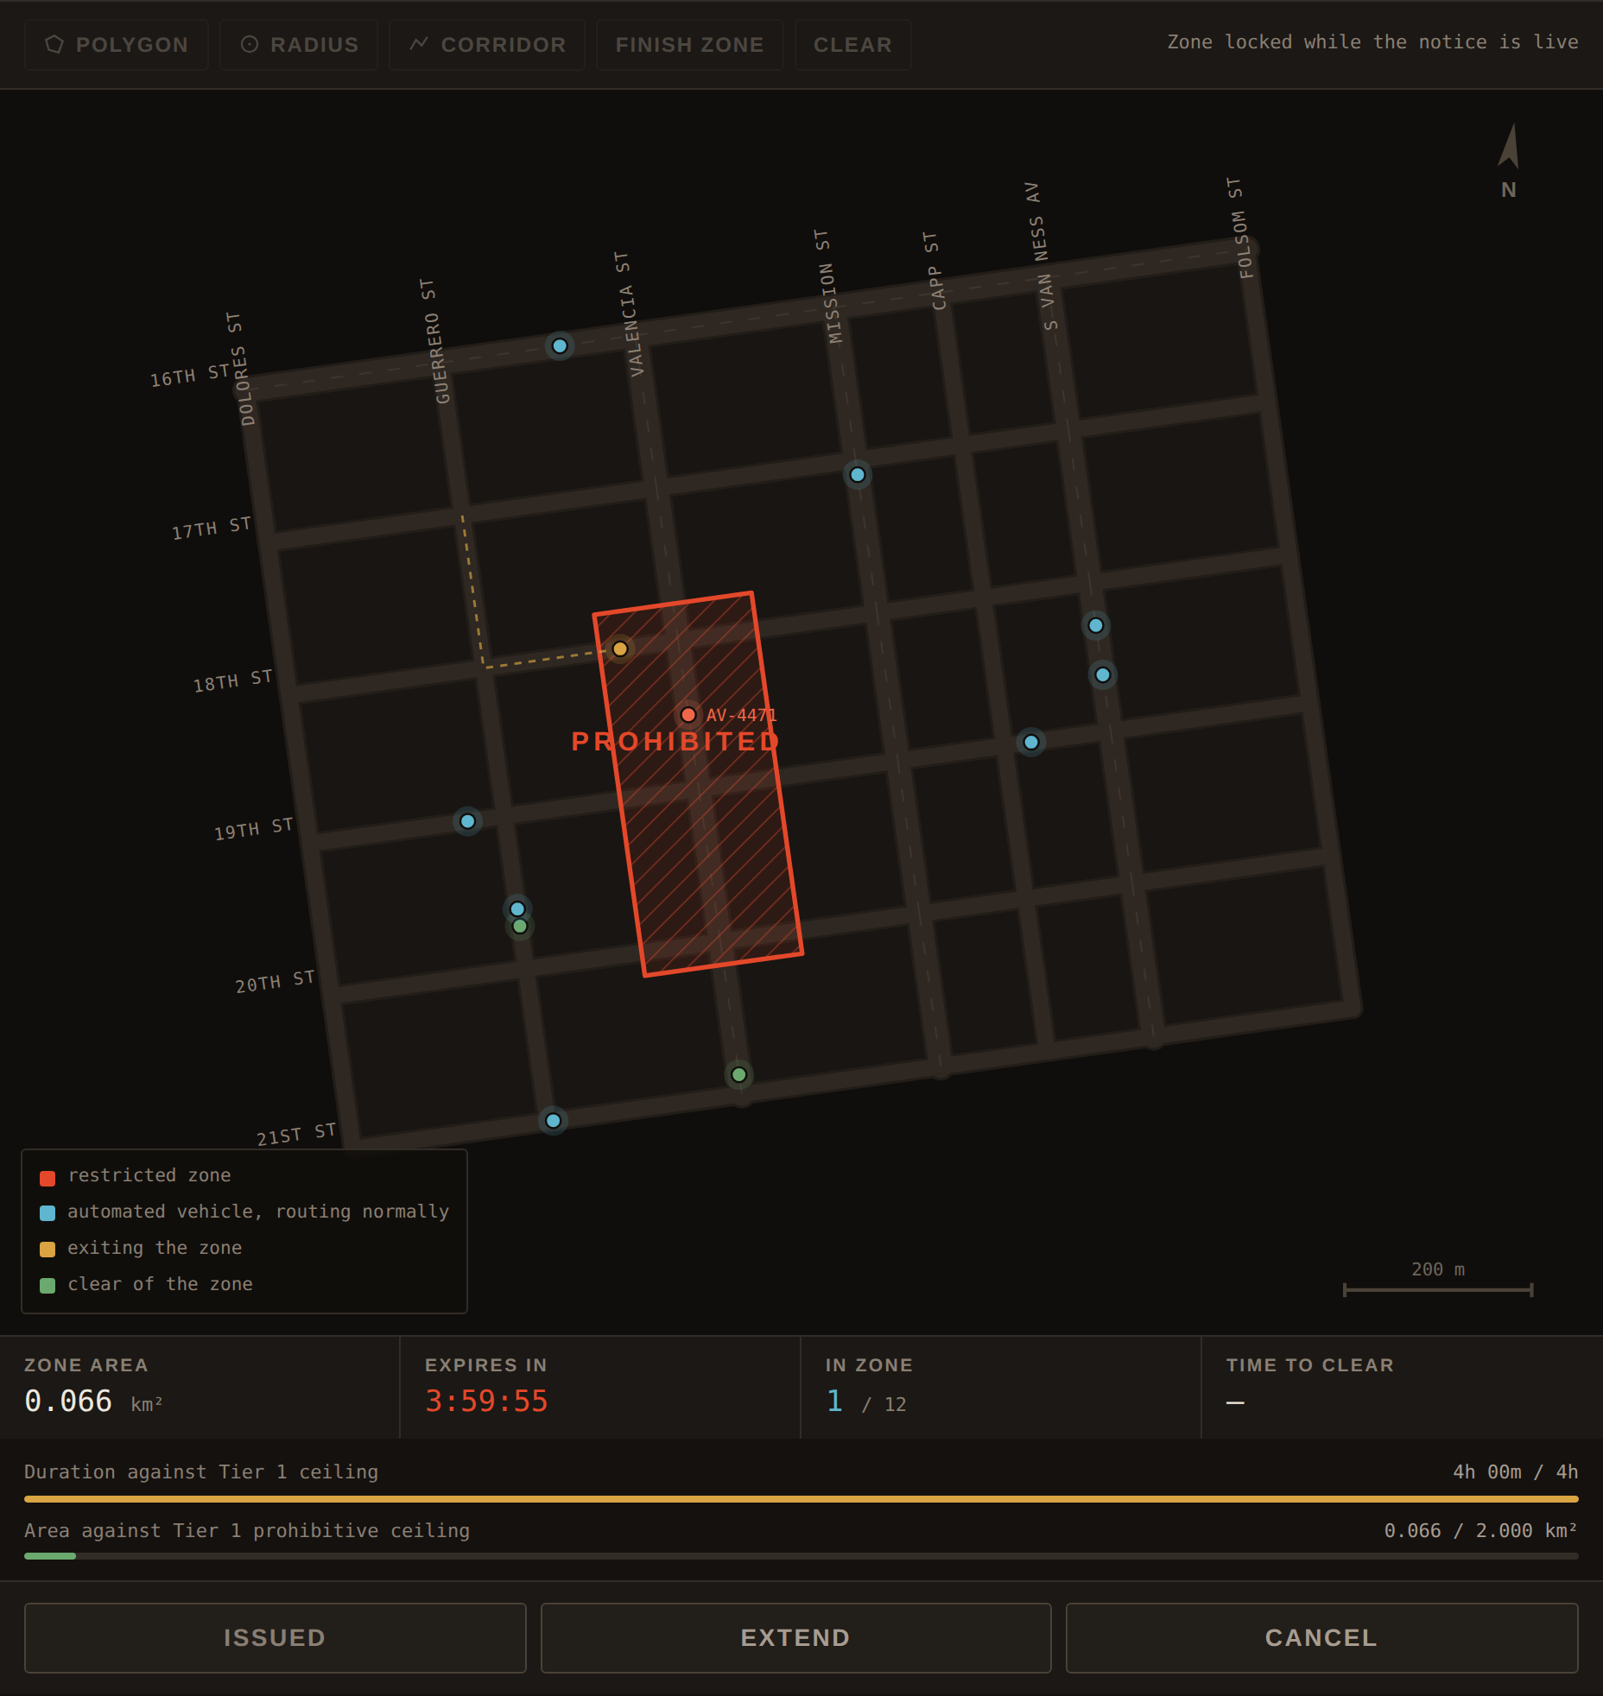
IN PRACTICE
A dispatcher draws the zone and issues it in under a minute
0:00
Draw the zone on the map. The console will not let you issue one that breaks a duration or area limit.
0:15
Every operator acknowledges, and reports how many of their vehicles are inside.
0:30
Routing is updated. No new vehicles enter.
5:00
Vehicles already inside are out. Any that cannot move are reported by exception on the hotline.
4:00:00
The restriction expires by itself unless the incident commander extends it.
Working demonstration console. The fleet, the acknowledgments and the signature are simulated; the notice it produces is real and validates against the specification.
Notes:
Show, do not describe. If you have a laptop, open the console and draw a zone live instead of using this slide. It takes about twenty seconds.
The timings on the right come from the specification's latency budget for a life-safety notice.
Point at the red vehicle in the map if it is visible: that is one that got boxed in by apparatus and could not leave. The format has a way to report that by exception rather than pretending the zone is clear.

Slide 9
ADOPTION
Four things a department needs. You already have the first.
1
2
3
4
The authority to send it
An authorized issuer
A way to draw the zone
Standing policy on levels
In California you have it now. A letter to each operator starts a 30 business day clock in which they must give you everything needed to begin issuing. You do not need anyone's permission and you do not need a credential to start.
Incident commander, watch commander or dispatch supervisor, per your policy. The format assumes an incident number and a staffed callback line. You already have both.
A CAD integration, or the standalone console. And a habit: send coordinates when your CAD can produce them. A landmark name makes somebody else guess how big the closure is.
The format supplies the vocabulary. Deciding that a working structure fire gets PROHIBITED and a fender bender gets AVOID is a local command decision, made before the incident.
The credential question is still open. Signing is what separates your notice from a forged one, and there is now a proposal on the table for who issues those certificates. If the fire service does not say how a twelve-person rural department gets one, that decision gets made without you.
Notes:
This slide changed. It used to say the first thing a department needs is a credential nobody can issue yet. In California that is no longer true: the authority to send is already yours, and the operator carries the duty to respond.
Card 1 is outlined in red because it is the action item, not because it is the obstacle. The letter is one page. We have a draft.
The red band is the remaining real gap. Signing is what makes a notice provably yours. There is a proposal now, which means the room has something to react to rather than a blank.
If someone asks who pays: nobody has costed this. Say so.

Slide 10
HONESTY SLIDE
Where this draft is tighter than the law requires
California law allows
This draft sets
Maximum duration
Whatever duration the official states, extendable. No ceiling.
4 hours for a fire or police incident, 24 hours cumulative. Longer only for planned infrastructure work.
Compliance timing
Fleet direction issued within 2 minutes
Acknowledge in 15 seconds, routing updated in 30 seconds, vehicles clear of the zone in 5 minutes.
What a location is
A street address or an intersection is enough
A shape. An address becomes a circle capped at 150 meters, recorded as synthesized, never quietly enlarged.
A four-hour ceiling is not a limit on your authority. It is a forcing function that makes someone look at the zone again while the incident is still live. Extending is one click. Forgetting is the failure the ceiling prevents.
Who may issue is the other gap. The law says any emergency response official, and does not define the edge of that list.
Notes:
Put this slide in deliberately. A room of chiefs will assume anything technical is overselling itself, and the fastest way past that is to volunteer where the draft disagrees with the law.
The duration row is the one people will push on. The answer: the law sets no ceiling at all, the draft sets working limits, and the limits are a proposal you can argue with. Extending is one click. Forgetting is the failure the ceiling prevents.
Row two: issue fleet direction in 2 minutes and have every vehicle clear in 5 are not the same claim, and the law only requires the first. Say that plainly.
Row three is the newest finding and the one worth dwelling on. Under the regulation, saying Valencia and 19th is a legally sufficient location. Somebody then decides whether that means a hundred meters or half a mile, and today that somebody works for the operator. The draft takes that decision back and bounds it.

Slide 11
SCOPE
What this is, and what it is not
IT IS
IT IS NOT
A draft technical specification, complete enough to implement.
The message format, the rules, a working console, and a validator.
Through one adversarial security and safety review, which found eighteen significant defects. All are fixed and covered by regression tests.
Open for comment, and expected to change.
An adopted standard. No standards body has taken it up.
A product. There is nothing to buy and nothing to install.
Agreed by anyone. No AV operator has committed to accept these notices.
Remote control. It cannot stop, steer or disable a vehicle, by design.
The credential registry, which everything else depends on, does not exist yet.
Notes:
Say this slide plainly and do not soften it. A command audience has been pitched vaporware before and will be listening for it.
The eighteen defects line is a credibility point, not a confession. A draft that has been attacked and repaired is worth more than one that has not.
If the room's takeaway is only that geofence notices need a common format and public safety should shape it, the briefing has done its job.

Slide 12
THE ASK
Four things. The first one is a letter.
01
Send the letter
One page to each operator running vehicles in your city, saying you intend to begin issuing and this is the interface you will use. California law then gives them 30 business days to make it work. We have a draft you can sign.
02
Run a tabletop
Take a real incident from your records, draw the zone in the console, and tell us where the format gets in the way.
03
Take a position on the registry
Who issues the signing credentials, and how a small department gets one. There is a proposal now. Argue with it.
04
Back a common format
The alternative is a separate bespoke arrangement with every operator, renegotiated each time a new one enters your city.
Federal rules average about five years, and only if the bill passes. The duty in California is in force today. Nothing about this is waiting on Washington.
Notes:
Close on the timing, and close hard. The old version of this slide said federal rules were two years out. The real figure is about five years on average, and the bill has not passed. None of that matters, because the California duty is already in force and the letter in ask 01 works today.
Ask 01 is the whole point of the briefing now. It is one page, it needs no legislature, no regulator, and no credential, and it starts a clock the operator has to answer.
Concrete second step: a one-hour tabletop with a real incident from their own records. Smallest useful commitment, and it produces the feedback the draft actually needs.
Leave behind: the executive summary, the California profile, the draft specification, and the console.

Slide 13
REFERENCE
The acronyms, in plain words
ADS
Automated Driving System. The driving automation itself. “AV” is the everyday word for a vehicle that has one.
CAD
Computer-Aided Dispatch. Your incident system, and where the incident number comes from.
CAP
Common Alerting Protocol. The standard format emergency alerts already travel in.
Covered entity
H.R. 10033's term for who carries the duty: the company operating the vehicles, or the manufacturer that sold them.
Geofence notice
A signed message telling automated vehicles to restrict operation in a defined area for a defined time.
H.R. 10033
The AV Emergency Response Coordination Act, introduced 3 August 2026. Not passed.
IPAWS
FEMA's national alert system. What your emergency manager sends alerts through.
NHTSA
National Highway Traffic Safety Administration. The federal vehicle safety regulator.
Registry
The credential authority that would issue signing certificates to agencies. Does not exist yet.
Tier
The authority class of the issuing agency, setting how long and how large a restriction it may impose.
WEA / EAS
Wireless Emergency Alerts to phones, and the Emergency Alert System on broadcast.
WZDx
Work Zone Data Exchange. How agencies already publish closures to Google Maps, Waze and Apple Maps.
Notes:
A leave-behind, not a slide to read out. Skip it in the room.
Useful if someone takes the deck away and circulates it, which is the most likely thing to happen to it.
The two worth saying aloud if they come up: covered entity is the bill's term and it covers manufacturers as well as fleet operators, which is what makes privately owned vehicles work. And the registry is the piece that does not exist.

