Slide 1
Heuristic Analysis
COMP 472 team: categorization pedants

Slide 2
Intro: Convolution
Board state represented as 3 2D arrays: X, O, B
Each win condition (horizontal, vertical, ascending, descending) represented as 2D array
  ex. descending for s=3:
[[1, 0, 0],
[0, 1, 0],
[0, 0, 1]]

Slide 3
Intro: Convolution
Convolution of board state and win condition gives the number of pieces in each possible win state
  Used for win detection and heuristic calculation
For large board sizes: compute FFT → convolution → IFFT
  Faster than iterating over board for large board sizes
    N >> 10
  Computable on GPU efficiently

Slide 4
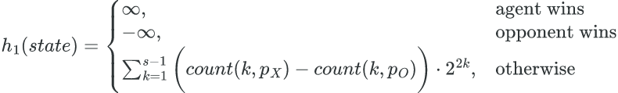
Heuristic 1
Uses convolution to determine the number of potential win states and the pieces in those states
  count(k,p): counts the number of potential win states with k pieces for player p
Weights exponentially based on number of pieces in win state

Slide 5
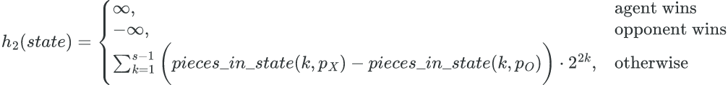
Heuristic 2
Uses convolution to count the number of pieces in each win state (ignoring whether a state is a valid potential win)
  pieces_in_state(k,p): counts the number of pieces for each win state with k pieces for player p
Faster than heuristic 1, but less informed

Slide 6
Game Analysis: Results
4431:
  H1: 5 wins H2: 0 wins
4435 (minimax):
  H1: 5 wins H2: 5 wins
5441:
  H1: 0 wins H2: 3 wins
5445:
  H1: 0 wins H2: 0 wins
8551:
  H1: 7 wins H2: 2 wins
8555:
  H1: 0 wins H2: 5 wins
8651:
  H1: 6 wins H2: 3 wins
5655:
  H1: 4 wins H2: 1 wins

Slide 7
Game Analysis: Time
With t=1, both AIs have very limited move selections
  Appears as AI taking the first available space
  GPU access would drasically improve AI performance
  H1 often wins: implies H1 is a better heuristic with shallower depth
    Counterpoint: 5441 (H2 won 3 times, 7 ties)
      Shows an edge case for heuristic: matches opponent’s state vs. blocking
Alpha-Beta pruning speeds AI up very significantly
  Especially with larger board sizes (greater branching factor)

Slide 8
Game Analysis: Depth
With given time settings, depth is typically not fully explored
I ran tests with no time limit: H1 won almost always (as expected)
H2 runs more evaluations deeper on average, given a time restriction (as expected)

Slide 9
Game Analysis: Conclusion
H1 > H2, even with limited time
Both heuristics are quite slow on small board sizes, but progressively better on larger boards
My system theoretically works much better with a CUDA-enabled GPU, having access to one would have been useful
Reading the project specification is a good idea :)

