Slide 1
Collaborative Code Editor
Submitted in the partial fulfillment for the award of the degree of
BACHELOR OF ENGINEERING
IN
BLOCKCHAIN TECHNOLOGY
Submitted by:
BHUPATI PARMAR (22BCT10004)
NIKHIL SAINI (22BCT10005)
ADITYA SHIRKOT (22BCT10035)
JAGDEEP SINGH (22BCT10044)
Under the Supervision of:
Asst Prof. SHAKSHI KATTNA
Department of AIT-CSE
DISCOVER . LEARN . EMPOWER

Slide 2
Outline
Introduction to Project
Problem Formulation
Objectives of the work
Methodology used
Conclusion
Future Scope
References

Slide 3
What is a Collaborative Code Editor ?
A Collaborative Code Editor is a tool that allows multiple developers to work together on the same codebase in real-time, enabling seamless communication, synchronized updates, and shared editing to streamline the development process.
A Collaborative Code Editor is like a shared digital whiteboard where multiple developers can write and edit code together in real-time. It's a tool that makes coding a team effort and allowing everyone to work on the same project simultaneously

Slide 4

Introducing CodeHive
CodeHive is a cutting-edge Collaborative Code Editor designed to bring developers together, enabling seamless real-time collaboration and efficient project management.
Collaboration..... Real-time code collaboration with instant updates.
Control..... Integrated version control for effortless tracking of changes.
Highlighting..... Syntax highlighting to enhance readability and reduce errors.
Support..... Multi-user support for seamless team coding across different locations.

Slide 5

Problem Formulation
Some of the limitations are discussed in detail in the following points: -
Fragmented Collaboration: Developers often struggle with coordinating their efforts when working remotely or across different time zones. Traditional coding environments lack real-time collaboration features, leading to fragmented communication and inefficiencies in project development.
Version Control Challenges: Managing multiple versions of a codebase is complex and error-prone. Without an integrated version control system, teams face difficulties in tracking changes, resolving conflicts, and maintaining the integrity of the project.

Slide 6
Code Readability Issues: Inconsistent coding styles and lack of visual differentiation in code can lead to readability challenges. This makes it harder for teams to quickly identify key elements, spot errors, and maintain a cohesive codebase.
Inefficient Team Coordination: Coordinating multiple developers on the same project can result in overlapping work, miscommunication, and delays. Traditional coding environments don’t effectively support synchronized efforts, causing bottlenecks in the development process.

Slide 7
Objectives of the Work
The core objectives are:-
TIME
EFFICIENCY
PRECISION
CREATIVITY

Slide 8
Methodology used
For this project several Python libraries are used for the development process. Here are some key libraries and their relevance to the project:
Agile Development: Employed Agile methodology to facilitate iterative development and continuous feedback. This approach allowed for rapid adjustments based on user feedback, ensuring that Codehive met evolving needs and maintained flexibility throughout the development cycle.
Real-Time Collaboration Tools: Integrated real-time communication frameworks and WebSocket technologies to enable synchronous code editing and updates. This ensured that changes made by one user were instantly visible to others, enhancing collaborative coding efforts.
Version Control Integration: Incorporated a robust version control system to manage code revisions, track changes, and resolve conflicts efficiently. This integration provided a seamless way for developers to handle codebase versions and maintain project integrity.

Slide 9
Syntax Highlighting Algorithms: Developed and implemented syntax highlighting algorithms to improve code readability. By color-coding code elements based on their function and structure, the system facilitated easier error detection and understanding of complex codebases.
User Experience (UX) Design: Focused on designing an intuitive and user-friendly interface to enhance overall usability. Conducted usability testing and incorporated feedback to refine the editor’s layout, navigation, and functionality, ensuring a smooth and effective coding experience for users.
Scalable Architecture: Utilized scalable cloud-based infrastructure to support concurrent users and handle high traffic volumes efficiently. This approach ensured that Codehive remained performant and reliable, even as the number of users and projects increased.
Security Measures: Implemented comprehensive security protocols to protect user data. Applied encryption, authentication, and authorization measures to safeguard sensitive information and ensure secure access to the platform.

Slide 10
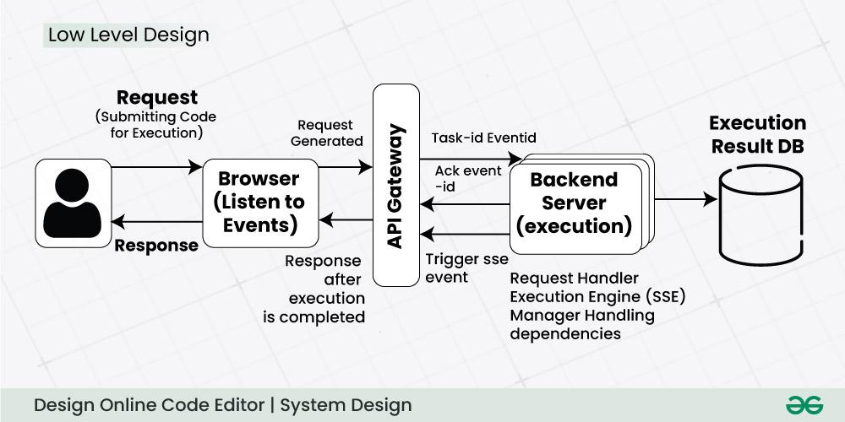
The approach we uses to create the Collaborative Editor is shown in the following diagram. We used Nextjs 14 as the Backend language .

Slide 11

Conclusion
Codehive addresses the key challenges of modern software development by providing a robust platform that fosters seamless collaboration, efficient version control, and enhanced code readability. By integrating real-time collaboration features, supporting multi-user environments, and ensuring consistent accessibility, Codehive transforms the coding process into a cohesive, synchronized effort.
This collaborative code editor not only streamlines project management but also accelerates development, making it an invaluable tool for teams aiming to produce high-quality code efficiently and effectively. Through Codehive, developers can work together more closely than ever before, regardless of location or time zone.

Slide 12

Future Scope
The advancements possible with respect to your project in future are:
Enhanced Accessibility
AI-Powered Code Suggestions
Advanced Code Analytics
Expanded Language Support
Enhanced Security Features
Mobile App Integration
Customizable Workspaces
Integration with Third-Party Tools
Enhanced Offline Capabilities

Slide 13
References
[1] A. M. Turing, Computing Machinery and Intelligence. Mind, 1950.
[2] J. Weizenbaum, Computer Power and Human Reason: From Judgment to Calculation. New York: W. H. Freeman and Company, 1976.
[3] M. Radziwill, N. Benton, “Evaluating quality of chatbots and intelligent conversational agents,” 2017.
[4] Virtual assistant: meaning in the cambridge english dictionary. [Online]. Available: https://dictionary.cambridge.org/dictionary/english/ virtual-assistant?topic=computer-programming-and-software.
[5] G. O. Young, “Synthetic structure of industrial plastics (Book style with paper title and editor),” in Plastics, 2nd ed. vol. 3, J. Peters, Ed. New York: McGraw-Hill, 1964, pp. 15–64.
[6] W.-K. Chen, Linear Networks and Systems (Book style).Belmont, CA: Wadsworth, 1993, pp. 123–135.
[7] H. Poor, An Introduction to Signal Detection and Estimation. New York: Springer-Verlag, 1985, ch. 4.
[8] E. H. Miller, “A note on reflector arrays (Periodical style—Accepted for publication),” IEEE Trans. Antennas Propagat., to be published.
[9] Ardissono, L., Boella. And Lesmo, L. (2000) “A Plan-Based AgentArchitecture for Interpreting Natural Language Dialogue”, International Journal of Human-Computer Studies.
[10] P. Greenberg, “Chatbots: Conversation for all of us.” Pitney Bowes.

Slide 14
[11] “Technology landscape review,” Torchbox: Council Chatbots, 2019.
[12] UNDP. Sustainable development goals. [Online]. Available: https://www. undp.org/content/undp/en/home/sustainable-developmentgoals.html
[13] D. Jurafsky and J. H. Martin, In Speech and language processing. Harlow: Pearson, 2014
[14] B. Smith, “An approach to graphs of linear forms (Unpublished work style),” unpublished.
[15] Watson assistant foundations. [Online]. Available: https://learn.ibm. com/course/view.php?id=4329
[16]. Python Programming - KiranGurbani
[17]. Learning Python - Mark Lutz
[18]. DesigningPersonalAssistantSoftwareforTaskManagementusingSemanticWebTechnologiesandKnowledge Databases.
[19]. PythoncodeforArtificialIntelligence:FoundationsofComputationalAgents,DavidL.PooleandAlanK.Mackwort
[20]. Chatbot Learning: Everything you need to know about machine learning chatbots (2020). https://www.whoson.com/chatbots-ai/chatbot-learning-everything-need-knowmachine-learning-chatbots/
[21]. How to use an API with Python(Beginner’s Guide). Retrieved from the link https://rapidapi.com/blog/how-to-use-an-api-with-python/
[22]. Introduction to Machine Learning using Python (January 2019). Retrieved from https://www.geeksforgeeks.org/introduction-machine-learning-using-python/

