Slide 1
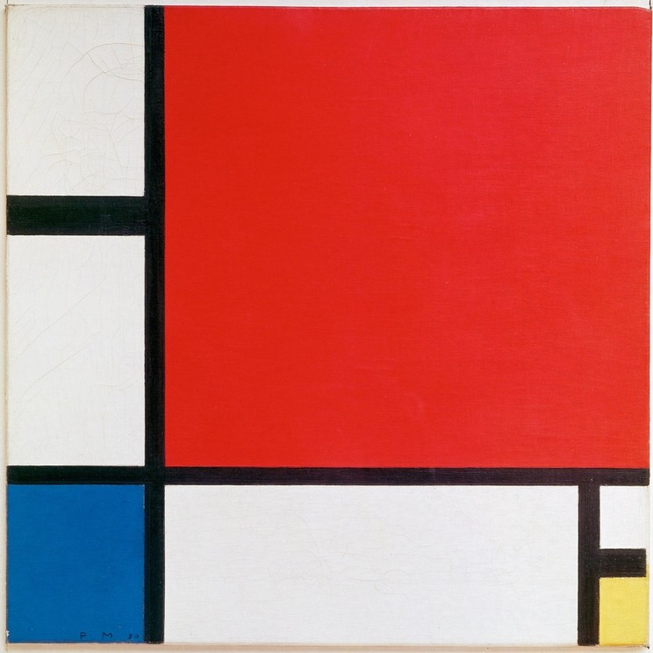
THE CRITICAL ESSAY
Titles and Formatting
Put it all together
YAWP! Writing Program · [CLASS] · [DATE]
Piet Mondrian
Composition with Red, Blue and Yellow, 1930
Oil on canvas · Kunsthaus Zürich

Slide 2
Today’s program
The last step of the writing process: make it ready for a reader.
i.
Course review
ii.
The conclusion, one more time
iii.
Titling your essay
iv.
Putting it all together

Slide 3
Course review.
Six questions from the lessons so far.
Pick your answer before the reveal. Hands up!
Notes:
Optional warm-up. These questions build from lesson to lesson, so you can watch students' answers improve over the unit. Delete this section to skip it.

Slide 4
QUESTION 1 OF 6
What’s the best way to write an essay?
a.
Just start writing and hope some good ideas come out.
b.
Take my ideas and plug them into a formula, like the five-paragraph essay.
c.
Develop my ideas into a thesis statement and build my essay around that.
d.
ChatGPT, duh.
e.
I have never actually written an essay, so I have no idea.

Slide 5
QUESTION 1 OF 6 · ANSWER
What’s the best way to write an essay?
a.
Just start writing and hope some good ideas come out.
b.
Take my ideas and plug them into a formula, like the five-paragraph essay.
c.
Develop my ideas into a thesis statement and build my essay around that.
d.
ChatGPT, duh.
e.
I have never actually written an essay, so I have no idea.
Notes:
Correct answer: c. Optional warm-up. These questions build from lesson to lesson, so you can watch students' answers improve over the unit. Delete this section to skip it.

Slide 6
QUESTION 2 OF 6
Critical thinking is best defined as:
a.
Asking questions and seeking answers about a topic in order to develop a position on it
b.
Finding all of the weaknesses in an argument
c.
Finding all of the strengths in an argument
d.
Arguing a specific point of view in front of an audience
e.
Researching experts’ perspectives and arguments on a topic in order to develop a position on it

Slide 7
QUESTION 2 OF 6 · ANSWER
Critical thinking is best defined as:
a.
Asking questions and seeking answers about a topic in order to develop a position on it
b.
Finding all of the weaknesses in an argument
c.
Finding all of the strengths in an argument
d.
Arguing a specific point of view in front of an audience
e.
Researching experts’ perspectives and arguments on a topic in order to develop a position on it
Notes:
Correct answer: a. Optional warm-up. These questions build from lesson to lesson, so you can watch students' answers improve over the unit. Delete this section to skip it.

Slide 8
QUESTION 3 OF 6
Which of the following is MOST true about a good thesis statement?
a.
It is easy for the reader to agree with.
b.
It contains two or three pieces of support.
c.
It contains observation and analysis.
d.
It contains research and facts.
e.
It is one or two sentences long.

Slide 9
QUESTION 3 OF 6 · ANSWER
Which of the following is MOST true about a good thesis statement?
a.
It is easy for the reader to agree with.
b.
It contains two or three pieces of support.
c.
It contains observation and analysis.
d.
It contains research and facts.
e.
It is one or two sentences long.
Notes:
Correct answer: c. Optional warm-up. These questions build from lesson to lesson, so you can watch students' answers improve over the unit. Delete this section to skip it.

Slide 10
QUESTION 4 OF 6
Your introduction paragraph’s MAIN function is to:
a.
Tell a story that illustrates the topic of your essay
b.
Give specific examples that support your thesis
c.
Define important terms that your reader may need to know
d.
Present questions that your essay will answer
e.
Welcome your reader into your discussion and state the thesis

Slide 11
QUESTION 4 OF 6 · ANSWER
Your introduction paragraph’s MAIN function is to:
a.
Tell a story that illustrates the topic of your essay
b.
Give specific examples that support your thesis
c.
Define important terms that your reader may need to know
d.
Present questions that your essay will answer
e.
Welcome your reader into your discussion and state the thesis
Notes:
Correct answer: e. Optional warm-up. These questions build from lesson to lesson, so you can watch students' answers improve over the unit. Delete this section to skip it.

Slide 12
QUESTION 5 OF 6
Which of the following would probably NOT show up in your body paragraphs?
a.
Supporting quotations about specific points
b.
Your opinions
c.
Your thesis statement
d.
Analysis of other people’s arguments

Slide 13
QUESTION 5 OF 6 · ANSWER
Which of the following would probably NOT show up in your body paragraphs?
a.
Supporting quotations about specific points
b.
Your opinions
c.
Your thesis statement
d.
Analysis of other people’s arguments
Notes:
Correct answer: c. Optional warm-up. These questions build from lesson to lesson, so you can watch students' answers improve over the unit. Delete this section to skip it.

Slide 14
QUESTION 6 OF 6
True or false: a good conclusion restates the thesis and main ideas of your essay.
a.
True
b.
False

Slide 15
QUESTION 6 OF 6 · ANSWER
True or false: a good conclusion restates the thesis and main ideas of your essay.
a.
True
b.
False
Restating your thesis and main points can feel very repetitive. A good conclusion offers final reflection, arguments, or a call to action based on everything you just said.
Notes:
Correct answer: b. Optional warm-up. These questions build from lesson to lesson, so you can watch students' answers improve over the unit. Delete this section to skip it.

Slide 16
Remember.
The suggested conclusion structure
1
Rhetorical question
2
Answer that question directly
3
Two sentences of opinion or analysis
4
A supporting quote (if you’re working with a text)
5
A final, concluding sentence: your big, final point

Slide 17
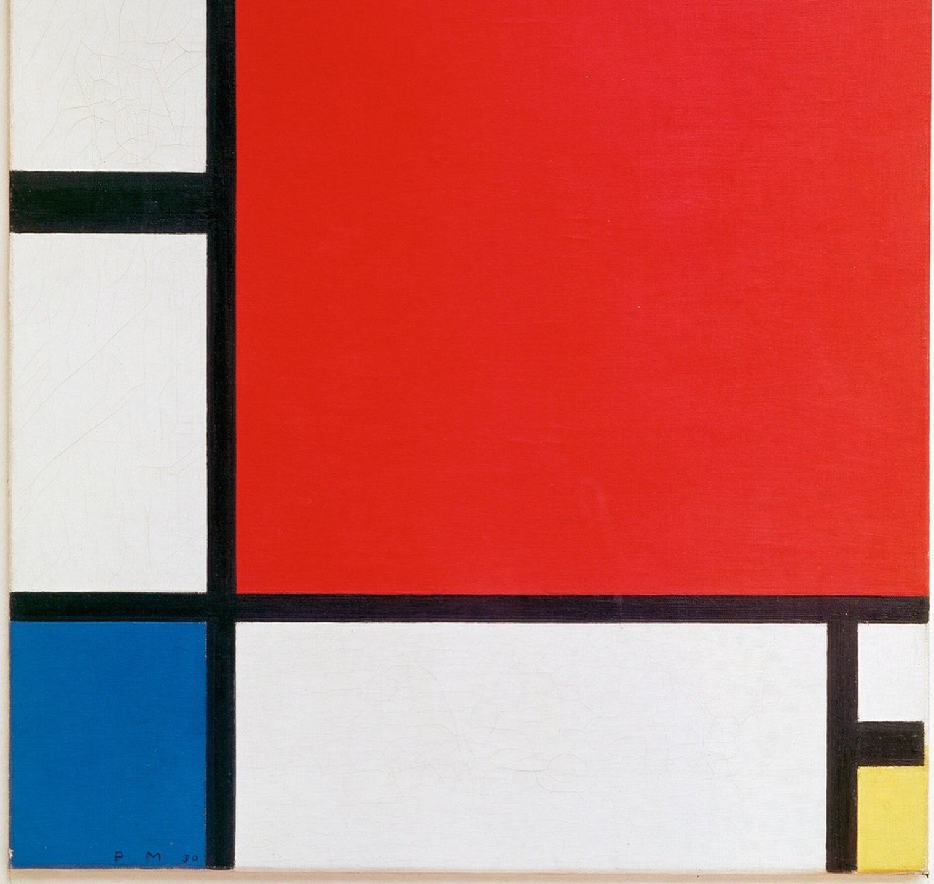
Step 6.
Give your essay a title.
Piet Mondrian, Composition with Red, Blue and Yellow (detail), 1930

Slide 18
Your title should be informative, smart, and memorable.
Let your title indicate the topic of your discussion in a thoughtful way.
Don’t ever, ever, EVER title your essay “Essay” or “English Paper.”

Slide 19
Try this.
The colon title
CREATIVE
CLEAR
Beyond the Boys’ Club:
How Female Heroes Define the Avengers Legacy
Bored in the USA:
How Lack of Creativity in Schools Hurts Students and Teachers
Unlocked and Loaded:
How Easy Gun Access Puts Children at Risk

Slide 20
Each title has two parts
LEFT OF THE COLON
A creative or “fun” element.
RIGHT OF THE COLON
A clear and direct description of the essay topic.
Alone, each side would be ordinary at best and confusing at worst. Together, they make a smart, informative, and memorable title.

Slide 21

TITLES AND FORMATTING
Last step.
Putting it all together

Slide 22
Finishing touches
Clean up your essay
Delete any pre-writing or non-essay text.
MLA FORMAT FOR THE ENTIRE ESSAY
a.
12-point, easy-to-read font (like Times New Roman)
Give it a title
Center it. No italics, bold, or underlining.
b.
Double-spaced throughout, with no extra space between paragraphs
c.
Indent the first line of each paragraph half an inch
Format the entire essay
Use MLA format, step by step →
d.
Aligned left (not centered!), with 1-inch margins
e.
Top left: your name, teacher, class, and date
f.
Top right: your last name and page number

Slide 23
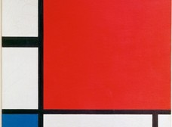
Before you go.
Clean it up. Title it. Format it.
Then your essay is ready for a reader.

