Slide 1

THE CRITICAL ESSAY
Develop Your Thesis Statement
The focal point of your essay
YAWP! Writing Program · [CLASS] · [DATE]
Katsushika Hokusai
Under the Wave off Kanagawa (The Great Wave), c. 1831
Woodblock print · from Thirty-six Views of Mount Fuji

Slide 2
i.
What’s happening in the picture?
Today’s Program
ii.
Quick review
iii.
Observation
Step two of the writing process: turn your pre-writing into a thesis.
iv.
Analysis
v.
Combine them into a thesis
vi.
Avoid the verb “to be”

Slide 3
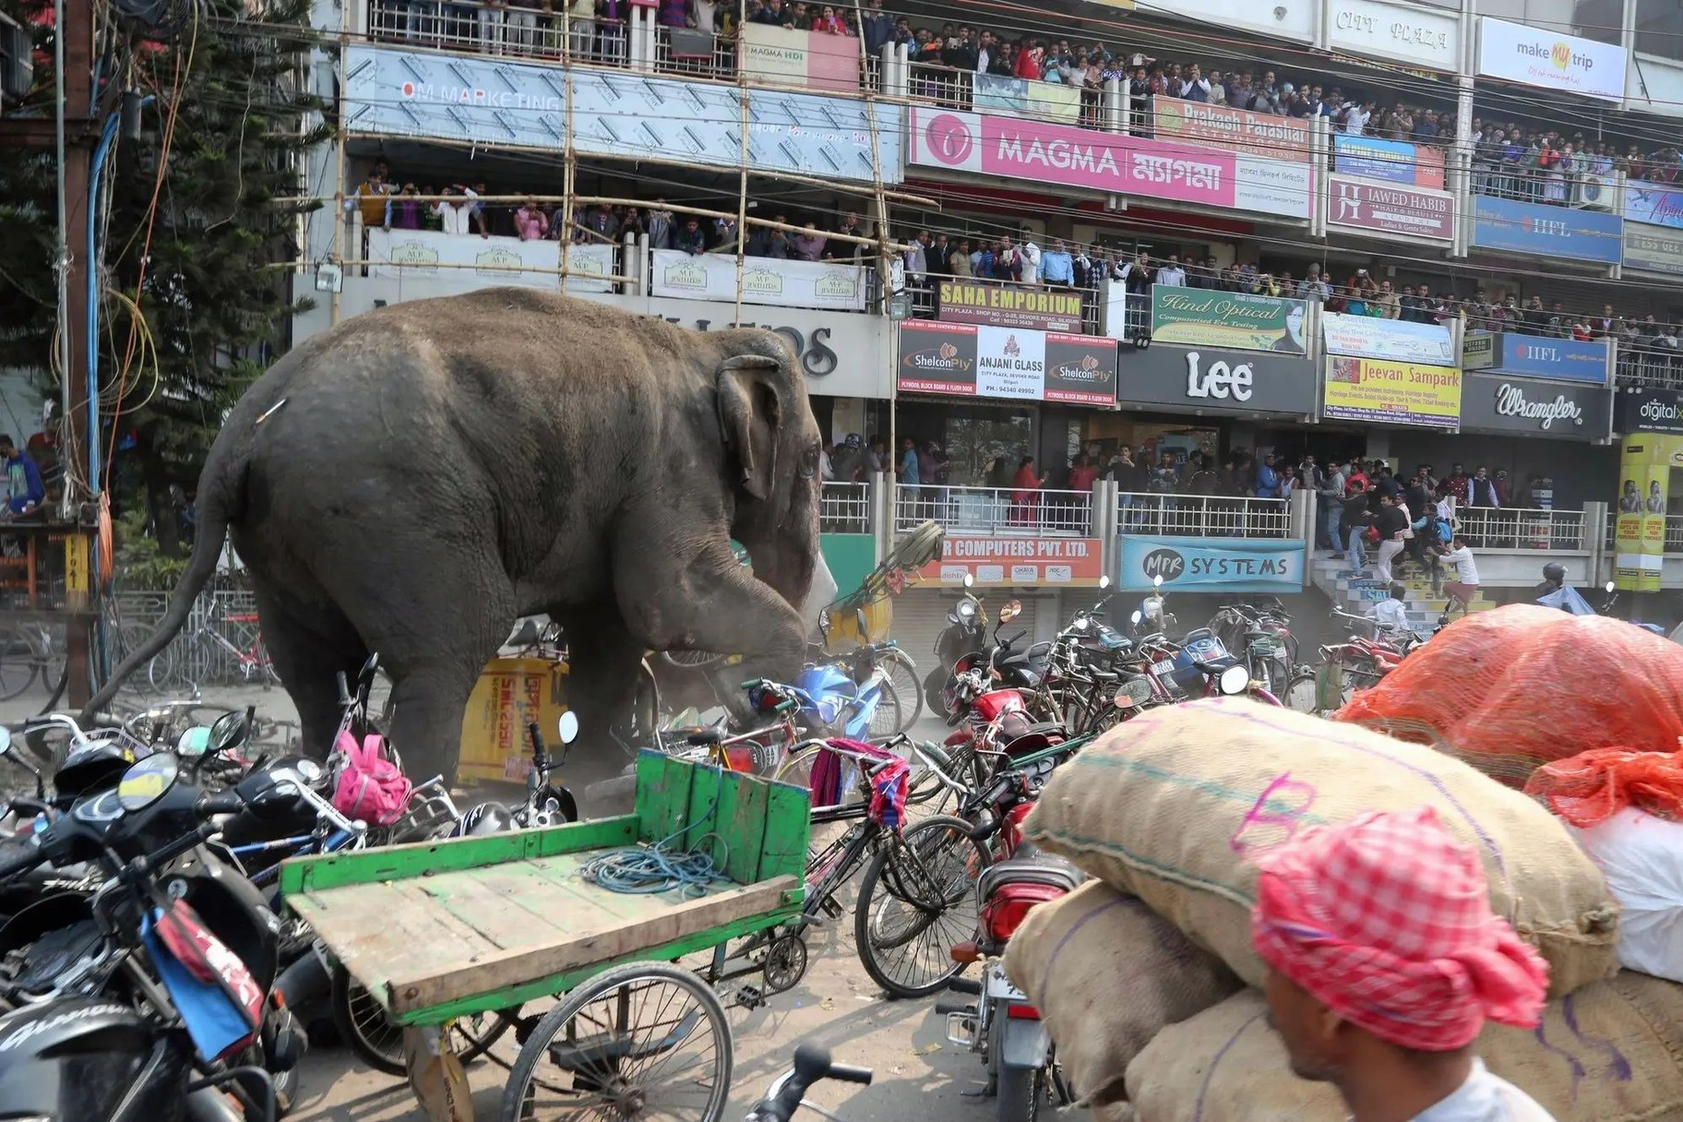
Observe and Analyze.
What is happening in this picture?
What details can you find?
What do they lead you to believe?
Photograph · what’s happening here? We’ll find out.

Slide 4

What happened.
This elephant wandered out of a forest and into the streets of a city in North Bengal, India, attacking houses, shops and vehicles over a period of hours. The elephant was finally calmed with three tranquilizer darts. The clash appeared to have a happy ending: the authorities said they returned the creature to the forest.
Photograph · North Bengal, India

Slide 5
Quick review.
What do we need to figure out before we can write a great essay?

Slide 6


DEVELOP YOUR THESIS STATEMENT
Remember.
The critical essay form
Look where the thesis sits: the last sentence of your introduction, where everything narrows to a point.

Slide 7
Hold this.
Great thesis statements lead to great essays.
(And weak or non-existent thesis statements lead to weak essays!)

Slide 8
… serves the purpose of narrowing your topic so that you can write your thesis.
Remember.
All of your pre-writing …
Flesh out all of your ideas and opinions about the subject: ask and answer, ask and answer, ask and answer.
Your discussion should get more specific as you go, until your answers start to sound like intelligent conclusions about the subject. At that point, you’re very close to your thesis.

Slide 9

Step 2.
Develop a thesis statement.
Everything in the picture points to one place
Katsushika Hokusai, The Great Wave (detail), c. 1831

Slide 10

DEVELOP YOUR THESIS STATEMENT
Hold this.
Your thesis statement represents the focal point of your essay.

Slide 11
Wording your thesis statement
1
2
3
Your thesis should be one sentence long.
Your thesis should include observation as well as analysis.
Your thesis should be specific.

Slide 12
Think.
What do we mean by “observation”?

Slide 13
An observation is something we notice or see about a subject.
Let’s look at some examples →

Slide 14
Observations.
i.
Creative thinking is not prioritized in schools.
Three things we notice about school
ii.
Most classroom teachers teach the way they were taught.
iii.
Schools place too much emphasis on right and wrong answers.

Slide 15
So what?
Without analysis, your thesis statement will fall flat.

Slide 16
Think.
What do we mean by “analysis”?

Slide 17
Analysis is a reaction, argument, examination, or conclusion based on an observation.

Slide 18
Add analysis.
OBSERVATION
ANALYSIS
Creative thinking is not taught enough in schools.
… this makes school boring for teachers and students
… takes away their motivation and excitement
… they don’t feel as accomplished

Slide 19
Add analysis.
OBSERVATION
ANALYSIS
Most classroom teachers teach the way they were taught.
… this creates a situation where old ideas and methods are recycled, and new, current ideas are ignored
… this is an ineffective teaching method

Slide 20
Add analysis.
OBSERVATION
ANALYSIS
Schools place too much emphasis on right and wrong answers.
… this is a limited approach to learning
… it puts too much emphasis on correctness
… it ignores the personal expression of students’ experience

Slide 21
Write.
On your document, create your own observation and 2–4 points of analysis.
USE THIS MODEL
Observation: Schools place too much emphasis on right and wrong answers.
Analysis:
… this is a limited approach to learning
… it puts too much emphasis on correctness
… it ignores the personal expression of students’ experience
Your observation, your analysis · 2–4 points

Slide 22
Combine.
Observation + analysis = thesis
OBSERVATION
ANALYSIS
Creativity is not prioritized enough in schools.
… this makes school boring for teachers and students
… takes away their motivation and excitement
… they don’t feel as accomplished
THESIS
When schools fail to prioritize creativity in teaching, school becomes boring for both students and teachers, resulting in a lack of shared motivation, excitement, and accomplishment.

Slide 23
Combine.
Observation + analysis = thesis
OBSERVATION
ANALYSIS
Most classroom teachers teach the way they were taught.
… this creates a situation where old ideas and methods are recycled, and new, current ideas are ignored
… this is an ineffective teaching method
THESIS
Teachers too often teach the way they were taught, which creates an ineffective learning environment where old ideas and methods are recycled, while new, current ideas are ignored.

Slide 24
Combine.
Observation + analysis = thesis
OBSERVATION
ANALYSIS
Schools place too much emphasis on right and wrong answers.
… this is a limited approach to learning
… puts too much emphasis on correctness
… ignores the personal expression of students’ experience
THESIS
The education system’s obsession with testing represents a limited approach to learning that puts too much emphasis on right and wrong answers and ignores the personal learning experience of individual students.

Slide 25
Hold this.
The two components of an effective thesis
Observation + Analysis = Complex thesis

Slide 26
Hold this.
Crafting a thesis statement that works is vital to the rest of your essay …
… so don’t ever begin writing your essay until you’ve created a strong thesis statement!

Slide 27
Review. A thesis statement must be …
One sentence
Observation + analysis
Specific
One complex, concise* sentence
It must include both.
Specific, not general.
*Concise does not equal brief!

Slide 28

One more thing.
Avoid the verb “to be.”
It creates wordy situations.
Katsushika Hokusai, The Great Wave (detail), c. 1831

Slide 29
Notice.
For example …
Creative design in lesson plans is really important and is something that isn’t taught in teacher training programs.

Slide 30
Change to.
Teacher training programs don’t emphasize creative design in lesson plans.
This is much better. It gives the sentence a stronger, more direct feel. This is called being concise, and being concise should be your goal in critical writing.

Slide 31
Before and after
WITH THE VERB “TO BE”
WITHOUT IT
Creative design in lesson plans is really important and is something that isn’t taught in teacher training programs.
Teacher training programs don’t emphasize creative design in lesson plans.

Slide 32
But wait, there’s more!
Now that you’ve taken the “to be” clutter out of that statement, there’s room for more good stuff.
Taking the verb “to be” out of a sentence is like weeding a garden: you remove the stuff you don’t need, and then there’s room for better stuff to grow.
Check it out →

Slide 33
This can now become this
When teacher training programs do not emphasize creative design in lesson plans, teachers fail to understand their role as entertainers, resulting in boring lessons.
Teacher training programs don’t emphasize creative design in lesson plans …
→

Slide 34

Whoa. Did you see that?
How that lame thesis statement from before just became kind of awesome?

