Slide 1
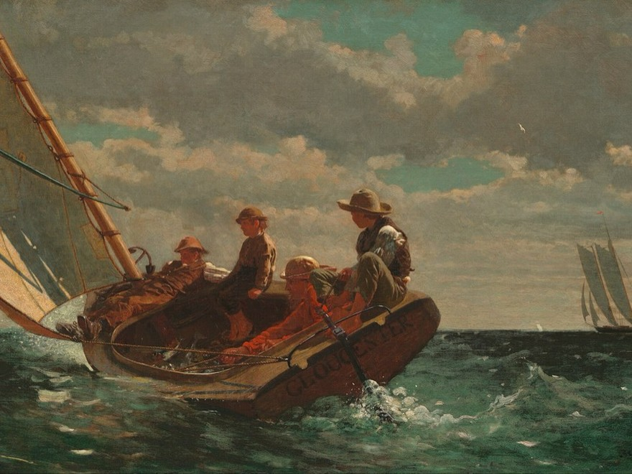
THE CRITICAL ESSAY · WELCOME
Welcome to YAWP!
Find your yawp, and learn how to make it heard.
YAWP! Writing Program · [CLASS] · [DATE]
Winslow Homer
Breezing Up (A Fair Wind), 1873–1876
Oil on canvas · National Gallery of Art, Washington

Slide 2
Today’s program
Our first session: who we are, why we write, and where we’re headed.
i.
Two truths and a lie
ii.
Why do we write?
iii.
Read a sample essay: “Bored in the USA”
iv.
What are we doing here?
v.
Get started in YAWP!

Slide 3
Play.
Two truths and a lie
Truths: have to be true.
The lie: has to be believable.
MINE
1
I have a twin who is a blonde-haired version of me.
2
I was born in Canada.
3
I met my wife in high school.
Which one is the lie?

Slide 4
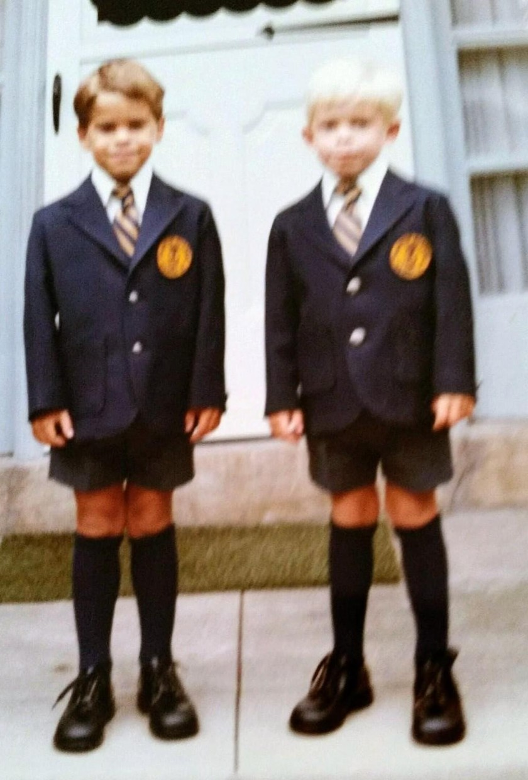
Hello.
I am Brian Connell.
I’m here because I love writing and helping other people become better writers.

Slide 5
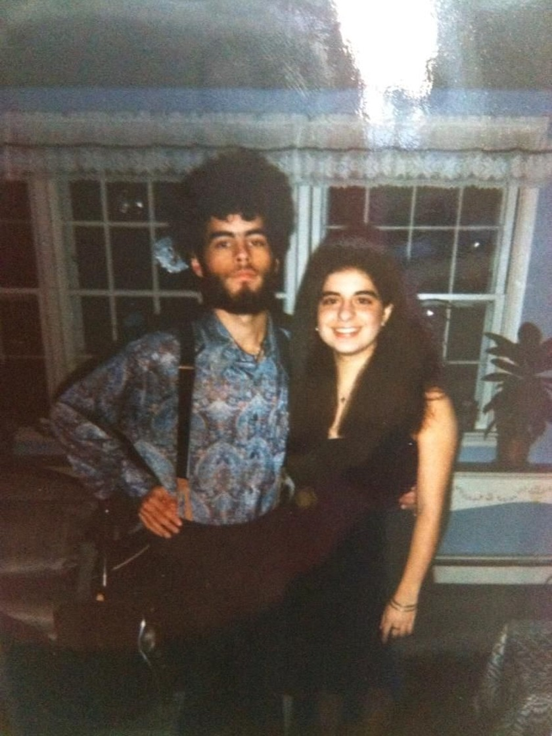
I am also Brian Connell.
(The late 1900s were amazing.)

Slide 6
Your turn.
Two truths and a lie
Remember: the truths have to be true, and the lie has to be believable!

Slide 7
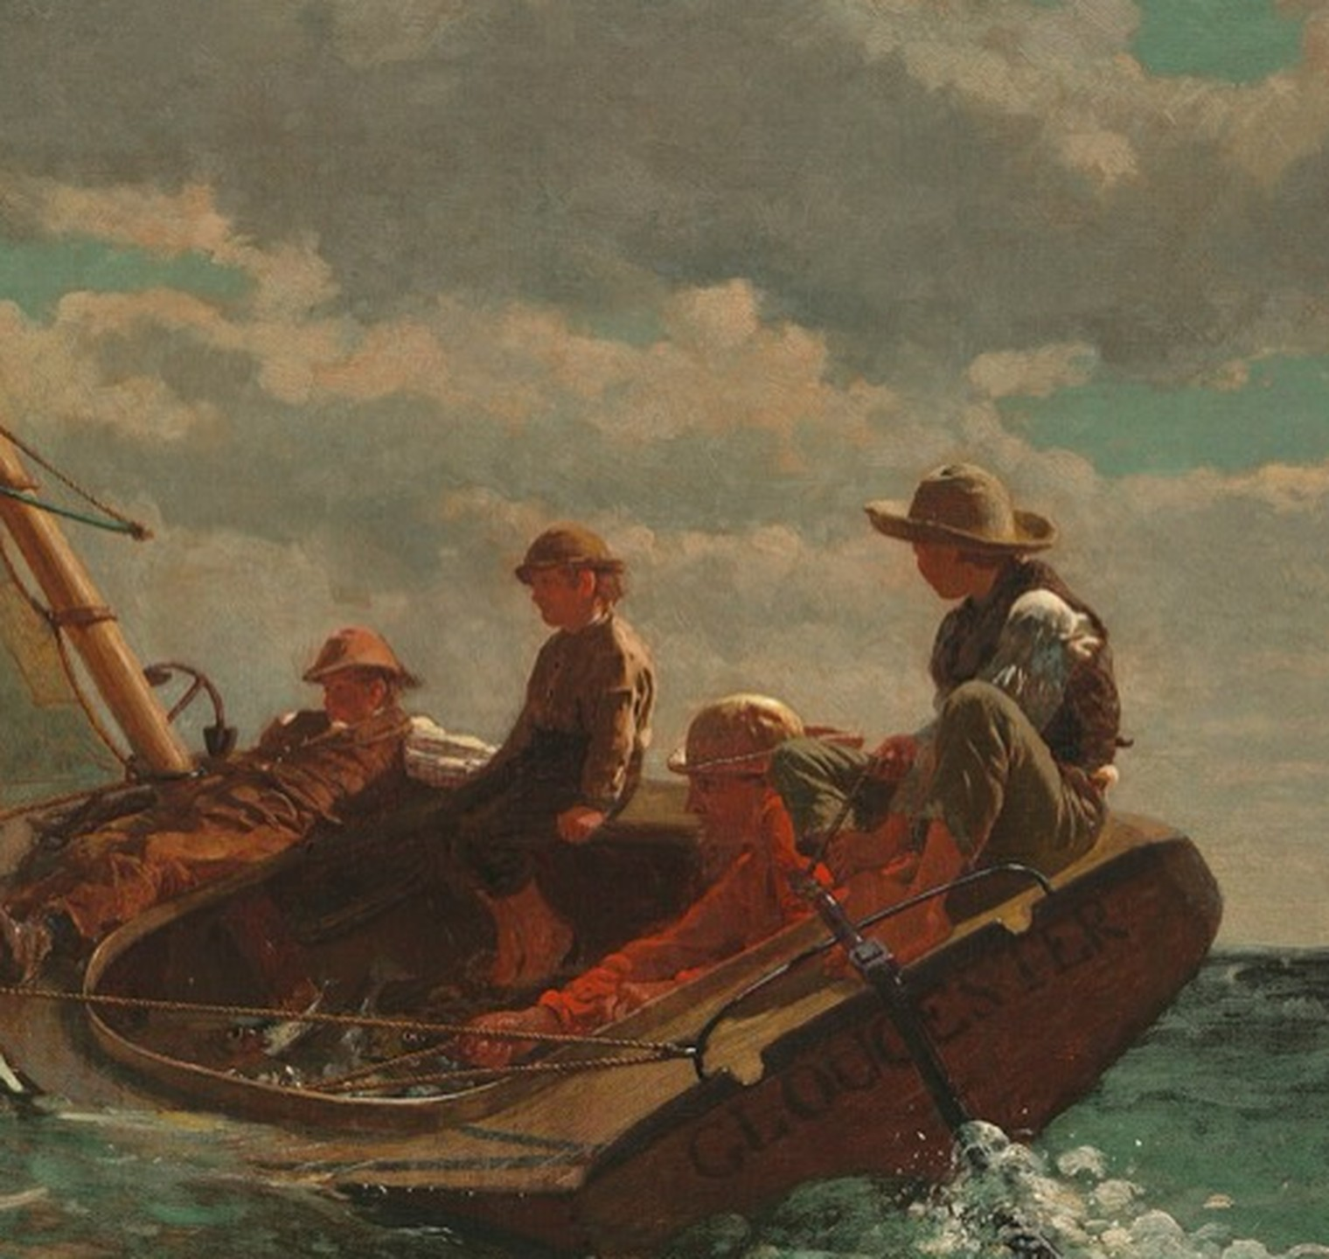
Why do we write?
Every writer sets out with something to say
Winslow Homer, Breezing Up (detail), 1873–1876

Slide 8
“I sound my barbaric yawp over the roofs of the world.”
Walt Whitman, “Song of Myself”

Slide 9
Why do we write?
i.
Because we have things to say! Our individual “yawp.”
ii.
Because writing is one of the most effective ways of expressing ourselves. What other ways can we express ourselves?
iii.
Because writing is power.

Slide 10
Read.
SAMPLE ESSAY
“Bored in the USA”
As you read, notice what you like, whether you agree, and what the writer is really arguing.

Slide 11
Class discussion
What do you like about this essay?
Do you agree with the writer?
What is the main point or argument?

Slide 12


INTRODUCTION TO YAWP!
Know this.
The critical essay form
The essay we just read follows this shape. So will yours.
This is also your handout

Slide 13
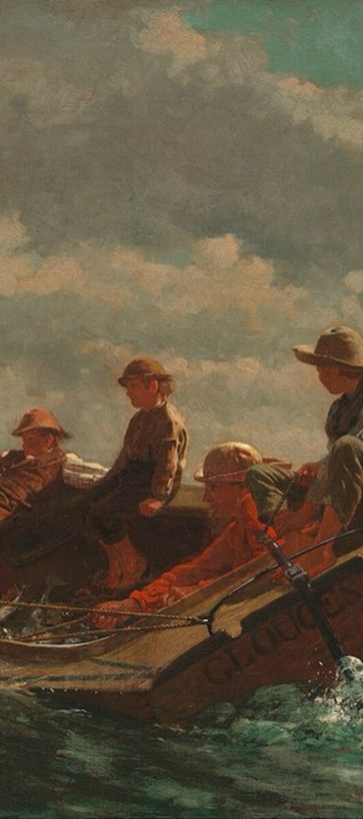
INTRODUCTION TO YAWP!
Why we’re here.
Over our sessions, you’ll learn to write a thoughtful, original, critical essay, like the one we just read.
Talk through our opinions about the topic
Learn a writing process
Write a lot

Slide 14
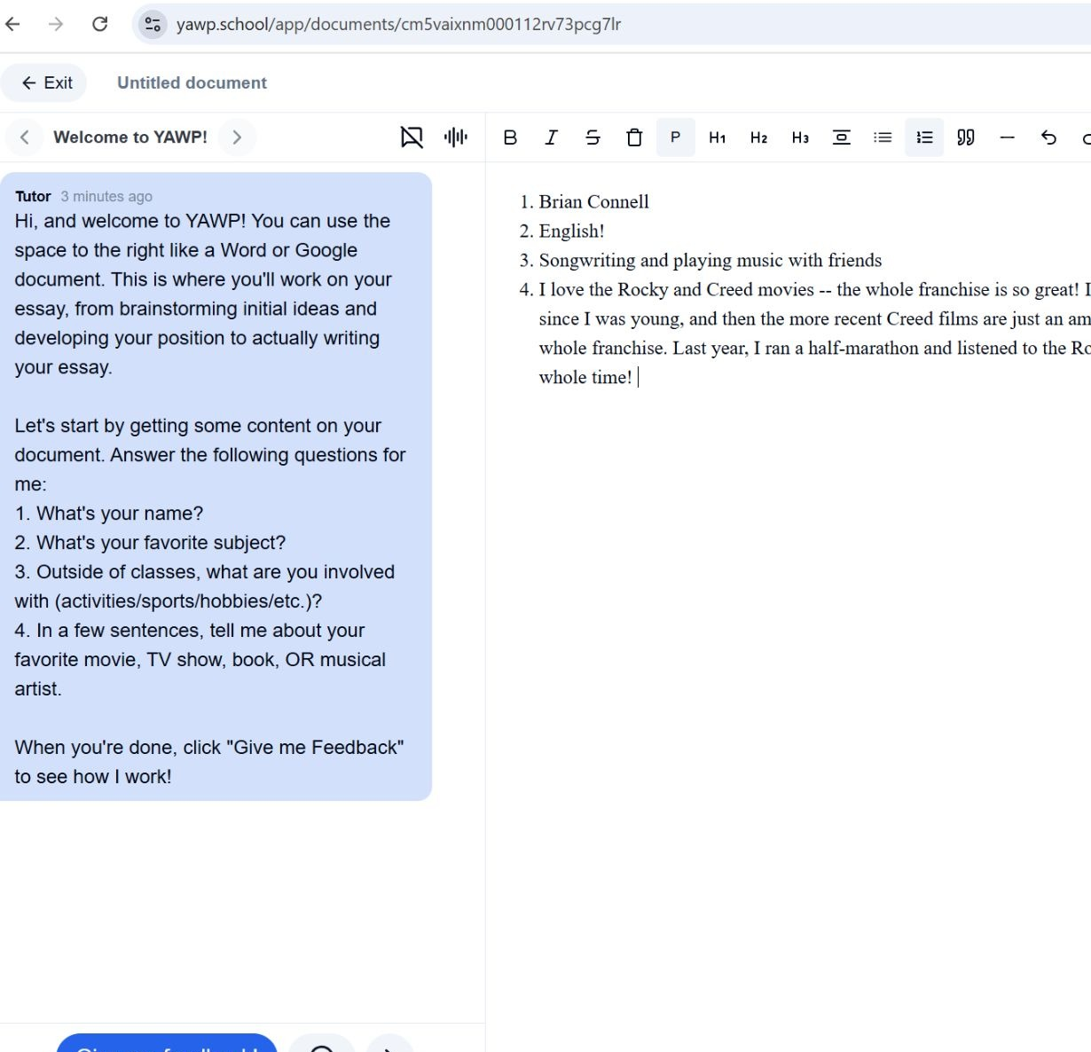
Start.
Your first document in YAWP!
Open YAWP!, read the tutor’s welcome, and answer its getting-started questions.

