Slide 1
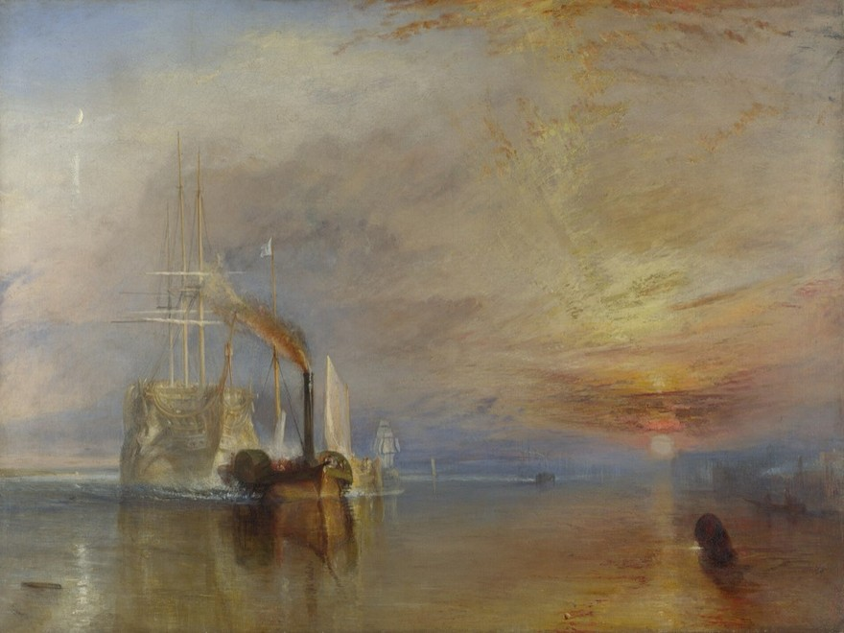
THE CRITICAL ESSAY
Conclusion Paragraph
Stick the landing.
YAWP! Writing Program · [CLASS] · [DATE]
J. M. W. Turner
The Fighting Temeraire, 1839
Oil on canvas · National Gallery, London

Slide 2
Today’s program
Step five of the writing process: finish strong.
i.
Quiz show
ii.
What a conclusion really is
iii.
Two pro tips
iv.
A suggested structure
v.
Back to the house tour

Slide 3
Quiz show.
Six questions from the lessons so far.
Pick your answer before the reveal. Hands up!
Notes:
Optional warm-up. These questions build from lesson to lesson, so you can watch students' answers improve over the unit. Delete this section to skip it.

Slide 4
QUESTION 1 OF 6
What’s the best way to write an essay?
a.
Just start writing and hope some good ideas come out.
b.
Take my ideas and plug them into a formula, like the five-paragraph essay.
c.
Develop my ideas into a thesis statement and build my essay around that.
d.
ChatGPT, duh.
e.
I have never actually written an essay, so I have no idea.

Slide 5
QUESTION 1 OF 6 · ANSWER
What’s the best way to write an essay?
a.
Just start writing and hope some good ideas come out.
b.
Take my ideas and plug them into a formula, like the five-paragraph essay.
c.
Develop my ideas into a thesis statement and build my essay around that.
d.
ChatGPT, duh.
e.
I have never actually written an essay, so I have no idea.
Notes:
Correct answer: c. Optional warm-up. These questions build from lesson to lesson, so you can watch students' answers improve over the unit. Delete this section to skip it.

Slide 6
QUESTION 2 OF 6
Critical thinking is best defined as:
a.
Asking questions and seeking answers about a topic in order to develop a position on it
b.
Finding all of the weaknesses in an argument
c.
Finding all of the strengths in an argument
d.
Arguing a specific point of view in front of an audience
e.
Researching experts’ perspectives and arguments on a topic in order to develop a position on it

Slide 7
QUESTION 2 OF 6 · ANSWER
Critical thinking is best defined as:
a.
Asking questions and seeking answers about a topic in order to develop a position on it
b.
Finding all of the weaknesses in an argument
c.
Finding all of the strengths in an argument
d.
Arguing a specific point of view in front of an audience
e.
Researching experts’ perspectives and arguments on a topic in order to develop a position on it
Notes:
Correct answer: a. Optional warm-up. These questions build from lesson to lesson, so you can watch students' answers improve over the unit. Delete this section to skip it.

Slide 8
QUESTION 3 OF 6
Which of the following is MOST true about a good thesis statement?
a.
It is easy for the reader to agree with.
b.
It contains two or three pieces of support.
c.
It contains observation and analysis.
d.
It contains research and facts.
e.
It is one or two sentences long.

Slide 9
QUESTION 3 OF 6 · ANSWER
Which of the following is MOST true about a good thesis statement?
a.
It is easy for the reader to agree with.
b.
It contains two or three pieces of support.
c.
It contains observation and analysis.
d.
It contains research and facts.
e.
It is one or two sentences long.
Notes:
Correct answer: c. Optional warm-up. These questions build from lesson to lesson, so you can watch students' answers improve over the unit. Delete this section to skip it.

Slide 10
QUESTION 4 OF 6
Your introduction paragraph’s MAIN function is to:
a.
Tell a story that illustrates the topic of your essay
b.
Give specific examples that support your thesis
c.
Define important terms that your reader may need to know
d.
Present questions that your essay will answer
e.
Welcome your reader into your discussion and state the thesis

Slide 11
QUESTION 4 OF 6 · ANSWER
Your introduction paragraph’s MAIN function is to:
a.
Tell a story that illustrates the topic of your essay
b.
Give specific examples that support your thesis
c.
Define important terms that your reader may need to know
d.
Present questions that your essay will answer
e.
Welcome your reader into your discussion and state the thesis
Notes:
Correct answer: e. Optional warm-up. These questions build from lesson to lesson, so you can watch students' answers improve over the unit. Delete this section to skip it.

Slide 12
QUESTION 5 OF 6
Which of the following would probably NOT show up in your body paragraphs?
a.
Supporting quotations about specific points
b.
Your opinions
c.
Your thesis statement
d.
Analysis of other people’s arguments

Slide 13
QUESTION 5 OF 6 · ANSWER
Which of the following would probably NOT show up in your body paragraphs?
a.
Supporting quotations about specific points
b.
Your opinions
c.
Your thesis statement
d.
Analysis of other people’s arguments
Notes:
Correct answer: c. Optional warm-up. These questions build from lesson to lesson, so you can watch students' answers improve over the unit. Delete this section to skip it.

Slide 14
QUESTION 6 OF 6
True or false: a good conclusion restates the thesis and main ideas of your essay.
a.
True
b.
False

Slide 15
QUESTION 6 OF 6 · ANSWER
True or false: a good conclusion restates the thesis and main ideas of your essay.
a.
True
b.
False
Restating your thesis and main points can feel very repetitive. A good conclusion offers final reflection, arguments, or a call to action based on everything you just said.
Notes:
Correct answer: b. Optional warm-up. These questions build from lesson to lesson, so you can watch students' answers improve over the unit. Delete this section to skip it.

Slide 16
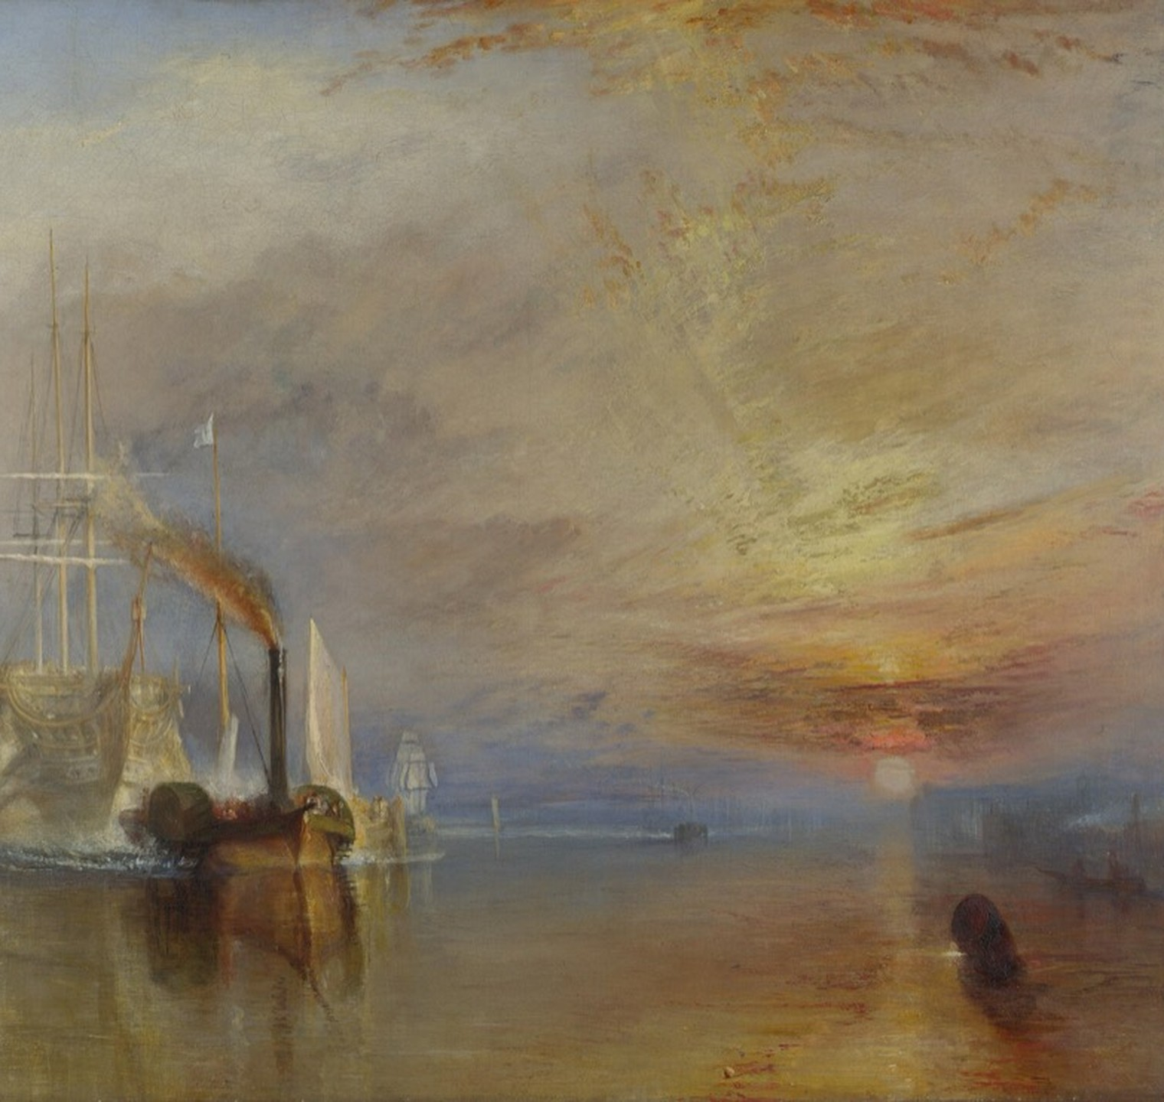
Step 5.
Write the conclusion.
J. M. W. Turner, The Fighting Temeraire (detail), 1839

Slide 17
Myth.
A good conclusion restates the thesis and main ideas of the essay.
Fact.
Restating your thesis and main ideas can make you seem like an alien.

Slide 18
Let’s reassess our understanding of the word.
conclusion (noun)
1.
An ending
2.
A deduction drawn from available information

Slide 19
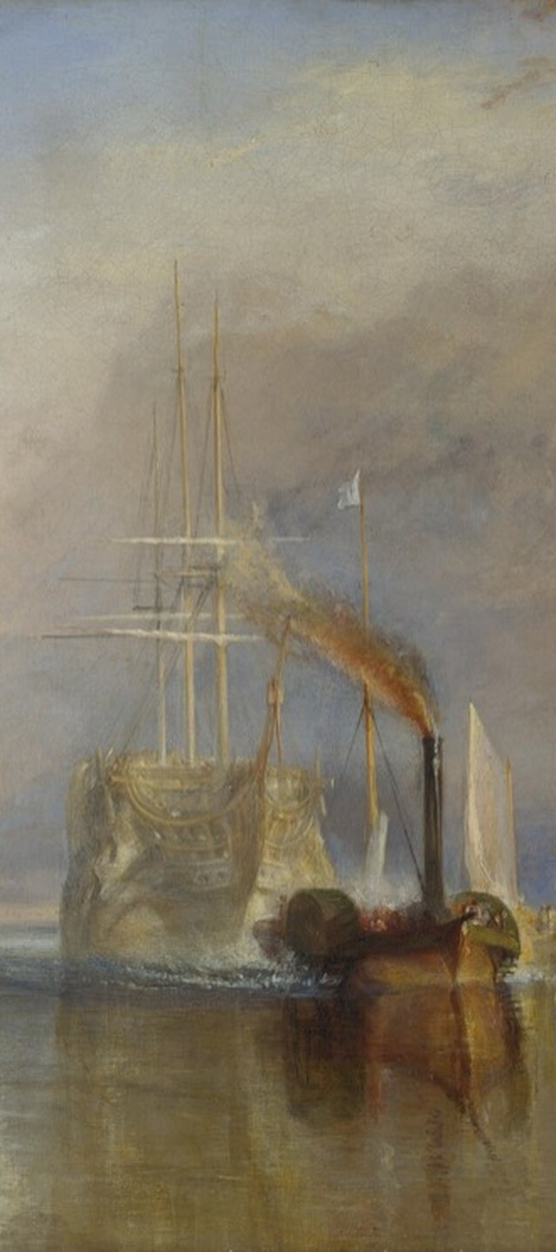
CONCLUSION PARAGRAPH
By the end of your essay, you should have exhaustively defined, illustrated, and proven the elements of your thesis. And your reader should be right there with you.
So if everything you just said is true, then what deductions, or conclusions, can you draw from it all?

Slide 20
Writing about a problem?
Your conclusion could be a great place to discuss solutions to that problem.

Slide 21
Pro tip 1.
Begin with a rhetorical question.
Rhetorical questions can create a nice shift in a discussion or argument. In the sample essay on education, Haley began her conclusion like this:
If we assume that teachers don’t like to be boring, then why doesn’t the education system teach them how to prioritize creative thinking in classrooms?
Read the whole conclusion together.

Slide 22
Pro tip 2.
Try a statement of “perhaps.”
Many a good conclusion begins a sentence with the word “perhaps.” It stays assertive and smart without being aggressive, and it fits the tone of a good conclusion: comfortable and confident.
With “perhaps,” you can offer ideas (even new ones) without having to offer new support. The support for these conclusions is already in your essay.

Slide 23
A statement of “perhaps,” in action
If we assume that teachers don’t like to be boring, then why doesn’t the education system teach them how to prioritize creative thinking in classrooms?
Perhaps the way teachers are taught today is wrong. They put too much pressure on teachers to increase scores, and this trickles down to the students, and suddenly everything we do in school is about “the test.”

Slide 24
A suggested conclusion structure
Five moves. The quote is optional.
1
Rhetorical question
2
Answer it directly (“Perhaps…”)
3
Two sentences of opinion or analysis
4
A supporting quote (if you’re working with a text)
5
A final, concluding sentence: your big, final point

Slide 25
SAMPLE CONCLUSION
Haley’s conclusion, move by move
If we assume that teachers don’t like to be boring, then why doesn’t the education system teach them how to prioritize creative thinking in classrooms? Perhaps the way teachers are taught today is wrong. They put too much pressure on teachers to increase scores, and this trickles down to the students, and suddenly everything we do in school is about “the test.” No one can learn under those conditions. However, if administrators and teachers prioritized creative lessons, we could build engagement and excitement between the teachers and students. Imagine the impact this could have on student learning and the teaching profession!
1
Rhetorical question
2
Answer it directly (“Perhaps…”)
3
Two sentences of opinion or analysis
4
Quote: none here, since this essay isn’t about a text
5
A final, concluding sentence: your big, final point

Slide 26
The house tour, stop 4
You’re the realtor. Your reader is the buyer.
LIVING ROOM
KITCHEN
BEDROOMS
1
2
3
4
THE NEIGHBORHOOD
Introduction
Drive in and get your bearings. Context first.
THE FRONT DOOR
Thesis
A handshake, and you’re in. Now you know where you are.
EACH ROOM
Body paragraphs
Point out the details that sell it: the wood floors, the fireplace, the new appliances. Skip the family photos.
THE BACK DECK
Conclusion
Widen the view. From here you can see the neighbors’ houses.
Not a conclusion: touring every room again (repeating yourself), or pushing the buyer out a second-story window (no ending at all).

Slide 27

Before you go.
If everything you just said is true, what follows?
Final reflection, arguments, or a call to action. Not a summary.
Next time: Titles and Formatting

