Slide 1
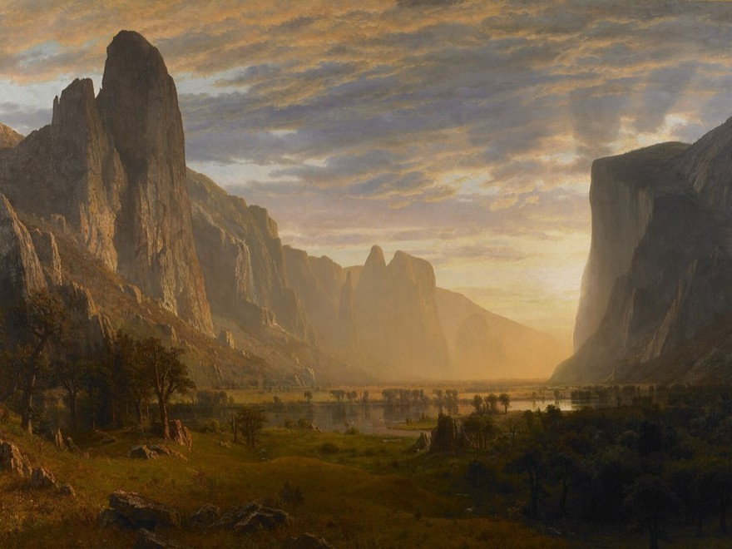
THE CRITICAL ESSAY
Introduction Paragraph
Welcome your reader in
YAWP! Writing Program · [CLASS] · [DATE]
Albert Bierstadt
Looking Down Yosemite Valley, California, 1865
Oil on canvas · Birmingham Museum of Art

Slide 2
Today’s program
Step three of the writing process: begin your essay.
i.
Quiz show
ii.
Wide to narrow
iii.
What an introduction does
iv.
Four ways to begin
v.
Write your introduction

Slide 3
Quiz show.
Four questions from the lessons so far.
Pick your answer before the reveal. Hands up!
Notes:
Optional warm-up. These questions build from lesson to lesson, so you can watch students' answers improve over the unit. Delete this section to skip it.

Slide 4
QUESTION 1 OF 4
What’s the best way to write an essay?
a.
Just start writing and hope some good ideas come out.
b.
Take my ideas and plug them into a formula, like the five-paragraph essay.
c.
Develop my ideas into a thesis statement and build my essay around that.
d.
ChatGPT, duh.
e.
I have never actually written an essay, so I have no idea.

Slide 5
QUESTION 1 OF 4 · ANSWER
What’s the best way to write an essay?
a.
Just start writing and hope some good ideas come out.
b.
Take my ideas and plug them into a formula, like the five-paragraph essay.
c.
Develop my ideas into a thesis statement and build my essay around that.
d.
ChatGPT, duh.
e.
I have never actually written an essay, so I have no idea.
Notes:
Correct answer: c. Optional warm-up. These questions build from lesson to lesson, so you can watch students' answers improve over the unit. Delete this section to skip it.

Slide 6
QUESTION 2 OF 4
Critical thinking is best defined as:
a.
Asking questions and seeking answers about a topic in order to develop a position on it
b.
Finding all of the weaknesses in an argument
c.
Finding all of the strengths in an argument
d.
Arguing a specific point of view in front of an audience
e.
Researching experts’ perspectives and arguments on a topic in order to develop a position on it

Slide 7
QUESTION 2 OF 4 · ANSWER
Critical thinking is best defined as:
a.
Asking questions and seeking answers about a topic in order to develop a position on it
b.
Finding all of the weaknesses in an argument
c.
Finding all of the strengths in an argument
d.
Arguing a specific point of view in front of an audience
e.
Researching experts’ perspectives and arguments on a topic in order to develop a position on it
Notes:
Correct answer: a. Optional warm-up. These questions build from lesson to lesson, so you can watch students' answers improve over the unit. Delete this section to skip it.

Slide 8
QUESTION 3 OF 4
Which of the following is MOST true about a good thesis statement?
a.
It is easy for the reader to agree with.
b.
It contains two or three pieces of support.
c.
It contains observation and analysis.
d.
It contains research and facts.
e.
It is one or two sentences long.

Slide 9
QUESTION 3 OF 4 · ANSWER
Which of the following is MOST true about a good thesis statement?
a.
It is easy for the reader to agree with.
b.
It contains two or three pieces of support.
c.
It contains observation and analysis.
d.
It contains research and facts.
e.
It is one or two sentences long.
Notes:
Correct answer: c. Optional warm-up. These questions build from lesson to lesson, so you can watch students' answers improve over the unit. Delete this section to skip it.

Slide 10
QUESTION 4 OF 4
Your introduction paragraph’s MAIN function is to:
a.
Tell a story that illustrates the topic of your essay
b.
Give specific examples that support your thesis
c.
Define important terms that your reader may need to know
d.
Present questions that your essay will answer
e.
Welcome your reader into your discussion and state the thesis

Slide 11
QUESTION 4 OF 4 · ANSWER
Your introduction paragraph’s MAIN function is to:
a.
Tell a story that illustrates the topic of your essay
b.
Give specific examples that support your thesis
c.
Define important terms that your reader may need to know
d.
Present questions that your essay will answer
e.
Welcome your reader into your discussion and state the thesis
Notes:
Correct answer: e. Optional warm-up. These questions build from lesson to lesson, so you can watch students' answers improve over the unit. Delete this section to skip it.

Slide 12
Challenge.
Put these words into a logical order.
City
Continent
Neighborhood
Country
Universe
State
Planet

Slide 13
From everything to right here
Universe
Planet
Continent
Country
State
City
Neighborhood

Slide 14
Put in order.
Now try it with sentences.
Across these movies, Iron Man is sometimes portrayed as arrogant, self-centered, elitist, and reckless.
One of those relationships is with Pepper Potts, and the other is with Peter Parker’s Spider-Man.
Iron Man is featured in 9 MCU movies.
However, two relationships help him develop less selfish and more human qualities.
There are 29 movies in the Marvel Cinematic Universe.

Slide 15
General to specific
Each sentence narrows the focus.
1
There are 29 movies in the Marvel Cinematic Universe.
2
Iron Man is featured in 9 MCU movies.
3
Across these movies, Iron Man is sometimes portrayed as arrogant, self-centered, elitist, and reckless.
4
However, two relationships help him develop less selfish and more human qualities.
5
One of those relationships is with Pepper Potts, and the other is with Peter Parker’s Spider-Man.

Slide 16
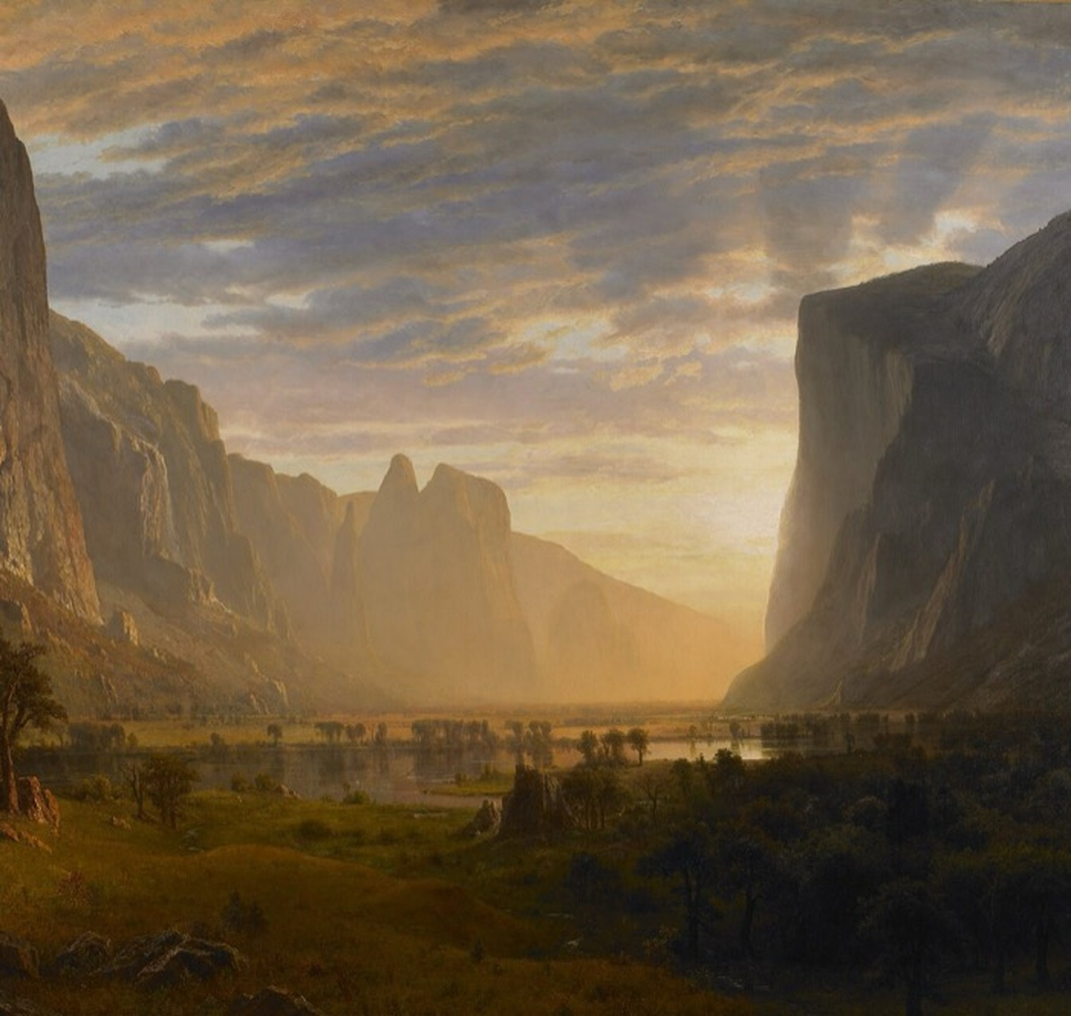
Step 3.
Write the introduction.
Now that you have your thesis, you can begin writing your essay.
Albert Bierstadt, Looking Down Yosemite Valley (detail), 1865

Slide 17


INTRODUCTION PARAGRAPH
Know this.
What an introduction does
It welcomes your reader into your discussion and prepares them to understand your thesis statement.

Slide 18
Four ways to begin
Same thesis, four different ways in.
i.
Story or scene that illustrates your topic
ii.
Rhetorical question
iii.
Quotation or fact
iv.
Definition

Slide 19
STYLE 1 OF 4
Story or scene
The thesis is in color. It doesn’t change.
Ms. Rodriguez watches as 28 ninth graders stare blankly at their worksheets, the only sound the fluorescent lights humming overhead. She had once dreamed of inspiring young minds, but now finds herself mechanically walking through the same lesson plan she’s used for five years. In the back row, students doodle in their notebooks and struggle to stay awake. Throughout the school, teachers click through PowerPoint slides and tell students to stop talking, while kids daydream and stare at the clock. This scene plays out in classrooms across the country, where both educators and students have lost the spark that should define learning. This may be because schools have lost a sense of what really works in terms of motivating students to learn. When schools fail to prioritize creativity in teaching, school becomes boring for both students and teachers, resulting in a lack of shared motivation, excitement, and accomplishment.

Slide 20
STYLE 2 OF 4
Rhetorical question
The thesis is in color. It doesn’t change.
Do you remember trying to learn how to ride a bike? It was exciting, blood rushing, and challenging, but worth it. When you got going but fell, you got back up and went a little further each time. You had more motivation to keep going because it was exciting. Schools today seem to lack this sense of excitement. Students have zero motivation to keep going because there is no excitement from the teachers and no sense of an end goal for the students. Shouldn’t the process of learning be inspiring and exciting for everyone? When schools fail to prioritize creativity in teaching, school becomes boring for both students and teachers, resulting in a lack of shared motivation, excitement, and accomplishment.

Slide 21
STYLE 3 OF 4
Quotation or fact
The thesis is in color. It doesn’t change.
Albert Einstein once said, “It is the supreme art of the teacher to awaken joy in creative expression and knowledge.” But walk into most American classrooms today and you’ll find the opposite: students mechanically filling out worksheets while teachers follow rigid scripts designed to meet testing requirements. The joy Einstein spoke of has been replaced by compliance and conformity. Both students and educators go through the motions of learning without the spark of curiosity or discovery that should drive education. When schools fail to prioritize creativity in teaching, school becomes boring for both students and teachers, resulting in a lack of shared motivation, excitement, and accomplishment.

Slide 22
STYLE 4 OF 4
Definition
The thesis is in color. It doesn’t change.
Education, by definition, is the process of facilitating learning, or the acquisition of knowledge, skills, values, and habits. This definition suggests an active, dynamic exchange between teacher and student: a collaborative journey of discovery and growth. However, in many of today’s classrooms, education has become something far more mechanical: the transfer of standardized information from textbook to test, with little regard for genuine understanding or intellectual curiosity. Students sit in rows, passively receiving information they’ll quickly forget after the exam, while teachers feel constrained by rigid curricula that leave no room for innovation. This results in ineffective learning environments. When schools fail to prioritize creativity in teaching, school becomes boring for both students and teachers, resulting in a lack of shared motivation, excitement, and accomplishment.

Slide 23
Write.
Choose an introduction style that speaks to you and begin your essay.
i.
Story or scene that illustrates your topic
ii.
Rhetorical question
iii.
Quotation or fact
iv.
Definition
Remember: the final sentence of your introduction is your thesis statement.

Slide 24

Before you go.
Your introduction ends where your essay begins: with your thesis.
Everything before it should lead your reader there.
Next time: [NEXT LESSON TITLE]

