Slide 1



THESIS-DRIVEN ESSAY · LESSON 3
Thesis Statement
YAWP!
WRITING PROGRAM
From the mines, with treasure
Notes:
Thesis day. If all goes to plan, by the end of class every student has a strong, complex thesis statement and can begin actually writing. In pre-writing they went down into the mines, digging; today they come up with their treasure. Before you start, check student docs: anyone who still hasn’t found a specific focus may need a few more minutes of pre-writing on their diamond first.

Slide 2

REVIEW · 1 OF 3
What’s the best way to write an essay?
a
Just start writing and hope some good ideas come out.
b
Take my ideas and plug them into a formula, like the 5-paragraph essay.
c
Develop my ideas into a thesis statement and build my essay around that.
d
ChatGPT, duh.
e
I have never actually written an essay, so I have no idea.
Notes:
Optional review quiz. Brian: "If that’s not your gig, delete the slides." If you keep it, make it a game: read the question, take answers, then click to the reveal. Candy or other small prizes help. Answer: Develop my ideas into a thesis statement and build my essay around that.

Slide 3
REVIEW · 1 OF 3
What’s the best way to write an essay?
a
Just start writing and hope some good ideas come out.
b
Take my ideas and plug them into a formula, like the 5-paragraph essay.
c
Develop my ideas into a thesis statement and build my essay around that.
d
ChatGPT, duh.
e
I have never actually written an essay, so I have no idea.
Notes:
The reveal. Develop my ideas into a thesis statement and build my essay around that.

Slide 4
REVIEW · 2 OF 3
Critical thinking is best defined as:
a
Asking questions and seeking answers about a topic in order to develop a position on it
b
Finding all of the weaknesses in an argument
c
Finding all of the strengths in an argument
d
Arguing a specific point of view in front of an audience
e
Researching experts’ perspectives and arguments on a topic in order to develop a position on it
Notes:
Optional review quiz. Brian: "If that’s not your gig, delete the slides." If you keep it, make it a game: read the question, take answers, then click to the reveal. Candy or other small prizes help. Answer: Asking questions and seeking answers about a topic. The same thing they did with the photo and in their pre-write.

Slide 5
REVIEW · 2 OF 3
Critical thinking is best defined as:
a
Asking questions and seeking answers about a topic in order to develop a position on it
b
Finding all of the weaknesses in an argument
c
Finding all of the strengths in an argument
d
Arguing a specific point of view in front of an audience
e
Researching experts’ perspectives and arguments on a topic in order to develop a position on it
Notes:
The reveal. Asking questions and seeking answers about a topic. The same thing they did with the photo and in their pre-write.

Slide 6
REVIEW · 3 OF 3
Which of the following is MOST TRUE about a good thesis statement?
a
A good thesis statement is easy for the reader to agree with.
b
A good thesis statement contains 2–3 pieces of support.
c
A good thesis statement contains observation and analysis.
d
A good thesis statement contains research and facts.
e
A good thesis statement is 1–2 sentences long.
Notes:
Optional review quiz. Brian: "If that’s not your gig, delete the slides." If you keep it, make it a game: read the question, take answers, then click to the reveal. Candy or other small prizes help. Answer: Observation and analysis. Some students (and some of us) will pick B, the 5-paragraph-essay answer; our thesis is going to be more complex than a three-pronged list.

Slide 7
REVIEW · 3 OF 3
Which of the following is MOST TRUE about a good thesis statement?
a
A good thesis statement is easy for the reader to agree with.
b
A good thesis statement contains 2–3 pieces of support.
c
A good thesis statement contains observation and analysis.
d
A good thesis statement contains research and facts.
e
A good thesis statement is 1–2 sentences long.
Notes:
The reveal. Observation and analysis. Some students (and some of us) will pick B, the 5-paragraph-essay answer; our thesis is going to be more complex than a three-pronged list.

Slide 8

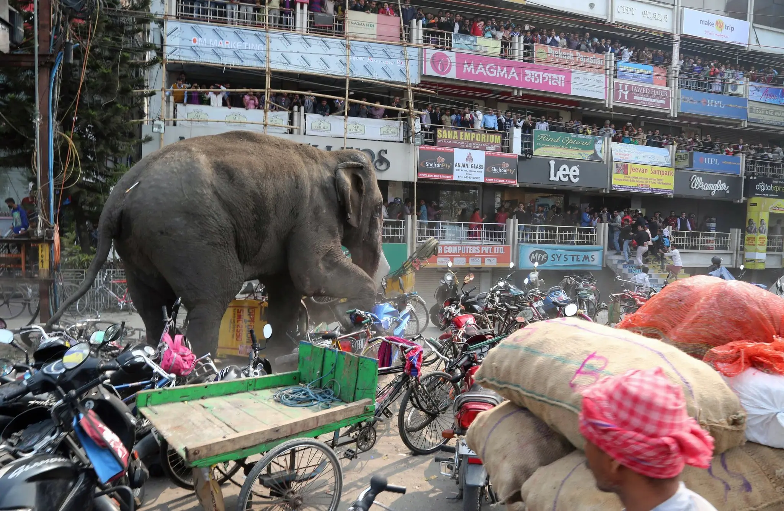
WARM-UP · OBSERVE
What details do you see in this picture?
What more can you find?
Then: what’s going on in this picture?
Notes:
"What’s happening in this picture?" again, same process as last time: first only what they SEE. An elephant; people up on store balconies; signs and advertisements; sacks of grain or rice in front; a man in a red and white turban; a cart with blue wire; something in the elephant’s rear (a dart?); a lamppost with exposed wires; motorcycles and bicycles; people running up stairs. Let them go, then ask what they think is going on. When students offer a theory, ask: "What do you see that makes you say that?" That is the observation-to-analysis move they will make in their thesis today. (The New York Times "What’s Going On in This Picture?" series has hundreds more of these.)

Slide 9
THE REVEAL
What was going on
“
This elephant wandered out of a forest and into the streets of a city in North Bengal, India, attacking houses, shops and vehicles over a period of hours. The elephant was finally calmed with three tranquilizer darts. The clash appeared to have a happy ending: the authorities said they returned the creature to the forest.
— Photo caption, The New York Times
Notes:
Read the caption. Plenty of students guess India. Point out what they just did: observed details, then analyzed them into a theory. That is exactly what a thesis statement does.

Slide 10
QUICK REVIEW
What do we need to figure out before we can write a great essay?
Hopefully someone in the room says it: a thesis statement.
Notes:
Let a student answer. The thesis statement: the starred spot at the bottom of the introduction on the form.

Slide 11
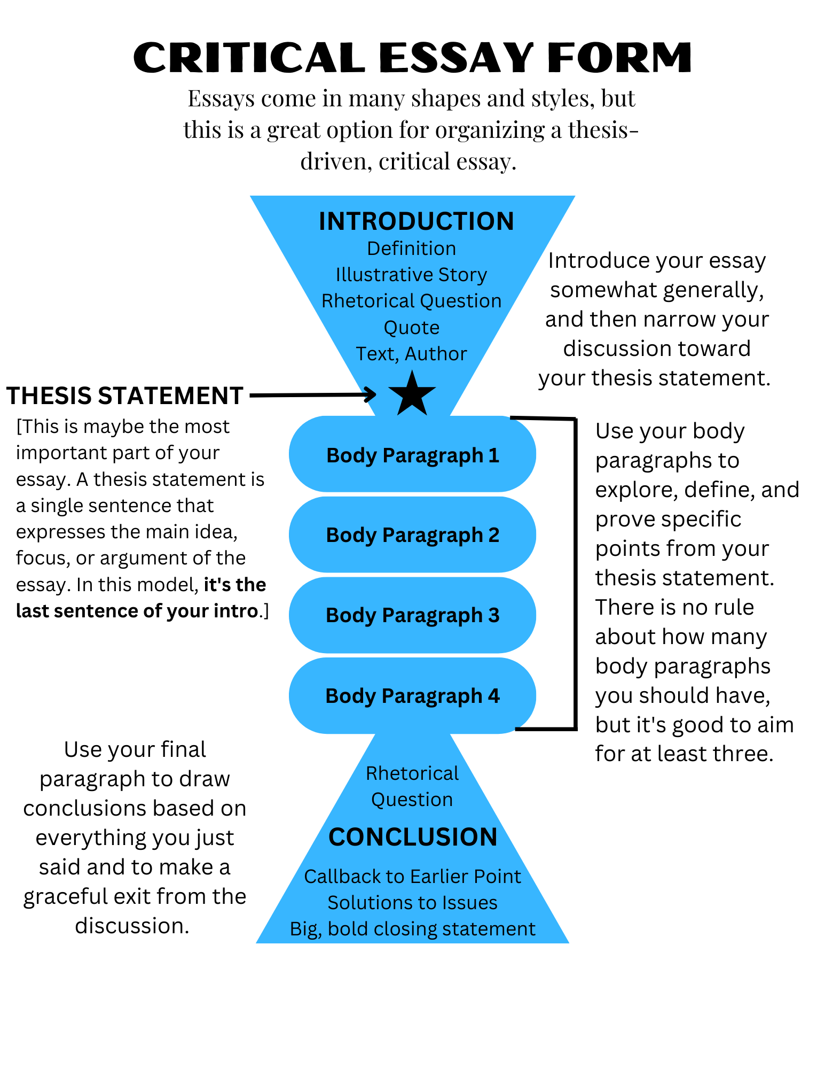
THE FORM
The Critical Essay Form
Introduction
Thesis statement ★ the most important part
Body paragraphs
Conclusion
Notes:
There it is in our form: starred, the last sentence of the introduction, the most important part of the essay.

Slide 12
REMEMBER
Great thesis statements lead to great essays!
(And weak or non-existent thesis statements lead to weak essays!)
Notes:
Pre-writing was a light lift for most kids, and it produced a topic that is theirs. That investment is what keeps them off the internet and off ChatGPT: they already know what they want to say.

Slide 13
WHERE WE ARE
All of your pre-writing…
WHAT IT’S FOR
WHERE IT LEADS
…serves the purpose of narrowing your topic so that you can write your thesis.
Flush out all of your ideas and opinions about the subject. Ask and answer, ask and answer, ask and answer.
Your discussion should become more specific as you go, until your answers start to resemble some pretty intelligent thoughts and conclusions.
When you get to this point, you’re very close to pinning down your thesis.
Notes:
A recap of the pre-writing process, to get them ready to develop a thesis on the specific topic they landed on.

Slide 14
STEP 2
Develop a Thesis Statement
Observation + analysis, in one sentence.
Notes:
Many students have never written an essay like this, so "thesis statement" may be an abstract idea to them. Don’t dwell on the definition; the examples will do the work.

Slide 15

DEFINITION
Your thesis statement represents the focal point of your essay.
Everything else in the essay points back to it.
Notes:
Go through these slides with the students. Have them read parts aloud if it keeps them engaged.

Slide 16

WORDING YOUR THESIS STATEMENT
Three rules for the sentence
1
2
3
Your thesis should be one sentence long.
Your thesis should include observation as well as analysis.
Your thesis should be specific.
Notes:
The number one problem with student thesis statements is that they are too general: "There are many themes in The Great Gatsby worth discussing." "Violence is a major problem in my community" is better but could be far more specific. Beware the 5-paragraph habit of three broad reasons; each of those is really its own essay. Specific is the goal.

Slide 17
OBSERVATION
What do we mean by “observation”?
Ask the room first.
Notes:
See if students can define it before you show the next slide.

Slide 18
OBSERVATION
An observation is something we notice or see about a subject.
Like the picture: what we see. Let’s look at some examples…
Notes:
The next three observations are all real, from Brian’s students pre-writing on the prompt "What’s wrong with education today?" The first is Haley’s, whose sample essay you may have read with the class.

Slide 19
OBSERVATION · EXAMPLE 1
Is this true? Does it reflect reality?
“Creative thinking is not prioritized in schools.”
Notes:
Haley’s observation, from her pre-writing. Ask: is this true? If it reflects reality, it’s true.

Slide 20
OBSERVATION · EXAMPLE 2
Is this true? Does it reflect reality?
“Most classroom teachers teach the way they were taught.”
Notes:
Ask whether it reflects reality. Some kids will say "for some teachers, not for others." If it reflects reality somewhere, it’s true.

Slide 21
OBSERVATION · EXAMPLE 3
Is this true? Does it reflect reality?
“Schools place too much emphasis on right and wrong answers.”
Notes:
Does this reflect reality? Yes. So it’s true. All three are good observations.

Slide 22
OBSERVATION
Three good observations
1
2
3
Creative thinking is not prioritized in schools.
Most classroom teachers teach the way they were taught.
Schools place too much emphasis on right and wrong answers.
Notes:
There they all are. Good observations. But…

Slide 23
BUT
So what????
Without analysis, your thesis statement will fall flat.
Notes:
These are great observations, but they are not thesis statements yet. They are the start of one. Now we add analysis.

Slide 24
ANALYSIS
What do we mean by “analysis”?
Ask the room first.
Notes:
Call on students to read these.

Slide 25
ANALYSIS
Analysis is a reaction, argument, examination, or conclusion based on an observation.
If I asked what’s happening in the picture and you just said “elephant, motorcycles, people,” I’d wonder what was wrong with you.
Notes:
Think about the picture again. Calling out observations is not what I asked for; I asked you to analyze. Now let’s look at some analysis.

Slide 26
ADD ANALYSIS
Add analysis: example 1
OBSERVATION
ANALYSIS
Creative thinking is not taught enough in schools.
…this makes school boring for teachers and students
…takes away their motivation and excitement
…they don’t feel as accomplished
Notes:
With "creative thinking is not taught enough in schools," the analysis we might offer: this makes school boring for teachers and students; it takes away motivation and excitement; they don’t feel as accomplished as they could if they were creating things.

Slide 27
ADD ANALYSIS
Add analysis: example 2
OBSERVATION
ANALYSIS
Most classroom teachers teach the way they were taught.
…this creates a situation where old ideas and methods are recycled, and new, current ideas are ignored
…this is an ineffective teaching method
Notes:
Second observation. Some analysis: old ideas and methods get recycled and new, current ideas are ignored; or simply, this is an ineffective teaching method. We could offer more; these are two examples.

Slide 28
ADD ANALYSIS
Add analysis: example 3
OBSERVATION
ANALYSIS
Schools place too much emphasis on right and wrong answers.
…this is a limited approach to learning
…it puts too much emphasis on correctness
…it ignores the personal expression of students’ experience
Notes:
Third observation. This is a limited approach to learning; it puts too much emphasis on correctness; it ignores the personal expression of students’ experience. Again, there is more analysis available; these are the three we’ll use.

Slide 29
WRITING ACTIVITY
Your observation and analysis
ON YOUR DOCUMENT
On your document, create your own Observation and 2–4 points of analysis. Use this model:
Observation: Schools place too much emphasis on right and wrong answers.
Analysis:
• this is a limited approach to learning
• it puts too much emphasis on correctness
• it ignores the personal expression of students’ experience
Notes:
Their observation is basically the specific topic they arrived at through pre-writing: "my essay is going to be about how schools place too much emphasis on right and wrong answers." Then 2–4 pieces of analysis: opinions, reactions, conclusions. Make sure everyone is on the "Thesis Statement" step at the top of the Tutor. Work the room; don’t sit down. The more specific they get, the better: we’re putting the topic under a microscope. Students sometimes think a long essay needs a big topic; it’s the opposite. Big and general makes a boring essay.

Slide 30
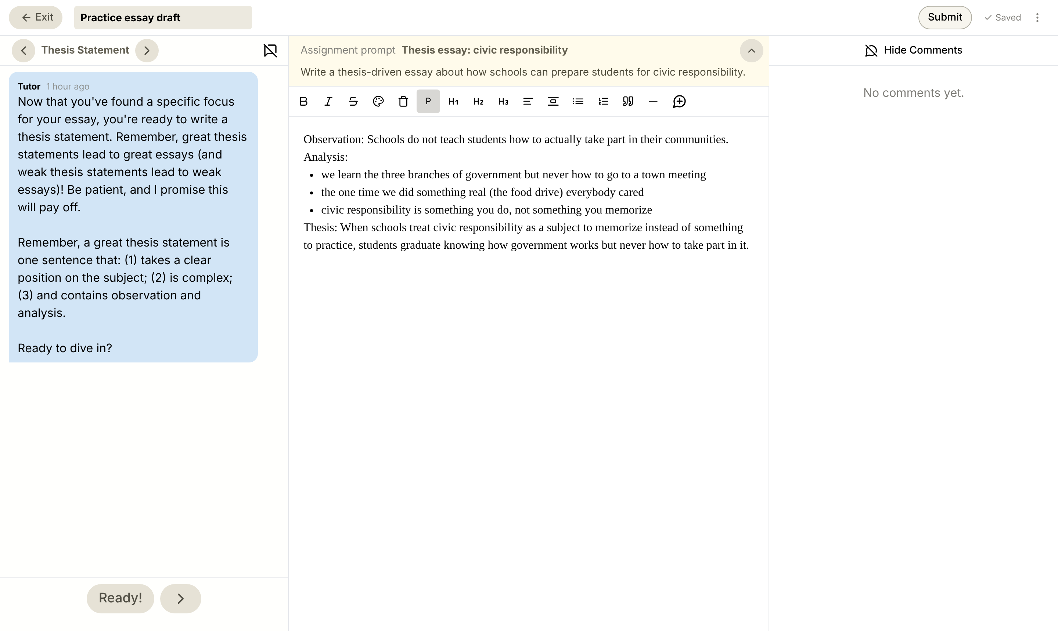
YOUR TURN
What it looks like
The Tutor says Thesis Statement
Observation first
2–4 points of analysis
Then combine them into your thesis
Notes:
Today’s YAWP! editor on the Thesis Statement step, with a sample observation, analysis and thesis typed in. The Tutor’s instructions are on the left; when students have a draft thesis, they can ask the Tutor for feedback.

Slide 31
COMBINE O & A TO FORM A THESIS
Combine them: example 1
OBSERVATION
ANALYSIS
Creativity is not prioritized enough in schools.
…this makes school boring for teachers and students
…takes away their motivation and excitement
…they don’t feel as accomplished
=
THESIS
When schools fail to prioritize creativity in teaching, school becomes boring for both students and teachers, resulting in a lack of shared motivation, excitement, and accomplishment.
Notes:
Combine observation and analysis and you get the thesis from the sample essay. It’s all in there: every piece of the observation and analysis, in one sentence.

Slide 32
COMBINE O & A TO FORM A THESIS
Combine them: example 2
OBSERVATION
ANALYSIS
Most classroom teachers teach the way they were taught.
…this creates a situation where old ideas and methods are recycled, and new, current ideas are ignored
…this is an ineffective teaching method
=
THESIS
Teachers too often teach the way they were taught, which creates an ineffective learning environment where old ideas and methods are recycled, while new, current ideas are ignored.
Notes:
Same move: teachers too often teach the way they were taught, which creates an ineffective learning environment where old ideas and methods are recycled while new, current ideas are ignored. One single complex sentence.

Slide 33
COMBINE O & A TO FORM A THESIS
Combine them: example 3
OBSERVATION
ANALYSIS
Schools place too much emphasis on right and wrong answers.
…this is a limited approach to learning
…it puts too much emphasis on correctness
…it ignores the personal expression of students’ experience
=
THESIS
The education system’s obsession with testing represents a limited approach to learning that puts too much emphasis on right and wrong answers and ignores the personal learning experience of individual students.
Notes:
And the third: the education system’s obsession with testing represents a limited approach to learning… It’s all in there. A beautiful, complex thesis statement.

Slide 34

THE 2 COMPONENTS OF AN EFFECTIVE THESIS
The equation for a thesis statement
+
=
Observation
Analysis
Complex thesis
Now combine yours.
Notes:
The English equation for a great thesis. Now have students combine their own observation and analysis into one sentence on their document. They can ask the Tutor for feedback; it will help clean up and refine the wording and keep the room moving instead of waiting on you. Watch for the Tutor sterilizing a student’s voice; help them keep their own words.

Slide 35
DON’T FORGET
Crafting a thesis statement that works is vital to the rest of your essay…
…so don’t ever begin writing your essay until you’ve created a strong thesis statement!
Notes:
Reinforce it: no essay until the thesis exists. After class, check every document for a working thesis; leave a positive comment, and where one is wordy or tangled, keep the original and add a "Revised thesis" below it so the student can see the difference. Don’t move on to the Introduction lesson until everyone who was here has one.

Slide 36
THESIS REVIEW
Thesis review
1
2
3
One, complex, concise sentence. (Concise does not equal brief!)
Includes observation + analysis.
Specific, not general.
Notes:
The end of the core lesson. Everything after this is optional: "thesis 2.0."

Slide 37
THESIS 2.0
Avoid the verb “to be”
Optional: for you, or for a class that’s ready.
Notes:
Optional second half. Use it for your own understanding, or share it if your students’ writing is ready for it. You can also end the lesson here.

Slide 38
THESIS 2.0
Avoid the verb “to be”
It creates wordy situations. It’s a little word that needs other words to make it work. For example…
Notes:
It isn’t that "to be" is never allowed. The problem is that it creates wordy situations, which is why some teachers ban it outright.

Slide 39
WITH THE VERB “TO BE”
Spot the clutter
Creative design in lesson plans is really important and is something that isn’t taught in teacher training programs.
Notes:
Three forms of "to be" in one sentence, and the sentence sags under them.

Slide 40
CHANGE TO
Teacher training programs don’t emphasize creative design in lesson plans.
This is much better. It gives the sentence a stronger, more direct feel. This is called being concise. And being concise should be your goal in critical writing.
Notes:
Editing "to be" out forces a rephrase. Read the new sentence aloud next to the old one and ask which sounds stronger.

Slide 41
BEFORE AND AFTER
Edit the verb “to be” out
WITH THE VERB TO BE
WITHOUT THE VERB TO BE
Creative design in lesson plans is really important and is something that isn’t taught in teacher training programs.
Teacher training programs don’t emphasize creative design in lesson plans.
Notes:
Taking "to be" out forces a rephrase, and the result is stronger and more direct. This is called being concise, and concise should be the goal in critical writing.

Slide 42
BUT WAIT
But wait, there’s more!
Now that the “to be” clutter is gone, there’s room for more good stuff.
Notes:
The sentence is shorter now, and that is the point: there is space to say more.

Slide 43
WEEDING THE GARDEN
Room for better stuff to grow
Taking the verb “to be” out of a sentence is like weeding a garden: you remove the stuff you don’t need, and then there’s room for better stuff to grow. Check it out…
Notes:
Set up the reveal on the next slide: the same sentence, grown into a real thesis.

Slide 44
THIS CAN NOW BECOME THIS
From a sentence to a thesis
THESIS
When teacher training programs do not emphasize creative design in lesson plans, teachers fail to understand their role as entertainers, resulting in boring lessons.
1
Observation: teacher training programs do not emphasize creative design in lesson plans
2
Analysis: teachers fail to understand their role as entertainers
3
Analysis: resulting in boring lessons
Notes:
"Teacher training programs don’t emphasize creative design in lesson plans" can now become: when teacher training programs do not emphasize creative design in lesson plans, teachers fail to understand their role as entertainers, resulting in boring lessons.

Slide 45
WHOA
WHOA, DID YOU SEE THAT??????
(How that lame thesis statement from before just became kind of awesome?)
Notes:
That is the power of removing "to be": it clears out words that have no power of their own. Officially the end of the lesson.

