Slide 1



THESIS-DRIVEN ESSAY · LESSON 1
Day 1
YAWP!
WRITING PROGRAM
Introduce students to YAWP!
Notes:
A light day of definition and context: what we are doing and why. Brian takes a full class period; you can also fold it into another lesson. Goals: students understand the purpose of YAWP!, read a sample essay, and create their YAWP! accounts. Have the sample essay (“Bored in the USA,” or your own) printed or shared, and your class’s join link ready.

Slide 2

2 TRUTHS AND A LIE
2 Truths and a Lie
The rules: the truths have to be true, and the lie has to be believable. Which one is the lie?
1
2
3
I have a twin who is a blonde-haired version of me.
I was born in Canada.
I met my wife in high school.
Notes:
These are Brian’s own slides, left as an example. Make your own the same way: three statements about you, two true and one believable lie, and a photo or two that make you human (self-deprecating works best). Or delete these slides and play the game without them. How Brian plays it: let students ask questions and "vibe it out," take guesses, then a vote by show of hands for each one. The reveal: he was not born in Canada.

Slide 3
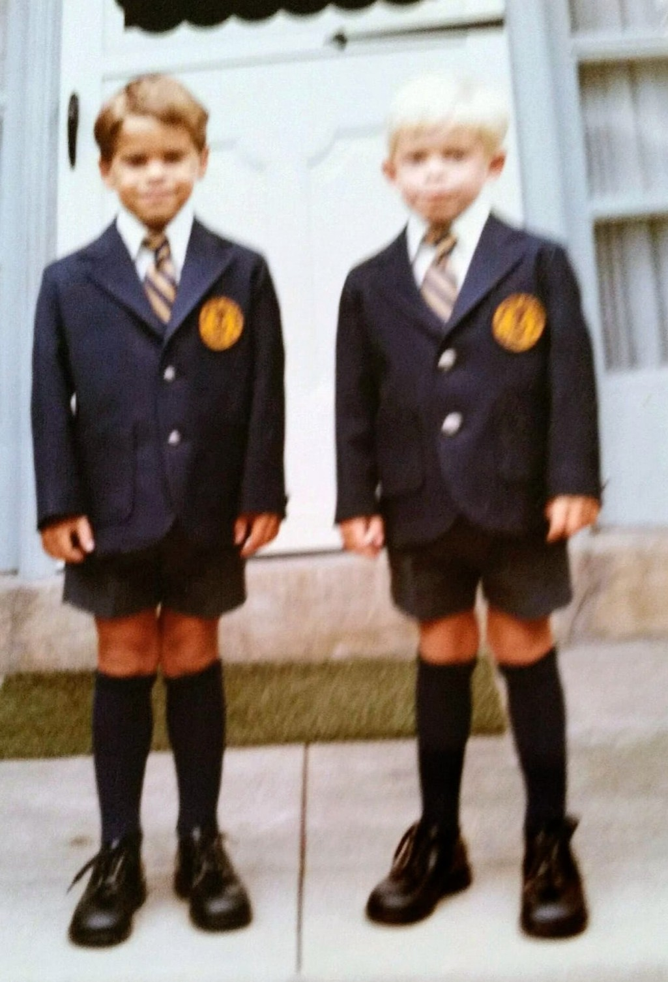
THE REVEAL
I am Brian Connell
I’m here because I love writing and helping other people become better writers.
Notes:
These are Brian’s own slides, left as an example. Make your own the same way: three statements about you, two true and one believable lie, and a photo or two that make you human (self-deprecating works best). Or delete these slides and play the game without them. Brian’s line: "Here’s my blonde-haired, blue-eyed twin brother Patrick and me, on our first day of kindergarten at a school that made us wear these uniforms. I’m obviously the handsome fella on the left."

Slide 4
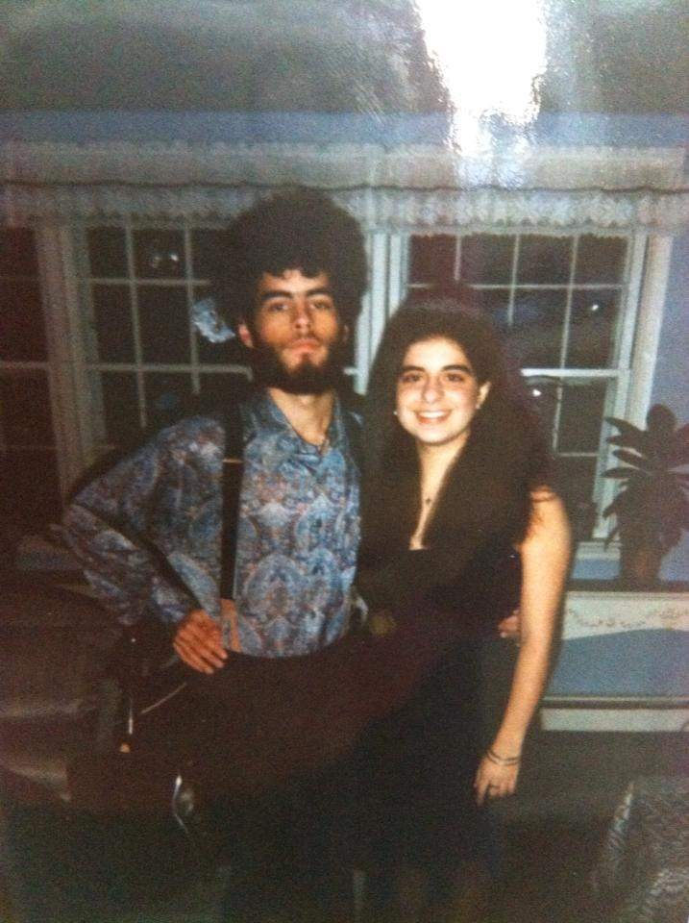
THE REVEAL
I am also Brian Connell
(The late 1900s were amazing.)
Notes:
These are Brian’s own slides, left as an example. Make your own the same way: three statements about you, two true and one believable lie, and a photo or two that make you human (self-deprecating works best). Or delete these slides and play the game without them. Brian’s line: "A short 12 or 13 years later, I looked like this. My wife and I did in fact meet in high school; this is us in our freshman year of college."

Slide 5
2 TRUTHS AND A LIE
Your turn…
Write your own. Remember, the truths have to be true, and the lie has to be believable!
Notes:
Students write three statements at their desks. Keep the lies believable ("I have eight children" or "I can fly" won’t work). Then share with a neighbor or table and guess. Watch the room come to life. Invite a few to try to stump the whole class, or you. The point is to disarm the room and have fun together at the top of the program.

Slide 6
WHAT IS A YAWP?
YAWP!
Writing Program
Notes:
Now introduce the program itself.

Slide 7
WALT WHITMAN
What do you think “yawp” means?
“
I sound my barbaric yawp over the roofs of the world.
— Walt Whitman, “Song of Myself”
Notes:
Ask what they think "yawp" means. A yell, a sound, a scream from a rooftop: all good. Say "yes, and" to every answer; how you respond matters to the whole room, not just the student who spoke. Then Brian’s framing: your yawp is your voice. Imagine everything inside you, your thoughts, opinions, experiences, relationships, the music in your head, and give it all one big, mighty sound. That is your yawp, and it is unique to you. In this program we unleash it through writing.

Slide 8
WHY DO WE WRITE?
Why do we write?
1
2
3
Because we have things to say! (Our individual “yawp.”)
Because writing is one of the most effective ways of expressing ourselves. (What other ways can we express ourselves?)
Because writing is power.
Notes:
Lead a quick discussion. How might a happy person express it without words? (Smile, laugh.) An angry one? Then: writing articulates something for yourself and others, and it lasts. That permanence is why writing is power. Most students hear this and think, "I want some of that." Day 1 is about getting them to buy in.

Slide 9
SAMPLE ESSAY
“Bored in the USA”
Highlight anything you find interesting.
Notes:
Use "Bored in the USA" from the resources, or your own sample, as long as it follows our form (intro ending in a thesis, body paragraphs, conclusion). Everyone has a copy. Before reading, ask everyone to underline or highlight anything interesting, at least one thing per paragraph. Volunteers read aloud, a paragraph each. Don’t overanalyze.

Slide 10
CLASS DISCUSSION
Class discussion
1
2
3
What do you like about this essay?
Do you agree with the writer?
What is the main point or argument?
Notes:
Keep it simple: "Tell me one thing you underlined and why." The point is that they’re talking. The question you must land is the third: the main point is the thesis statement, the last sentence of the introduction. Have everyone underline it. It’s one sentence that captures the main argument of the whole essay, and you’ll come back to it for weeks.

Slide 11
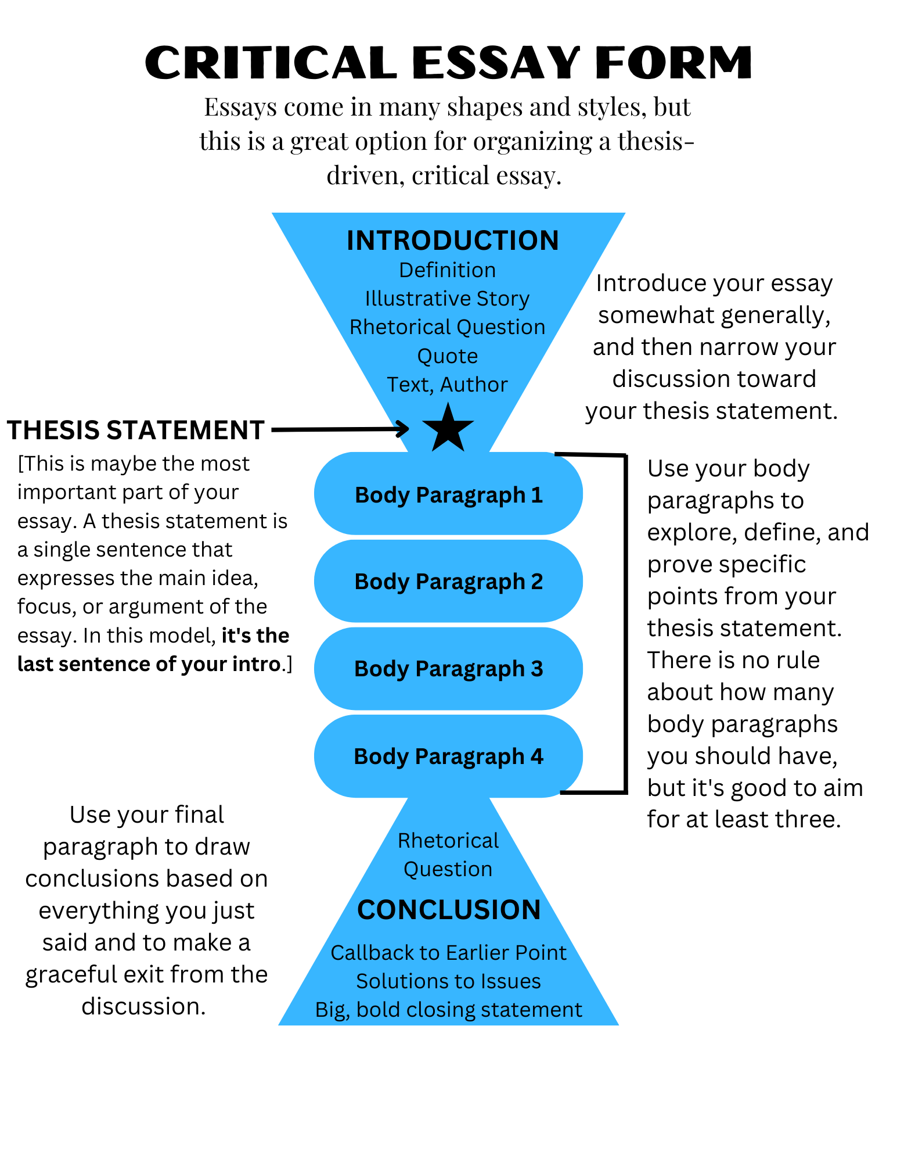
THE FORM
The Critical Essay Form
Introduction
Thesis statement ★ the sentence you just underlined
Body paragraphs
Conclusion
Notes:
The shape of the essay they just read and the one they are about to write. Point at the thesis: the most important part, the last sentence of the intro. Don’t spend long here; it’s also a handout, and you’ll come back to it.

Slide 12
WHY WE’RE HERE
What are we doing here?
Over the course of our sessions, you will learn how to write a thoughtful, original, critical essay like the one we just read. To accomplish this, we will:
1
2
3
Analyze and discuss our opinions about the topic
Learn a writing process
Write a lot
Notes:
You can tell them the topic is coming later. This is a writing class: they’ll spend real time writing and thinking about what they think.

Slide 13
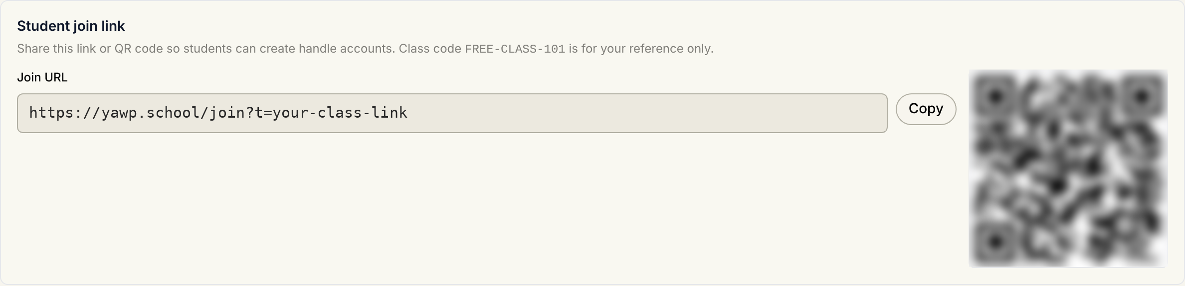
GET EVERYONE IN
Share your class’s join link
1
Open your class in YAWP! and go to its Students tab
2
Copy the join link, or put the QR code up on the board
3
Students open it on their device and create an account
4
No email needed: just a handle and a password
Notes:
The current sign-up flow. Each class has its own join link and QR code on its Students tab. The class code shown there is for your reference only; it is not enough to join. Students pick a display name, a handle and a password. Keep a note of handles and passwords, or give the class a pattern to follow, to avoid the inevitable forgotten passwords; you can reset a student’s password from the Students tab.

Slide 14
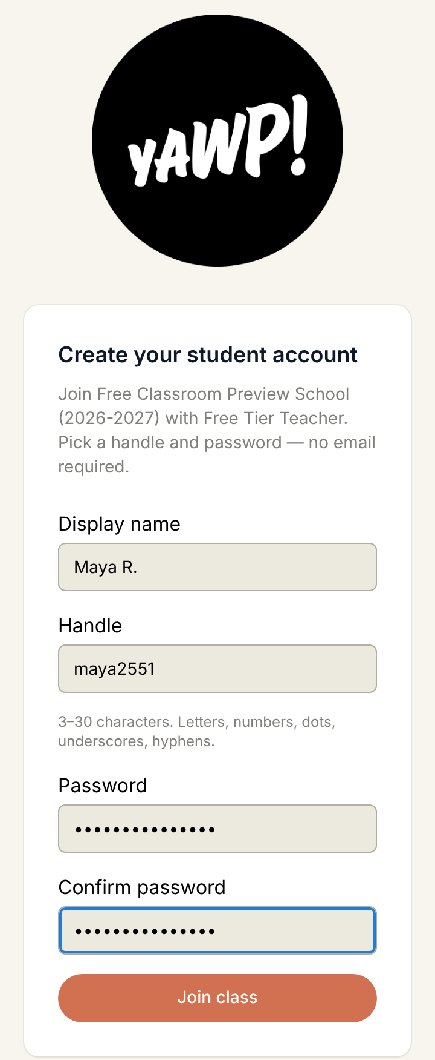
FOR STUDENTS
Create your student account
Open the link or scan the QR code
Your display name: what your teacher sees
A handle: how you log in
A password, twice, then Join class
Notes:
Walk the room while students sign up. Handles are 3 to 30 characters: letters, numbers, dots, underscores and hyphens. Already have an account? They can log in from the same page.

Slide 15
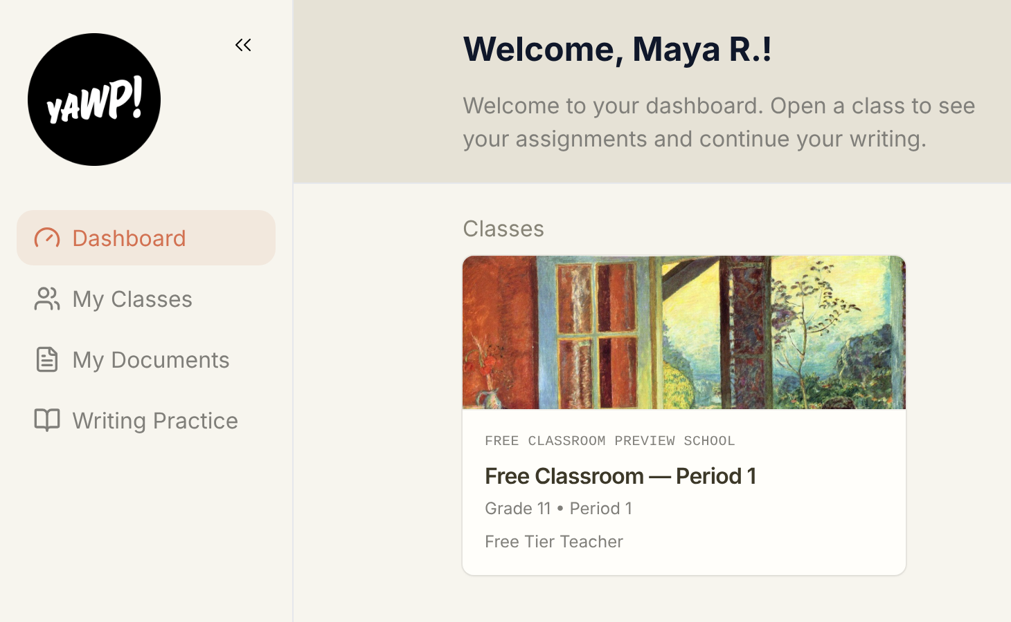
YOU’RE IN
Your YAWP! dashboard
Your class is on your dashboard
Open it to see your assignments
Start an assignment to open your document
The Tutor guides you from the left
Notes:
Once they’re in, have them open the class and start the first assignment you’ve given them, which creates their document. Next class they open the same document (not a new one) and begin pre-writing.

