Slide 1



THESIS-DRIVEN ESSAY · LESSON 7
Titles
YAWP!
WRITING PROGRAM
The cherry on top, and the finishing touches
Notes:
The last day of the program. Students have written their introductions, theses, body paragraphs and conclusions; all that’s left is the title. The title is the cherry on top of the ice cream sundae that is a great essay. We’ve all seen "English Essay" and "My Paper." Our students have invested real time in something original, so they deserve a title that is too.

Slide 2
OPTIONAL
Course Review
Everything you’ve learned, one question at a time.
Notes:
Optional: run the whole review as a final quiz, maybe for an easy grade to reward their hard work. Delete these slides if you don’t want them.

Slide 3

REVIEW · 1 OF 6
What’s the best way to write an essay?
a
Just start writing and hope some good ideas come out.
b
Take my ideas and plug them into a formula, like the 5-paragraph essay.
c
Develop my ideas into a thesis statement and build my essay around that.
d
ChatGPT, duh.
e
I have never actually written an essay, so I have no idea.
Notes:
Optional review quiz. Brian: "If that’s not your gig, delete the slides." If you keep it, make it a game: read the question, take answers, then click to the reveal. Candy or other small prizes help. Answer: Develop my ideas into a thesis statement and build my essay around that.

Slide 4
REVIEW · 1 OF 6
What’s the best way to write an essay?
a
Just start writing and hope some good ideas come out.
b
Take my ideas and plug them into a formula, like the 5-paragraph essay.
c
Develop my ideas into a thesis statement and build my essay around that.
d
ChatGPT, duh.
e
I have never actually written an essay, so I have no idea.
Notes:
The reveal. Develop my ideas into a thesis statement and build my essay around that.

Slide 5
REVIEW · 2 OF 6
Critical thinking is best defined as:
a
Asking questions and seeking answers about a topic in order to develop a position on it
b
Finding all of the weaknesses in an argument
c
Finding all of the strengths in an argument
d
Arguing a specific point of view in front of an audience
e
Researching experts’ perspectives and arguments on a topic in order to develop a position on it
Notes:
Optional review quiz. Brian: "If that’s not your gig, delete the slides." If you keep it, make it a game: read the question, take answers, then click to the reveal. Candy or other small prizes help. Answer: Asking questions and seeking answers about a topic. The same thing they did with the photo and in their pre-write.

Slide 6
REVIEW · 2 OF 6
Critical thinking is best defined as:
a
Asking questions and seeking answers about a topic in order to develop a position on it
b
Finding all of the weaknesses in an argument
c
Finding all of the strengths in an argument
d
Arguing a specific point of view in front of an audience
e
Researching experts’ perspectives and arguments on a topic in order to develop a position on it
Notes:
The reveal. Asking questions and seeking answers about a topic. The same thing they did with the photo and in their pre-write.

Slide 7
REVIEW · 3 OF 6
Which of the following is MOST TRUE about a good thesis statement?
a
A good thesis statement is easy for the reader to agree with.
b
A good thesis statement contains 2–3 pieces of support.
c
A good thesis statement contains observation and analysis.
d
A good thesis statement contains research and facts.
e
A good thesis statement is 1–2 sentences long.
Notes:
Optional review quiz. Brian: "If that’s not your gig, delete the slides." If you keep it, make it a game: read the question, take answers, then click to the reveal. Candy or other small prizes help. Answer: Observation and analysis. Some students (and some of us) will pick B, the 5-paragraph-essay answer; our thesis is going to be more complex than a three-pronged list.

Slide 8
REVIEW · 3 OF 6
Which of the following is MOST TRUE about a good thesis statement?
a
A good thesis statement is easy for the reader to agree with.
b
A good thesis statement contains 2–3 pieces of support.
c
A good thesis statement contains observation and analysis.
d
A good thesis statement contains research and facts.
e
A good thesis statement is 1–2 sentences long.
Notes:
The reveal. Observation and analysis. Some students (and some of us) will pick B, the 5-paragraph-essay answer; our thesis is going to be more complex than a three-pronged list.

Slide 9
REVIEW · 4 OF 6
Your introduction paragraph’s MAIN function is to:
a
Tell a story that illustrates the topic of your essay
b
Give specific examples that support your thesis
c
Define important terms that your reader may need to know
d
Present questions that your essay will answer
e
Welcome your reader into your discussion and state the thesis
Notes:
Optional review quiz. Brian: "If that’s not your gig, delete the slides." If you keep it, make it a game: read the question, take answers, then click to the reveal. Candy or other small prizes help. Answer: Welcome the reader in and state the thesis. A, C and D are styles an intro can use, not its job.

Slide 10
REVIEW · 4 OF 6
Your introduction paragraph’s MAIN function is to:
a
Tell a story that illustrates the topic of your essay
b
Give specific examples that support your thesis
c
Define important terms that your reader may need to know
d
Present questions that your essay will answer
e
Welcome your reader into your discussion and state the thesis
Notes:
The reveal. Welcome the reader in and state the thesis. A, C and D are styles an intro can use, not its job.

Slide 11
REVIEW · 5 OF 6
Which of the following would probably NOT show up in your body paragraphs?
Supporting quotations about specific points
a
Your opinions
b
Your thesis statement
c
Analysis of other people’s arguments
d
Notes:
Optional review quiz. Brian: "If that’s not your gig, delete the slides." If you keep it, make it a game: read the question, take answers, then click to the reveal. Candy or other small prizes help. Answer: Your thesis statement. It lives at the end of the introduction; the body paragraphs support, define and illustrate its parts.

Slide 12
REVIEW · 5 OF 6
Which of the following would probably NOT show up in your body paragraphs?
Supporting quotations about specific points
a
Your opinions
b
Your thesis statement
c
Analysis of other people’s arguments
d
Notes:
The reveal. Your thesis statement. It lives at the end of the introduction; the body paragraphs support, define and illustrate its parts.

Slide 13
REVIEW · 6 OF 6
True or False: a good conclusion restates your thesis and main ideas.
True
a
False
b
Notes:
Optional review quiz. Brian: "If that’s not your gig, delete the slides." If you keep it, make it a game: read the question, take answers, then click to the reveal. Candy or other small prizes help. Answer: False. Restating can feel very repetitive. A good conclusion offers final reflection, arguments, or a call to action based on everything you just said.

Slide 14
REVIEW · 6 OF 6
True or False: a good conclusion restates your thesis and main ideas.
True
a
False
b
Notes:
The reveal. False. Restating can feel very repetitive. A good conclusion offers final reflection, arguments, or a call to action based on everything you just said.

Slide 15
SUGGESTED CONCLUSION STRUCTURE
A conclusion that works
1
Rhetorical question
2
Answer it directly (“Perhaps…”)
3
2 sentences of opinion or analysis
4
Supporting quote (if working with a text)
5
Final, concluding sentence: the big, final point
Notes:
The one question students still get wrong: some cling to "a good conclusion restates the thesis." Here’s the structure again for anyone still finishing. The Tutor shows this structure in its box too.

Slide 16
STEP 6
Titling Your Essay
Informative, smart, and memorable.
Notes:
Now the title. A lot of people dread it, but with the colon-title model it becomes pretty easy and quick.

Slide 17

GIVE YOUR ESSAY A TITLE
The colon title
Your title should be informative, smart, and memorable. Don’t ever, ever, EVER title your essay “Essay” or “English Paper.” Let it indicate your topic in a thoughtful way. Try the colon title:
1
2
3
Beyond the Boys’ Club: How Female Heroes Define the Avengers Legacy
Bored in the USA: How Lack of Creativity in Schools Hurts Students and Teachers
Unlocked and Loaded: How Easy Gun Access Puts Children at Risk
Notes:
Read the three aloud. With each one we know exactly what the essay is about, and it makes us want to read it. The second is the sample essay’s.

Slide 18
GIVE YOUR ESSAY A TITLE
Two halves, one great title
THESIS
Beyond the Boys’ Club: How Female Heroes Define the Avengers Legacy
Left of the colon · creative, fun: Beyond the Boys’ Club
1
Right of the colon · clear, direct: How Female Heroes Define the Avengers Legacy
2
Notes:
Each title has two parts. The left side is a creative or "fun" element; the right side delivers a clear, direct description of the topic. Alone, each would be ordinary at best and confusing at worst: "Beyond the Boys’ Club" could be about single-sex schools, fraternities, men in politics… The right side gives it context; the left side gives the right side flavor. The right side doesn’t have to start with "How" (all three just happen to). The Tutor knows the colon title too and can help students draft and revise theirs.

Slide 19
FINISH
Putting it All Together
Clean up, title, submit, celebrate.
Notes:
The last stretch: clean up the document, put the title on it, format it simply, and submit.

Slide 20
FINISHING TOUCHES IN YAWP!
Finishing touches
1
Clean up. Delete your pre-writing, your observation and analysis notes, and headings like “Introduction.” Only the essay stays.
2
Title it. Type your title on the first line, then use the toolbar to center and italicize it.
3
Keep it simple. YAWP! sets the font for you. Paragraphs stay left-aligned (only the title is centered), with an empty line between them.
4
Read it, then Submit. Read it once from the top, ask the Tutor for feedback if you want, then click Submit.
Notes:
Brian: "Be normal with your formatting. This is not the place to be creative." Some students like to center everything or pick fancy fonts; don’t. If you have your own formatting standard, use it. Then celebrate: ask students for a reflection on the process, or have them highlight their favorite part of their essay and add a comment saying why. Share the work: within the class, with other teachers or administrators. (The YAWP! program can also publish a class’s essays as a printed book.)

Slide 21
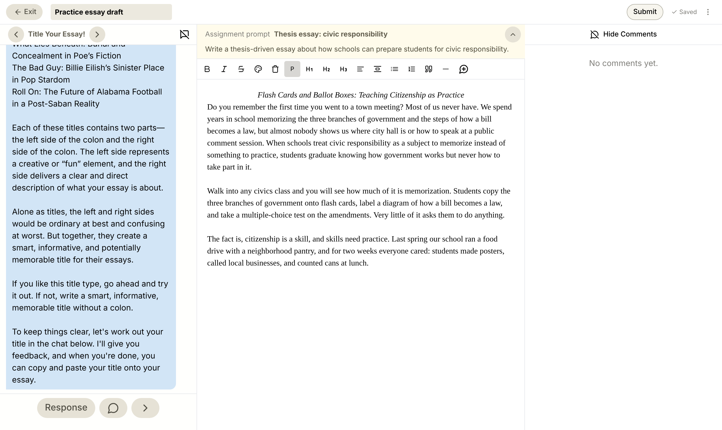
DONE
What finished looks like
Title on the first line, centered and in italics
Only the essay: no notes or headings
Paragraphs left-aligned
Then click Submit
Notes:
A finished essay in today’s YAWP! editor, ready to submit. They wrote a critical, thesis-driven essay that could stand up in any high school or college classroom. Good work!

